Slide 1

The Business of Media
Entrepreneurship for the Creative Industries
Henry Loeser PhD

Slide 2
The Business of Media
Types of Content
Information
Opinion
Entertainment

Slide 3



The Business of Media

Slide 4


The Business of Media

Slide 5

The Business of Media

Slide 6

The Business of Media

Slide 7
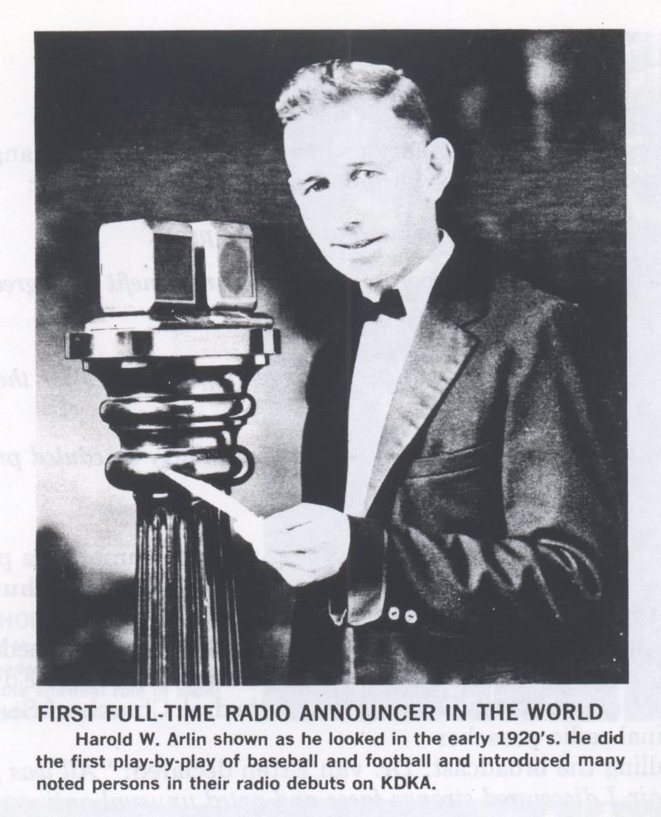
The Business of Media

Slide 8
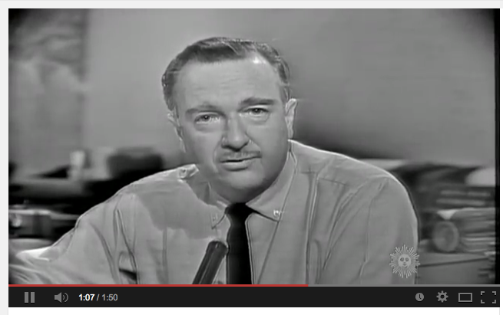
The Business of Media

Slide 9
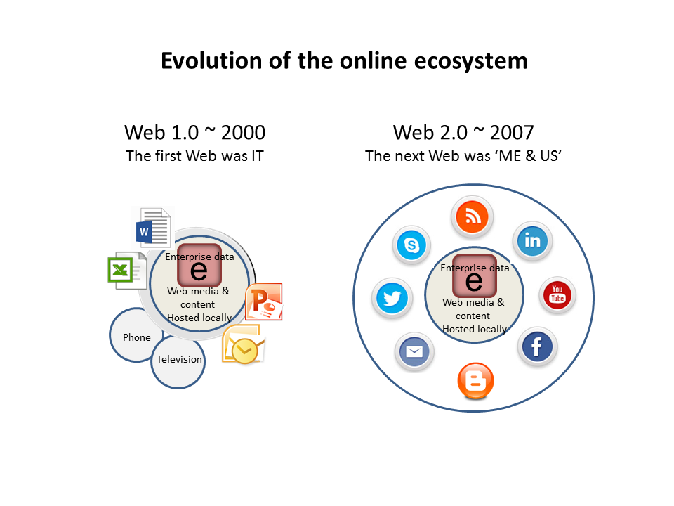
The Business of Media

Slide 10
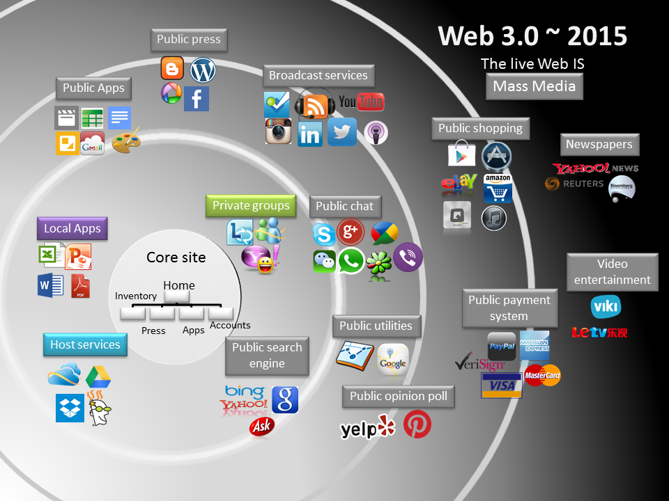
The Business of Media

Slide 11
The Business of Media
Linear Model of Creative Content
Production > Distribution > Exhibition

Slide 12
The Business of Media
Production
Market driven
Idea driven

Slide 13
The Business of Media
Distribution (Wholesale)
- Agents, brokers, distributors, aggregators

Slide 14
The Business of Media
Exhibition (Retail)
-Platforms
- Offline
- Online

Slide 15
The Business of Media
Revenue Models
Subscription
Advertising
Enterprise
Community

Slide 16
The Business of Media
Revenue: Subscription
-Standard
-SVOD

Slide 17
The Business of Media
Revenue: Subscription
-Paywall
-Tiered
-Metered
-Freemium

Slide 18
The Business of Media
Revenue: Advertising
Programmatic

Slide 19
The Business of Media
Revenue: Advertising – Native
Branded
Sponsored

Slide 20
The Business of Media
Revenue: Enterprise
Content
Fee for service
User capture
Data capture

Slide 21
The Business of Media
Revenue: Community
- User Support
- Crowdfunding

Slide 22
The Business of Media
Interrelated Actors & Institutions
Legal / Regulatory
Economic
Technical
Social

Slide 23
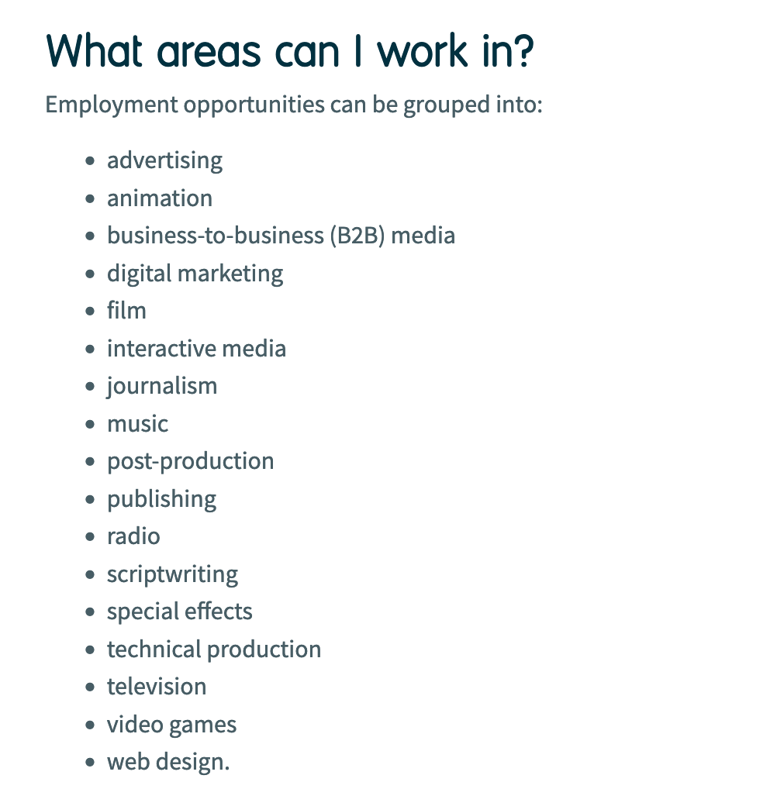
The Business of Media

Slide 24
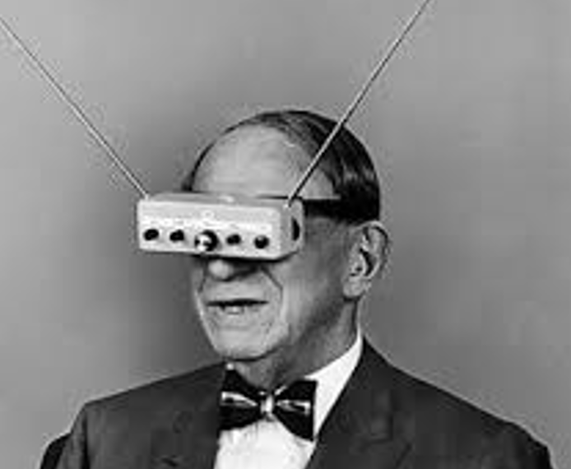
The Business of Media
A Look into the Future
new technologies, ecosystems, industries
cross-media, platforms, applications, mobile, IoT, gaming, voice, VR, AR, wearables,
enterprises, business models, opportunities

Slide 25
The Business of Media
Entrepreneurship for the Creative Industries
Henry Loeser PhD

