Slide 1

The Business of Media
Work in Media Industries
Henry Loeser PhD

Slide 2
The Business of Media
Types of Content
Information
Opinion
Entertainment

Slide 3



The Business of Media

Slide 4

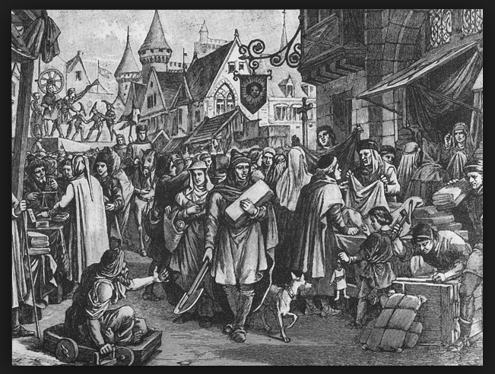
The Business of Media

Slide 5

The Business of Media

Slide 6

The Business of Media

Slide 7
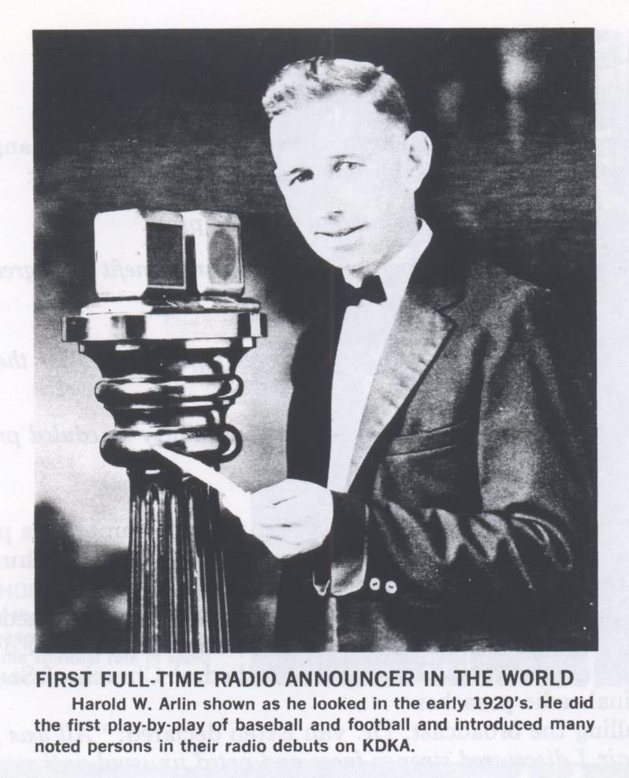
The Business of Media

Slide 8
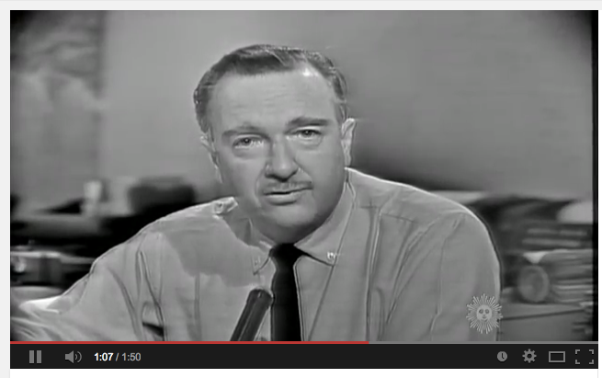
The Business of Media

Slide 9
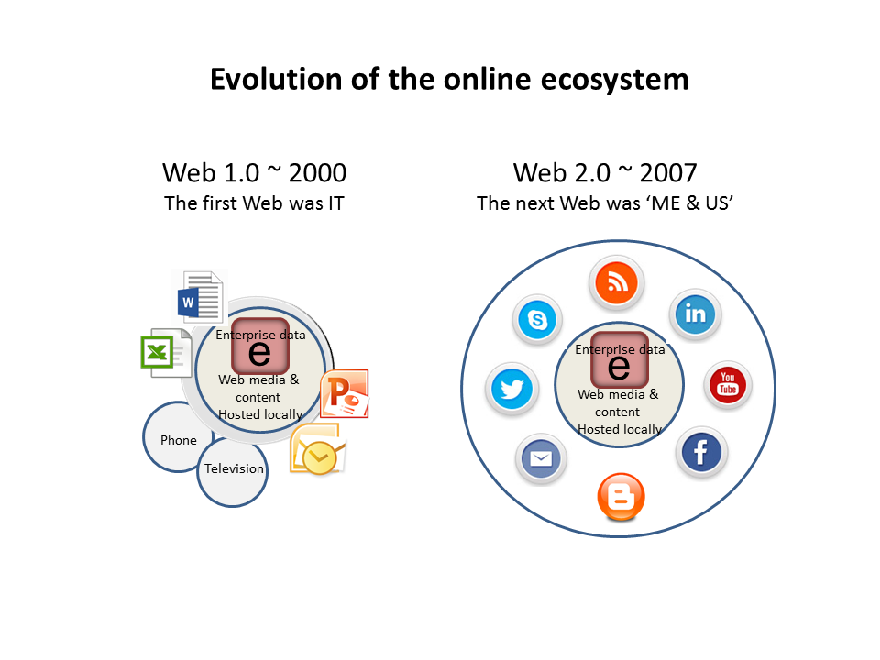
The Business of Media

Slide 10
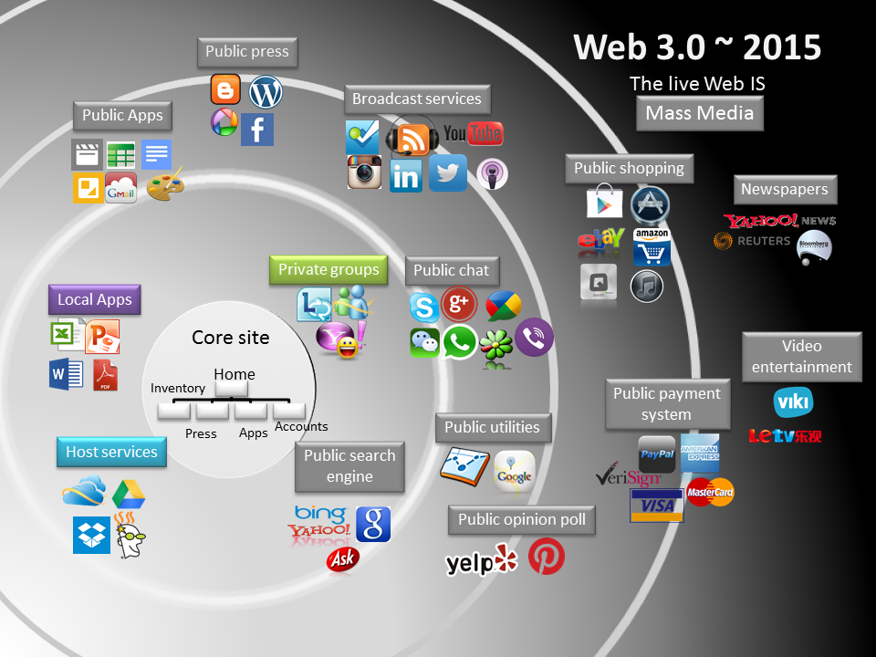
The Business of Media

Slide 11
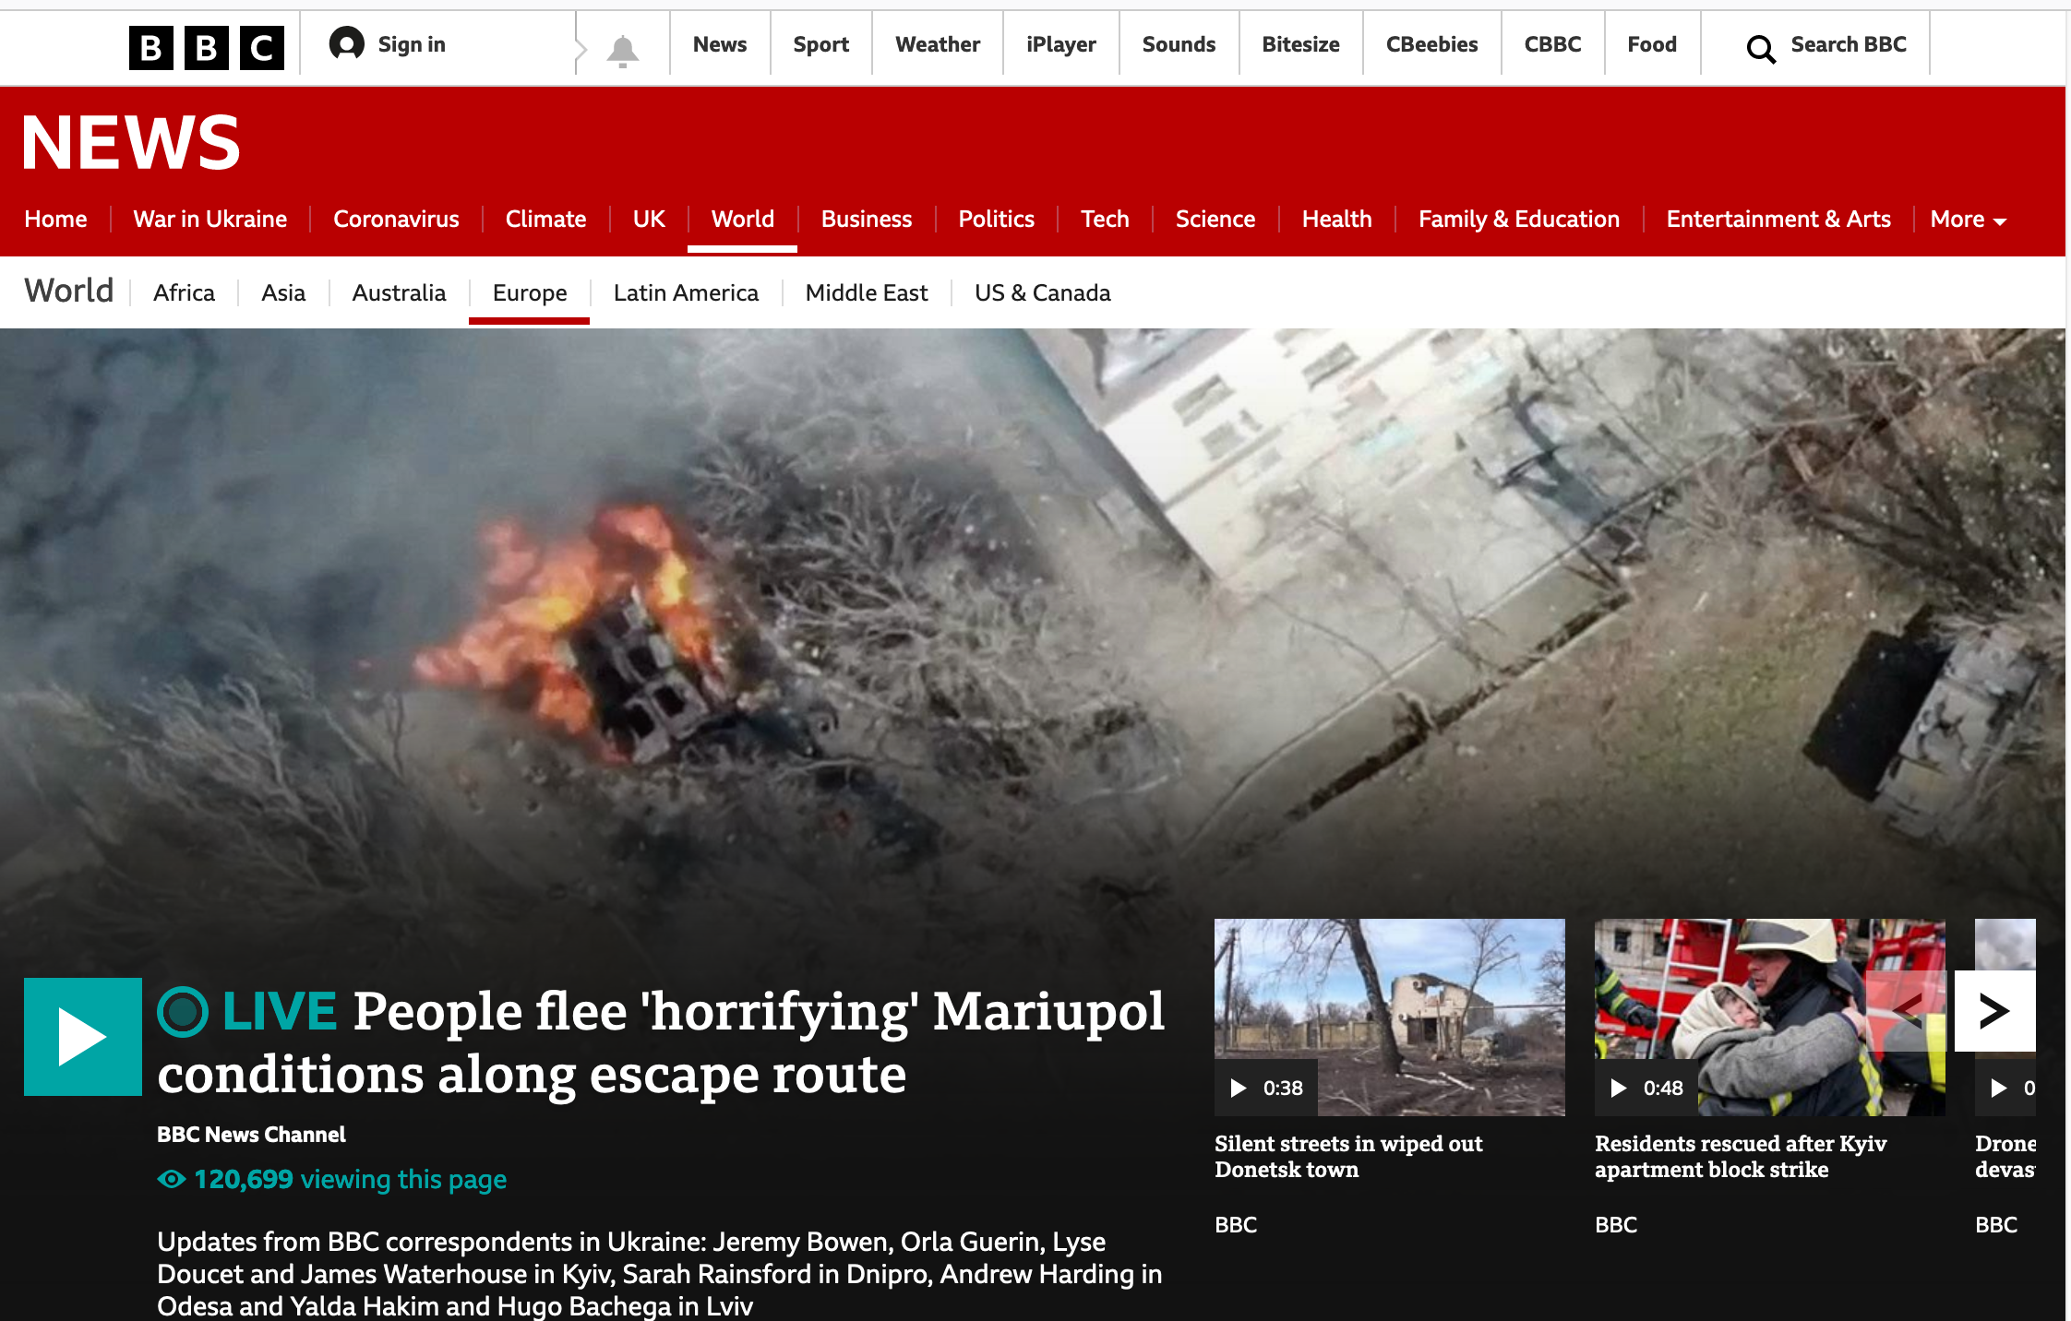
The Business of Media

Slide 12
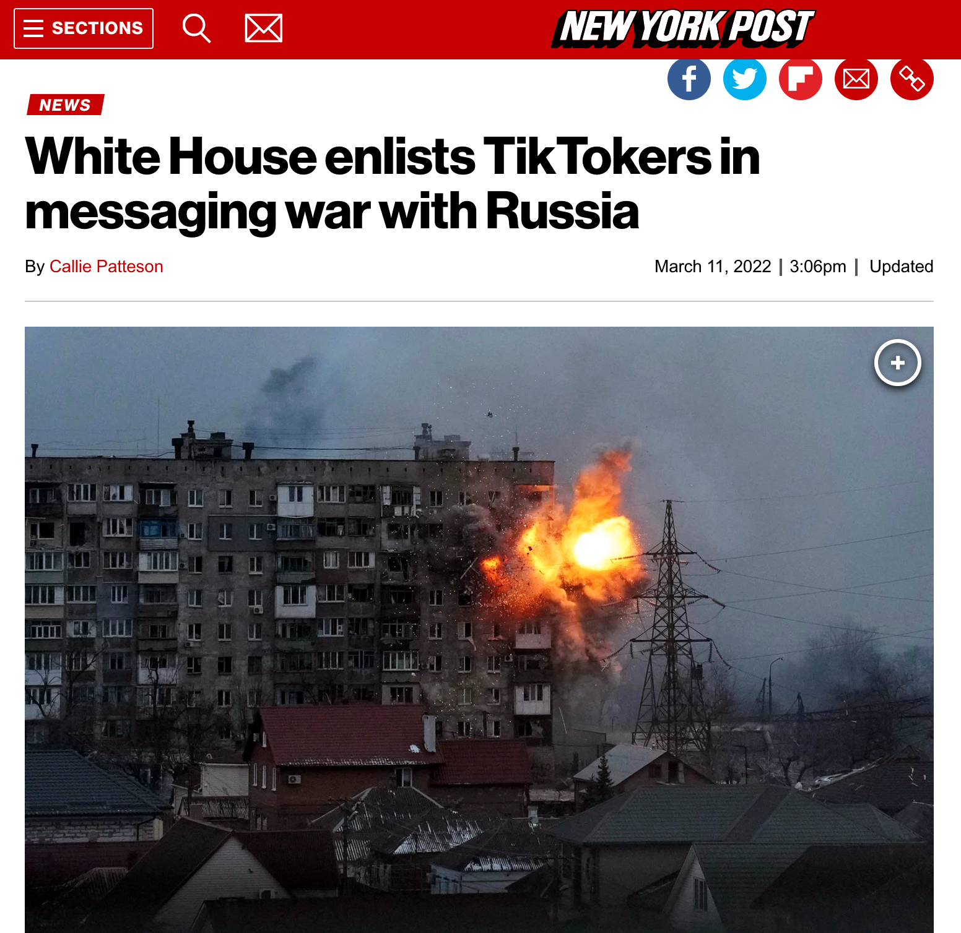
The Business of Media

Slide 13
The Business of Media
Linear Model of Creative Content
Production > Distribution > Exhibition

Slide 14
The Business of Media
Production
Market driven
Idea driven

Slide 15
The Business of Media
Distribution (Wholesale)
- Agents, brokers, distributors, aggregators

Slide 16
The Business of Media
Exhibition (Retail)
-Platforms
- Offline
- Online

Slide 17
The Business of Media
Revenue Models
Subscription
Advertising
Enterprise
Community

Slide 18
The Business of Media
Revenue: Subscription
-Standard
-SVOD

Slide 19
The Business of Media
Revenue: Subscription
-Paywall
-Tiered
-Metered
-Freemium

Slide 20
The Business of Media
Revenue: Advertising
Programmatic

Slide 21
The Business of Media
Revenue: Advertising – Native
Branded
Sponsored

Slide 22
The Business of Media
Revenue: Enterprise
Content
Fee for service
User capture
Data capture

Slide 23
The Business of Media
Revenue: Community
- User Support
- Crowdfunding

Slide 24
The Business of Media
Interrelated Actors & Institutions
Legal / Regulatory
Economic
Technical
Social

Slide 25
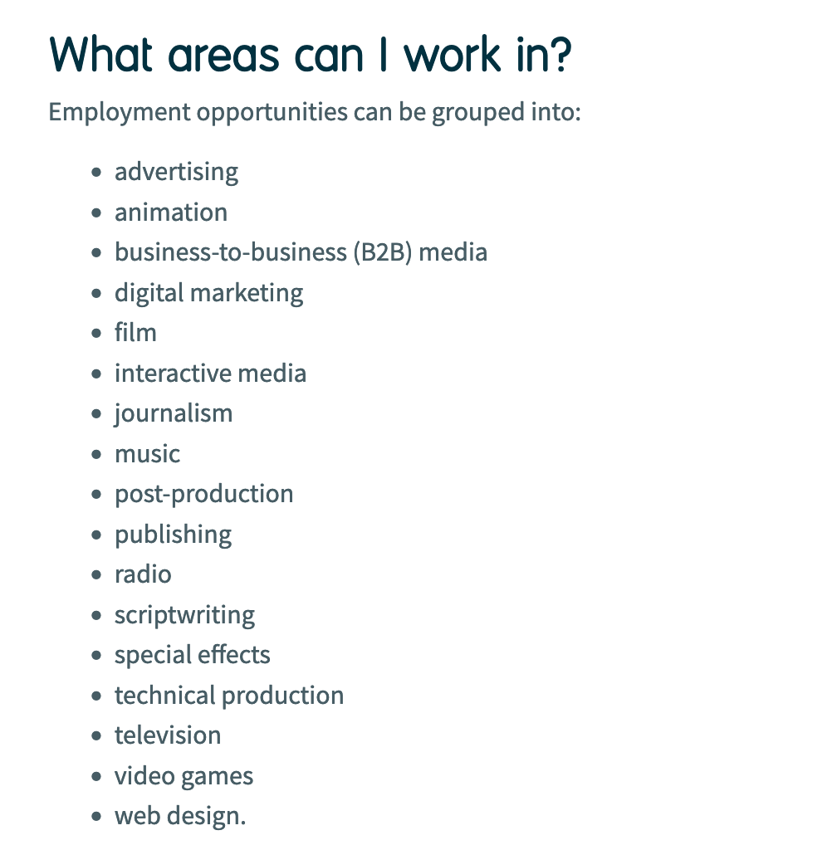
The Business of Media

Slide 26
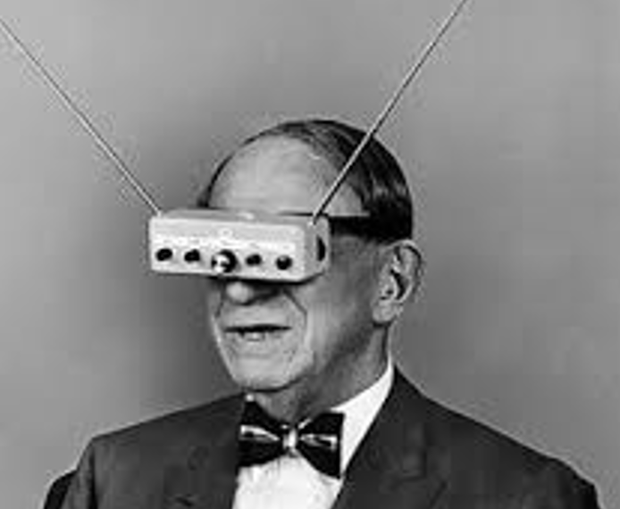
The Business of Media
A Look into the Future
new technologies, ecosystems, industries
cross-media, platforms, applications, mobile, IoT, gaming, voice, VR, AR, wearables,
enterprises, business models, opportunities

Slide 27
The Business of Media
Work in Media Industries
Henry Loeser PhD

