Slide 1
Media & Cultural Industries
Professor Elavsky

Slide 2
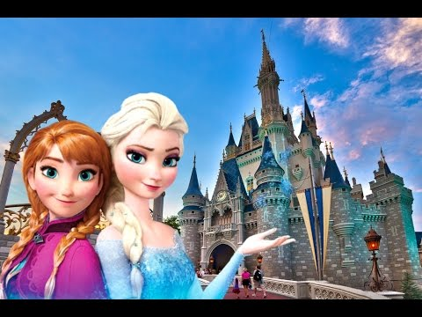
Media & Cultural Industries
What is the course about?
How is it related to
  Meaning
  Creativity?
  Economy?
  Policy?
  Organizational Culture?
  Labor/Work?
  Praxis?
  You?

Slide 3
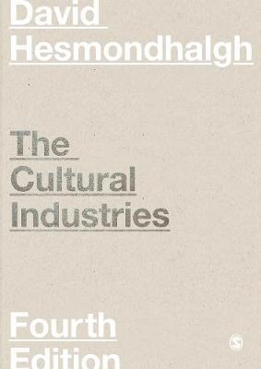
Concepts
Change and Continuity, Power and Creativity
Theories of Culture, Theories of Cultural Production
Cultural Industries across History
Cultural Policy
Ownership: Concentration, Conglomeration and Corporate Power,
Digital Culture
Creativity, Commerce, and Organization
Working Conditions and Inequalities in the Cultural Industries
Internationalisation
Texts: Diversity, Quality, and Social Justice

Slide 4
Syllabus, Course Dynamic, Caveat
Readings
Quizzes
Class
Final Exam

