Slide 1

Theories of Culture, Theories of Cultural Production
Week 4

Slide 2
Terms
(Critical) Political Economy
Cultural Studies
Neoliberalism
Neoclassical Economics
Content analysis
Active audiences
Discourse
Polysemy

Slide 3

Perspectives
Sensitive to the potential power of the cultural industries
  As makers of texts,
  As systems for the management and marketing of symbolic creativity
  As agents of change
  ethical and normative questions

Slide 4
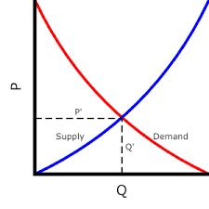
Neoclassical Economics
A scientific study of economic affairs – how consumer preferences might be most efficiently satisfied
  Cut off from moral philosophy, questions of human rights/needs, social justice
  “ The equation of human well-being with the meeting of preferences, rather than in terms of fundamental human needs …. provides a limited basis on which to proceed in assessing the cultural industries”
  Neoliberalism: the production of efficient markets should be the primary goal of public policy; “TV = a toaster with pictures”
  - Such a definition denigrates the way in which culture can potentially contribute symbolically to people’s lives in powerful ways

Slide 5
Critical Political Economy
Places emphasis on ethical and normative questions related to moral philosophy
  Questionable role of large corporations and state agencies in cultural production
  Explicitly aims to challenge the lack of adequate ethical perspective in the neoliberal paradigm
  Different from Mainstream Economics
    Holistic
    Historical
    Balance of capitalist enterprise with public intervention (policy)
    Engage with the basic moral questions of justice, equity, and public good
      Critique of Capitalism/capitalist logics/practices
        How do the cultural industries serve the wealthy and the powerful
          Ownership/control of the media?
          Moral Economies of Culture

Slide 6
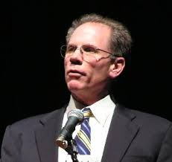

Critical Political Economy: Trajectories
North-American
  Reductionist/Determinations
Cultural Industries
  Cultural Industries Approach is better at examining:
    Contradictions
    The Specific Conditions of Cultural Production
    Tensions between Consumption and Production
    Symbol Creators
    Information and Entertainment
    Historical Variations in the social relations of Cultural Production
    What are the systemic social consequences of cultural production?

Slide 7

Sociology of Culture/Business, Management/Organization Studies
What actually happens in these organizations?
  Company Data/Business relations + Discourse (how to achieve “success”)
Data Analysis – how to maximize efficiency (achieve success)
Macrosocial and Microsocial Analyses
  Pressures, Forces, Dynamics, Mediations

Slide 8
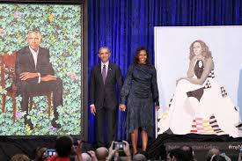
Texts, Meanings, Representation
Content Analysis – objective, verifiable measure of meaning
  Polysemy
  Aesthetic variation for interpretation
Cultural Studies
Questions of ordinary cultural artefacts and experiences
Ordinary culture needs to be taken seriously; integrated analysis
The complexity of “culture” (anti-essentialism/politics of recognition)
The politics of authority in culture
Identity, subjectivity, discourse, and meaning
Who speaks and how are we heard? Active Audiences? Social Power?
- Fiske (uncritical populism)/digital optimism

Slide 9

Production Studies
Creative Industries (Power (Foucault), postmodernism) – policy oriented)
Cultural Work/Labour – lived experiences of cultural workers (creative industry/economy policy issues)
  Precarity
Production Studies – routines and rituals/grounded in-depth analyses to better understand dynamics of macrosocial forces
Critical Media Industry Studies – strategies as they intersect workers experiences in all their complexity, ambiguity, and ambivalence.

Slide 10
Theoretical trajectories
Neoclassical Economics
Critical Political Economy
Moral Economy of Culture
Sociology of Culture
Production of Culture/Cultures of Production
Critical Sociological Approaches
Cultural Studies
Cultural Economy
Creative Industries
Cultural Work/Labour
Production Studies
Critical Media Industry Studies

