Slide 1
LANGUAGE AND SOCIAL CLASS
ROBERT HELÁN
DEPARTMENT OF MEDIA STUDIES AND JOURNALISM
FACULTY OF SOCIAL STUDIES, MASARYK UNIVERSITY

Slide 2
AGENDA
WHAT IS SOCIAL CLASS?
LANGUAGE AND SOCIAL CLASS
REGIONAL VARIATION VS. SOCIAL CLASS VARIATION
RESEARCHING SOCIAL CLASS LANGUAGE VARIATION
LANGUAGE USE AND SOCIAL CLASS CONCEPTS

Slide 3
1A. WHAT IS SOCIAL CLASS?
A LAYER OF A SOCIETY THAT IS CHARACTERIZED BY A SPECIFIC AMOUNT OF WEALTH, PRESTIGE AND POWER
DEFINES AN INDIVIDUAL’S OR A GROUP’S STANDARD OF LIVING AND LIFE PROSPECTS
HOW IS SOCIAL CLASS MEASURED? OBJECTIVELY: ECONOMICS SUBJECTIVELY: PRESTIGE, STATUS, POWER AND PERCEPTION

Slide 4
1B. WHAT IS SOCIAL CLASS? DETERMINING SOCIAL CLASS
A person might not have a lot of income but for subjective reasons, can still be in a higher social class
A person’s occupation doesn’t always reflect their income
A person’s family name can determine their social class

Slide 5
1c. WHAT IS SOCIAL CLASS? DETERMINING SOCIAL CLASS
Home assignment: discussion forum
Analyze the society that you are currently living in…. A. what are the social classes that exist? B. how are those social classes determined?

Slide 6
1d. WHAT IS SOCIAL CLASS? How do we identify someone’s social class?
As human beings, we make very quick first impressions of people based on their: clothing, accessories, personal style behavior, non-verbal communication language use car, house, neighborhood education
The first impression system isn’t always right!
We can position ourselves as belonging to one social class, when we actually belong to another

Slide 7
2a. Language and social class
Research shows that there is a close connection between social class and language use choices.
Sociolect: a distinct variation of a language that is used by members of a specific social class
In multilingual societies, members of differing social classes might choose to speak different languages
French use in Europe (aristocracy)
English use in India (higher social classes)

Slide 8
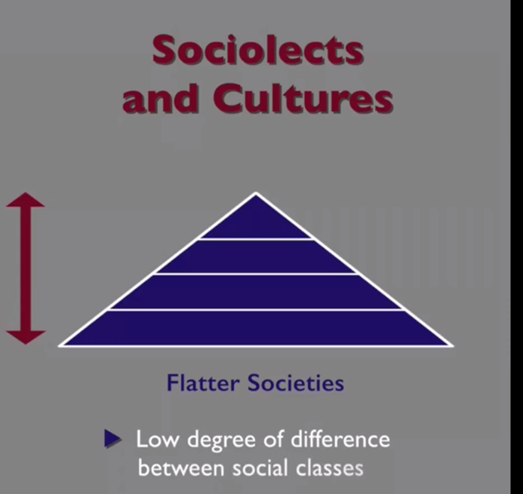
2b. Language and social class

Slide 9
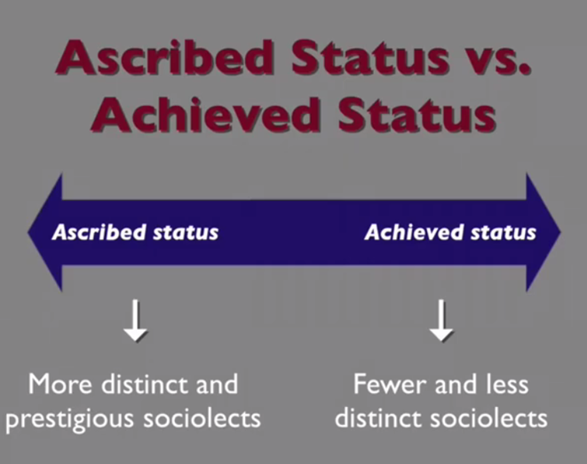
2c. Language and social class: sociolects and cultures
The people at the top of hierarchical societies have very distinct sociolects
In flatter societies, the distinction between sociolects is not as clear
Ascribed status: status that is assigned involuntarily at birth or later in life
Achieved status: status that is earned through hard work

Slide 10
2d. Language and social class: sociolects and social class in uk
The UK is a hierarchical society with a lot of ascribed status based on family name
There are a lot of sociolects with distinct degrees of prestige and status associated with them
Upper class sociolect: received pronunciation (Rp) “the queen’s English”

Slide 11
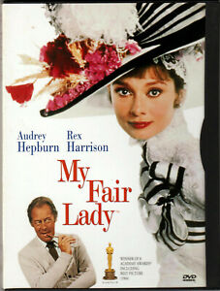
2e. Language and social class: sociolects and social class in the uk
A lot of hiring decisions are made based on how someone speaks
Marrying from one social class to another is not very common
For an example of sociolects and social class in the uk, watch the movie: my fair lady

Slide 12
2f. Language and social class: social class in india
India is a hierarchical society with many distinct layers
The class that you’re born into is the one that you stay in for life (often decided by family name)
Social class indicators: English language use dialect choices language choices

Slide 13
2g. Language and social class: social class language variation in canada
Not a hierarchical society
Only three social classes (upper, middle and lower)
No distinct sociolects

Slide 14
3. Regional variation vs. social class variation
Regional variation: language differences depending upon the geographical area the users live in
Which is more powerful? Social class variation or regional variation the UK: upper classes – social class variation (sociolect) lower classes – regional variation India: all classes – social class variation (sociolect)

Slide 15
4a. Researching social class language variation
William labov (1960’s) this research focused on the language that sales staff chose to use with customers in three different department stores, each catering to different social classes results: the sales staff adjusted their language use to that of their clientele, allowing researchers to identify clear sociolects

Slide 16
4b. Researching social class language variation
Peter trudgill (1960’s/1970’s) researchers created a social index, had participants self-identify as being part of a particular social class, and then analyzed their language use results: the higher the social class the participants self-identified with, the closer to the prestige variation of the language they spoke. Five distinct social classes were identified by analyzing language features of the different sociolects.

Slide 17
4c. Researching social class language variation
Labov and trudgill speakers can strategically choose to use one sociolect over another in order to associate themselves with a particular social class

Slide 18
4d. Researching social class language variation
Current research focuses on individual language choices that people make, in specific situations, depending upon how they want to be perceived

Slide 19
4e. Researching social class language variation
Matched guise testing: participants rate speakers on their social class, wealth, intelligence, etc., based only upon how they speak results: if a person changed how they spoke, participants would rate them in a different social class

Slide 20
5a. Language use and social class concepts: style
Style: individual language use choices, on a scale of formal to informal, based upon context or how we want to be perceived formal language: perceived as being “the standard” Informal language: focus is on equality, not power
Style is closely related to sociolects, social class and language use choices upper class sociolects are typically more formal lower class sociolects are typically more informal

Slide 21
5b. Language use and social class concepts: register
Register: communication shortcuts developed by a group of people who regularly communicate together to be as efficient as possible
Register depends on: the topic who you’re talking to where you’re talking why you’re talking

Slide 22
5c. Language use and social class concepts: register
There are 5 main categories of register: 1. static 2. formal 3. consultative 4. casual 5. intimate

Slide 23
5d. Language use and social class concepts: register
static register: a set of language use that never changes the lord’s prayer constitutional documents legal documents
Formal register: very formal, one-way communication speeches lectures pronouncements

Slide 24
5e. Language use and social class concepts: register
Consultative register: used in groups of two or more people, where one person, the “knower”, provides information or advice doctor-patient lawyer-client
Casual register: an informal style of communication used amongst people who are socially equal (friends/peers) inside jokes vocabulary is unique to the group common specific phrases

Slide 25
5f. Language use and social class concepts: register
Intimate register: an informal style of language used between people who are very close (family members, spouses, etc.) that is characterized by emotional communication intonation pet phrases and nicknames non-verbal communication
The higher social classes tend to use more formal registers
The lower social classes tend to use more informal registers

Slide 26
5g. Language use and social class concepts: politeness
Politeness: language choices that we make when we’re speaking with someone, to make him or her feel comfortable not imposing on someone not directly asking someone for something
Face threatening act (fta): something that a person does or says that makes the other person feel uncomfortable, embarrassed or threatened used when deliberately trying not to be polite

Slide 27
5h. Language use and social class concepts: politeness
Positive politeness: “I respect you and I want you to respect me.” complimentary, professional
Negative politeness: “I want something from you.” ingratiating putting the other person above yourself

Slide 28
5i. Language use and social class concepts: politeness
language use strategies for negative politeness: hedging – hesitating, showing little confidence pessimism – using negative language indicating deference – putting the other person above yourself in terms of power apologizing – excusing yourself for imposing impersonalization – taking yourself out of the picture

Slide 29
5j. Language use and social class concepts: Brown and levinson’s politeness strategies
bald on-record strategy: the speaker doesn’t care if s/he uses face threatening acts, embarrasses or makes the hearer uncomfortable urgent situations task-oriented situations making strong requests giving warnings

Slide 30
5k. Language use and social class concepts: Brown and levinson’s politeness strategies
Positive politeness strategy: the speaker assumes that a friendly, respectful and professional relationship exists with the hearer attending to the hearer avoiding disagreements assuming agreement hedging an opinion

Slide 31
5l. Language use and social class concepts: Brown and levinson’s politeness strategies
negative politeness strategy: the speaker knows and acknowledges that s/he is imposing on the other person being indirect apologizing minimizing the imposition pluralizing the responsibility

Slide 32
5m. Language use and social class concepts: Brown and levinson’s politeness strategies
Off-record indirect strategy: a complete avoidance of any face threatening act giving hints being vague being sarcastic/making jokes

Slide 33
5n. Language use and social class concepts

Slide 34
5o. Language use and social class concepts: language use and social class
Students need to be aware of any language variation that exists in the language that they are learning:
Sociolects
Style
Register
politeness

