Slide 1
Defining homelessness
Absolute - the condition of people without physical shelter who sleep outdoors, in vehicles, abandoned buildings or other places not intended for human habitation
Relative - the condition of those who have a physical shelter, but one that does not meet basic standards of health and safety; these include protection from the elements, access to safe water and sanitation, security of tenure, personal safety and affordability (Hwang, 2001)
Apparent, hidden, potential (Hradecký & Hradecká, 1996)
Alienation for the rest of the society (Ravenhill, 2016)
Broad consensus that the term ‘homelessness’ covers more living situations than being without a roof over one’s head

Slide 2
Home
“having a decent dwelling (or space) adequate to meet the needs of the person and his/her family (physical domain); being able to maintain privacy and enjoy social relations (social domain) and having exclusive possession, security of occupation and legal title (legal domain)“ (Edgar, 2009, p. 15)
Three domains of home (Edgar, 2009)
Physical
Legal
Social
Homelessness is absence of home
Absence of two and more domains – homelessness
Absence of 1 domain – housing exlusion

Slide 4
ETHOS – The European Typology on Homelessness and Housing Exclusion
Roofless
Living rough
Emergency accommodation
Houseless
Accommodation for homeless
Women‘s shelters
Accommodation for immigrants
People due to be released from institutions
Insecure housing
Insecure accommodation
Under threat of eviction
Under threat of violence
Inadequate housing
Temporary or non-conventional structures
Unfit housing
Extreme overcrowding

Slide 5
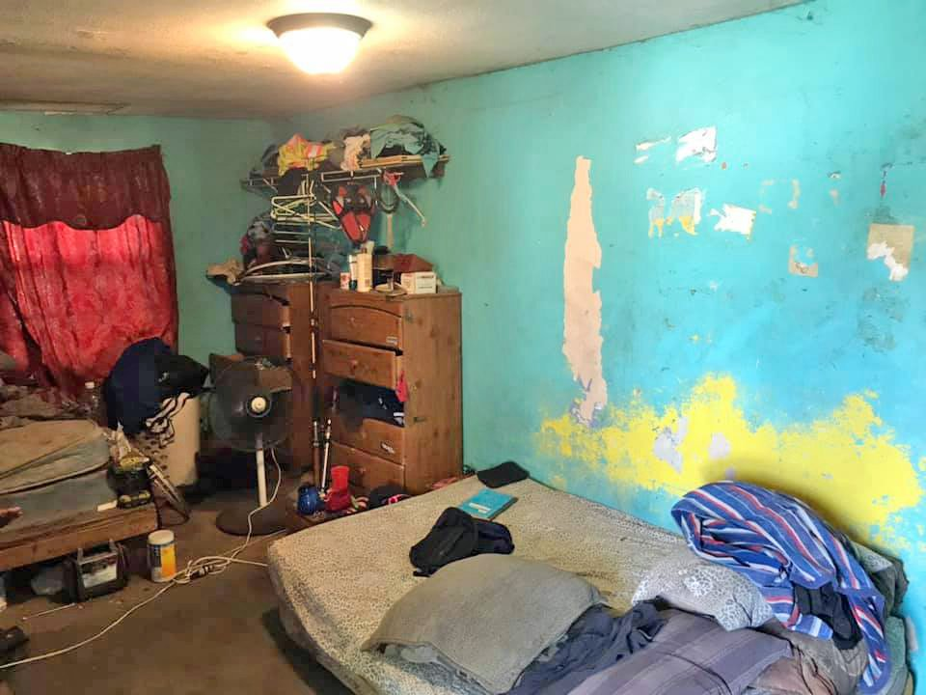

Slide 6
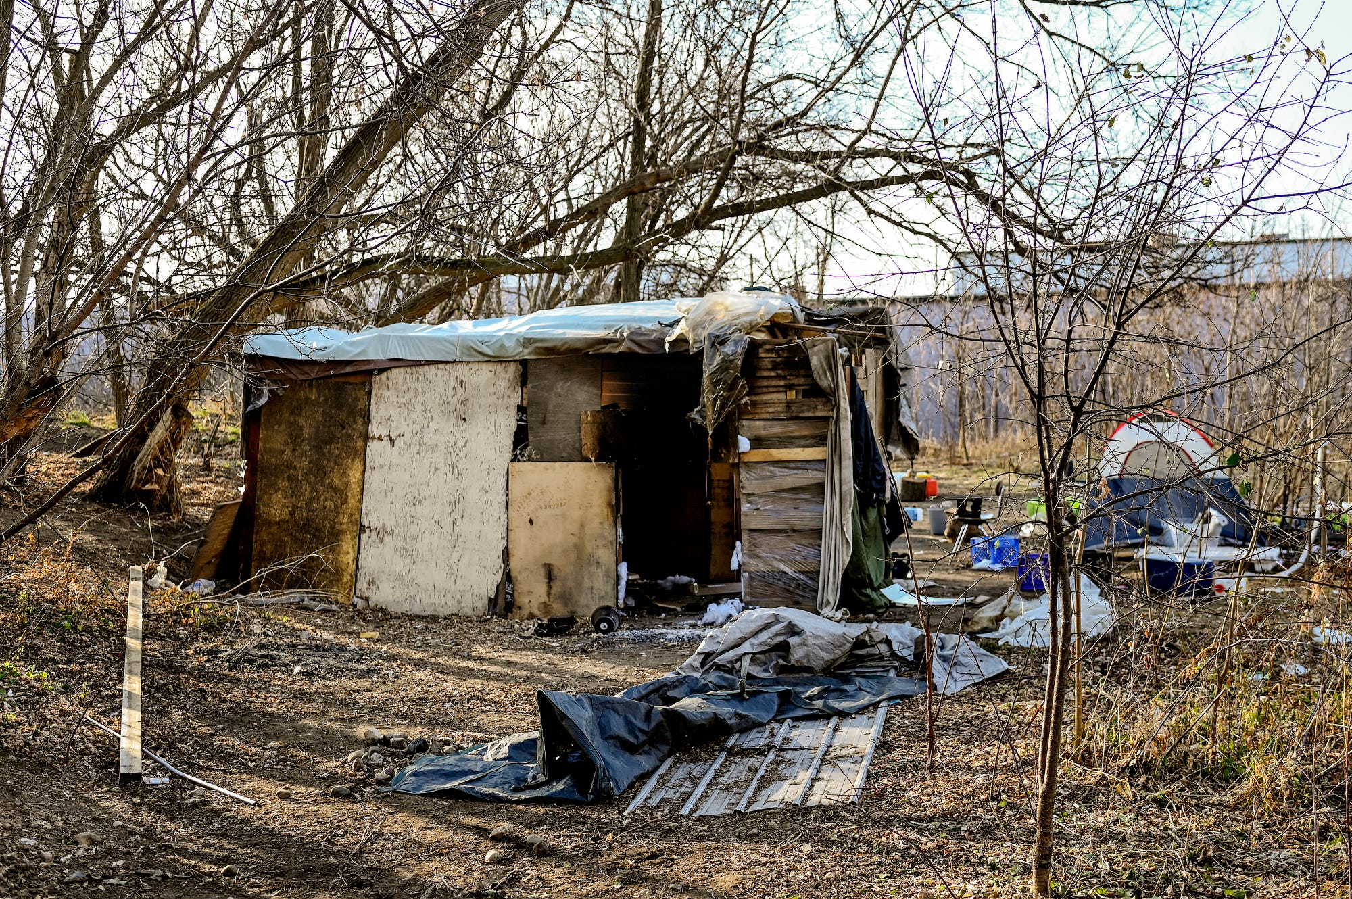
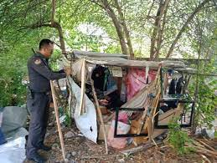

Slide 7
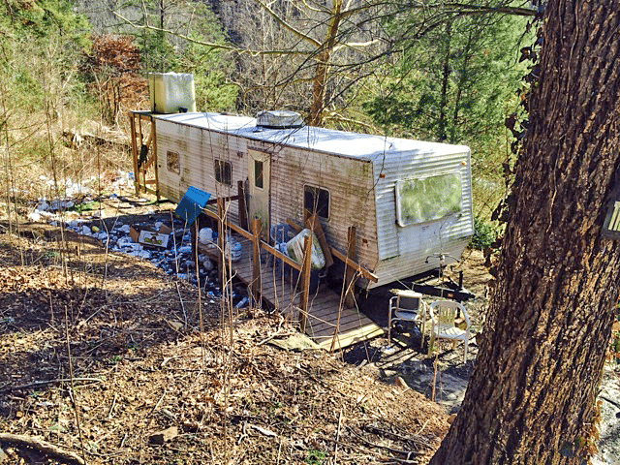

Slide 9
Causes of homelessness
Structural
Economic processes that affect income or employment stability
Citizenship and lack of access to social protection
Housing market (affordability, social housing)
Institutional
Shortage of services
Lack of coordination between existing services
Allocation mechanisms
Relationship
Family status – e.g. single parents more vulnerable
Relationship situation – abusive partners, step-parents
Relationship breakdown – death, divorce, separation
Personal
Disability, long-term illness
Low education attainment
Addiction - drugs, alcohol, gambling (bitcoin?)
Age and gender
Immigration situation – refugee status / recent arrival

Slide 10
Transitions and trajectories
Transition – a single life change or event
Married to single
Employed – unemployed
Healthy – injured
Trajectory – long-term process, set of transitions
Education
Career
Mental illnesses

Slide 11
Some numbers (2019)
23 825 in total
2 595 children
11 608 – sleeping rough or at night shelters
Due to be released from:
Prisons – 1500
Hospitals – 2 668
Prague – 3 056
Brno – 1 762
700 000 – Europe estimation (FEANTSA, 2020) – 70 % increase in 10 years
COVID?
Reality?

Slide 12
More numbers
In Ireland 1 in 3 homeless people in temporary accommodation was a child
In England 90% of single parent families applying for public support for homeless people were women
In Finland 25% of homeless families are immigrants
In Austria homeless people had a mortality risk 4 times higher than the rest of the population
In London the coronavirus mortality rate of homeless people living in emergency accommodation has been 25 times higher than that of the general adult population
In France 495 homeless people died in the streets in 2019

Slide 13
Why understanding homelessness matter?
The public perception
Based on the roofless
Just the tip of the iceberg
Most controversial, problematic
Financing
Prevention
Social exclusion
More societal groups in one bag
Young, elderly, physical/mental health, addictions, immigrants, criminals
Fear

Slide 14
Who are homeless people?

Slide 15
1st assignment
Essay (750 words) covering:
Your perception and understanding of homelessness
Identify potential stereotypes/prejudice you may have
Reflect it using ETHOS
Suggest ways how to overcome stereotypical/prejudicial understanding of homeless people

