Slide 1

Mainstream media and homlessness
Both positive and negative (more prevalent) depictions (Best, 2010)
Stereotypical, simplistic
Reinforcement of the „obnoxious, dirty, hopeless, aggressive and drunk tramp“ (Ravenhill, 2016)
Deficits and deviant characteristics are much more discussed
Dangerous criminals, drug abusers, mentally ill, having contagious diseases (Buck et al., 2004)
At best victims of violence, or helpless, dependent on society‘s benevolence (Schneider, 2012; Doudaki & Carpentier, 2019)

Slide 2
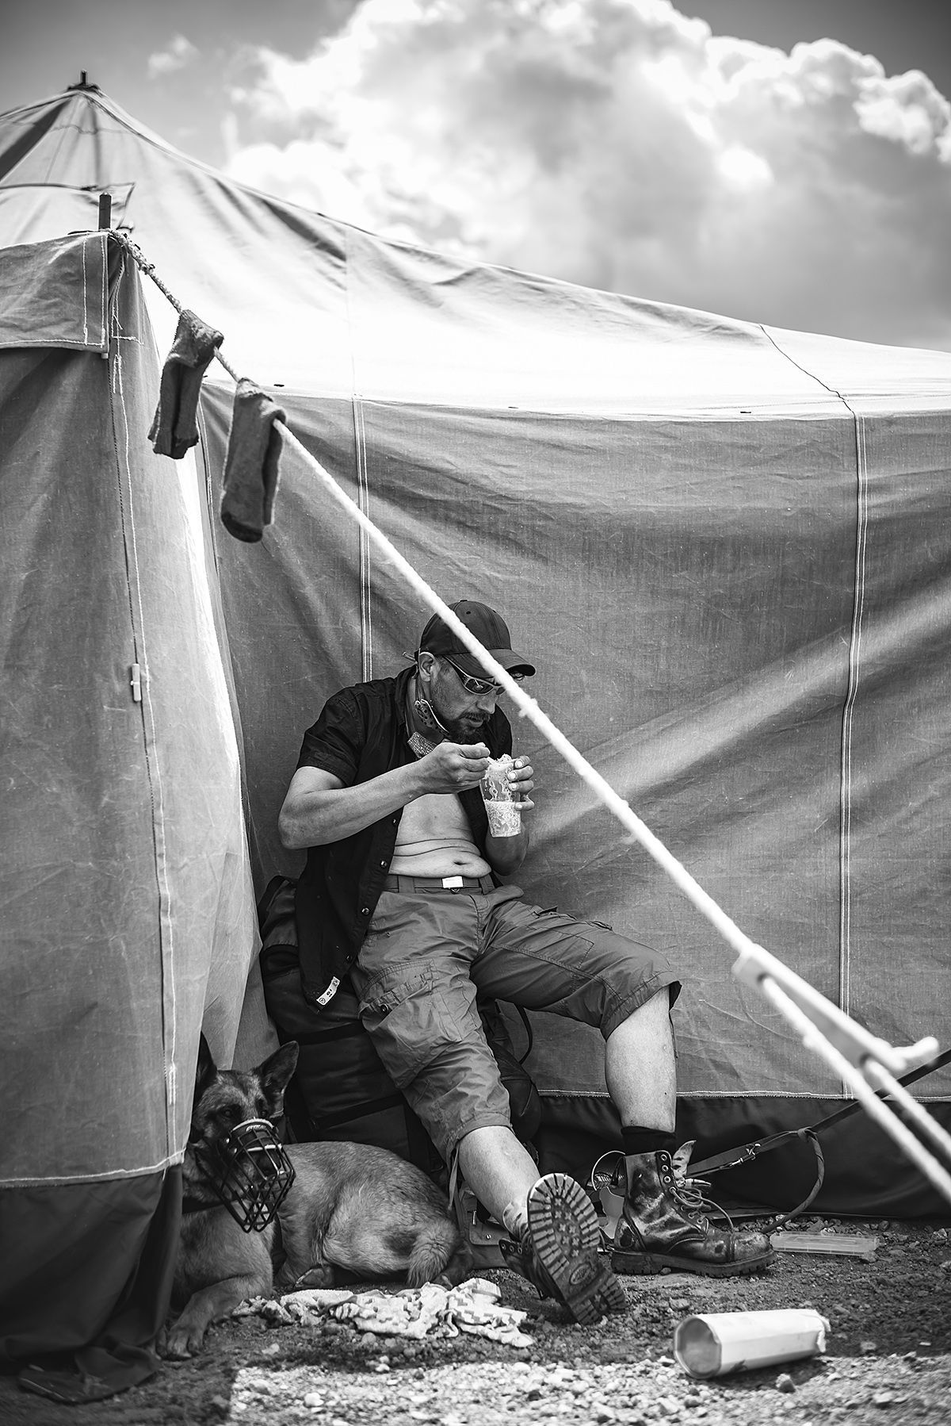
Representing it as a social issue is scarce or insufficient
Not a matter for public action
Leaving out causes and possible solutions (Best, 2020)
Episodical (Schneider, 2012)
  Winter, Christmas
    Leaving them unnoticed for the rest of the year
    Compassion fatigue (Bunis et al., 1996)
Most attention goes to the roofless (Busch-Geertsema, 2010)
  Highly vulnerable population suffering mental disorders, drug/alcohol abuse
Google a bit: https://www.google.com/search?q=homeless&hl=cs&sxsrf=APq-WBsWKUgIwAyCmS9zN5DlDChSu9BK2A:1646254281040&source=lnms&tbm=isch&sa=X&ved=2ahUKEwiog4aNp6j2AhXUnVwKHfHkBbQQ_AUoAXoECAEQAw&biw=1536&bih=722&dpr=1.25

Slide 3
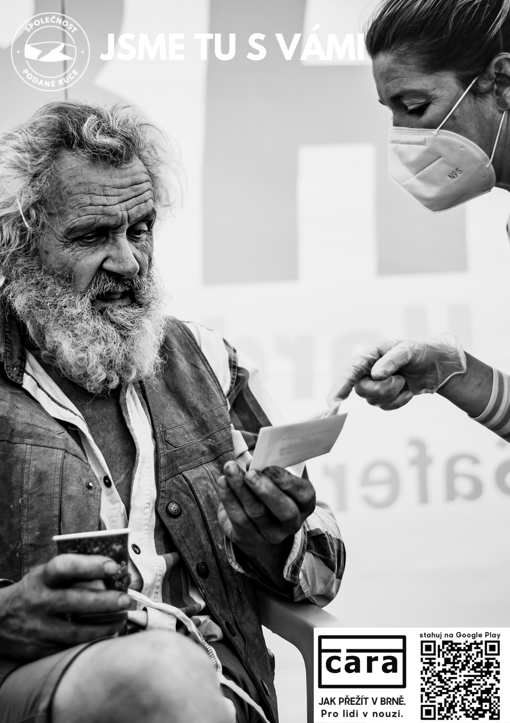
Rare active voice (Schneider, 2012)
No in-depth life stories
Sharing their first-hand experiences but rarely addressing homelessness in general
  Contribution to the perception of homelessness as an individual rather than a social problem
What about the Covid pandemic?
  More interest and coverage
  Slight shift to „a social issue“ narratives
  Risk of compassion fatigue

Slide 4
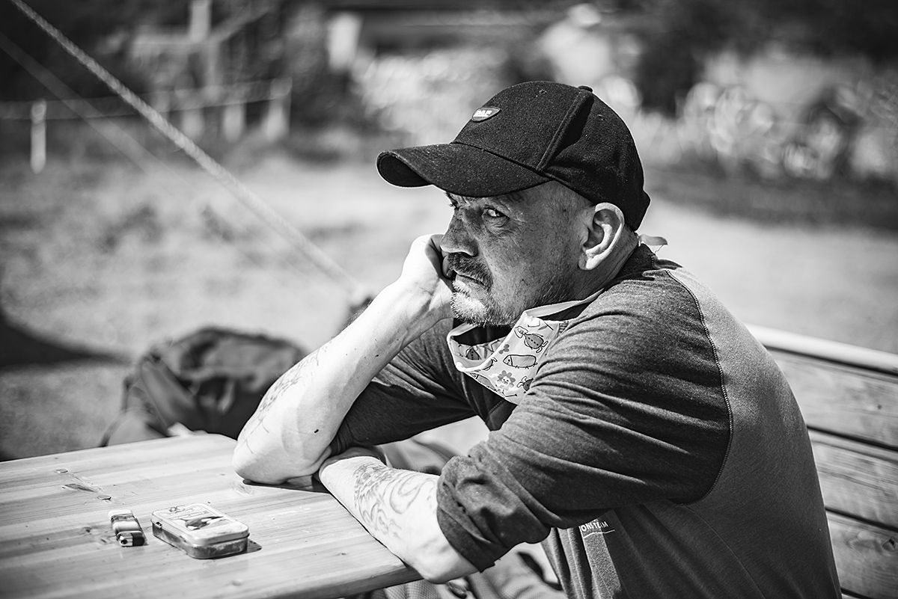
What‘s behind?
  Roofless people provide for most controversial, shocking readymade material that is considered newsworthy
  Inadequate training and understanding of homelessness
    Is it possible to understand it from the outside?
  Criteria of newsworthiness and the competition to attract large audiences

Slide 5
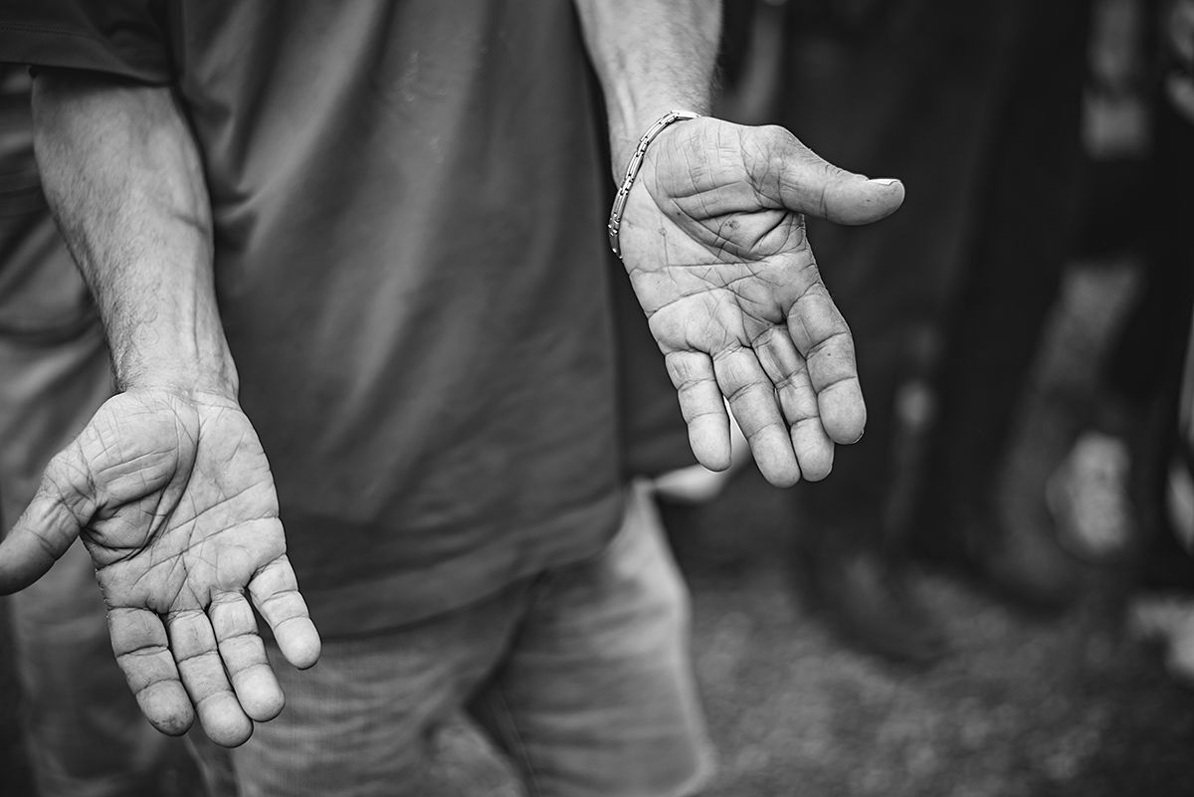
Alternative media
Independent, non-commercial, critical content, commited to social change
Community news, street papers (Doudaki & Carpentier, 2019)
  Resisting the mainstream media discourses
  Focus on homelessness, and other social inequalities
  Inclusive discourse
  Raising awareness of social injustice
  Seeking to bring in the voices and perspectives of the homeless and poor
    https://www.youtube.com/watch?v=6TLVgwoqhoc
    https://www.youtube.com/watch?v=276RZVt-SDk
Street papers
  Opportunities for homeless people to become the vendors of the publication
    Income
    Reconnection with the society?

Slide 6

Documenting and analyzing impacts of economic and policy changes on their lives
Seeking to critically engage the reading public
Helping to disrupt the stereotypical depictions of homeless
Opportunities to have their voices expressed
https://www.youtube.com/watch?v=H6ZFzEW7_Q4

Slide 7
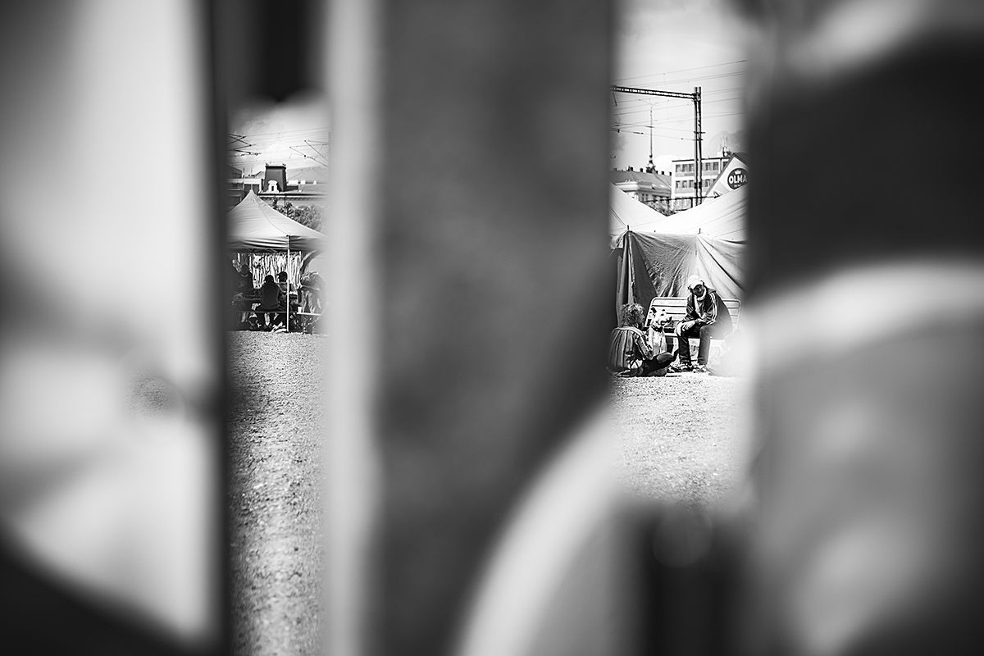
The limits
Their voices receive only limited space
Also restricted to specific writing genres and narratives (Torck, 2001)
  Focus on the life stories
  Limited/none power over the decision making
Limited reach
Already involved audiences

Slide 8
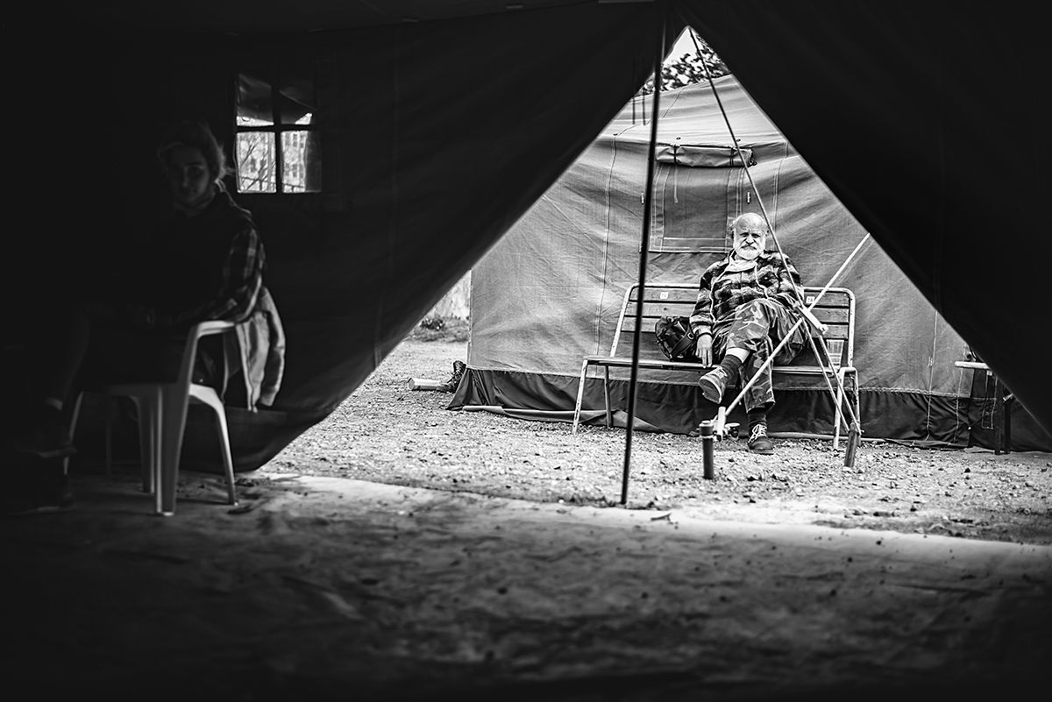
And again, why does it matter?
Social services, prevention and financing
Low self-esteem, self-acceptance
High social exclusion levels
Stigmatization

Slide 9

Next week: seminar
1st assignment
Search homelessness
What are the avenues for change?

Slide 10

Literature
Best, R. (2010). Situation or Social Problem: The Influence of Events on Media Coverage of Homelessness. Social Problems, 57(1), 74–91.
Ravenhill, M. (2016). The culture of homelessness. London: Routledge.
Buck, P. O., Toro, P. A., & Ramos, M. A. (2004). Media and Professional Interest in Homelessness over 30 Years (1974-2003). Analyses of Social Issues and Public Policy (ASAP), 4(1), 151–171.
Schneider, B. (2012). Sourcing homelessness: How journalists use sources to frame homelessness. Journalism, 13(1), 71–86.
Doudaki, V., & Carpentier, N. (2019). Critiquing hegemony and fostering alternative ways of thinking about homelessness: The articulation of the homeless subject position in the Greek street paper shedia. Communications. Media. Design, 4(1), 5-31.
Bunis, W. K., Yancik, A., & Snow, D. A. (1996). The cultural patterning of sympathy toward the homeless and other victims of misfortune. Social Problems, 43(4), 387–402.
Busch-Geertsema, V. (2010) Defining and Measuring Homelessness. In E. O’Sullivan, V. Busch-Geertsema, D. Quilgars and N. Pleace (Eds.) Homelessness Research in Europe: Festschrift for Bill Edgar and Joe Doherty (Brussels: FEANTSA)
Torck, D. (2001). Voices of Homeless People in Street Newspapers: A Cross-Cultural Exploration. Discourse & Society, 12(3), 371–392.

