Slide 1

What‘s next?
Monday 28/3, 5 pm, Vlhká 21 – Theatre play in our day center
  Everyone is welcome, let me know if you are interested
Week 9
  No class but…
    Groups of 2 or 3
    Fieldwork, choose date
      7/4
      8/4
      11/4
      13/4
      14/4
      19/4
Week 11
  One day out
  No resources
  Panhandling?
  Sleepover rough in the park (?) – together

Slide 2
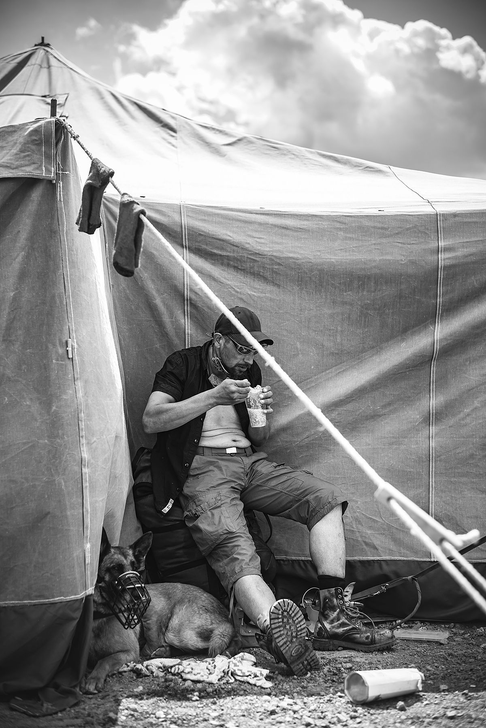
Group project
Community/street news pilot based on ethnography
  1 issue – this 1 covering homelessness
  16 to 20 pages?
What needs to be done
  Name
  Audience
  Purpose
  Format, color (using templates may be ok, since it is just a pilot that doesn‘t necessarily have to be published…)
  Front page
  Topics
  Corretions?
  …
When

Slide 3
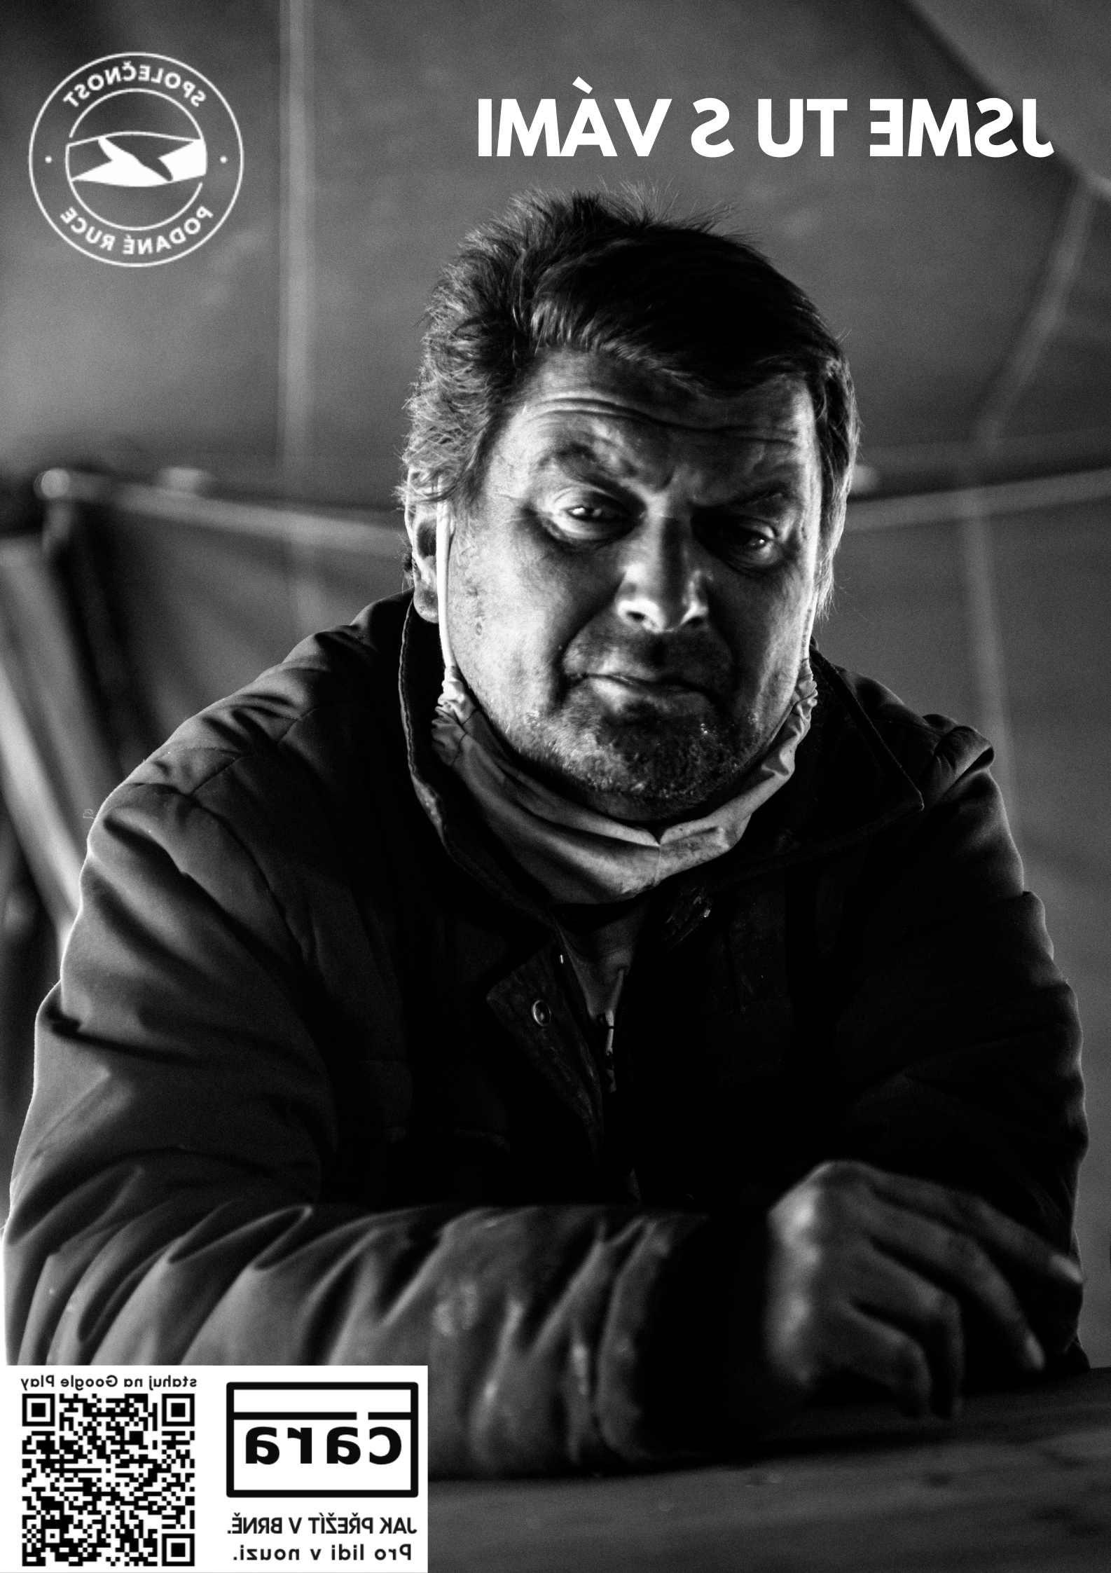
Topics
What do you want to explore more and cover?
Who are homeless people?
Understanding homelessness – more perspectives?
Own experiences – participant observation
  What does it feel like?
Causes
What can society do more?
What to do when approached by a homeless person?
Interviews
  Social workers, academics, politicians, …
Photos
Education
The team behind, purpose

Slide 4
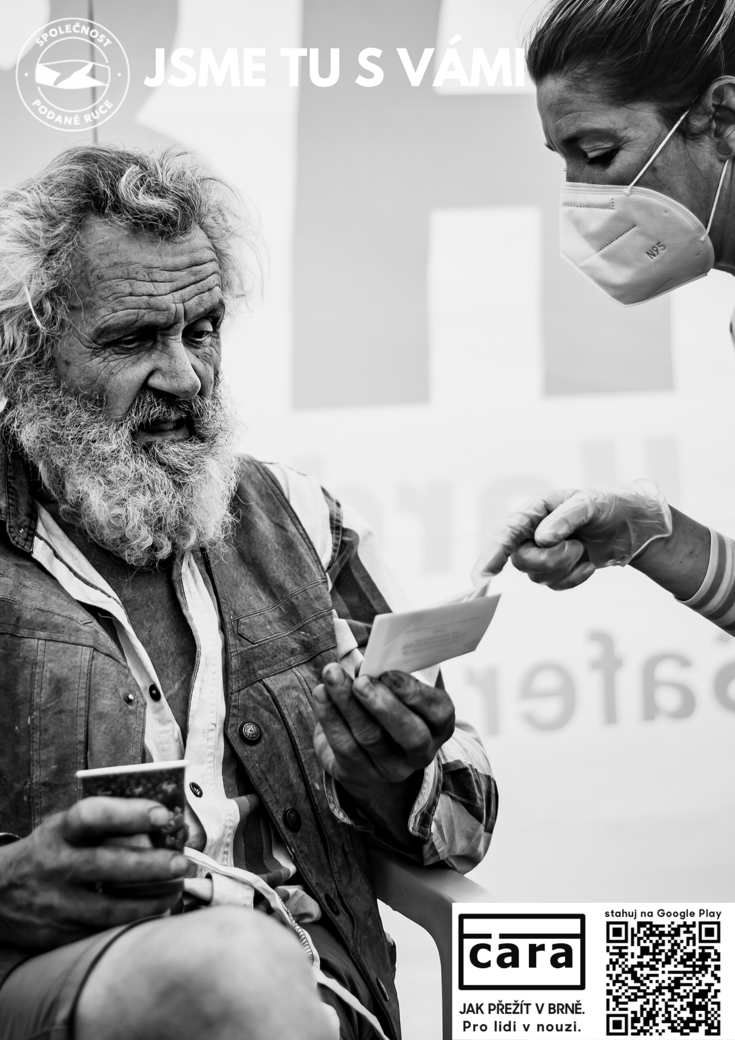
Using homeless people‘s participation
Writing, art, culture, entertainment
Stories
Plans and the future
What to do not to lose home, what to do if you lose it?

Slide 5
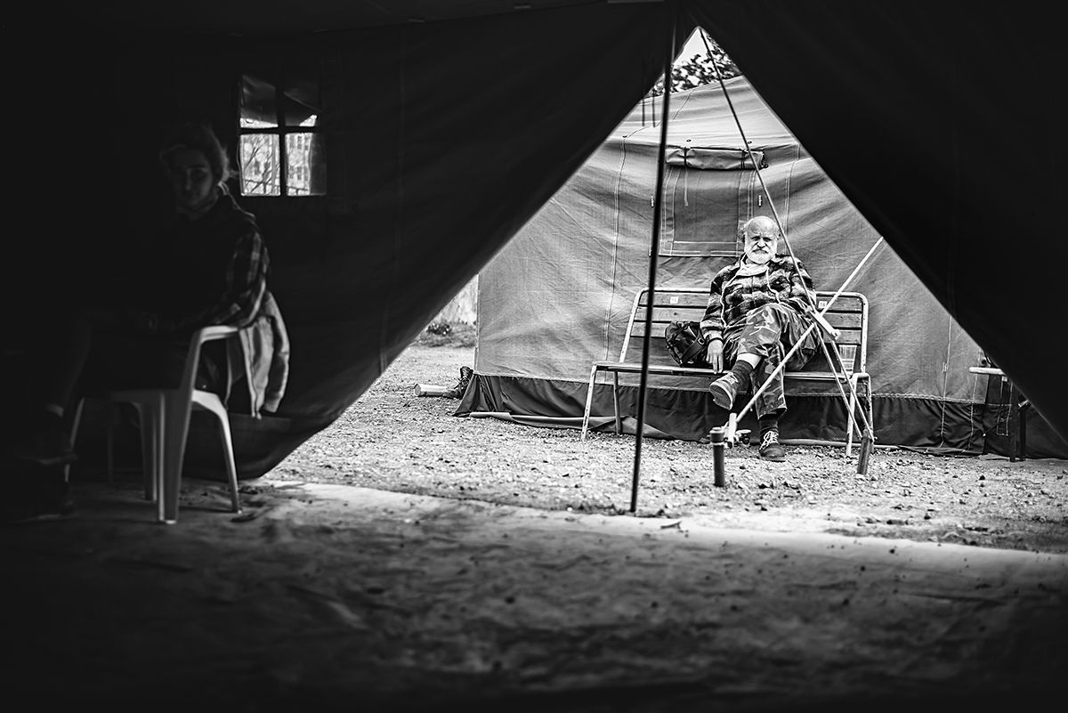
Assignment 2
Take fieldnotes (try !at least! 15 minutes every day)
Reflective essay on the fieldnotes
  Start with questions such as:
  What did you see, feel?
  What did you make of it?
  What have you learnt?
  Has anything changed? What, when, why?
  What do you need to explore more?
  And so on…
Deadline: 10/4

Slide 6

Final essay
2000 words
Follow the shifts of your understanding of homelessness
  If not, why?
What have you learnt?
Cover your experience from the field and how you can (if true, if not, explain) use it to report on homelessness in more responsible ways
Use at least 4 sources
Deadline: May 30

Slide 7
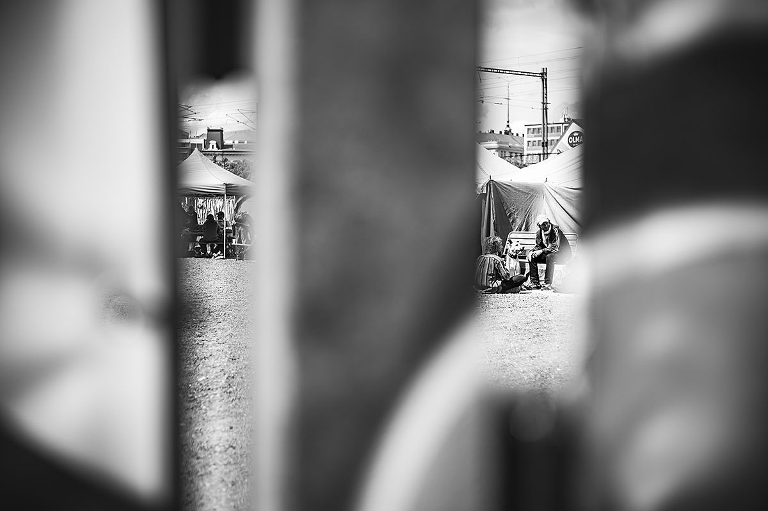
Next week
Reading week – no class!
Reading – media participation
Go to the field
Take fieldnotes
Reflect

Slide 8
