Slide 1


BSSb1194
Threats from Outer Space
Marek Dvoracek
28/03/2023

Slide 2
Content
What is going on?
SST
NEOs
Weather
Other

Slide 3
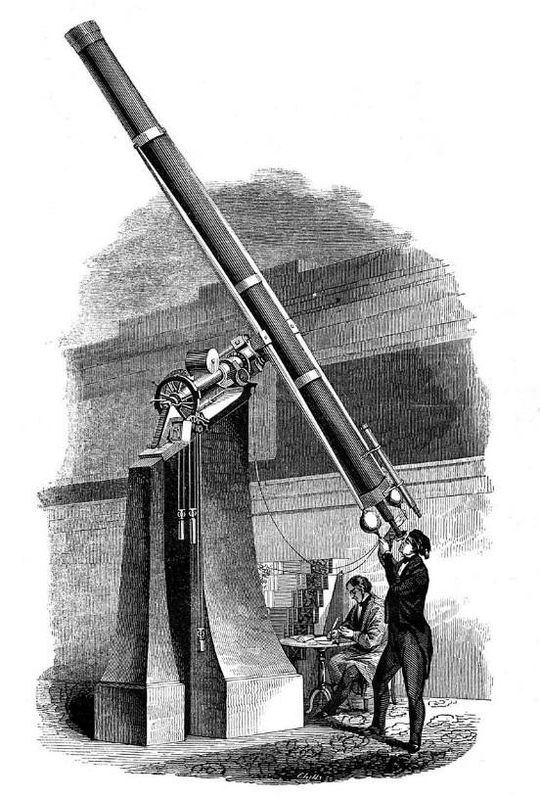
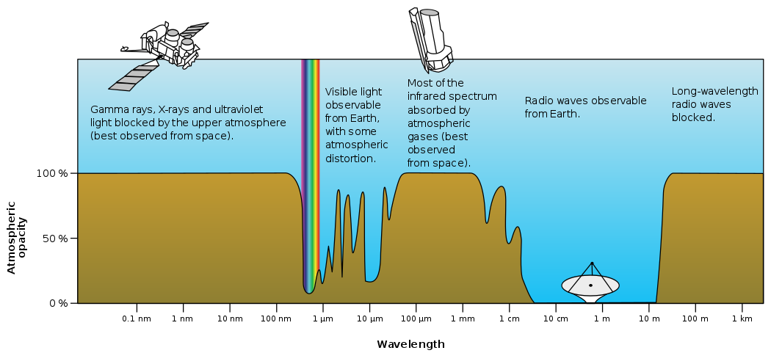
What is going on?
Planetary and Stellar unintentional and natural threats
1608 - Hans Lippershey patent for refracting telescope

Slide 4
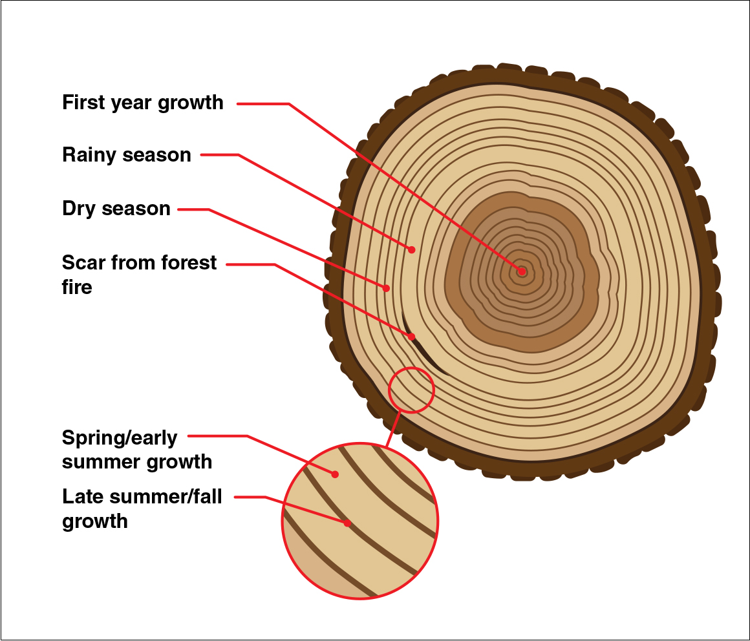
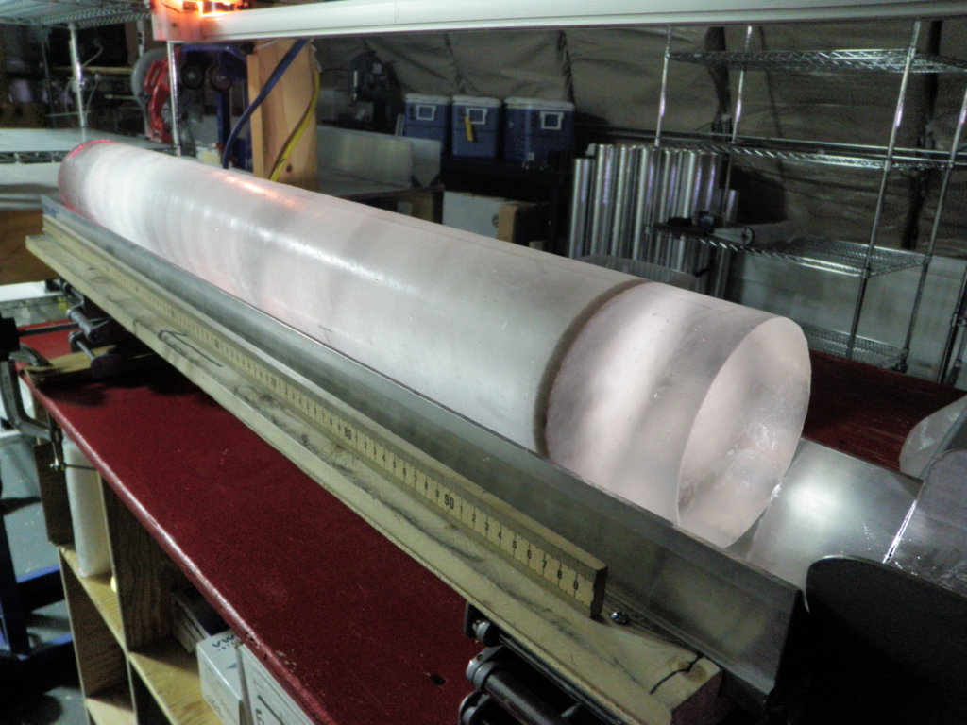
https://www.youtube.com/watch?v=odGrgsLkfUQ

Slide 5
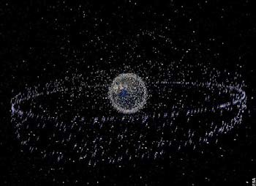
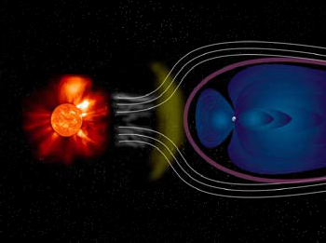
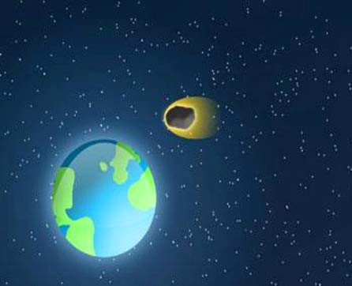
Space Situational Awareness
Space Surveillance and Tracking
Space Debris
Space Weather
Sun-related Phenomena
Near-Earth Objects
Asteroids

Slide 6
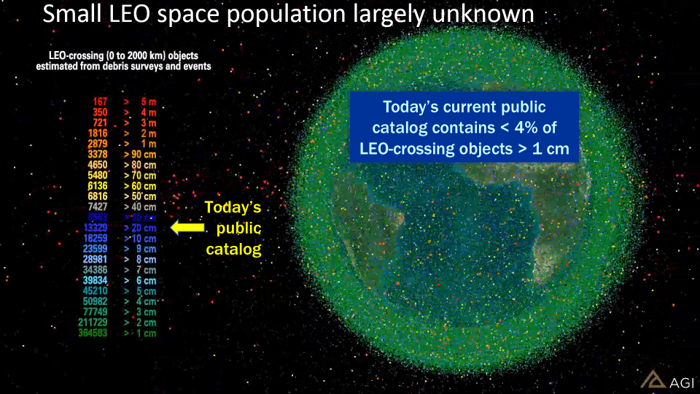
Cislunar outer space is not an empty space. On the contrary it is becoming more „contested, congested, competitive“
Space Surveillance and Tracking (SST)

Slide 7
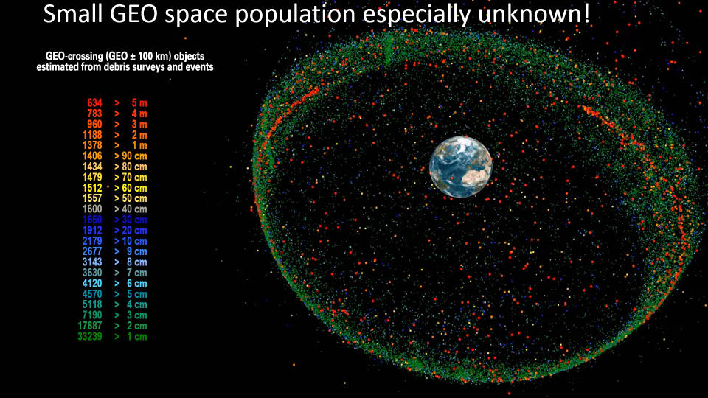

Slide 8
Sources and Sinks of Space Debris
Sources
Sinks
Launches (rocket bodies, payloads, mission related objects)
Natural decay (atmospheric drag, solar radiation pressure, lunisolar perturbations)
Fragmentations (explosions, collisions)
Active Removal (de-orbit, non-propulsive maneuvers)
Non-fragmentation debris (surface degradation, solid rocket motor particles)
Notes:
Natural decay efficiency diminishes drastically with altitude

Slide 9
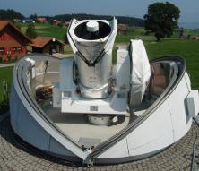
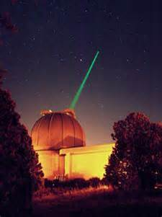
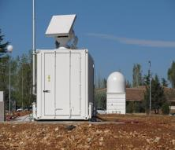
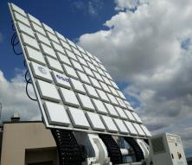
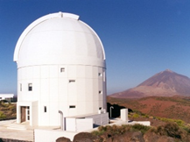
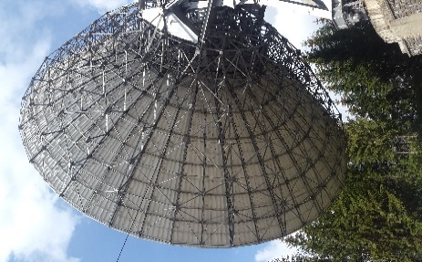
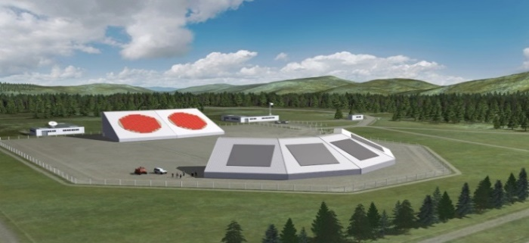
Enhanced SST capabilities

Slide 10
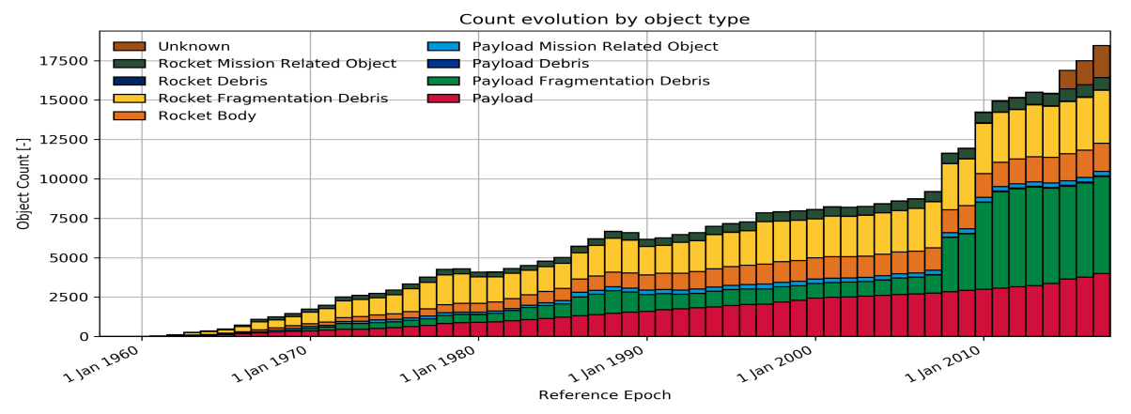
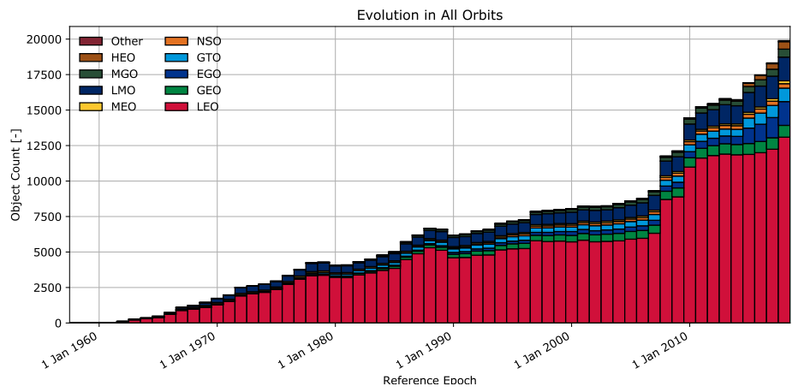
Iridium-33 and Cosmos-2251 collision (2009): 17% increase of trackable objects
Feng Yun-1C anti-satellite test (2007): 34% increase of trackable objects

Slide 11
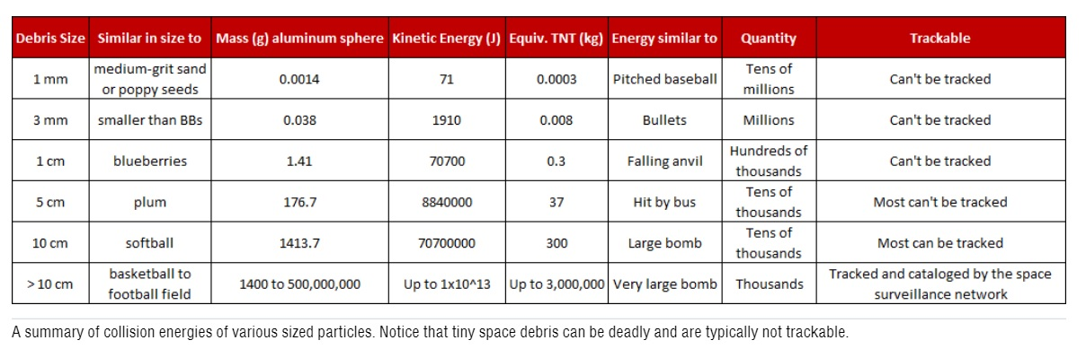
https://aerospace.org/story/space-debris-and-space-traffic-management

Slide 12
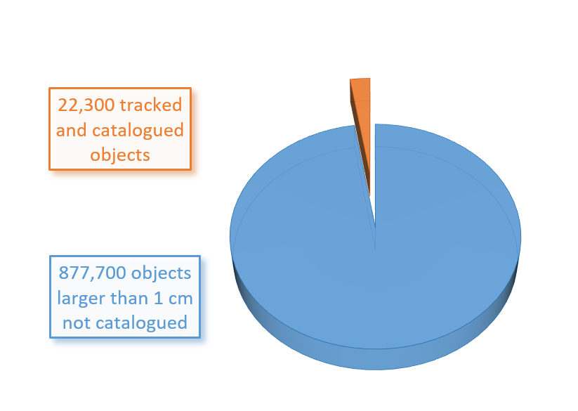
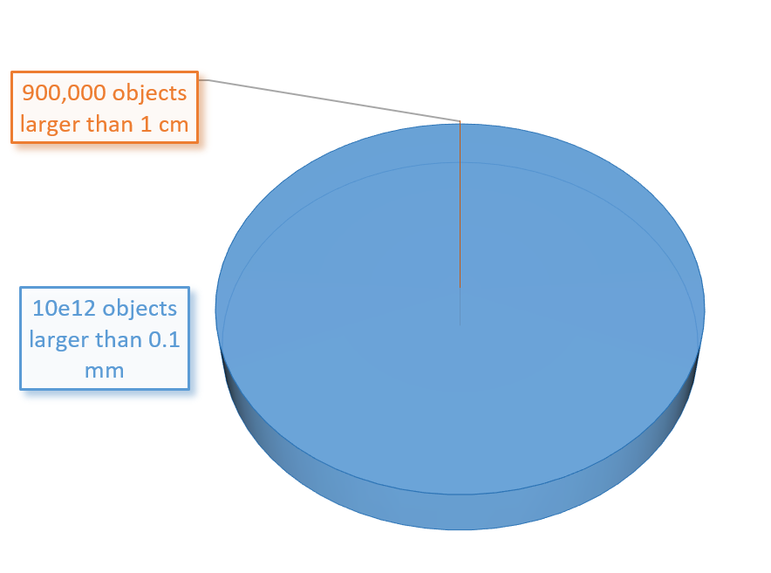
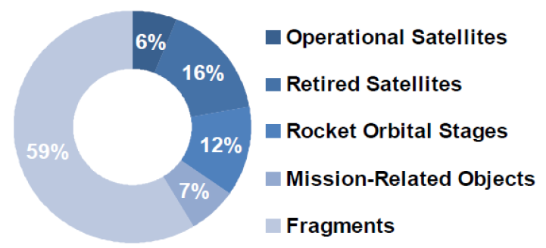
Why even care?

Slide 13
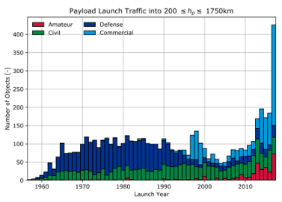
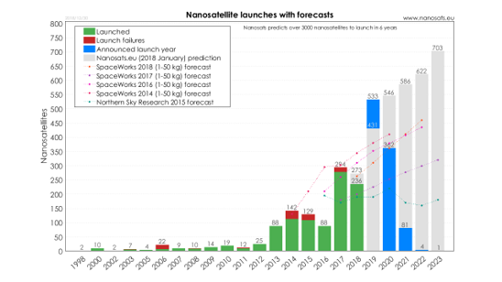
http://www.unoosa.org/res/oosadoc/data/documents/2019/aac_105c_12019crp/aac_105c_12019crp_7_0_html/AC105_C1_2019_CRP07E.pdf

Slide 14
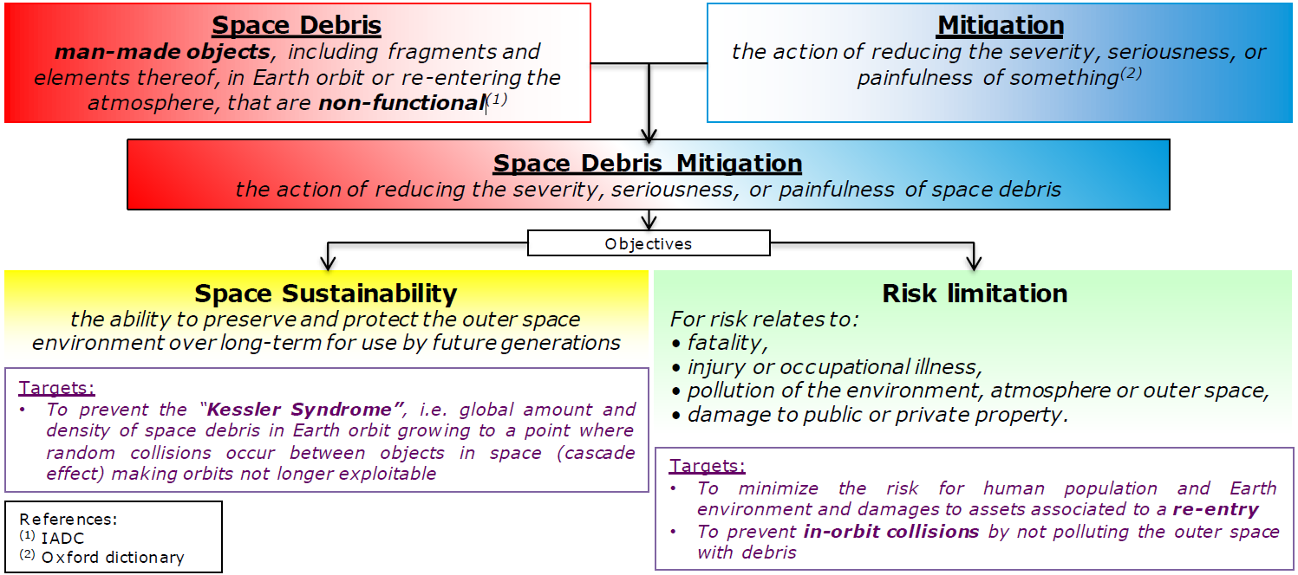
What to do now?

Slide 15




NEOs

Slide 16
NEOs
Near Earth Objects
Asteroids or comets of sizes ranging from metres to tens of kilometres that orbit the Sun and whose orbits come close to that of Earth’s. Of the more than 600 000 known asteroids in our Solar System, more than 18000 are NEOs.
comprising natural objects that can potentially impact Earth and cause damage, and assessing their impact risk and potential mitigation measures
Less than 1% of NEOs (15 – 40m) discovered
Average one impact every 10 years (Chelyabinsk type – 20m)

Slide 17
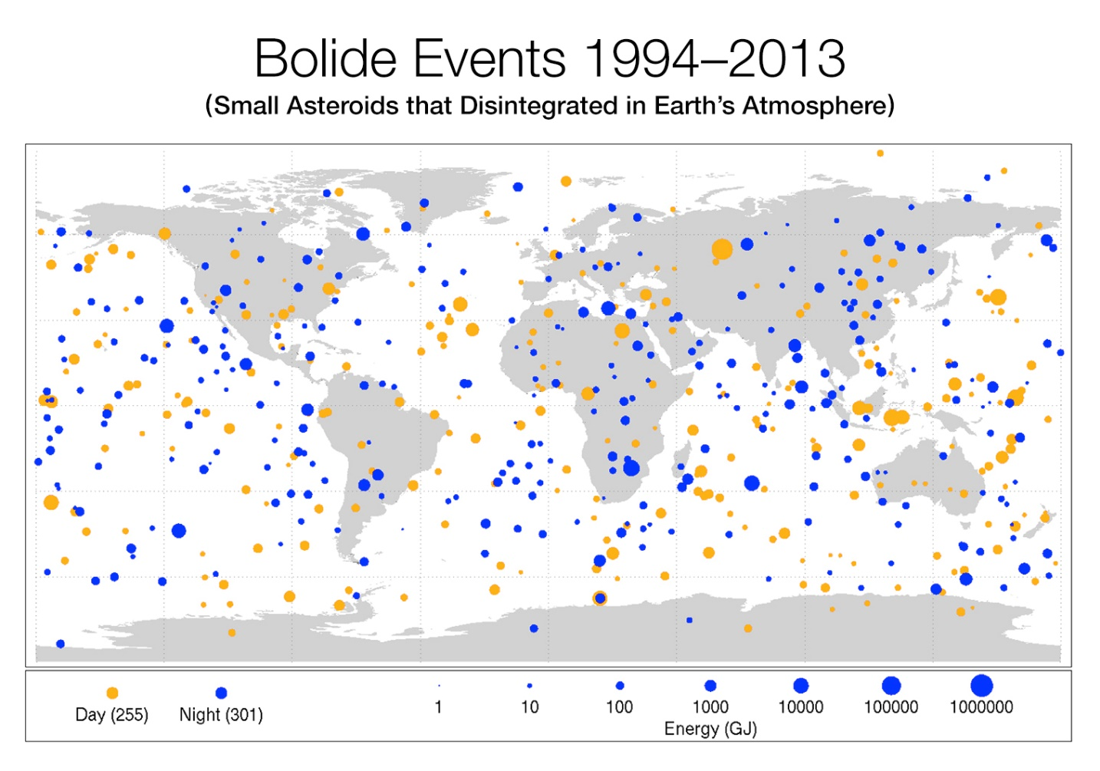
Stuff from space
https://www.youtube.com/watch?v=9q3uNcJh4pc
meteorites are everywhere
There are probably more than 500 000 fireballs a year (shooting star)

Slide 18
2022
The Subcommittee noted that some 36.5 million observations of asteroids and comets had been collected in 2022 by the worldwide network of astronomical observatories, based in more than 40 countries. It also noted that the total number of known near-Earth objects came to 31,366 as at 5 February 2023, of which a record number of 3,190 had been discovered in 2022, and that currently a total of 2,328 catalogued asteroids with approximate diameters of 140 m or more had orbits that brought them within 8 million km of Earth’s orbit. In that regard, the Subcommittee also noted that, although that number seemed high, it was estimated that only about 42 per cent of the near-Earth objects in that size range had been found
https://www.unoosa.org/res/oosadoc/data/documents/2023/aac_105c_1l/aac_105c_1l_406add_4_0_html/AC105_C1_L406Add04E.pdf
Released in February 2023

Slide 19
More Hunting to Do
NASA's NEO Observations Program (asteroid surveys) is responsible for over 90 percent of near-Earth asteroid and comet discoveries. The discovery rate averages about 40 per week.
NEO Observations Program - to discover 90 percent of the NEOs down to the much smaller size of 140 meters (size–larger than a small football stadium).
While no known asteroid larger than 140 meters in size has a significant chance to hit Earth for the next 100 years, only about 42 percent of those asteroids have been found as of February 2023.
These smaller asteroids may not present a threat of global catastrophe if they impact Earth, but they could still cause massive regional devastation and loss of life, especially if they occur near a metropolitan area
https://www.jpl.nasa.gov/news/news.php?feature=7194
https://www.youtube.com/watch?v=V_eEXScLFBA
https://www.vox.com/xpress/2014/9/8/6118717/interactives-calculator-asteroid-meteoroid-meteorite-comet-destroy
https://www.nasa.gov/planetarydefense/dart

Slide 20
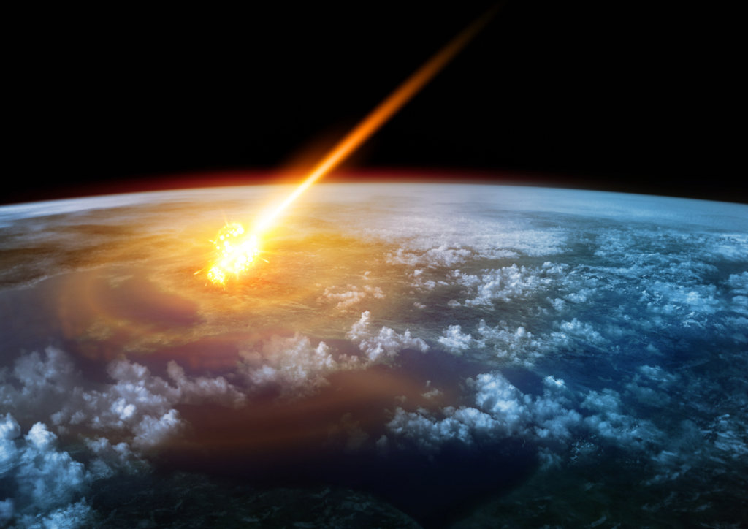

Slide 21
Impacts
- Siljan ring – 375 mil. years ago, 52km
  largest crater in Europe
- Chicxulub crater - 66 mil. years ago, 150km, 11-80km diameter
  killed dinosaurs (helped create Amazon rainforest?)
- Vredefort crater – 2 bil. years ago, 160 km
  largest confirmed known crater on Earth

Slide 22
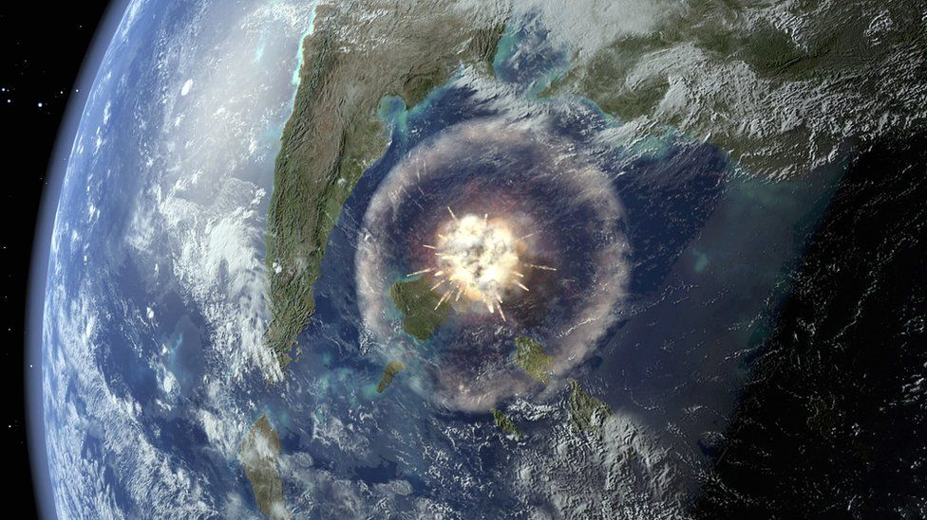

Slide 23
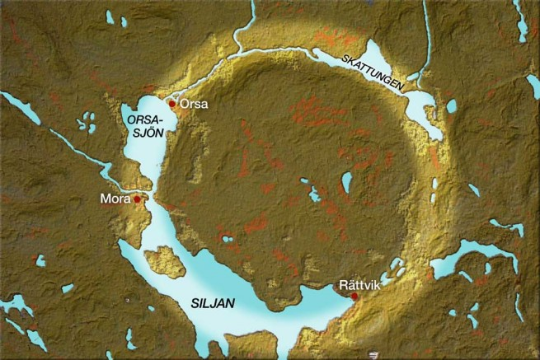

Slide 24
Impact consequences
- instant destruction at the impact site
- firestorms, shockwave, tsunamis
- “impact winter” – dust and ash blocking sun
  drop in temperatures, no photosynthesis
  food chain collapse, extinction of species
  Experience the Disaster that Wiped Out Dinosaurs
  How to survive?

Slide 25
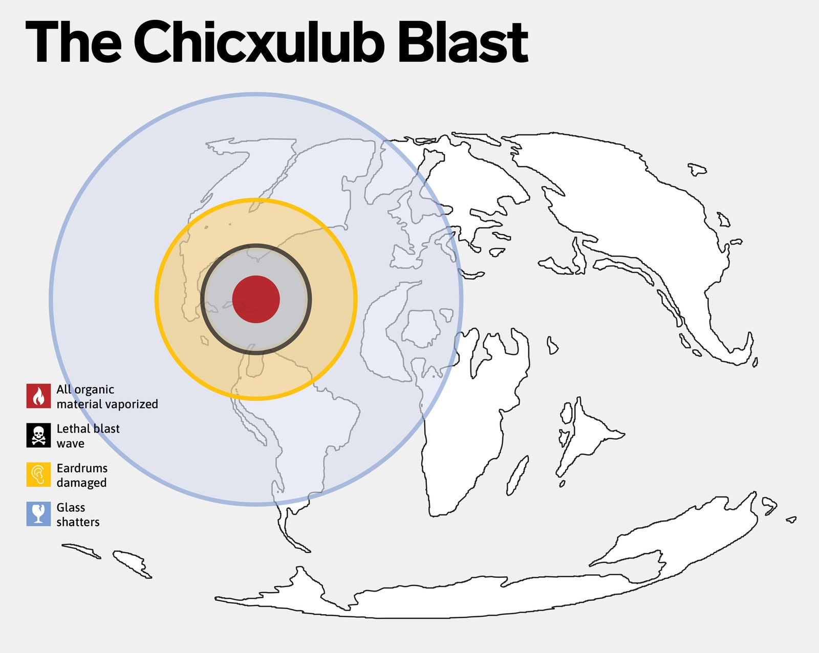

Slide 26
Impacts in the present
- Tunguska, 1908 – 30m in diameter
  10 megaton equivalent airburst
  80 mil trees damaged, no known victims
- Chelyabinsk, 2013 – 20m in diameter
  440 kilotons of energy
  1500 injured, thousands of buildings damaged
-Bering Sea, 2018
  173 kilotons of energy, 11x Little Boy
  Remote area, unnoticed, ex-post
- small impacts and near misses are very common

Slide 27
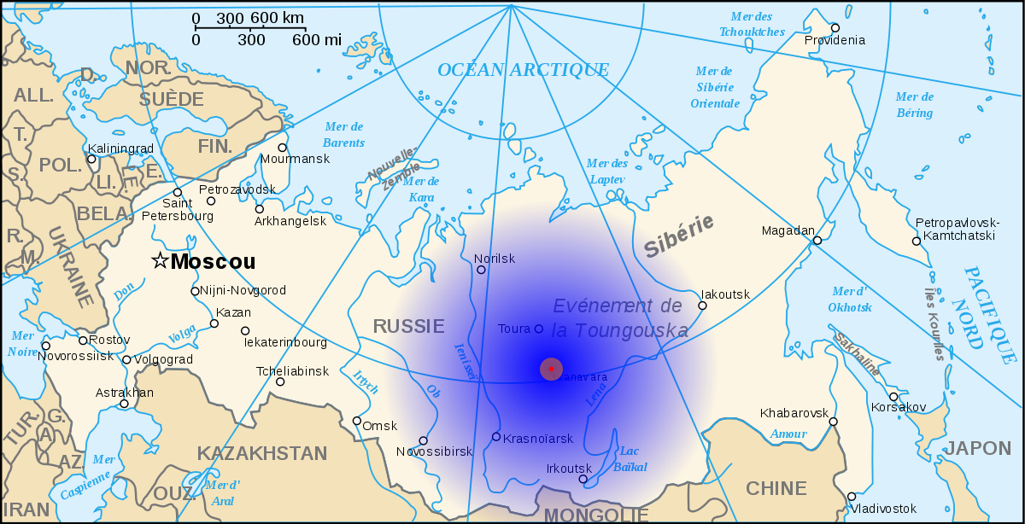
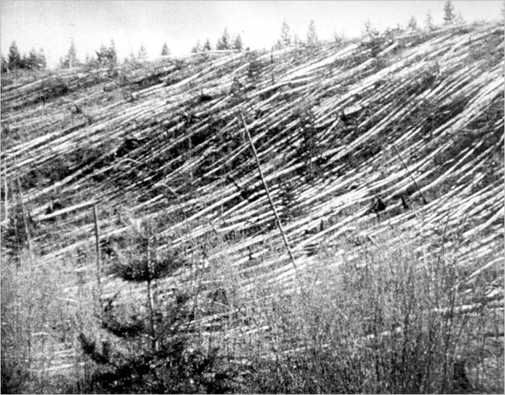

Slide 28
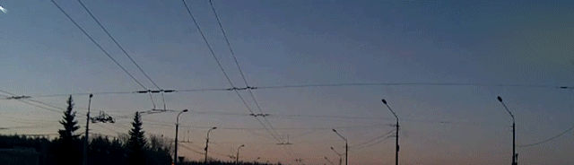

Slide 29
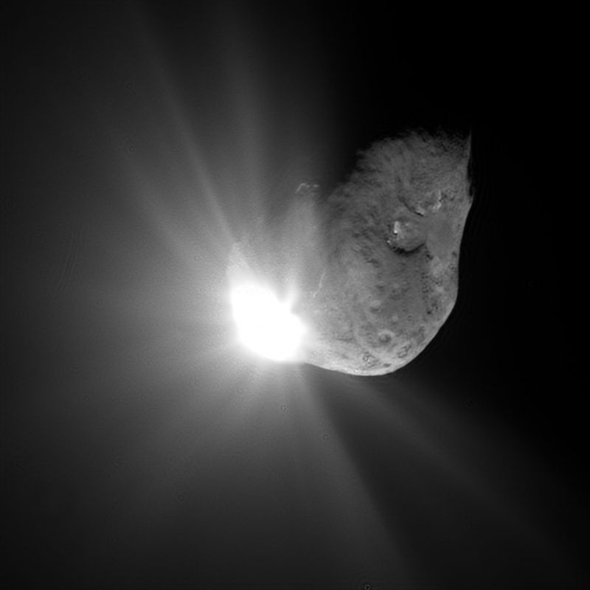
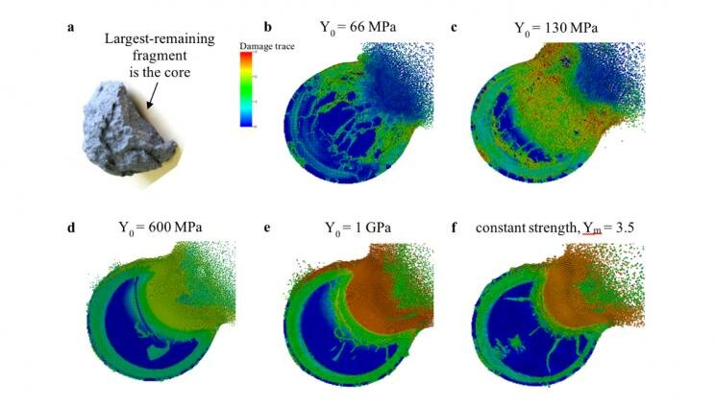
Asteroid / Planetary Defence
- by impact
  kinetic
  nuclear
- deflection
  gravitational
  solar
  propulsion
  laser
- crucial element: monitoring and early warning

Slide 30
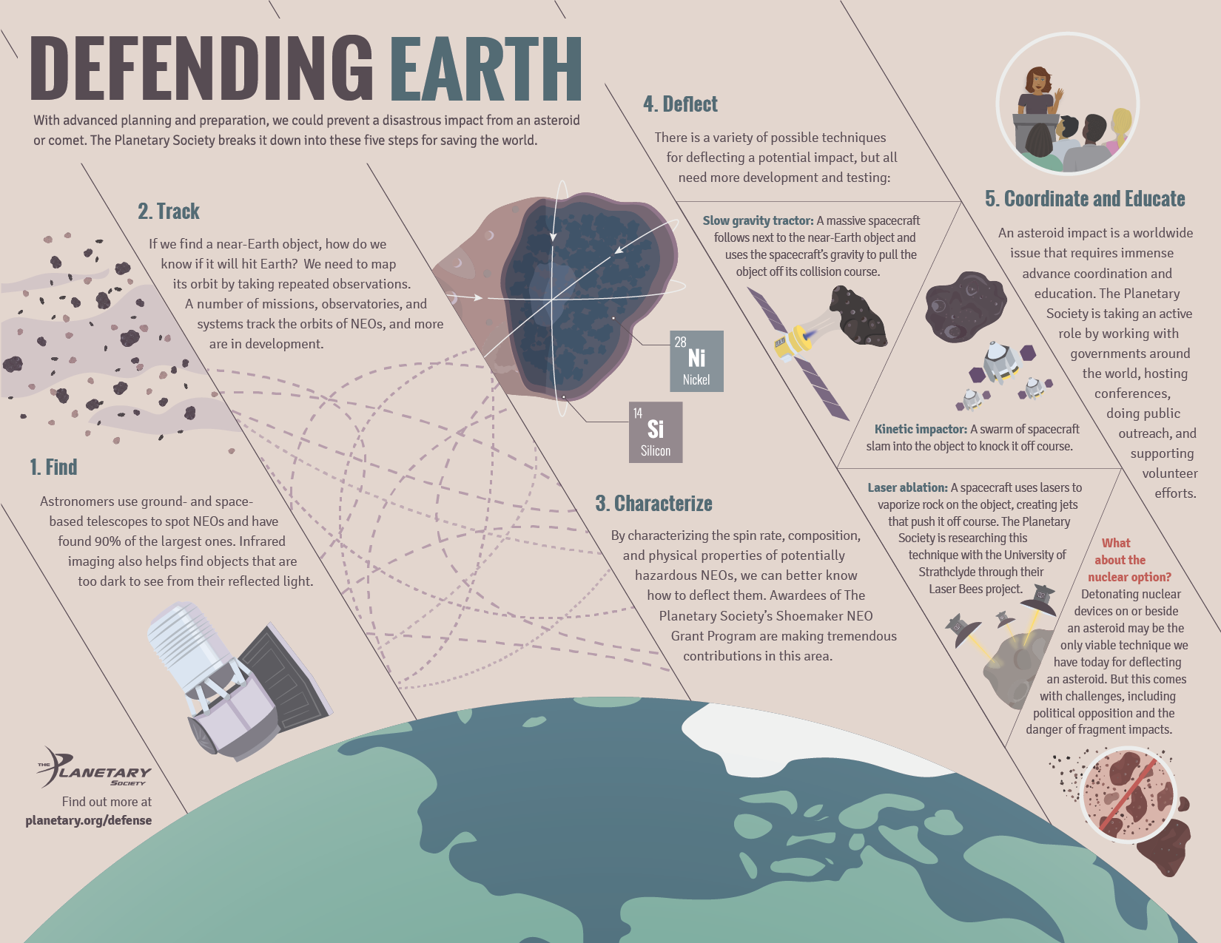

Slide 31
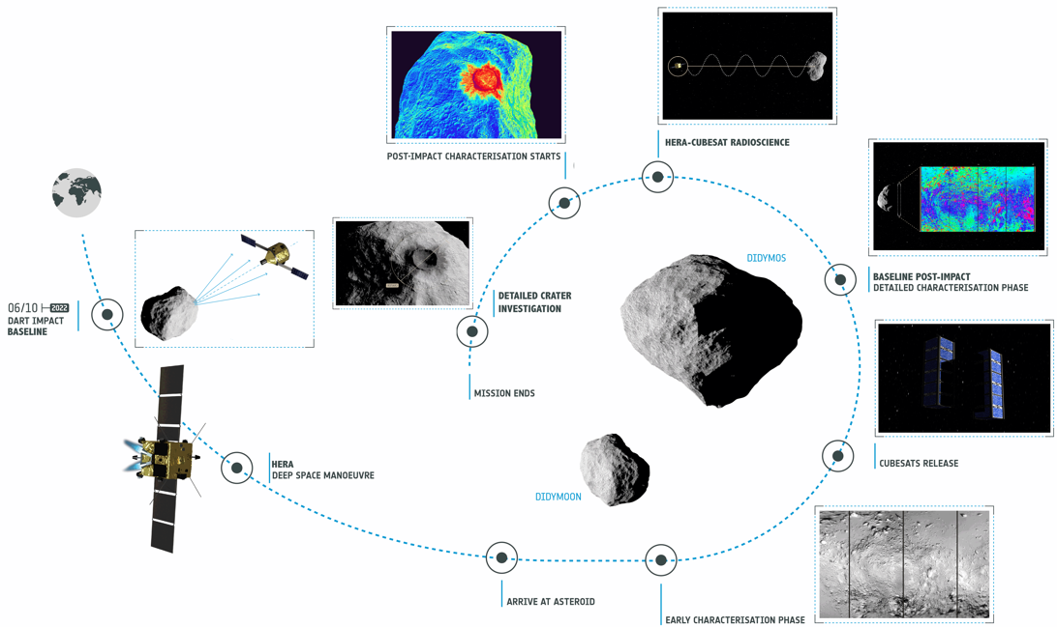
NASA‘ Double Asteroid Redirection Test + ESA Hera experiment
First precise measurement of deflection efficiency and Planetary Defence capability
First binary asteroid and smallest asteroid ever visited
First detailed measurement of small body cratering physics
First deep-space CubeSat for very close asteroid inspection

Slide 32
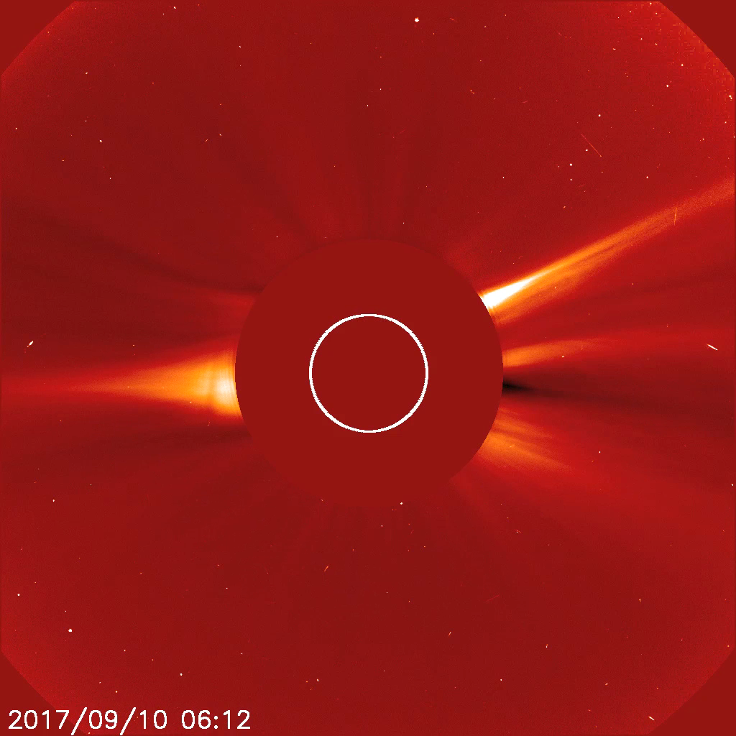
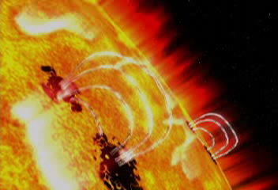
Space Weather

Slide 33
Space Weather
I) A solar flare is an eruption of radiation emitted from the energy accumulated in the sun’s magnetic fields as they become increasingly unstable
II) Coronal Mass Ejections are large expulsions of plasma and magnetic field originating from the Sun’s coronal atmosphere
III) Solar Energetic Particles, are high energy charged particles accelerated by the Sun, a form of cosmic ray

Slide 34
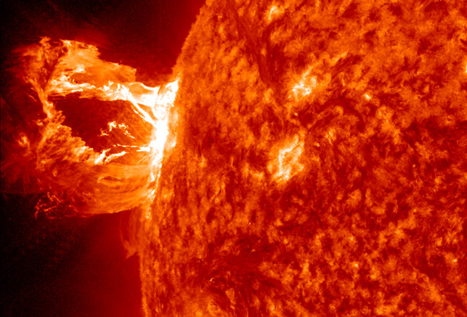

Slide 35
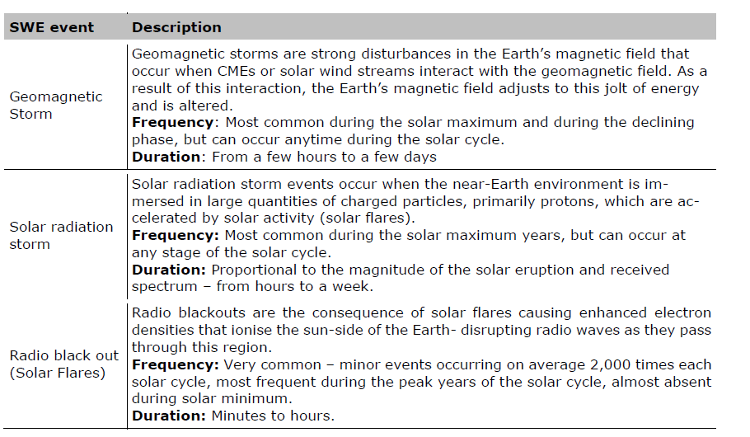
Space Weather event

Slide 36
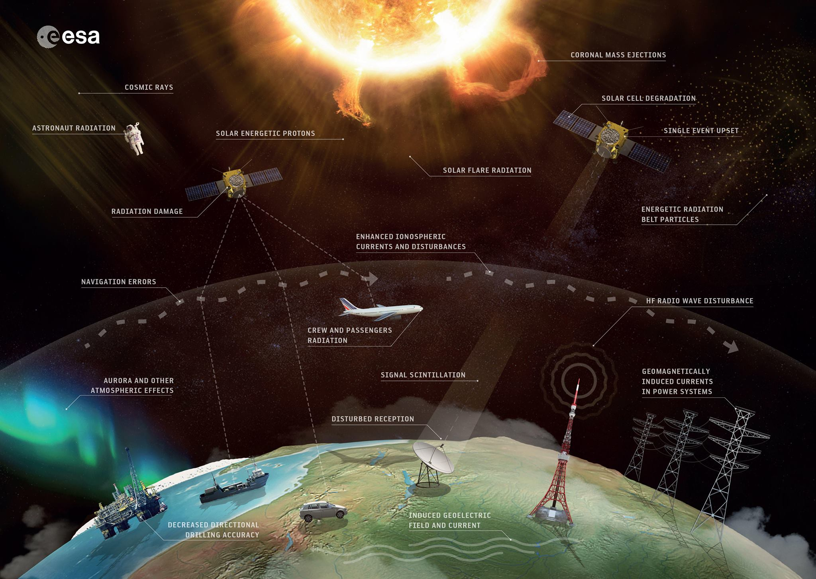

Slide 37
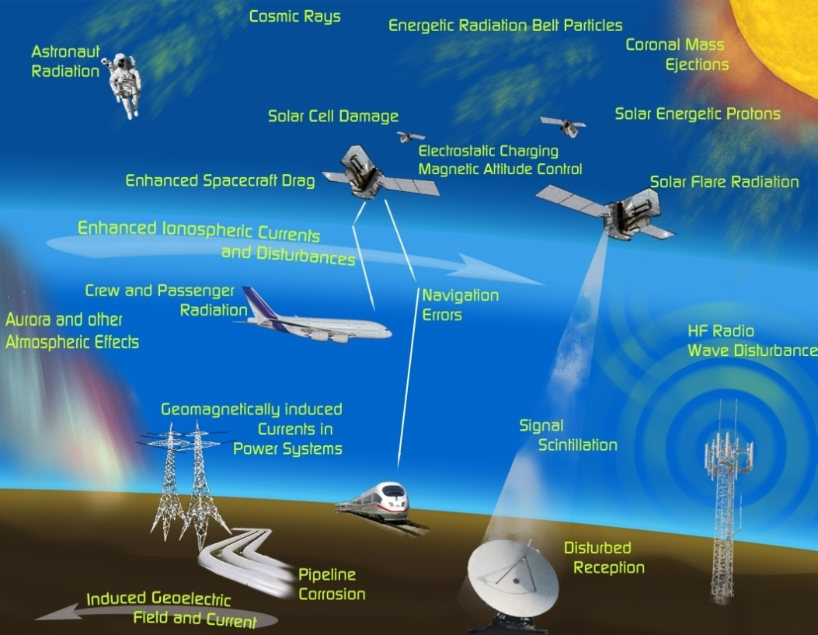

Slide 38
Space Weather
- Carrington event (1859)
  extreme aurora visible in the Caribbean, Africa
  telegraph wires overloaded, fires, shocks, etc.
- SC 22 flare (1989, quite small)
  auroras in Texas, blackout in Quebec
  satellites failing, people panicking over WW3
- 2012 near miss, Carrington-sized
- we cannot really predict them

Slide 39
Space Weather
Modern society is totally dependent upon energy networks, and a repeat of the Carrington Event – a solar storm in 1859 that severely impacted the worldwide telegraph infrastructure – would have even more extreme consequences today
As a result of increased dependency on the systems that would be affected, with estimated losses of up to $2 trillion in the US alone
Not IF, but WHEN, with a similar level (or worse) event likely within the next 50 years.
Contingency plans? Not yet. Duck and hope for the best.

Slide 40
L1-L5 ESA Project
The L1 point is “located in the solar wind “upstream” from Earth, so measurements at L1 provide information about the space weather coming toward Earth”.
The L5 point, “located 60 degrees behind Earth, close to its orbit, will provide a way to monitor Earth-oriented coronal mass ejections (CMEs) from the 'side' so as to give more precise estimates of the speed and direction of the CME”.
The primary objective of the L1 mission is “to provide in-situ observations of the interplanetary medium, including solar wind speed, density, temperature and dynamic pressure, as well as characteristics of the charged particle environment and the direction and strength of the Interplanetary Magnetic Field (IMF). The L1 mission will also monitor the solar disc and solar corona and measure solar energetic particles that may be associated with solar flares and the onset of coronal mass ejections”.
The L5 mission objective is “to complement measurements made from L1 by providing a view of the Sun away from the direct Sun-Earth line. This gives visibility of the propagation of plasma clouds emitted by the Sun toward Earth, as well as views of the solar disk before it rotates into view from Earth.

Slide 41
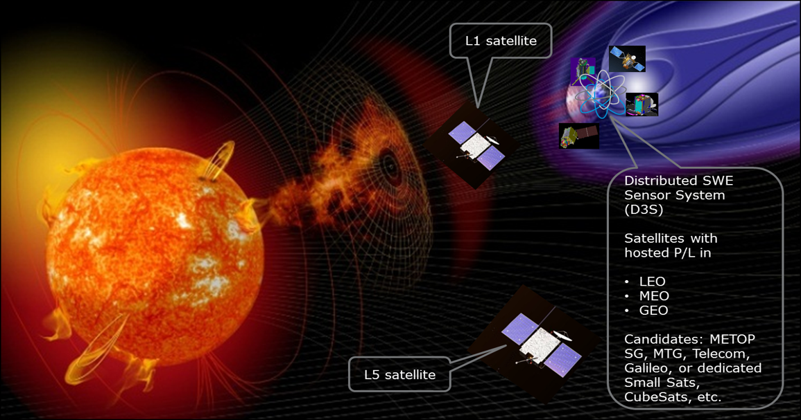

Slide 42
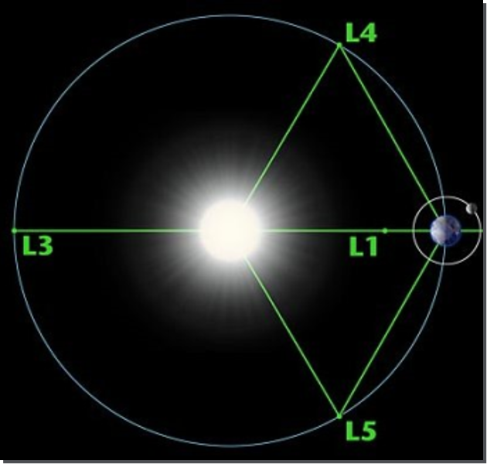
The sun rotates with
a period of 27.25 days
Development of SWE L5:
Solar corona monitoring
Heliospheric imaging
Solar disc magnetic field
EUV imaging
In-situ measurements:
  solar wind
  magnetic field
  charged particles
  hot plasma
Mission phases in SSA-P3
  A/B1
  Readiness for B2/C/D

Slide 43
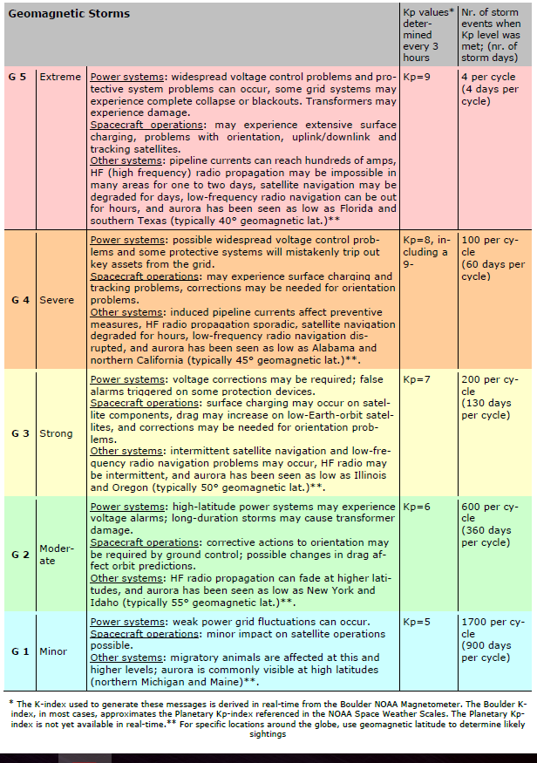

Slide 44
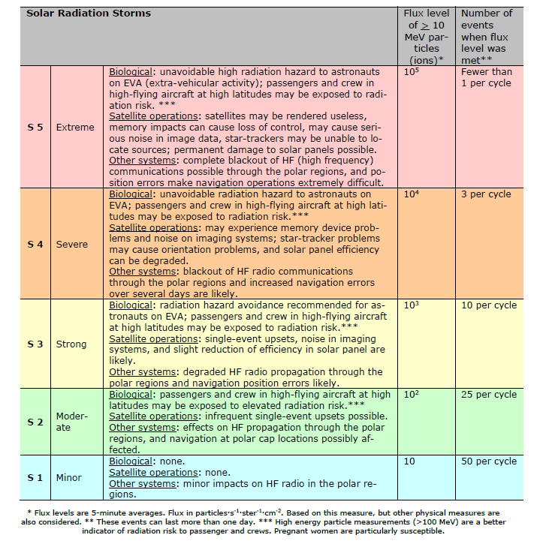

Slide 45
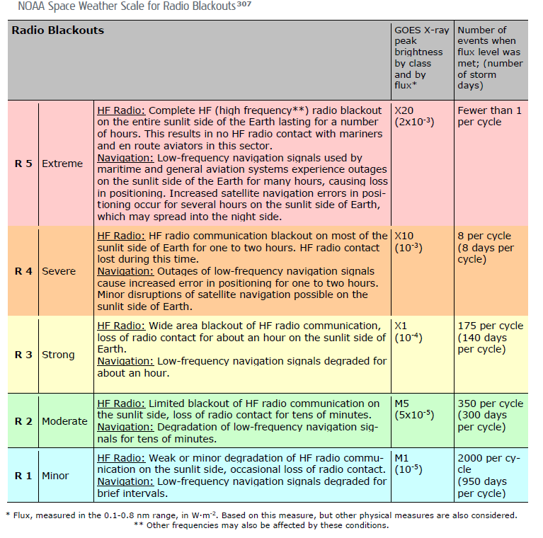

Slide 46
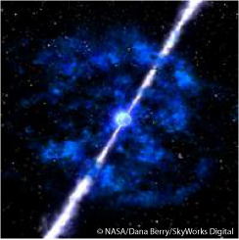
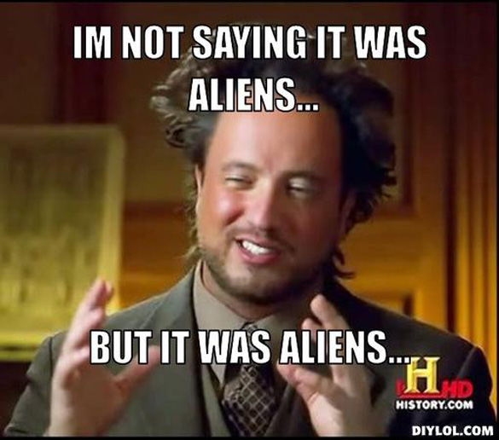
Honorable mentions - others
- Supernovas
- Gamma-ray burst
- our Sun will turn into red giant in about 5e9 years
- Milky Way will collide with Andromeda in 4e9 years
- Earth will become too hot in 1e9 years (billion)
- heat death of the universe in 1e100 years
- ALIENS!

Slide 47
Aliens
If aliens do exist, theoretical physicist Dr. Michio Kaku posits, why would they want anything to do with us? It would be like a hunter talking to a squirrel, he suggests. Hollywood and science fiction novels have conditioned us for years to believe that aliens either want to hang out on our intellectual level and learn from us... or destroy us.
If alien life really does have the technology and know-how to make it all the way here, perhaps we should just play it cool and not assume that we are the top species in the universe. Mankind's biggest folly, Kaku suggests, might just be in its insistence that we are an exceptional species.
- Arrival, Annihilation, Expanse, Stanislaw Lem…

Slide 48
Some other video sources
https://www.youtube.com/watch?v=itdYS9XF4a0&t=308s
https://www.youtube.com/watch?v=OfvkKBNup5A
https://www.youtube.com/watch?v=Ez609kf49y8
https://www.youtube.com/watch?v=HJfy8acFaOg
https://www.youtube.com/watch?v=fu3645D4ZlI
https://www.youtube.com/watch?v=qXXZLoq2zFc

Slide 49
Some interesting sources
Planetary Defense: Global Collaboration for Defending Earth from Asteroids and Comets
http://www.jwc.nato.int/images/stories/_news_items_/2017/SPACESUPPORT_NATO_ThreeSwordsJuly17.pdf
https://espi.or.at/news/new-espi-report-european-space-weather-services
https://espi.or.at/publications/espi-public-reports/send/2-public-espi-reports/371-security-in-outer-space-rising-stakes-for-europe
https://esamultimedia.esa.int/multimedia/publications/BR-338/BR-338.pdf

