Slide 1
Environment
Mgr. Kateřina Gratrix

Slide 2
Listening
You will be watching the lecture The Route to a Sustainable Future (17:31) by Alex Steffen at:
https://www.ted.com/talks/alex_steffen_sees_a_sustainable_future
Alex Steffen, co-founder of WorldChanging.com, argues that reducing humanity’s ecological footprint is incredibly vital now, as the western consumer lifestyle spreads to developing countries.
WorldChanging.com serves as a source of information and inspiration dedicated to increasing sustainability and livability in the 21st century, emphasizing solutions over problems.

Slide 3
Task 1: Pre-Listening
Before you listen, think about the following concepts and formulate your own definitions:
ecological footprint
consumer lifestyle
environmental sustainability
technological progress
global equity
techno-optimism

Slide 4
Task 1: Pre-Listening / key:
ecological footprint – the amount of impact we have on the planet that is measurable (resources used, waste created)
consumer lifestyle – way of living that is based on rapid consumption and disregard for waste
environmental sustainability – a way of using the planet’s resources that does not deplete or damage the environment
technological progress – scientific and technical innovations that may advance the well being of humans (and other life forms on earth)
global equity – more equal distribution of resources and power to people and countries around the world
techno-optimism – a liberal belief that modern technology will prove to be beneficial for society

Slide 5
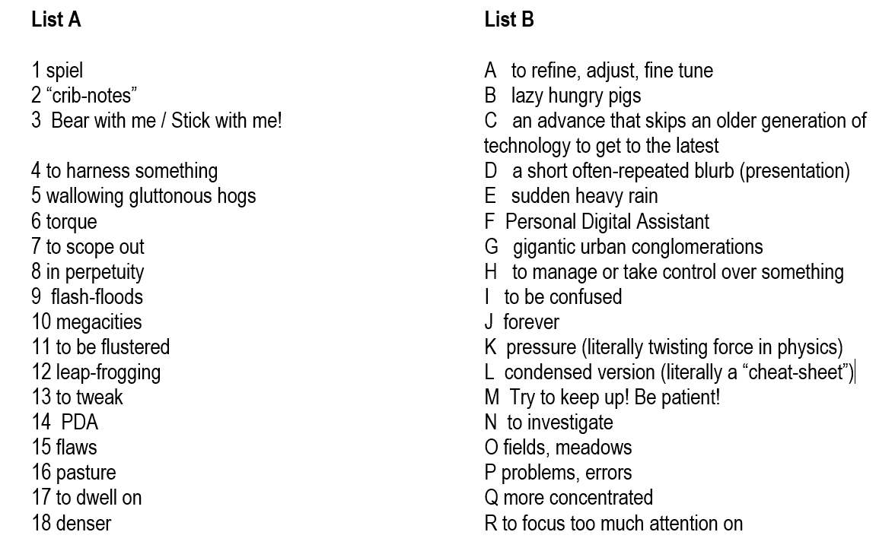
Task 2: Vocabulary development
In this lecture a lot of jargon and colloquialisms are used. In order to prepare yourself to listen to the presentation, match the words from the transcript in list A with the synonyms/explanations in list B.

Slide 6
Task 2: Vocabulary development / key:
Answers: 1D, 2L, 3M, 4H, 5B, 6K, 7N, 8J, 9E, 10G, 11I, 12C, 13A, 14F, 15P, 16O, 17R, 18Q

Slide 7
Task 3: Listening and Note-taking
Listen to the lecture The Route to a Sustainable Future (17:31) by Alex Steffen at https://www.ted.com/talks/alex_steffen_sees_a_sustainable_future
Take notes while listening then formulate answers to the following questions in writing.
1) What is the organization Worldchanging trying to accomplish?
2) What are some qualities of Bright Green cities?
3) What is meant by leap-frogging in the mega-cities of the developing world?
4) How can tools for collaboration be used to provide social and environmental benefits?
5) List three of your favourite inventions mentioned by Steffen and describe the implications of their implementation.
6) Can you think of any similar inventions or organizations that promote such invention?

Slide 8
Task 3: Listening and Note-taking / key:
Possible answers:
1) What is the organization Worldchanging trying to accomplish? The organization called Worldchanging is searching for examples of tools, models and ideas which, if widely adopted, would change societies and help them function in more sustainable ways.
2) What are some qualities of Bright Green cities? Bright Green cities are denser but more livable urban spaces which use concepts like greener urban planning, public transport, growth management, green spaces, zero energy developments and architecture, and information sharing such as car-share clubs.
3) What is meant by leap-frogging in the mega-cities of the developing world? Using the latest technology, the developing world can skip over less efficient older technology in order to attain the maximum social and environmental benefits (e.g. cell phones) more quickly.
4) How can tools for collaboration be used to provide social and environmental benefits? Collaboration tools allow people to work together freely to come up with alternative and innovative solutions to all kinds of problems at a low cost, thereby helping to craft new political realities, such as the Telecentro open source software facility in Sao Paulo.
5) List three of your favorite inventions mentioned by Steffen and describe the implications of their implementation

Slide 9
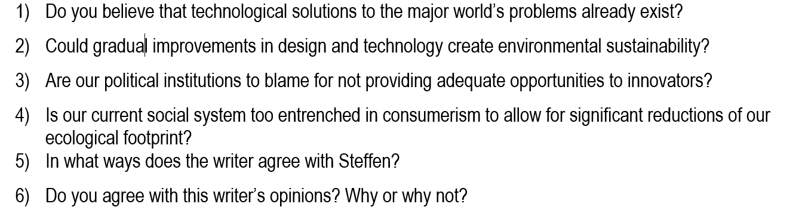
Task 4: Responding to opinions
The text below is a response to Steffen’s talk. Read the text and then answer the questions that follow.
“All the resources needed to resolve the major problems on the planet have been available for years, but the will to change political and economic priorities of society have not. As a result, increasing global wealth has been accompanied by increasing global poverty. Even though leaders may have good intentions, their efforts to implement change are constrained by the existing system. Our current worldview, values and structures oppose the development of new priorities such as the reduction of consumption.” Amit Patel, 6 January 2010, commentary on Steffen’s presentation.

Slide 10
Task 5: Word Formation
Try to come up with as many derivatives as possible for the following words. Use the transcript to find at least one for each word.
1) sustain – (un)sustainable, sustainability
2) society
3) measure
4) expose
5) prosper
6) joy
7) imagine
8) achieve
9) develop
10) account

Slide 11
Task 5: Word Formation / key:
Try to come up with as many derivatives as possible for the following words.
1) sustain – (un)sustainable, sustainability
2) society – social, societal, socialize, socialized
3) measure – measured, measuring, (un)measurable, measurability
4) expose – (un)exposed, exposure, exposition
5) prosper – (un)prosperous, prosperity
6) joy – enjoy, enjoyable, enjoyment, joyless, joyful
7) imagine – (un)imaginable, imagination, imaginary
8) achieve – (un)achievable, achievement
9) develop – developing, (un)developed, underdeveloped, over-developed, development
10) account – (un)accounted, accountable, (un)accountability

Slide 12
Task 6: Sentence correction of common grammatical mistakes
The town hall meeting will take part in 30 minutes.
She is used to get up early to bike to work.
He asked me what am I doing.
I am in this study program for two years now.
I know all which he said about climate change.
At the end they reached the centre in time for the conference.
John wasn’t interested in the problem too.
You must make your work carefully if you want anyone to pay attention.
I am very interesting in this issue.
You can get lots of informations on their web site.
All the money were donated to the NGO.
The bird was feeding it’s young in the nest.
I have any lessons to prepare for, so I can relax.
The gold is still a valuable commodity these days.
There’s many people waiting outside.
The town hall meeting will take place in 30 minutes.
She is used to getting up early to bike to work.
He asked me what I was doing.
I have been in this study program for two years now.
I know everything that he said about climate change.
In the end they reached the centre in time for the conference.
John wasn’t interested in the problem either.
You must do your work carefully if you want anyone to pay attention.
I am very interested in this issue.
You can get lots of information on their web site.
All the money was donated to the NGO.
The bird was feeding its young in the nest.
I don’t have any lessons to prepare for, so I can relax.
Gold is still a valuable commodity these days.
There are many people waiting outside.

Slide 13
Task 7: Research
Try finding some more recent information on Steffen’s current activities and/or another equally positive video with suggestions for dealing with environmental and social change. Take notes and bring your ideas to the next lesson.

Slide 14
Other Inspirational Talks
How to Fight Desertification and Reverse Climate Change (21:44) by Allan Savory, who is working to promote the holistic management of the grasslands of the world:
https://www.ted.com/talks/allan_savory_how_to_fight_desertification_and_reverse_climate_change
Why I Live a Zero-waste Life (13:30) by Lauren Singer at TEDxTeen
https://www.youtube.com/watch?v=pF72px2R3Hg

Slide 15
Cities
What are some of the advantages of living in a city?
What aspects of life in the city would you complain about?
If you had grown up in a different place, how would your
life have been different?
Would you enjoy designing a new city?
Do you think some cities are becoming too large?
Which cities would you like to visit around the world?

Slide 16
Do Sustainable Cities Matter?
What are some of the most pressing challenges that cities face today?
Inequality and the levels of urban energy consumption and pollution.
Cities occupy just 3 per cent of the Earth’s land, but account for 60-80 percent of energy consumption and 75 per cent of carbon emissions.
Many cities are also more vulnerable to climate change and natural disasters due to their high concentration of people and location
The cost of poorly planned urbanization can be seen in some of the huge slums, tangled
traffic, greenhouse gas emissions and sprawling suburbs all over the world.
2022 The sustainable goals report: https://www.un.org/sustainabledevelopment/wp-content/uploads/2022/07/Goal-11-infographic.pdf

Slide 17
What can we do to help cities be more inclusive, safe, resilient, sustainable?
Take an active interest in the governance and management of your city.
Advocate for the kind of city you believe you need.
Develop a vision for your building, street, and neighborhood, and act on that vision.
Are there enough jobs?
Can your children walk to school safely?
Can you walk with your family at night?
How far is the nearest public transport?
What’s the air quality like?
What are your shared public spaces like?
The better the conditions you create in your community, the greater the effect on quality of life
Source: https://www.un.org/sustainabledevelopment/wp-content/uploads/2019/07/11_Why-It-Matters-2020.pdf

Slide 18
Urban Planning
Shaping future cities and the future of architecture.
Eartscraper proposals: watch the following video:
https://www.youtube.com/watch?v=SoGcnJ15TlM
What are you first impressions of the idea? What are the challenges of urban renewal?

Slide 19
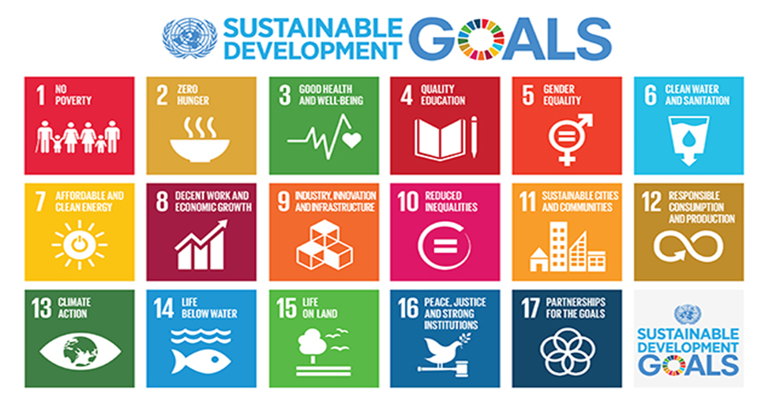
The Sustainable Development Goals (SDGs)
also known as "Transforming our World: the 2030 Agenda for Sustainable Development" or 2030 Agenda in short, are a collection of 17 global objectives set by the United Nations. The 17 broad goals are interrelated though each has its own targets (169 in total). The SDGs cover a range of social and economic development issues, as indicated in the colour icons. The goals were developed to replace the Millennium Development Goals (MDGs), which ended in 2015. Unlike the MDGs, the SDG framework does not distinguish between "developed" and "developing" nations. Instead, the goals apply to all countries.
Task: Find out more about each goal and its ongoing projects at
http://www.un.org/sustainabledevelopment/sustainable-development-goals/

