Slide 1
Current Events
and Writing Leads

Slide 2
Topics – optimistic, entertaining, truthful, serious?
Parasite
Hospital built in 10 days
Megxit
Central Perk
“How dare you?”

Slide 3
What do you know about the story?
I’ve never heard of it
I have heard about it
I know a little
I know all about it
With your group, try to recall the basic news story

Slide 4
W5 – LEAD questions in journalism
Who?
What ?
Where?
When?
Why?
Formulate answers to the above questions into 1 or 2 sentences.

Slide 5
a) Parasite – title, caption, heading, key words
Who? What? Where? When? Why?

Slide 6
a) Parasite
Who? What? Where? When? Why?
The film "Parasite" by South Korean director, producer and writer Bong Joon Ho made history in more ways than one when on 2 February 2020, as a foreign film, it took home the night's biggest honor, Best Picture, at the 92nd Academy Awards in Hollywood.

Slide 7
Who? What ? Where? When? Why?
The film "Parasite" by South Korean director, producer and writer Bong Joon Ho made history in more ways than one when on 2 February 2020, as a foreign film, it took home the night's biggest honor, Best Picture, at the 92nd Academy Awards in Hollywood.

Slide 8
Who? What ? Where? When? Why?
The film "Parasite" by South Korean director, producer and writer Bong Joon Ho made history in more ways than one when on 2 February 2020, as a foreign film, it took home the night's biggest honor, Best Picture, at the 92nd Academy Awards in Hollywood.

Slide 9
Who? What ? Where? When? Why?
The film "Parasite" by South Korean director, producer and writer Bong Joon Ho made history in more ways than one when on 2 February 2020, as a foreign film, it took home the night's biggest honor, Best Picture, at the 92nd Academy Awards in Hollywood.

Slide 10
Who? What ? Where? When? Why?
The film "Parasite" by South Korean director, producer and writer Bong Joon Ho made history in more ways than one when on 2 February 2020, as a foreign film, it took home the night's biggest honor, Best Picture, at the 92nd Academy Awards in Hollywood.

Slide 11
Who? What ? Where? When? Why?
The film "Parasite" by South Korean director, producer and writer Bong Joon Ho made history in more ways than one when on 2 February 2020, as a foreign film, it took home the night's biggest honor, Best Picture, at the 92nd Academy Awards in Hollywood.

Slide 12
Who? What ? Where? When? Why?
The film "Parasite" by South Korean director, producer and writer Bong Joon Ho made history in more ways than one when on 2 February 2020, as a foreign film, it took home the night's biggest honor, Best Picture, at the 92nd Academy Awards in Hollywood.

Slide 13
Who? What ? Where? When? Why?
The film "Parasite" by South Korean director, producer and writer Bong Joon Ho made history in more ways than one when on 2 February 2020, as a foreign film, it took home the night's biggest honor, Best Picture, at the 92nd Academy Awards in Hollywood.

Slide 14
Who? What ? Where? When? Why?
The film "Parasite" by South Korean director, producer and writer Bong Joon Ho made history in more ways than one when on 2 February 2020, as a foreign film, it took home the night's biggest honor, Best Picture, at the 92nd Academy Awards in Hollywood.

Slide 15
Who? What ? Where? When? Why?
The film "Parasite" by South Korean director, producer and writer Bong Joon Ho made history in more ways than one when on 2 February 2020, as a foreign film, it took home the night's biggest honor, Best Picture, at the 92nd Academy Awards in Hollywood.

Slide 16
Who? What ? Where? When? Why?
The film "Parasite" by South Korean director, producer and writer Bong Joon Ho made history in more ways than one when on 2 February 2020, as a foreign film, it took home the night's biggest honor, Best Picture, at the 92nd Academy Awards in Hollywood.

Slide 17
a) Parasite
https://www.insider.com/movies-that-won-best-picture-oscars-with-no-acting-nominations

Slide 18
Follow-up questions
What other Oscars did the film win?
How large was the budget?

Slide 19
b) Hospital built in 10 days – caption, heading, key words
Who? What ? Where? When? Why?
On 2 February 2020, builders in the city of Wuhan, China completed a makeshift emergency hospital to treat patients infected with the coronavirus in just 10 days.

Slide 20
b) Hospital built in 10 days – caption, heading, key words
Who? What ? Where? When? Why?
On 2 February 2020, builders in the city of Wuhan, China completed a makeshift emergency hospital to treat patients infected with the coronavirus in just 10 days.

Slide 21
Follow-up questions
How many workers participated in the construction?
7500
How did they manage to build the hospital so quickly?
By using pre-fabricated units set in place using cranes

Slide 22
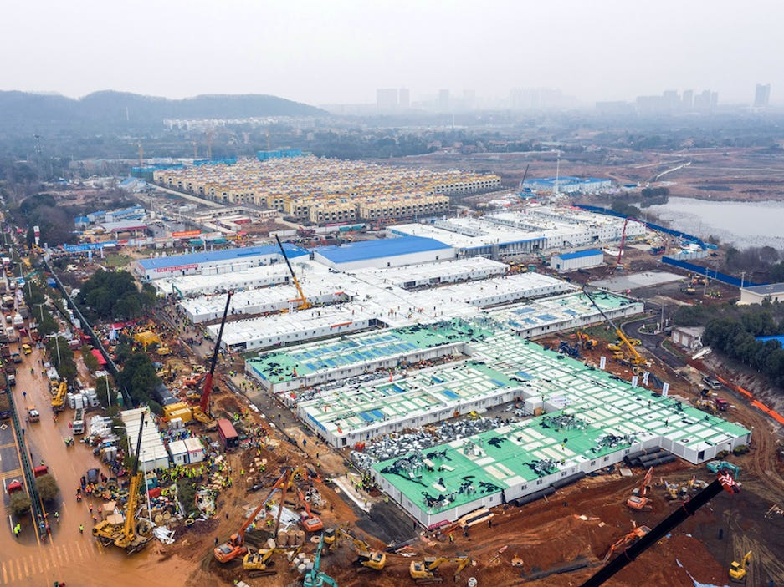
https://www.businessinsider.com/how-china-managed-build-entirely-new-hospital-in-10-days-2020-2

Slide 23
Create a lead that makes your reader want to learn more!

