Slide 1
Writing Summary and Response Papers

Slide 2
Agenda
A
Why is it Important?
Why do we write it?
How long should it be?
Choosing an arguable question
Formatting and referencing

Slide 3
Why Writing S&Rs is Important?
Summary and response papers (S&Rs) are vital for learning how to do research because they help you to:
absorb the information you read,
analyze it,
decide how it can be used to support the points you want to make in your own essay.

Slide 4
Whether you take notes in the margins of a printed book or article, scribble notes on a separate piece of paper, or type up a formal essay or set of notes, you are always doing these steps as you read something for your research paper.
In fact, in order to write a good research paper, you must first learn how to write a summary and response paper.

Slide 5
It’s a simple essay; it only has 2 parts:
1. Summary: What is the main idea of the text? What does the author want the audience to think, do or believe after reading? What evidence do they use to support their ideas?
2. Response: What do I think about the argument in this text? Why? How can I use this text in my research paper? What will it help me to prove?

Slide 6
Why Write S&Rs?
Ideally, when you write a longer research paper, like a Bachelor Thesis, you should begin with writing short summary and response essays (called annotated bibliographies) for each of the sources that you will find for your research paper topic.
So, learning how to write an S&R is a good way to help you both understand your chosen research sources and explain their importance, in your opinion, for your research topic.

Slide 7
How Long Should They Be?
Most S&Rs do not have to be very long, but everyone has their own style.
For this course, the essay must be between 400-450 words.

Slide 8
Choosing an Arguable Question
A research paper should be written on an issue that people can disagree about.
This is called an "arguable or debatable question“.
Sometimes it is easy to choose a debatable question before you start looking for research, but other times, it will be easier for you to form your question after doing your research.

Slide 9
Different Kinds of Arguable Questions:
When you are formulating your question, it helps to know that there are 5 basic kinds of claims:
● Fact claims (Is it true that...? What really happened?)
● Definition claims (What does it mean? The true meaning is...)
● Value Claims (How important is it? How much attention should be paid to it?)
● Cause Claims (What caused it? What are the effects? What is the sequence of causes and effects?)
● Solution Claims (What should we do about it? What is the best way to solve this problem?)

Slide 10
Steps to take for your research
After you choose your question, you will need to think about what kinds of positions or opinions different people may have on this issue.
The ‘Research Worksheet’ is designed to help you to first think about what you expect to find, and then how at least one of your research article sources could fit what you need to say in your paper.

Slide 11
Formatting and referencing
After you have gathered your research, you will need to read it carefully and take notes.
Then, you’ll need to note down some important information about the research articles (or other sources) themselves so that you can include these citations (or references) at the end of your essay.
Research and Citation Resources - Purdue OWL® - Purdue University

Slide 12
1. Bibliographic Citation:
Do this part first, but you will put this at the very end of your essay. There is nothing more frustrating than having to create citations from your sources after you’ve finished your essay; it is easiest to note these down when you first find them and decide to include them in your research.
You will need to put the author, title, journal, and dates in the correct format, and then copy that information at the end of your essay.

Slide 13
2. Summary:
In one paragraph, explain in your own words what the main claim of the author is and how they support their point of view.
Don't use quotations in a summary. Keep the sentences in your own style and words.
Don't tell all the details. Just stick to the main points. It helps to underline the topic sentence of each paragraph and then read those all together to get the gist of the main point.

Slide 14
3. Response:
A response is your thoughts about the article. There are 3 parts to a response:
● Personal Response: You can respond to the content, whether you agree or disagree, and also to the way it is written, whether you found it effective or not.
● Explain Place of Article in Debate: In addition, you need to explain how this article fits into the argument about this issue. Does this article explain one side? Try to look at several sides objectively? Argue passionately for a particular view?
● How it Can Help Your Essay: Finally, you need to explain how this article will help you in your own essay. Where will you use this article? What will this article help you explain?

Slide 15
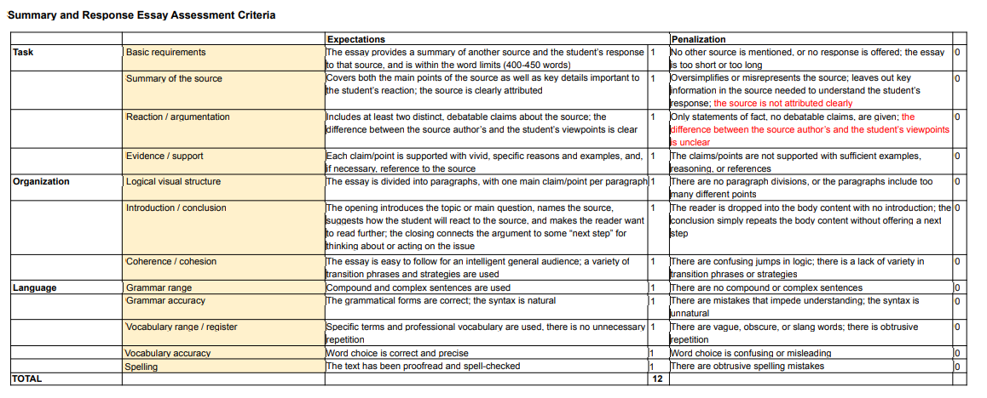

Slide 16
Thank you

