Slide 1
Food, sustainability and
alternative food networks
Changing narratives:
debates about sustainability and security
Dr Daniel Keech
Countryside and Community Research Institute
University of Gloucestershire, UK
dkeech@glos.ac.uk
Masaryk University, Brno, 24th April 2023

Slide 2
Aims of this session
Examine narratives around sustainability in relation to food, including
Food (in)security
Environmental performance and climate change
Self-sufficiency and globalisation (incl since COVID-19)
Discuss the idea that sustainability is a complex aspiration, rather than a settled state or particular truth.
Notes:
2

Slide 3
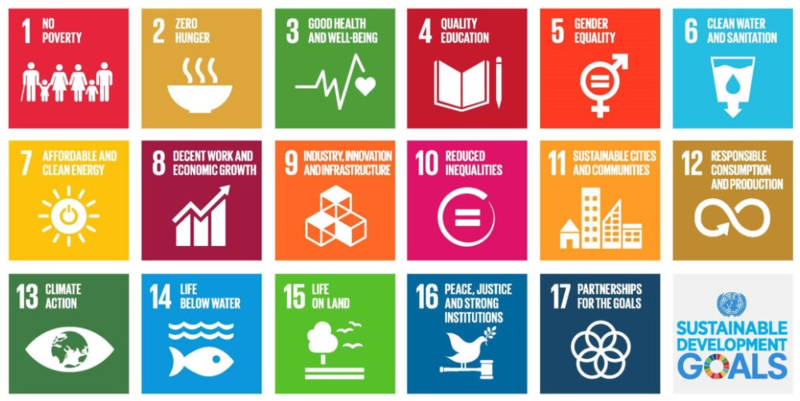
Sustainability and how it relates to food
Sustainability is when human and natural systems are able to survive and flourish in the long-term. (Behrens et al. 2020). (Interactions and interdependence between humans-nature.)
Source: ©United Nations 2018
Notes:
This definition is broad and the first thing we might notice is that it separates humans from nature. This is a hot topic and not for now, but it’s worth thinking about as we go through the week.
The SDG goals are interesting because they offer a way of really articulating sustainability in terms of development (economic, social and environmental) and the SDG programme monitors progress towards these targets.
Lastly, let’s identify where in these 17 SDG goals, food appears.
SGD 2 is explicit – no hunger. But also implicit in most of the others. Ask them for some suggestions here.
3

Slide 4
Sustainable diets
The challenge of creating a mode of food provisioning that is ecologically sustainable, while addressing nutritional issues (Lang and Mason, 2017).
‘Any discussion of sustainability and which way we should go, has to take into account, and explore, the values that stakeholders bring to the debate.’ (Garnett 2014 https://core.ac.uk/download/pdf/132647716.pdf)
Move from meat (EAT Lancet 2019)
1/3rd of food bought is thrown away (UC Davis) https://www.ucdavis.edu/food/news/why-is-one-third-of-food-wasted-worldwide#:~:text=Nearly%20one%2Dthird%20of%20all,economic%2C%20environmental%20and%20social%20costs.
Well-being, health
Food security, access, nutrient needs
Cultural heritage, skills
Sust. diets
Equity, fairtrade
Bio-diversity, envir, climate
Eco-friendly, local seasonal
Source: Reproduced from Lairon (2010)
Notes:
Sustainable diet is a concept which is about a complex and interlocking set of attributes. These are linked to technical challenges a such as producing and eating food in ways that don’t damage the environment or exacerbate climate change, but also political, cultural and ethical values such as fair trade and access. And what about heritage? How does this affect understandings of climate change. Did you read the paper by Jehlička?
So already we have encountered some complex relationships when it comes to food and sustainability and we can think a bit more as the week proceeds about how compatible all these objectives are. Sometimes, it may be more a case of how to make decisions, rather than knowing exactly what to do.
4

Slide 5
Plenty, healthy, quality?
Some generalised key developments post 1945:
Marshall Plan, ‘Green revolution’, Soviet collectivisation, self-sufficiency, surplus for trade and aid
Oil dependency highlighted in oil crisis of early 1970s (see Jones, A. (2001) Eating Oil. Sustain, London; and AEA (2005) The Validity of Food Miles as an indicator of Sustainability.)
CAP production subsidies until 2003 ⟹ surpluses, global dumping, falling food prices for consumers. Supermarket dominance and foreign direct investment (FDI) (see Neil Wrigley).
CAP reform from 2003 ⟹ decoupling of subsidy from production and link to environmental stewardship, farming as a multifunctional activity
Notes:
With these next few slides I want to look at the idea that we in comparatively wealthy European nations, have a safe, secure and plentiful supply of healthy food. I want to start by tracing some historical approaches to food policy, production innovations and consumption issues.
5

Slide 6
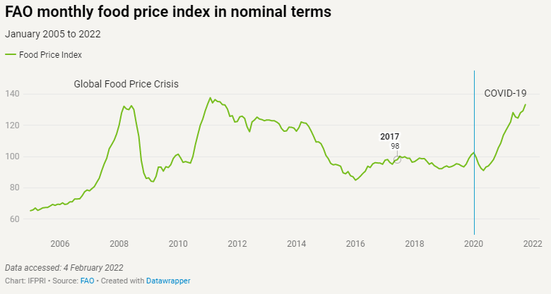
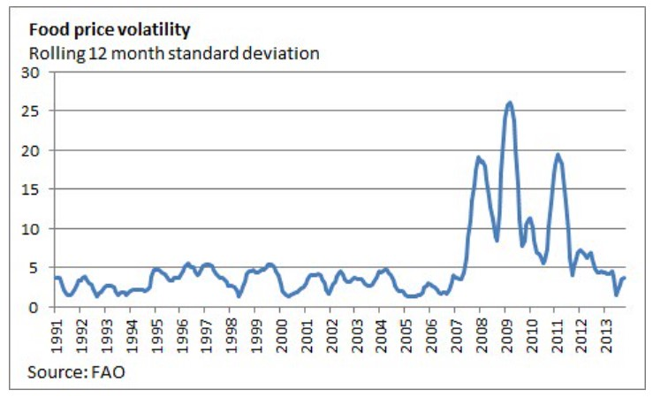
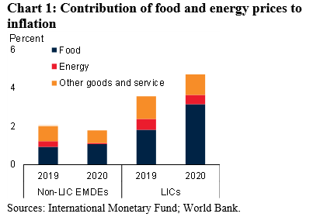
Plenty, healthy,
quality? (2)
More or less falling consumer prices until 2000s, but derivatives and CIFs cause price volatility following the 2007-8 financial crisis.
Environmental degradation (Carson 1966), food safety scares, growth of organic movement from 1990s (see Julie Guthman 2002 and Gill Seyfang 2006…)
‘Quality turn’ and shift from public to individualised concerns in 2000s – health, lifestyle, ‘alternative hedonism’ (Soper 2004)
Lack of diversity in trade – 97% of all food in UK sold in 10 supermarkets.
Obesity/famine paradox, food poverty - the rise of social food co-ops in the absence of policy (e.g. see Elizabeth Dowler and Martin Caraher and allies). COVID exacerbating this.
Notes:
In the 1980s and 1990s financial and agricultural markets in the capitalist global economies were increasingly deregulated.
This combination meant that financial speculation tools such as derivatives and commodity index funds were used to invest in global food commodity markets. It also meant that speculators needed to have no contact with farmers or knowledge about food. They just had to trade with banks which issued financial contracts which were based on expectations of the harvest.
Not only does such rapid growth in financialisation of food markets increase price volatility but people like Oliver De Schutter suggest that the movement of banks and pension funds into food commodity speculation was a contributing factor in the financial crisis of 2007-08, leading in turn to a reduction in demand in the post-crash recession. Remember this when we later think about alternative scales, business models and economic aspirations.
The third chart also reveals that food price inflation is unequally experienced, in this case in low income countries.
COVID – in the UK exacerbated (made worse) food insecurity. One initial problem was that the global food system was unable to be mobile, so shops had shortages of many provisions. But they soon recovered. This is interesting because, although it shows that supply chains are adaptable, this return to the status quo is possibly an indication of unwelcome resilience, because so much is known about the negative impacts of the food system.
6

Slide 7
Food in the public health arena
Public health concerns around dietary intake affected by structural and social changes:
Fewer people work in industrial settings and other jobs which feed workers. Traditional family structures are changing. Post-modern cities and working arrangements. ‘On the hoof ‘ eating, convenience shopping. COVID ⟹ routine home-working.
Move from 1980s (in UK) away from institutionalised public catering to consumer choice, lowest price tendering and de-skilling kitchen labour. School cooks ⟹ food assembly workers (Morgan and Sonnino 2008).
By highlighting choice, the state moved some public health responsibilities to the private domain.
Notes:
7

Slide 8
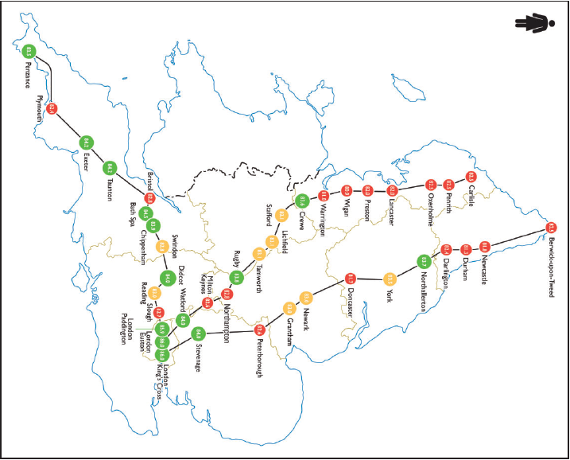
Spatial/social health inequality
In their 2016 paper, Bambra and Orton outline differences in regional life expectancy in England, mapped through the train network.
Wigan 80.9 years
London 86 years
Q: If we assume some of these differences could be linked to food, what might be the food-related causes of these differences?
Bambra, C. and Orton, C. ( 2016) A train Journey through the English health divide: Topographical map. Environment and Planning A 48(5) 811–814
Notes:
This map covers only women, not men.
Really marked north-south divide – regional health inequalities
Some of the red areas are far away from the capital – peripheral and regionally imbalanced economy
In the south west fishing and farming are very important – possibly reflected in regional diets?
Northern cities are especially post-industrial
8

Slide 9
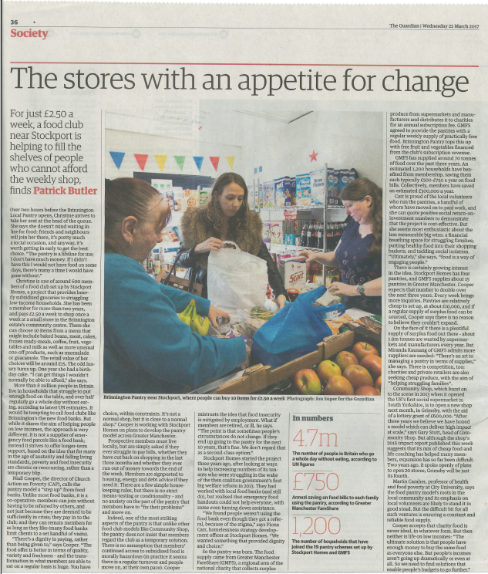
Household food insecurity
Food insecurity: ‘the inability to acquire or eat an adequate quality or sufficient quantity of food in socially acceptable ways’ (Dowler & O’Connor 2012)
Oxfam (2013) and the Church of England (2018) link food poverty and the rise of food donation projects to welfare reforms.
COVID has made a bad picture worse: unemployment, stockpiling, supply chain mobility, price rises: ‘Lockdown has led to 503 million more (+38%) in-home meals eaten per week creating further pressures on food supplies’ (Power et al. 2020)
‘More than 8m people in Britain struggle to put enough food on the table… half regularly go a whole day without eating…’
Guardian newspaper 22nd March 2017
Notes:
Food insecurity at a national or other large regional scales is usually something associated with poor countries, perhaps even with war and famine.
In richer countries, however, food poverty is usually related to individuals, households or local communities. Food insecurity (or food poverty) is defined
Remember Bambra & Orton: female life expectancy for London (86)? This masks health inequalities within London:
Jubilee line Westminster to Star Lane/ Canning Town – average life expectancy in Westminster is 83 or 75 in Star Lane. DIET IS A CONTRIBUTORY FACTOR.
This led in the early 2000s to the establishment of food distribution co-ops. It opens up debates about physical access, right to a healthy diet, the attractiveness of poor areas to supermarkets and the stigmatisation of food co-ops.
About 9% of people in the UK have experienced food insecurity in the last 6 months.
BUT: we also know that COVID has led to a huge rise in demand for local food through commercial CSAs and box schemes, in response to the drop in availability experienced at the start of the pandemic; and in the closure of restaurants etc.
9

Slide 10
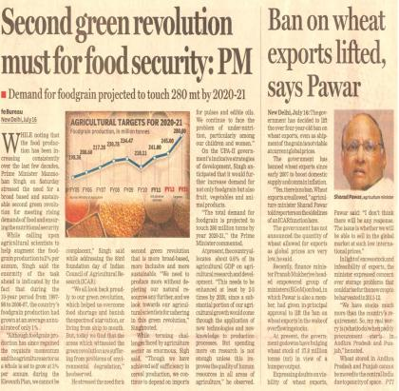
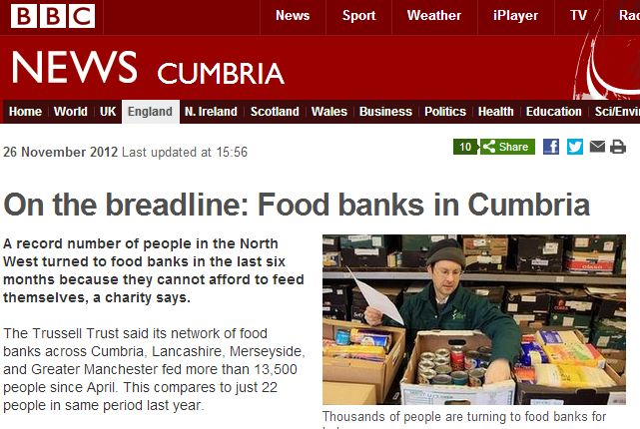
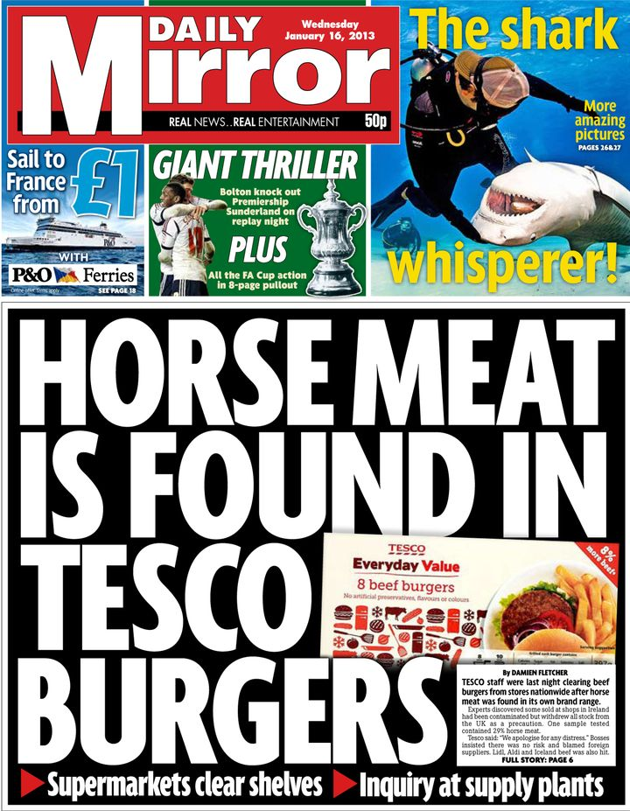
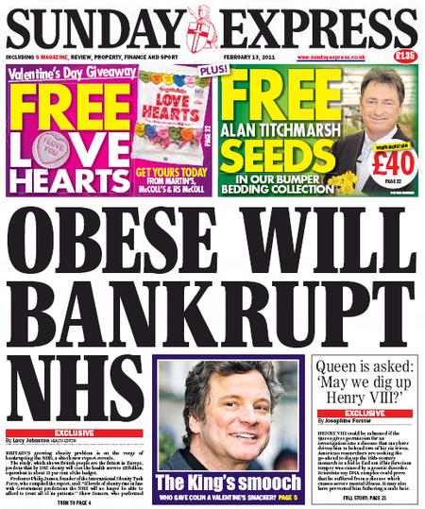
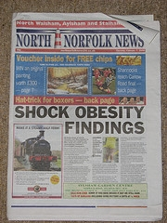
Notes:
Here’s just a collection of recent ‘food crisis’ newspaper reports and media coverage…

Slide 11
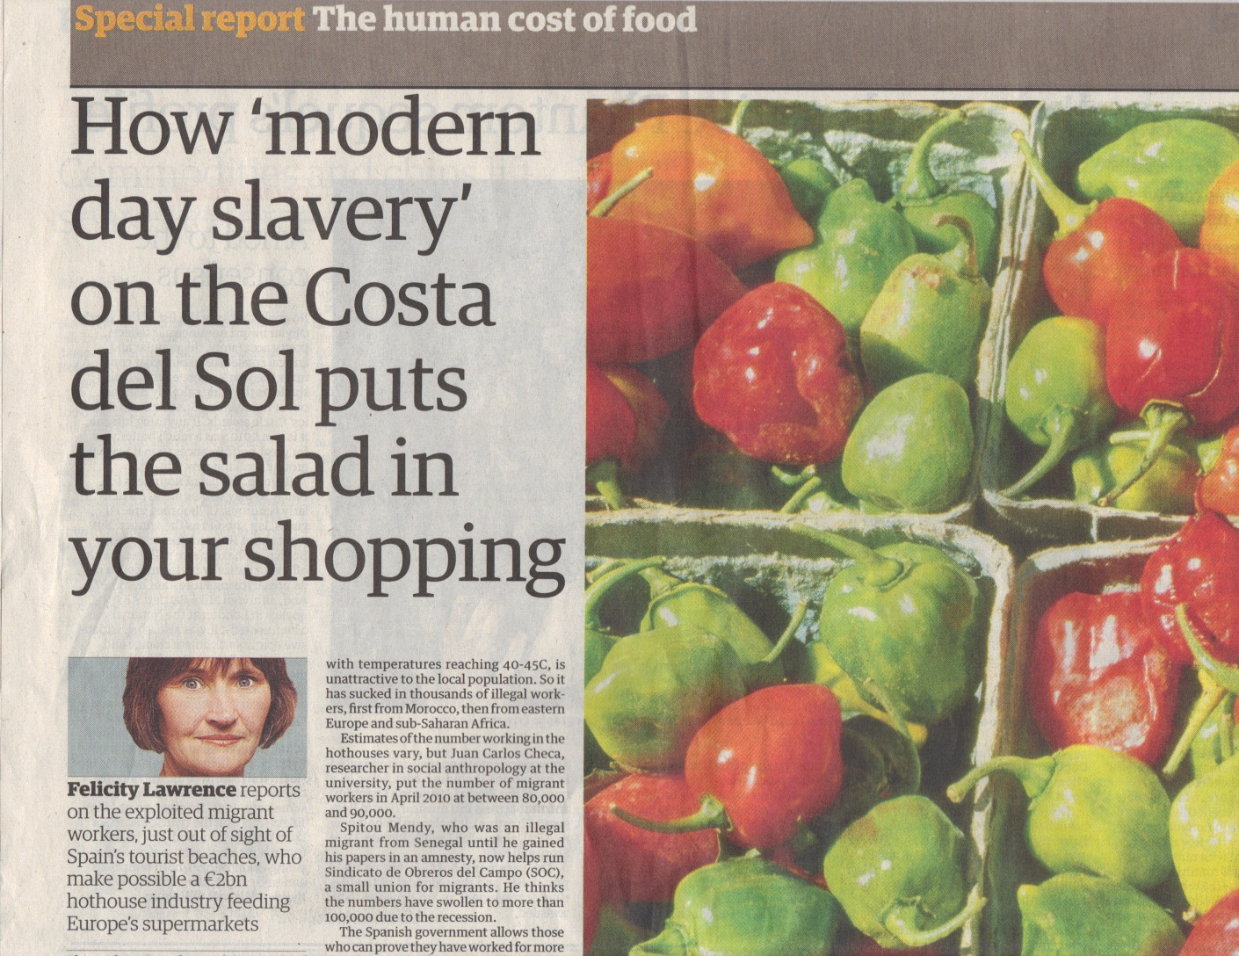
CO2 vs. social justice
Source: The Guardian 8th Feb ‘11
Notes:
In our sweep of complex and unsettling narratives around the food system, we can introduce the idea of labour and carbon performance as competing measures of sustainability. In 2005, a report written for the UK government suggested that it used less CO2 to import tomatoes from Spain, where they are grown in unheated greenhouses, than growing the tomatoes in the UK, where gas heating was required for some of the year. The argument was that efficient road transport is less carbon intensive that heating glasshouses.
This report from 2011, of which there are many more recent examples (and the title is so striking) the author suggests the carbon-efficient tomatoes are grown by illegal migrants from North Africa, who have no union, labour regulation or health care rights, and who work in conditions of modern slavery.
This raises several interesting questions including: what is carbon actually able to measure in terms of a sustainable food system? How is it possible in European countries with highly regulated labour markets and social security systems, that slavery is a normal part of feeding people. And perhaps, if I can’t trust Spanish horticulture, what should I be eating?
11

Slide 12
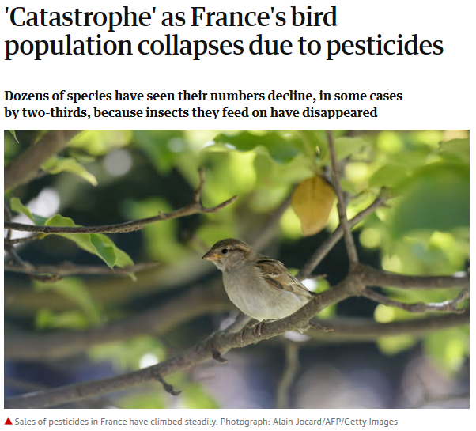
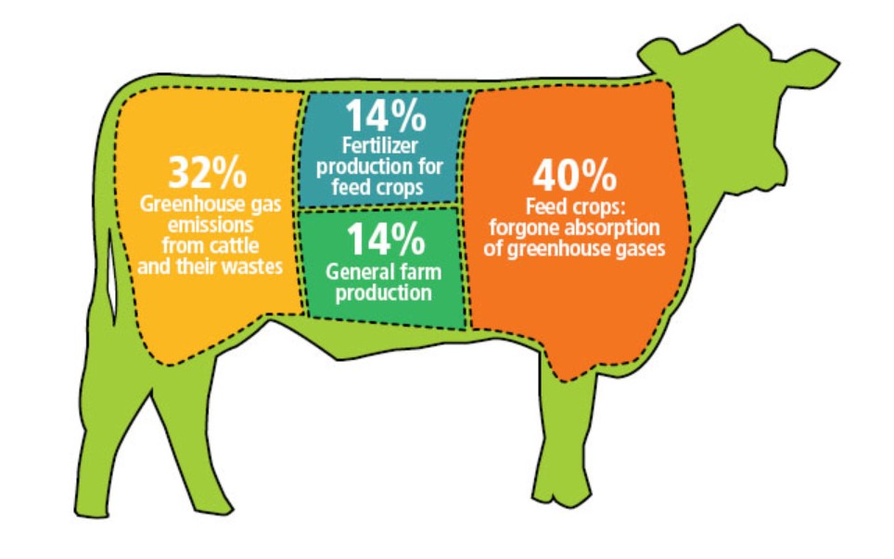
Environmental impacts
‘Have you eaten the Amazon today?’ www.vegetarianformeatlovers.weebly.com
Guardian 22nd March 2018
Notes:
Agriculture in the ‘global north’ depends on fossil fuels and accounts for 40% of CO2 emissions, produces fewer calories than it consumes (for some foods) and depletes biodiversity.
C. 1bn people are starving while another 1bn suffer from diet-related ill-health (acquired diabetes, CHD…) and obesity.
Peak oil, gas, phosphorous, water (Garnett 2011, Ingram et al. 2013).
80% of tropical rainforest destruction has been to graze animals or grow animal feed (and palm oil…)
12

Slide 13
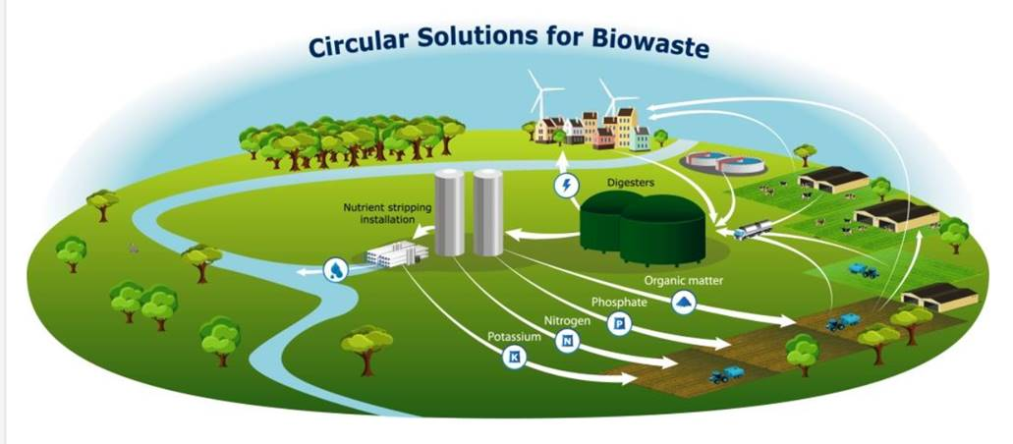
Circular farming in the Netherlands
Notes:
Circular farming makes a lot of sense but has encountered resistance around:
Human and geared towards urban consumers in Europe’s most densely populated area
Animal welfare due to less extensive, houses animals with robotic processes
The traditional cultural landscapes of NL need to be rethought – who gets a say in that?

Slide 14
Different scales/aspects of food security (note overlaps)
Global/international | National | Household
Trade – barriers/alliances? Distribution Environmental factors – eg drought, deforestation, soils Population rises Migration patterns | Self-sufficiency Brexit Subsidy/tariffs Land avail./quality Skills and labour Retail structure (supermarkets?) Fuel consumption | Income Family structures Nutrition Eating (cultural) preferences Access Knowledge
COVID-19
Notes:
14

Slide 15
Food system issues
Sustainable Food
Well-being | Social justice | Environ. Sust. | Resilience
Impact of pesticides on nearby residents | Poor labour conditions Dependence on gang-masters | Degradation (soil, water, over-fishing) Habitat destruct’n | Highly energy intensive Dependence on migrant labour
More processing = harder to control salt fat sugar consumption |  |  | Dependence on global trade
Road intensive = noise, pollution, traffic | Power balance against producers | Carbon intensive | Fuel cost
Junk food adverts target children | Power balance against small or indep. shops |  | Consolidation of retail sector
 |  | High levels of waste & packing
Production
Processing &
manufacture
Distribution
Advertising &
marketing
Disposal
Notes:
15

Slide 16
Food culture issues
Sustainable Food
Well-being | Social justice | Environ. Sust. | Resilience
 | Poor avail. of healthy food in disadvantaged areas Low income = inadequate for healthy diet | Expectation of year-round avail. of all products
Time poverty = more consumption of prepared foods |  |  | Falling levels of food ‘literacy’
Loss of eating together |  |  | Fuel cost
Disconnection to rural and farming issues |  |  | Homogenisation of food & places
Shopping
Cooking
Eating
Meaning
Notes:
16

Slide 17
Post-normal science?
The best way forward seems uncertain – who are the winners and losers? Science is behind practice.
But the need is very urgent and there are multiple legitimate perspectives (Funtowicz & Ravetz 1993)
One thing we can say, therefore, is that the decision-making process about where we go next needs to be democratised.
This brings us finally to local and alternative approaches to sustainable food. How do local networks try to forge a sustainable food system based on more democracy and shared values?
Notes:
We’ve discussed that there are many variables involved in configuring food systems to become more sustainable. These are values-based, geographical, technical, political, environmental and dietary etc.

Slide 18
Key beliefs in local and sustainable food
It is better (healthier) to eat a more rather than a less diversified diet
It is better (healthier) to eat fresh food rather than preserved/prepared food
It is better (less environ. damaging, & food chain more transparent) to eat food produced closer to rather than further from the point of consumption
It is better (healthier, and less environmentally damaging) to eat food produced with a minimum of pesticides
It is better (less environmentally damaging) to eat food produced with a minimum of inorganic fertilisers
It is better (more socially just) to eat food produced, processed and/or marketed by smaller-local rather than larger-international operations
(Sustain: the alliance for better food and farming, London.)
Notes:
18

Slide 19
NGO and market innovations
Farmers’ markets
Hyperbolic organic sales (mainstreaming) (until 2008)
Box schemes
CSA and buying groups (growth during COVID)
Public food procurement (FFL, SFT, free school meals)
Food access co-ops
NGOs as civil society agitators → under-paid market innovators?
Notes:
19

Slide 20
In summary…
Food is complex – farming, nutrition, education, consumption, industry, diet, culture, shopping, politics, income, town planning, waste, political activism…
"...the concept of a base-line sustainability standard is non-sense, as sustainability is an aspirational open-ended agenda involving trade-offs and a range of potentially conflicting priorities...” Smith, B. (2008) Developing Sustainable Food Supply Chains. Philosophical Transactions of the Royal Society for Biological Sciences. 363, pp. 849-861.
“What is most pressing is alliances that move local food beyond a single-issue topic. This overcomes defensive localism autarky, articulating instead local food as part of place-centred community resilience…” Jones et al. (2021) Resilience and Transformation: Lessons form, the UK local food sector in the COVID-19 pandemic. Geographical Journal https://doi.org/10.1111/geoj.12428
Questions?
Notes:
20

