Slide 1
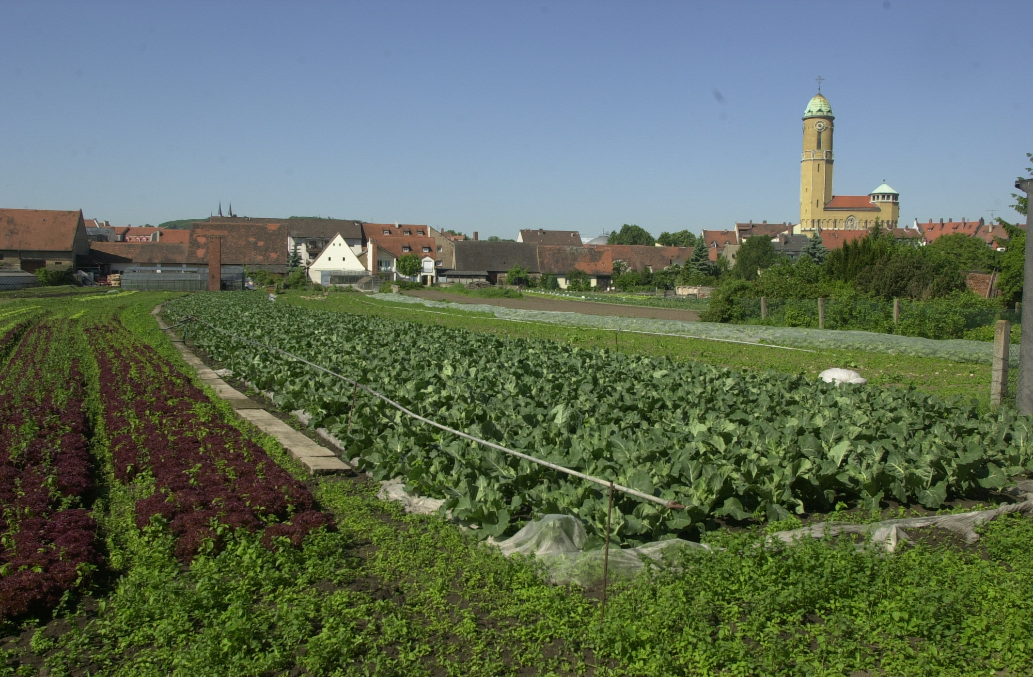
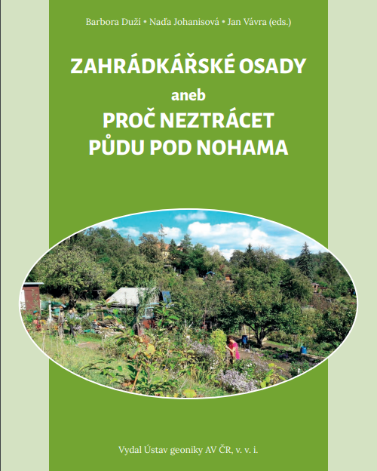
Food in cities Urban food production, provisioning and citizenship MUNI, Brno, 25th March 2023
Bamberg, Germany. Image – R. Rinklef
Dr Daniel Keech, CCRI, University of Gloucestershire dkeech@glos.ac.uk
https://tichaudrzitelnost.geogr.muni.cz/wp-content/uploads/2022/01/Zahradkarske-osady-2021.pdf
Notes:
The large picture shows commercial urban horticulture in the German city of Bamberg, pop. c.75,000.
The smaller image is the book co-edited by Nadia, with a short chapter about UK allotments by the both of us. It’s open access and free to download.

Slide 2
Outline for the session
Some definitions and characteristics assigned to UA
Illustration of the diversity of these using references from the literature
Some illustrations from my research in Ghent and Bamberg – rather different stories.
Time for questions, then a class exercise
Notes:
Hope to spend about 40 minutes on lecturing, then about 35 mins on class exercise. That gives us more time for questions and discussion if needed.

Slide 3
Urban Agriculture
Urbanisation trends 1950-2050
(% urban) (UN 2014)
Region 1950 2050
Africa 14.4 56.0
Asia 17.5 64.4
Europe 51.3 81.2
Latin/Caribb 41.4 86.0
North Amer 63.9 87.3
Oceania 62.4 74.0
Spatially - not in the countryside, but possibly on the edge of the countryside; definitely in the city.
Functionally – may include household and community provisioning, social cohesion, innovation and environmental land use.
Generally different emphases in global ‘North’ and ‘South’;
Not everyone agrees on whether UA is a new thing or a really ancient practice. Partly this is linked to rapid urbanisation.
Steel, C. (2020) Sitopia: How Food Can Save the World. London, Chatto & Windus
Thornton, A. (ed.) (2020) Urban Food Democracy in the Global North and South. Cham, Palgrave MacMillan.
https://www.youtube.com/watch?v=XaEKJ5Vv3Zg
Notes:
UA is differently understood in the literature to rural agriculture.
(Notes)
Urbanisation is partly about the human mobility from rural (food producing) areas to the city to find work, or better work than farming, or because mechanisation is reducing the demand for farm labour in the countryside. Some really substantial areas of rural Europe are now being more or less abandoned in a wide range of countries across the whole continent.
Urbanisation is also expanding into productive urban fringe areas, so some farms are being lost to development. On the other hand, it also means that voices which demand urban food production are growing, while cities remain very important as places as food markets.

Slide 4
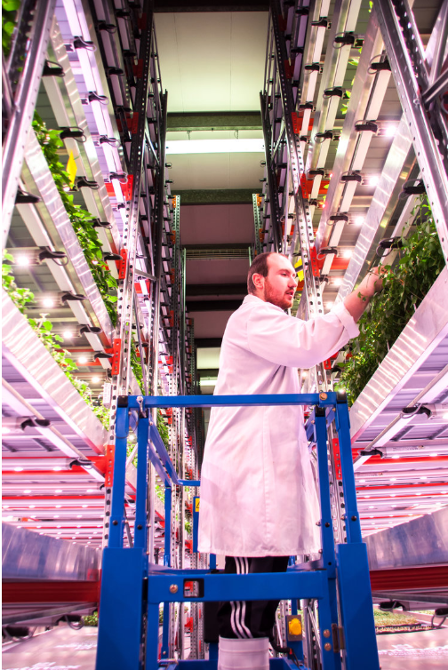
What is UA (1)?
Grow Up Urban Farms, London. Image Mandy Zammit.
‘…the production of food in city spaces.’ (Keech & Redepenning 2020). ‘… has various functions in the urban system’. (de Zeeuw & Drechsel 2015: vii) ‘…As the name suggests, UA is any food production in urban areas… in some cases production can occur on top of buildings themselves.’ (Behrens et al. 2020: 172)
‘… become an increasingly relevant topic in the science and planning of urban food systems aimed at reducing food insecurity at the level of the household…and community. … Peri-urban agriculture is a residual form of agriculture at the fringes of growing cities… (Opitz et al. 2015) – see also http://www.ccri.ac.uk/covid19-food-db/
‘Urban food growing … a post-modern response to socio-economic problems associated with the … post-war ideas of modernisation and related failings of neo-liberal urban industrial growth.’ (Thornton 2019: 3)
Notes:
Very bad to start with my own quote but it’s very simple – perhaps too simple.
The quotations which follow complicate matters considerably. The Behrens citation in particular, really revolutionises the idea that farming is a rural project.
Opitz and co suggest that UA really is only historically something linked to serious provisioning, but in more recent times has been associated with food security. This is echoed by Tornaghi (2014 – overleaf) who, like Opitz, cites the Dig for Victory campaign of the Second World War as a time when food production came ‘back’ into the city due to the experience of crisis. By contrast, peri-urban agriculture is commercial and productive and really like rural agriculture, but with some of the spatial and social distinctions of being next to (expanding) cities – this implies clashes in land use perhaps. This might be fly tipping, trespassing, but also access to markets.
In which ways might UA represent a failure of modernism: - perhaps because the market is not adequately nourishing everyone? Perhaps because the industrial agricultural system planned in the countryside is economically flawed? How does this understanding of a failed industrial model compare with the previous idea of agriculture in the urban system.

Slide 5
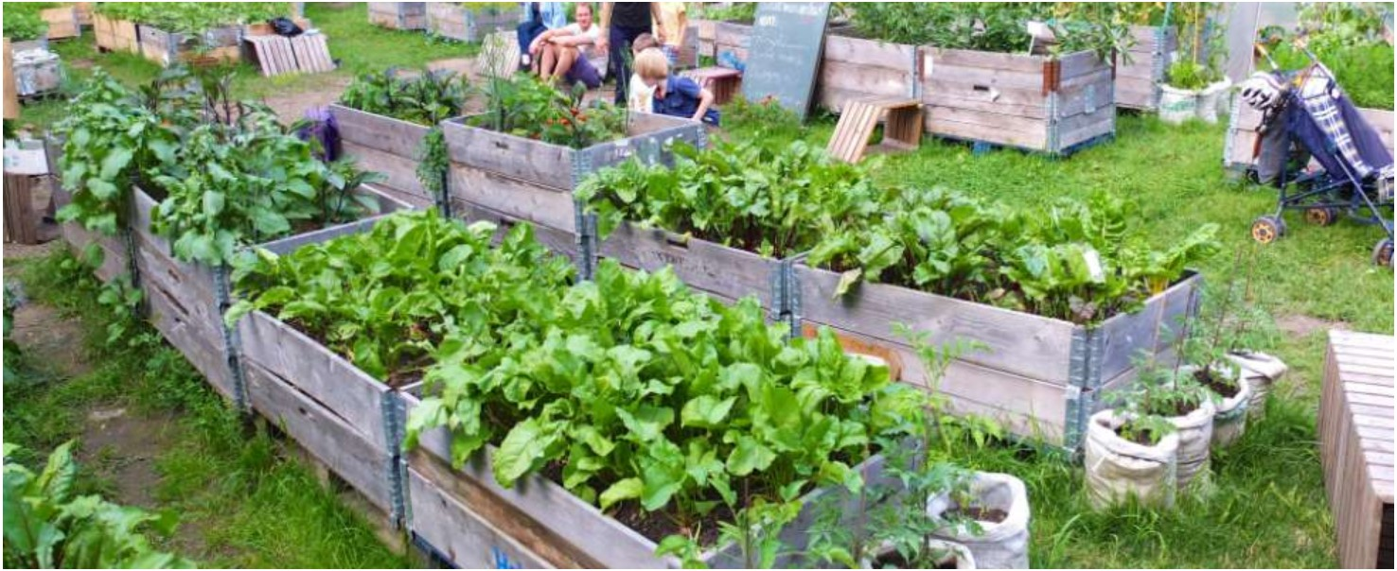
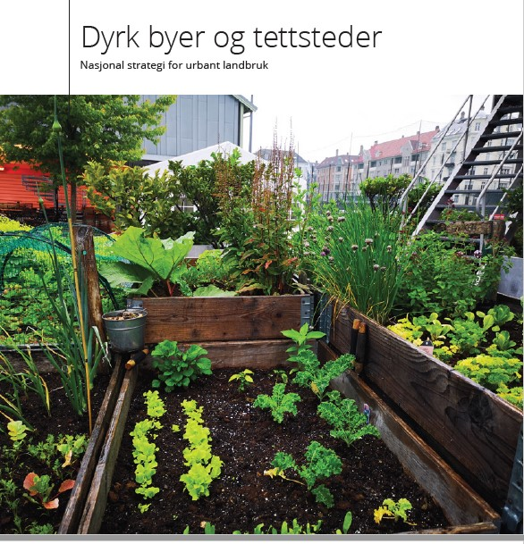
What is UA (2)?
Pics: www.gruen-in-der-stadt.de and Norwegian Government.
‘…includes small-intensive urban farms, food production on housing estates, land sharing, rooftop gardens and beehives, schoolyard greenhouses, restaurant-supported salad gardens, public space food production, guerrilla gardening, allotments, balcony and windowsill vegetable growing and other initiatives.’ (Tornaghi 2014)
‘The growing costs of transporting food will increase the demand for urban agriculture spaces in cities by compelling planners with the task of integrating the urban open space system, as well as local, fresh food markets as standard elements of urban infrastructure.’ (Russo & Cirella 2019)
Notes:
Tornaghi also indicates that there are a lot of claims made for UA, especially in terms of reducing the ecological foot print of cities, improving urban food security and making good use of vacant lots. This is not least in cities which have suffered from inner city economic decline and spatial abandonment, such as Detroit, East London, Belgrade, and Ghent (Mettepenningen et al. 2015)
Tornaghi implies a much more social and rather organic approach to UA than Alessio, who suggests that UA needs to be built into strategic urban design.
Russo’s quote suggests that transportation costs will create demand for food less well-travelled, implying of course that UA can play a part in local food networks to feed a growing urban population. This is a really major narrative too. Jack Jones MA Land Arch on roof top gardens capacity in Bristol.
The pictures show policy support at (national level) for UA as both a food security issue and – very importantly – Green Infrastructure. Liveable Cities. Remember the SDGs yesterday – sustainable cities SDG 11.

Slide 6
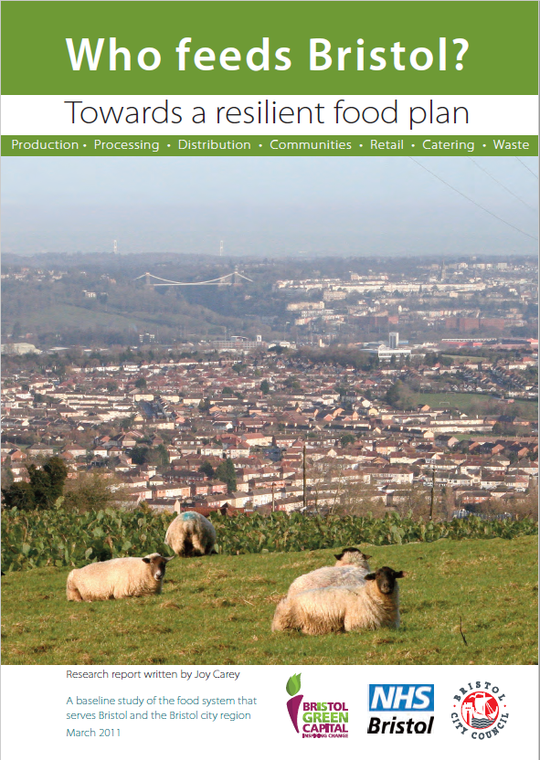
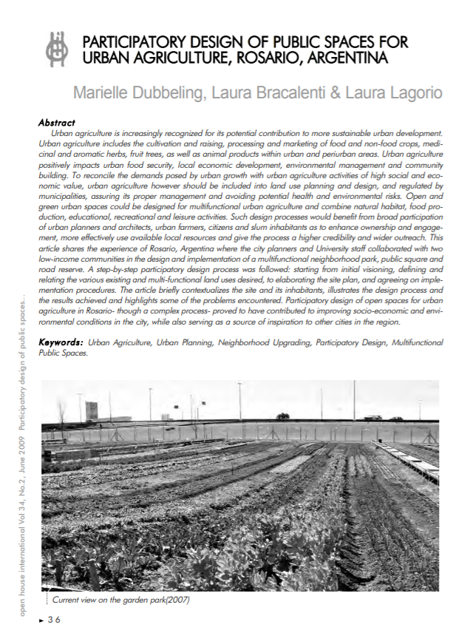
Self-sufficiency and participation
‘Who Feeds Bristol?’ (Carey 2013)
Lincoln Food Food Partnership newsletter April 2020
Rosario – UA to address poverty
Notes:
Joy’s report was responding to the idea that around 90% of fruits and 60% of vegetables are imported into the UK. It juggles interesting issues, for example the (at that time) rising cost of oil (cf. Alessio’s paper) and the associated impact om the environment on climate change. It also acknowledged that Bristol has been associated with global food trade – some of it linked to slavery – for almost 1000 years. And it estimated that around 2,000 acres (800 ha – or 7%) of the city could be devoted to vegetable production. It also positions the city as a driver for the regional food economy, offering markets for regional farmers.
Lincoln’s Food Partnership is concerned with food poverty. Similarly, 310ha are identified as potential spaces for cultivation in the quest for self-sufficiency. This is especially interesting in Lincoln, because it is the capital of the county where 10% of Britain’s agriculture is produced, mainly in industrial arable and horticulture concerns.
So these two examples position the city as, on one hand, related to the region and, on the other hand, distinct from and not integrated with the region.
The Bristol example is normative in relation to UA as a sustainability driver, but look who has funded it. Lincoln is more closely linked to poverty, as is Rosario.
Marielle’s paper indicates the frequently practiced public participatory processes of designing urban space for food production. The Rosario (Argentina) story is especially linked to the leadership of the city council to use public spaces (parks) to help get people eating better food.

Slide 7
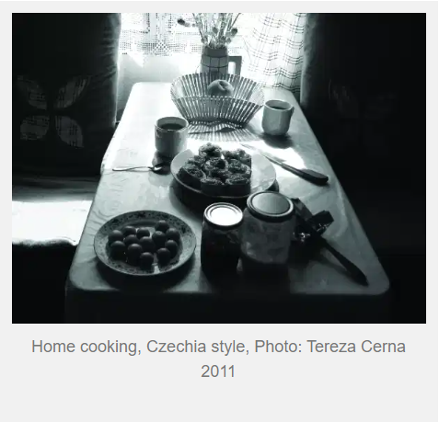
Central and Eastern Europe
What is alternative and where?
Brno: centre of Czech AFN expertise. + SlowFood Central Europe.
https://foodpathsnetwork.slowfood.com/
Research in Moravia-Silesia shows a higher intensity of AFNs close to cities; organic farms not integrated with AFNS (Hruška et al 2020).
‘Thinking like an Eastern European’ (Jehlička et al. 2020)
Notes:
In ‘the west’, especially in North America, AFNs are seen as oppositional to the mainstream commercial system and outside it and favour organic methods. AFNs have been linked to communities of people trying to achieve some kind of rural lifestyle, although the importance of cities as special markets for enlightened consumers is evident – see Henderson and Van En (2007).
In the UK and continental western Europe, AFNs are also trying to lever back control of some of the power of corporate food business, and increasingly have been associated with enterprise innovation (Grivens et al 2017), as well as urban place-making (Koopmans et al 2017).
Important work by Petr Jehlicka and Petr Danek (plus others such as Vavra, Duzi, Spilkova etc) highlighted that western-centric science publishing (partly because of the dominance of the English language) means that very little is getting heard about the applicability of AFN notions in CEE countries, where high levels of self-provisioning and non-market distribution mean that some of the aspirations of western AFNs are quiet forms of lived sustainability.
Have a look at the Slow Food central Europe project – unity, diversity, heritage, sharing, solidarity, local identity and European common ground, innovations. Very complex and varied messages. Brno appears around 3 mins 50 secs.

Slide 9
Women’s community garden in the grounds of the Cistercian priory at Tišnov, 29th March 2022.

Slide 10
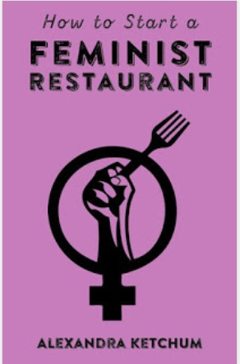
(Urban) food and gender
Eileen Cowen (2020) https://medium.com/the-innovation/selling-domesticity-how-food-and-consumption-launched-a-feminist-revolution-5bd01dba9b02
Starting point: inequality. ‘Women do 66% the world’s work, produce 50% of the food, but earn 10% of the income and own 1% property.’ In HCT, women = 70% workforce. (UN Women 2013).
Multiple urban ‘foodscapes’: home, shops, workplace, on the move, eating out. (Parham 2015).
Urban food projects often blend co-operative cooking, child-friendly growing and are inclusive or reflective of the cultures living in the city.
Notes:
Gender is a very rich area of research interest in any kind of food study but is especially dynamic in urban settings.
A starting point is gender inequality per se, but this can be seen very clearly in relation to food. For example, the top picture is a 1959 advert for kitchen appliances. These may have removed some of the drudgery of housework in earlier times, but also reinforced views of the women’s position as a home-maker, cook and carer in urban and suburban economic settings. Expectations about how a woman (and the kitchen) might look is also notable, compared to some of the people and food producing settings of UA projects today.
There are many foodscapes in the city that reveal gendered social, political and cultural issues, including in the Hospitality, Catering and Tourism sector, which is more and more important as an economic regeneration lever for food culture quarters and gentrification of post-industrial cities.
Alternative, approaches, such as outlets run by and for women sometimes draw on the cosmopolitanism of city populations, or revive traditional menus from handed down knowledge, or use different business models such as pop-ups, subscriptions or using surplus food. So just as AFNs have emerged as a response to the dominant food system, so do gendered perspectives inform food production models and citizenship/representation through food. SDG5 = Gender Equality. Please also take a look later at the links I put in creative practice (Bread Street) which also challenge narrow localist approaches to ‘white people’s’ food in cosmopolitan urban settings. In this respect (and drawing on Kern and on Gibson-Graham’s Feminist economics) feminism is a way of thinking about intersetionality and alternatives. So: feminism is a fruitful research lens through which to study food, sustainability and diversity.
In feminist studies, the body is the common scale of analysis and individual scale experiences of nourishment are another connection to our food diaries, where in past years there has been a very clear difference between male and female eating preferences.
At household and city level, we also see a major role played by women in food security, nutrition and environmental projects such as food banks, in- or after-school nutrition, as public service caterers and innovators (for example in CSAs – remember the Norwegian paper.)

Slide 11
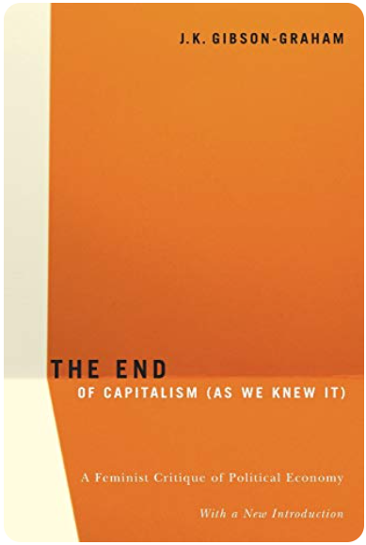
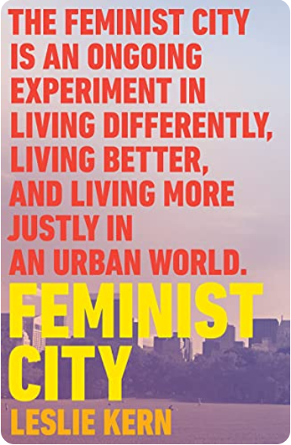
Food feminism and the city
The statistics → concept of embodiment of pain / exhaustion of everyday labour. Raises questions about work and power in the food chain. SDG5.
‘The ubiquity of food and gender difference in all societies makes the overlapping of food and gender studies particularly constructive for a social progress agenda.’ (Horvorka 2013)
Changing urban open space design: safe, clean, convivial, child friendly etc…
Feminism: powerful lens which shines a light not only on the lived food experiences of city women, but also more generally: justice, citizenship, alternative economics, sustainability and diversity.
Notes:
Alternative, approaches, such as outlets run by and for women sometimes draw on the cosmopolitanism of city populations, or revive traditional menus from handed down knowledge, or use different business models such as pop-ups, subscriptions or using surplus food. So just as AFNs have emerged as a response to the dominant food system, so do gendered perspectives inform food production models and citizenship/representation through food. SDG5 = Gender Equality. Please also take a look later at the links I put in creative practice (Bread Street) which also challenge narrow localist approaches to ‘white people’s’ food in cosmopolitan urban settings. In this respect (and drawing on Kern and on Gibson-Graham’s Feminist economics) feminism is a way of thinking about inter-sectionality and alternatives. So: feminism is a fruitful research lens through which to study food, sustainability and diversity.
In feminist studies, the body is the common scale of analysis and individual scale experiences of nourishment are another connection to our food diaries, where in past years there has been a very clear difference between male and female eating preferences.
At household and city level, we also see a major role played by women in food security, nutrition and environmental projects such as food banks, in- or after-school nutrition, as public service caterers and innovators (for example in CSAs – remember the Norwegian paper.)

Slide 12
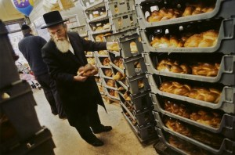
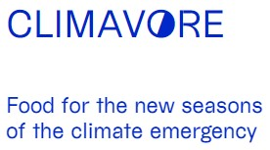
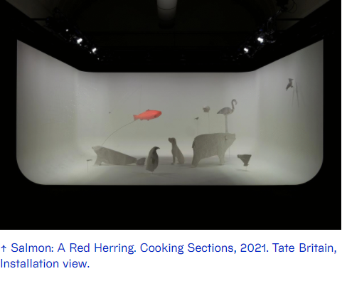
Locality diversity and/through creative practice
Image: Sara Hannant
https://www.sustainweb.org/news/01_2004_from_brick_lane_to_bread_street/

Slide 13
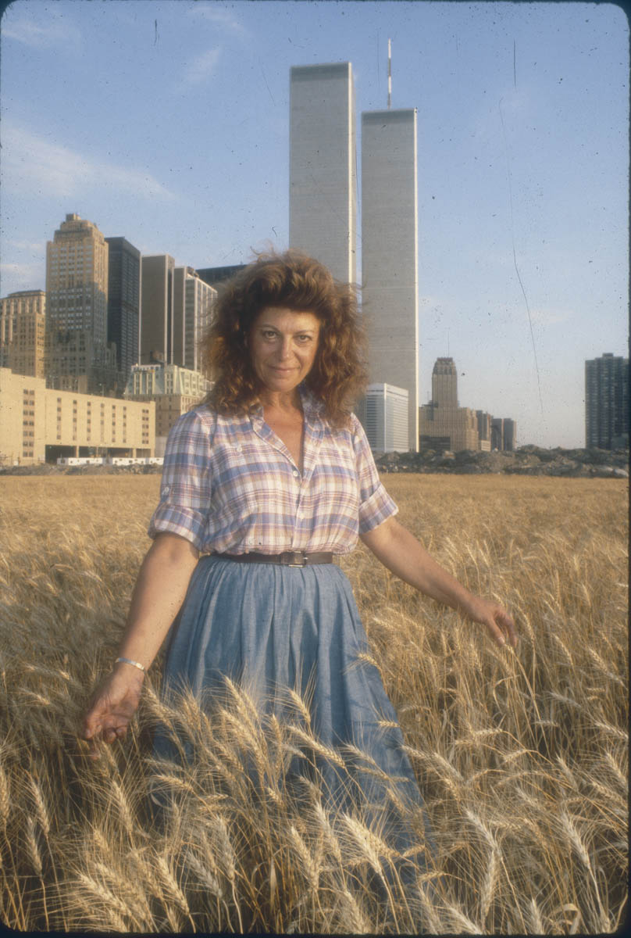
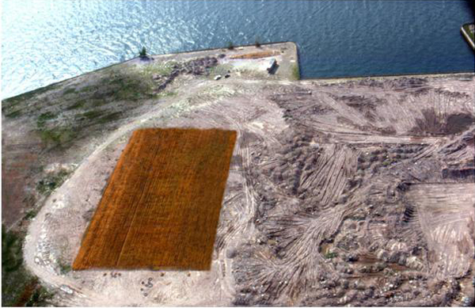
Farming as confrontation
‘Wheatfield was a symbol, a universal concept. It represented food, energy, commerce, world trade, economics. It referred to mismanagement, waste, world hunger and ecological concerns. It was an intrusion into the Citadel, a confrontation of High Civilisation. Then again it was also Shangri-La, a small paradise, one’s childhood, a hot summer afternoon in the country…’
The yield was 1,000lbs of ‘healthy, golden wheat’ worth £158 from land worth $4.5bn.
Agnes Denes in her Manhatten Wheatfield, 1982.
Pic: Donna Svennevik
Notes:
Denes echoes some of the polarisation raised earlier by Mabey about personal and received wisdoms/experiences. The validity of certain structures and ideas over others, and challenging ideas of universality, such as that the (possibly scornful?) occupants of the High Citadel were once children who walked in cornfields, who want their children to do so… And issues of city/country separation.

Slide 14
Image by permission: Zentrum Welderbe Bamberg, ©Jürgen Schraudner.
Notes:
I want to make three main points:
Firstly, there has been a huge upsurge in scholarship on urban gardening as a post-industrial, civil society innovation in response to a range of urgent concerns, for example: is urban gardening an answer to food security in global and rapidly-growing mega-cities? Yet in many smaller cities, commercial urban horticulture is an on-going and longstanding tradition. The picture above shows the German city of Bamberg as a case in point, where about 20, mainly family-run businesses, continue a practice which has its roots in the 14th century.
My second point relates to methods and themes used in studying urban gardens. Really exciting studies by well-known geographers and sociologists in particular have focused on issues such as food security and climate resilience, community cohesion and integration, as well as power relations and governance of the urban food chain. Matt will cover some of these issues no doubt. Instead, Marc and I have been captivated by issues including cultural structures and institutions, because in Bamberg the gardens are part of the World Heritage designation of the city; and the gardens are run by ancient, male-dominated fraternities who have a key role in upholding tradition and identity. So we have used culture as a different way in to studying urban horticulture.
My last point is that by thinking about urban gardens culturally and historically, we can begin to see their role as important contributions to the physical fabric, spatial layout and formation of rural identities in the city.

Slide 15
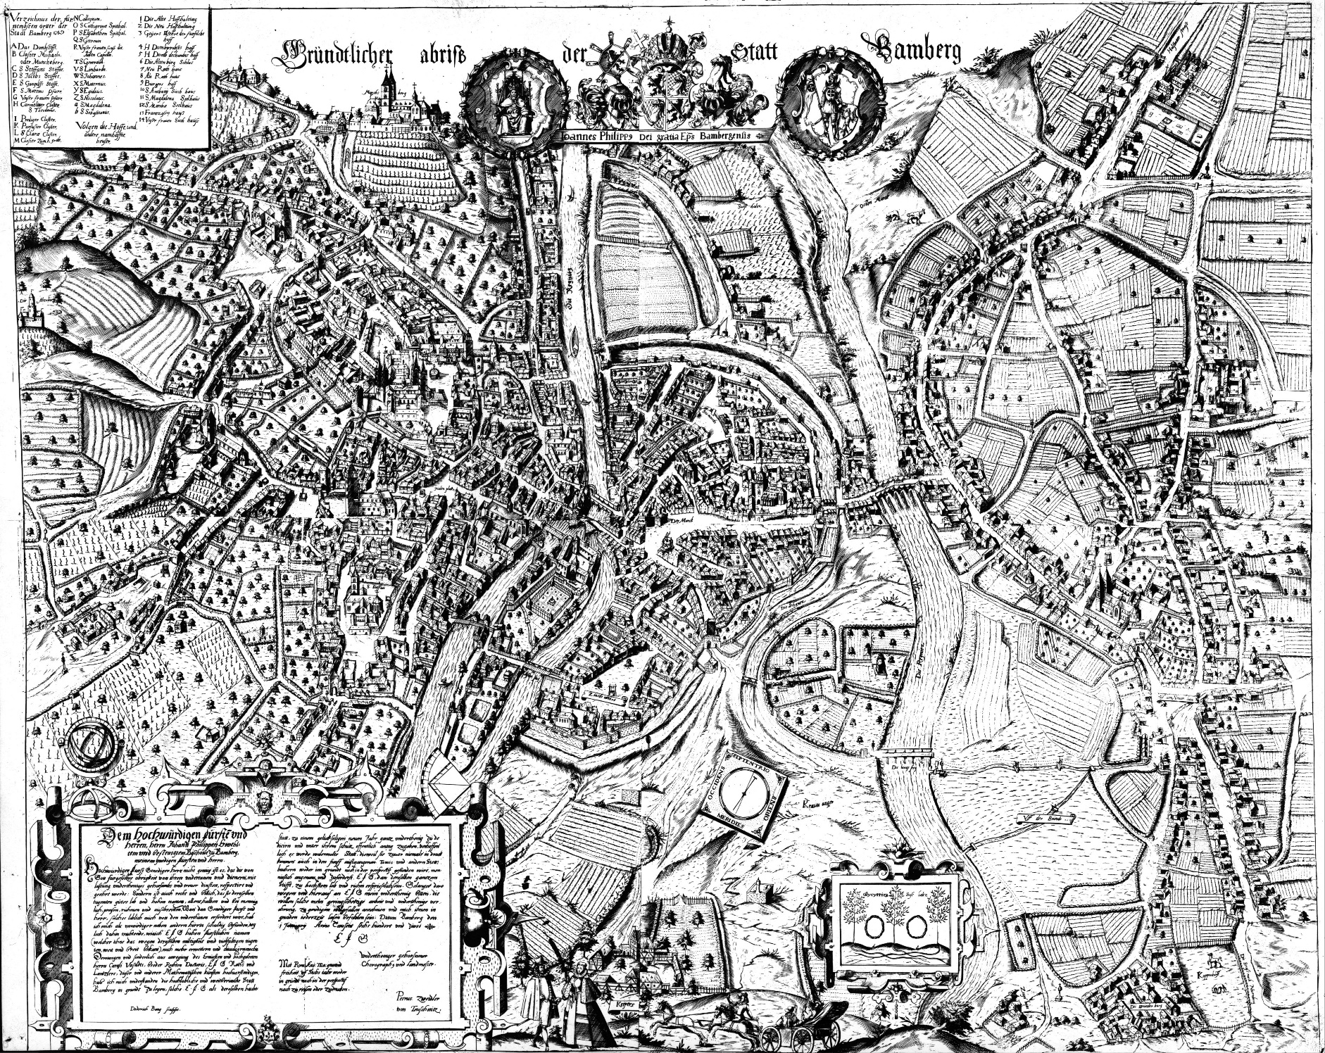
Zweidler-Plan, 1602 (Lower Gardener’s District in frame)
Source. City of Bamberg
Notes:
This is the 1602 map of the city which shows, in the yellow frame, the Lower Gardeners’ Quarter. You can see how many cultivated fields there are also just outside the frame, and similarly in the left hand side of the picture you can see orchards and vineyards.

Slide 16
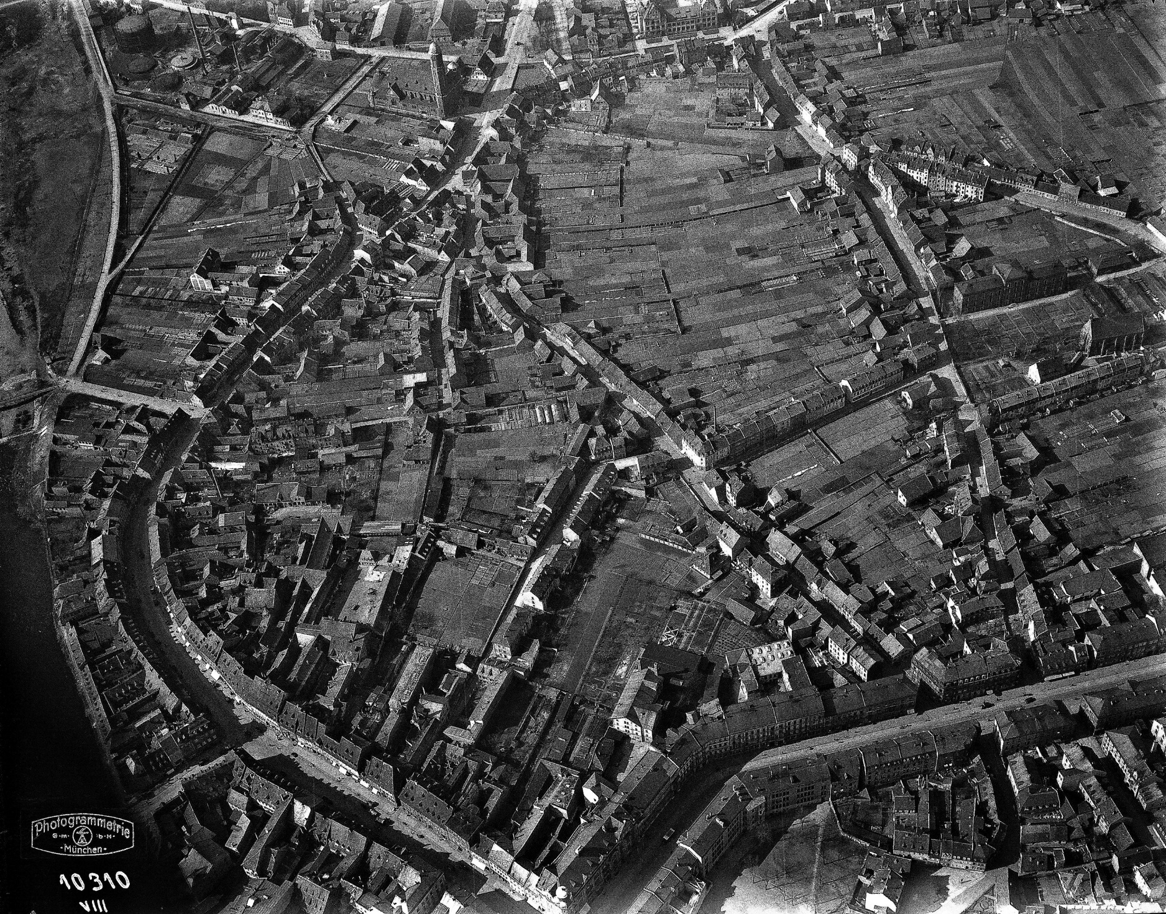
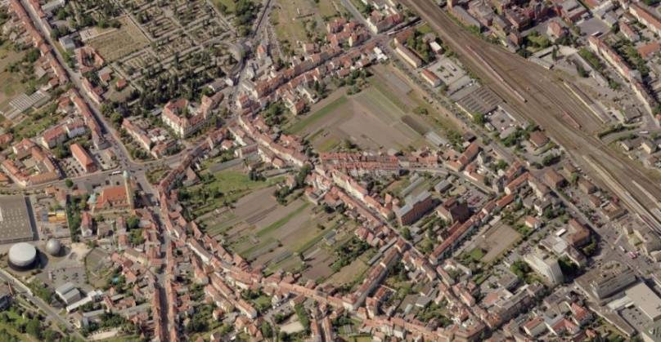
The Lower Market Gardener’s District (1930)
Source. Stadt Bamberg
The Lower Market Gardener’s District (2017)
Source. Bing maps
Notes:
This is the same area in 1930 and again in 2017 where you still see a very similar layout, not just between these two dates, but also the earlier one from 1602. In this respect we can recall Sarah Parham’s idea of ‘food space’ (Parham 2015: 71) as a spatial quality and local identity that has developed over centuries and serves (here though small and privately owned gardens) as ‘rural green space’ in the city.

Slide 17
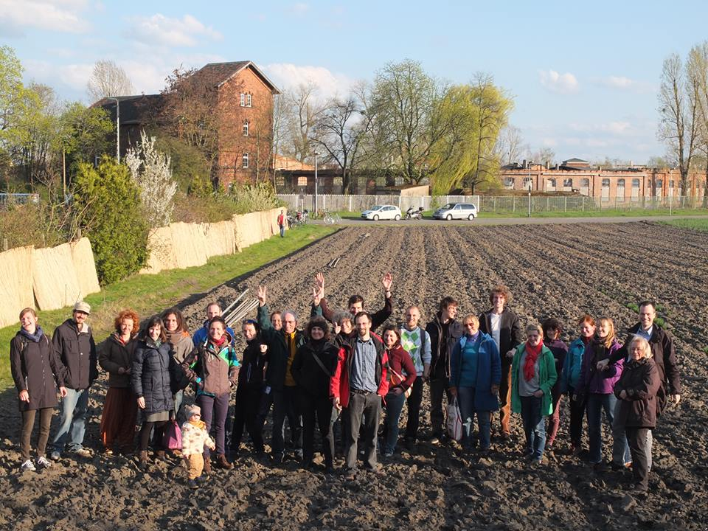
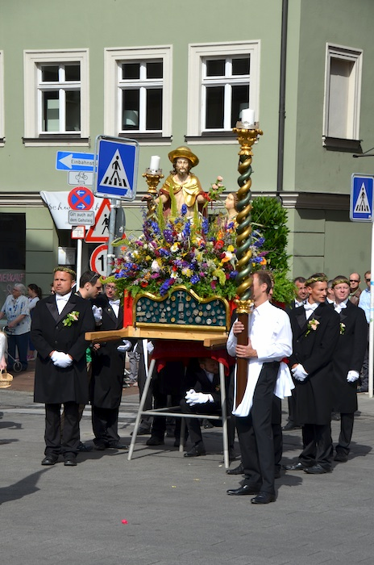
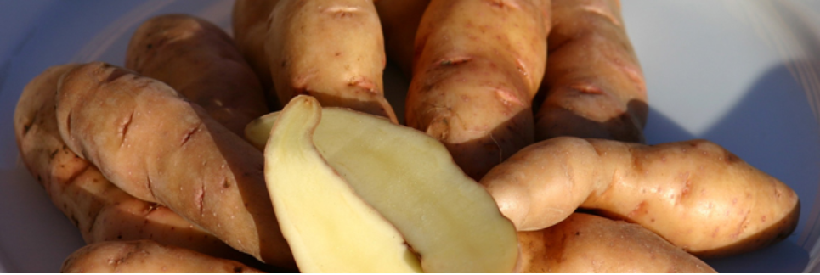
Images: From left, clockwise -
Bamberg Hörnla potato (Slow Food Presidia); Selbsterntegarten (Transition Bamberg); Corpus Christi procession (www.bamberger-onlinezeitung.de/2014/07/24/maria-magdalena-schutzheilige-der-gaertner-wegen-eines-irrtums/)
Notes:
In my last slide, I want to highlight that, despite the strict traditions of the gardeners and the pressures to give up their land for housing demand, a new alliance has cautiously but enthusiastically developed between new politically and lifestyle motivated urban growers (seen on the left) and the gardening fraternities (seen on the right, during their traditional role in Corpus Christi procession).
New gardeners have emerged from green-left groups who want to engage in healthy physical activity and protect urban open spaces for environmental reasons. The gardener fraternities tend to be more conservative and sceptical of these new motivations. Yet both groups now rely on each other.
The new gardeners rent land from retiring growers and seek their help in growing local varieties which the traditional gardeners have always sold to local brewery restaurants (which are in their own right, guardian of local gastronomic culture). The traditional gardeners recognise among the new entrants, enthusiastic continuity for urban horticulture upon which the city’s World Heritage status rests. So the final point is, again, that in the heart of the city, cultural institutions, environmental functions and food production persist and evolve at the interface of innovation and tradition. Thank you (now show last slide).

Slide 18
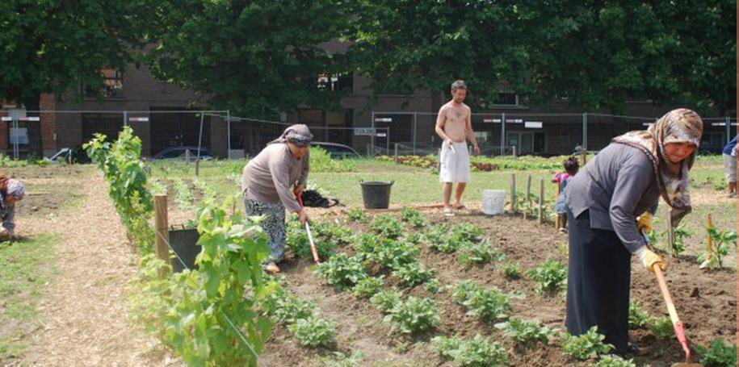
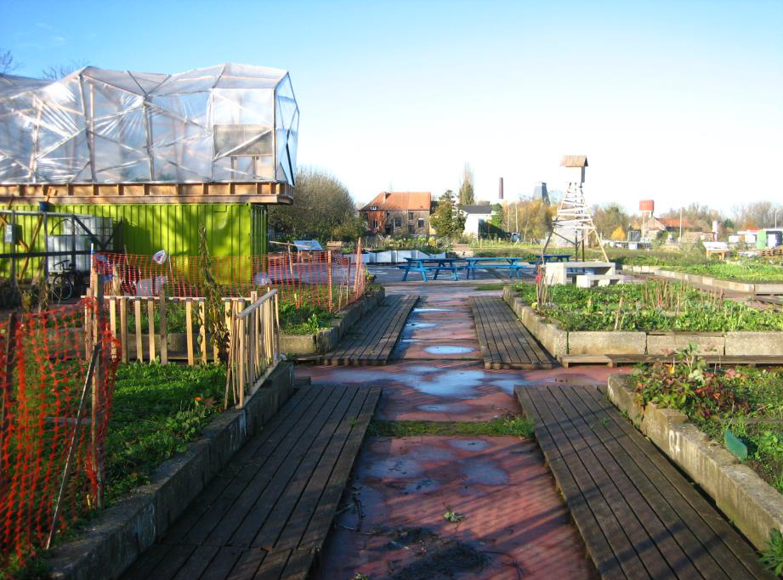
Image – Matt Reed
www.rabotsite.be More details Koopmans et al. (2017)
Notes:
In Rabot, Ghent, a community development project was started on the site of a former paint factory.
New soil
Social ent sells veg in the site shop
Are of ‘sans-papiers’ people with no papers, homeless, immigrants awaiting asylum decisions etc.
Soc ent offers plots to local people who grow veg for personal consumption. But can sell the surplus to the Soc Ent shop and get paid in local alternative currency.
Social inclusion... and brownfield restoration.

Slide 19
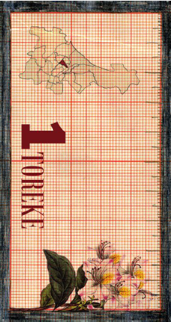
De Site (2) – Parallel economy?
Temporary urban brownfield site of 3,000m² – moving production concept (consequences?).
Led by community development organisation to stimulate integration in Rabot, a neighbourhood with 60 nationalities and poverty/homelessness challenges.
Project sells its produce for profit to the catering trade.
Locals and homeless provide labour, rewarded with their own parcel of land.
Allotment surplus can be sold to project by parcel holders and payment in alternative local currency (TAX!).
This can be spent in the project’s subsidised restaurant and shop on household goods and other food.

Slide 20
De Site (3) – Some contexts
Long-standing Social Democrat-Green-Liberal city coalition. Which has prioritised social integration and sustainability. Food policy, non-meat public food days.
De Site complemented by Wijveld CSA, urban food production SMEs, some city-produced foods (mushrooms, veg, honey) stocked in Delhaize supermarket – but difficult.
Soil degradation and compaction in intensive agricultural areas outside the city. Opportunities for closing waste cycles in the wider city-region?
In both Bristol and Ghent the alternative food production and retail systems are a form of active citizenship. Read more at www.supurbfood.eu

Slide 21
What have we learnt?
Cities are important as places of food production and always have been.
Urban food can ‘repair’ some of the disconnections associated with industrialised agriculture, including between town and countryside.
City food economies continue to shape the fabric of cities and offer multiple social functions
Food culture and identity are complex, dynamic and need to be democratically renegotiated, sometime with local government assistance, or sometimes to make policy.
Gender, tradition and innovation are rich research arenas in city food research and can encourage sustainability solidarity and inclusion.
In Europe, provincial cities, not just larger capitals, are interesting locations of urban food and reveal ‘rurbanity’.

Slide 22
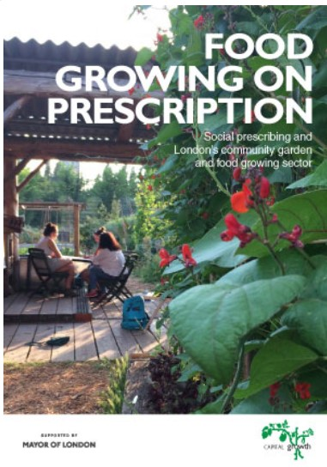
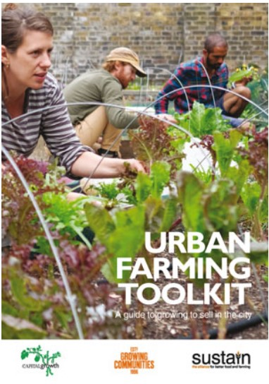
Classroom exercise
Get into four breakout groups. Please develop plan for an evaluation of an urban food project.
What kind of project are you evaluating (could be a real example you know about; or you could just imagine)?
What exactly are you evaluating and why? (Productive output, gender issues, functions of the growing space, innovation, connections with other networks?)
What research method(s) do you think could work well in informing your evaluation?
Please work up a brief evaluation plan (in 1 or 2 slides?) to share with the group. You may need a note-taker and/or speaker.

