Slide 1
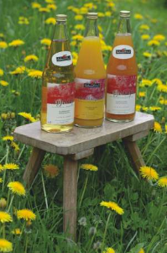
Food, sustainability and
alternative food networks
Session 3: Rural food social enterprises:
CSAs, the ‘third’ sector and cultural landscapes
Dr Daniel Keech
Countryside and Community Research Institute
University of Gloucestershire, UK
dkeech@glos.ac.uk
Masaryk University, Brno, 25th April 2023

Slide 2
Overview of the session
Introduction to the idea of social enterprise as a way of organising AFNs striving for sustainable food systems
Review of two types of rural social enterprises in Germany and the UK which show SE business models to achieve:
The conservation of cultural landscapes
The production and supply of organic food and business opportunities for young farmers
We’ll watch a short film about another (different) English CSA followed by a short discussion about key themes.
Short account of a community rural land acquisition scheme
Check progress on the food diary presentations.
No breakout rooms today so please join in the discussion.
Notes:
Lot of interest in SE – both as market mechanisms introduced into public sector (under Labour, with many associated structures – regional SE agencies, funding programmes) and as a way to reduce direct public spending on social services under the Coalition.
AFNs are SEs because they try to organise novel ways of trading in food, specifically to create some social or environmental objective.

Slide 3
Social enterprise as our sustainability ‘lens’
The study of social enterprise (SE) has burgeoned since the late 1990s. Huge expectation invested in SE as engine of social change and inclusion (Amin et al. 2002).
One group of SEs = AFNs that apply profits to social or environmental outcomes. (Goodman et al. 2012).
Some AFNs can have a ‘political’ goal – (anti-supermarket, co-operative, fair-trade…) and have been studied using e.g. transition theory (scale), communitarian/Marxian approaches (power) and social innovation (routines).
My case is that SEs are also interesting (and accessible) if considered for how they (i) balance multiple goals and (ii) have ‘agency’ (or impact) in markets.
Notes:
Lot of interest in SE – both as market mechanisms introduced into public sector (under Labour, with many associated structures – regional SE agencies, funding programmes) and as a way to reduce direct public spending on social services under the Coalition.
AFNs are SEs because they try to organise novel ways of trading in food, specifically to create some social or environmental objective.

Slide 4
Environmental SEs
Alter 2007 – Hybrid spectrum of SE
Traditional non-profit | Non-profit with income generating activities | Social Enterprise | Socially responsible business | Business practicing Corporate social responibility | Traditional for-profit
Mission motive
Stakeholder accountability
Income reinvested in social programmes or operations
Profit-making motive
Shareholder accountability
Profit redistributed to shareholders
SEs have a wide range of definitions and organisations forms (Teasdale 2010). Today I’ll suggest that they are:
enterprises which trade principally to fund a ‘social’ mission, requiring them to balance a range of commercial and non-commercial objectives (Keech 2016).
Some SEs have primarily, or substantially environmental (as well as social?) goals.
Notes:
Alter’s spectrum – SEs are non-profit companies; or simply companies with CSR policies.
You can have a think about where the food enterprises we are about to examine fit on this spectrum. You might also say that in the case of CSA, the boundary between a stakeholder and a shareholder is rather uncertain or blurred.

Slide 5
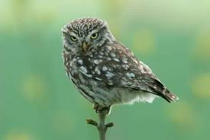
The ‘mission’
Decline of 70% in area since 1960s.
Juice price is around €6/100kg.
Result = unviable.
Loss of precious biodiveristy.
Pictures: Buechele/Dagenbeck; BUND.
Notes:
Explain that these are traditional orchards. They are multifunctional, linked to the different habitat structures they represent. These include grassland, which is good for flowers and insects, trees of different ages, which is good for other insects and birds, and also used for grazing. The tall trees allow seasonal grazing without damaging trees. The fruit is for juice so you don’t have to pick the trees, the fruit falls to the ground.
Such trees are familiar in Czechia, including the almond orchards at Hostopece, and the SE I’m about to describe might easily be Hostetin perhaps.

Slide 6
‘Disorder’ (Beckert 2007) in the juice market
apples
Commercial
press
Farmers
Sales income
Wholesale
Retail
Juice products
€€€
logistics
Problem: inadequate
Notes:
Here is the simple supply chain.
Jens Beckert is a German sociologist who is interested in market dynamics and relationships and he says markets are intrinsically dynamic and market actors are constantly striving for stability. Instability may be corrected by power arrangements, price regulation or co-operation and competition. In our model, instability is caused by the uncompetitive nature of the mass apple juice market for the people who manage these wonderful orchards.

Slide 7
Networked market
Civic procurem’t
Sales income
Farmers
apples
Juice
products
Press
Logistics, w’sale, retail
more ££
differentiation
Marketing, customers, grants
contract
parent NGO
sets up
separate SE
Sales 600,000 litres p.a.
Management and replanting.
https://www.bund-ravensburg.de/naturschutz-planung/streuobst-saft/ and https://www.nabu.de/natur-und-landschaft/landnutzung/streuobst/
Notes:
The networked market is one of three models I have studied and is the simplest. The juice is the same but sales massively increase due to the efforts of the Third Sector-led SE. This is great because high sales mean the price premium is affordable – about 10-20cents per litre (or about 5CzKr).
As well as that, the labour force is the same (the farmer), the juicing plant is the same. So the lovely thing is, you are nudging or shifting the existing market arrangement to have better outcomes. The higher return for the farmers is contractually linked to caring for and replanting traditional orchards.

Slide 8
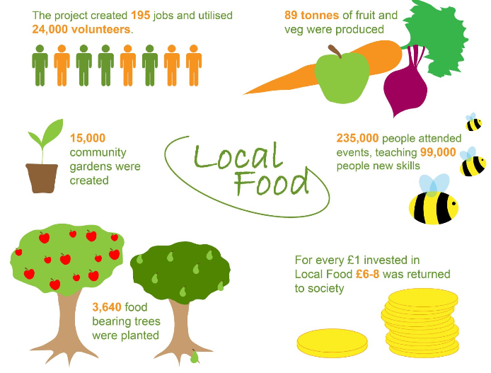
Local food movement emerges in UK from
the Third Sector
Negligible contribution in terms of food output but social innovation and new enterprise models - ‘more than just the veg’ films: https://www.youtube.com/watch?v=bcGdJqrlmRM&list=PLGLfXygsryTD_r3poB2dXDvNpgj4KLPW_&index=2
Notes:
The Third Sector has also been very important in UK AFNs and SEs.
In 2012 a really big project (funded by our National Lottery) came to an end. It spent £10m (300m CzKr) on supporting 500 local food groups around the UK. UoG did the evaluation. We found that for all that money, hardly any food had been produced, but for every £1 invested, £6-8 was reinvested was returned to society. This is a calculation method called Social Return on Investment and is another way of measuring social benefit.

Slide 9
1. CSA - What is it?
CSA has a number of characteristics which may include:
Shared risk between farmer and consumer (member)
Advanced, or regular payment for food
Co-operative/democratic management
Contribution by members to labour
Access to the farm for education, relaxation… etc.
Essentially, it is a way of planning cash-flow and cropping; and may renegotiate the distinction between farmer, landholder, customer.
https://www.asociaceampi.cz/co-delame/komunitou-podporovane-zemedelstvi/

Slide 10
Current models include:
Share in the harvest (a proportion of the harvest)
Committed market (a minimum, or informal commitment)
Support group around a farm (events, festivals, markets)
Rent a tree (for fruit – can be non-local)
Do the work yourself (labour for food)
Shares or gifts in the farm capital
Community owned enterprise (see shares above and later)
Main point is breadth – one size will not fit all, all schemes are different.

Slide 11
Stroud Community Agriculture - Community Owned Enterprise
Operates solely to further a set
of principles (mission-led)
F/T Farmer + grower paid c.£27,000 p.a. (CzKr 810,000), + 4 day worker, + 3 seasonal (summer staff)
30 ha. organic mixed farm, 3 locations
IPS members represent 320 households
£200,000 turnover (CzKr 6,000,000) (2021)*
*Ave. farm business profit for mixed farms in 2020 £22,711 (Farm Business Survey, England).
Films:
https://www.stroudcommunityagriculture.org/
https://www.agricology.co.uk/file/chagfoods-community-supported-agriculture-csa-chagford-devon

Slide 12
What is it for? What are their principles?
To support organic and biodynamic agriculture.
To pioneer new economic model and ensure the farmers have a decent livelihood.
Low income shall not exclude anyone. Practical involvement on all levels encouraged.
To be transparent in all affairs and make decisions on the basis of consensus.
To offer opportunities for learning, therapy and re-connecting with the earth.
To network with others to promote CSA to other communities and farms.
To encourage members, in co-operation with the farmers, to use the farm for their individual and social activities and celebrations.

Slide 13
How does it work?
Members pay £3/10CzK subscription, plus £41/1200CzK per month for a vegetable share, which they collect.
Members can buy meat from freezer, and eggs – honesty box and swap box.
Members decide all matters, delegated to a core group, many volunteers.
Farmers have delegated responsibility for farming.
No compulsion for members to be active.
Open access to the farm.
Three rented sites, one very close to Stroud town.
https://www.youtube.com/watch?v=eaTE9RkqLo8

Slide 14
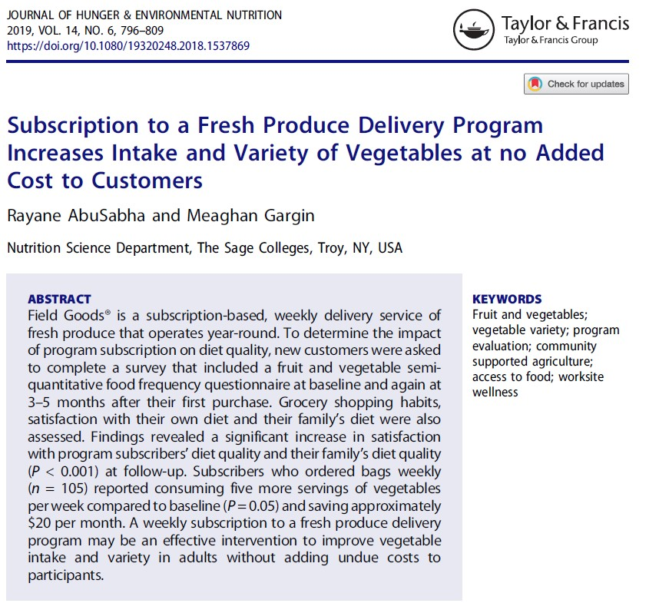
CSA - Some critical reflections
Too small to affect food system performance
Pricing policies exclusive for some citizens? CSAs used by the educated, wealthy and white (Gutman et al 2009, Gutman 2007)
They can be complex and hard work – relies on high degree of farmer and business skills
Land is expensive if you want to start up
Farmers may appreciate the support of their communities but find the limited/fluctuating sales volumes hard to accommodate
Customers must manage limited choice, seasonality, neophobia (Hanson et al. 2018, 2017)
The ‘othering’ of CSAs. Instead, integrate them within lower-risk agricultural new entry options and including small farms in AES would help a lot.
Notes:
14

Slide 15
Positive Summary CSA
CSA takes many forms but most expect consumers to share production risks with farmers
CSAs may be ideologically led but are businesses
CSAs make successful links with other alternative food projects – farmers’ markets, organic box schemes and create innovative financial models; and create solidarity with existing farmers.
Potentially transferable? – housing and energy generation
Community supported agriculture or agriculture supporting the community?

Slide 16
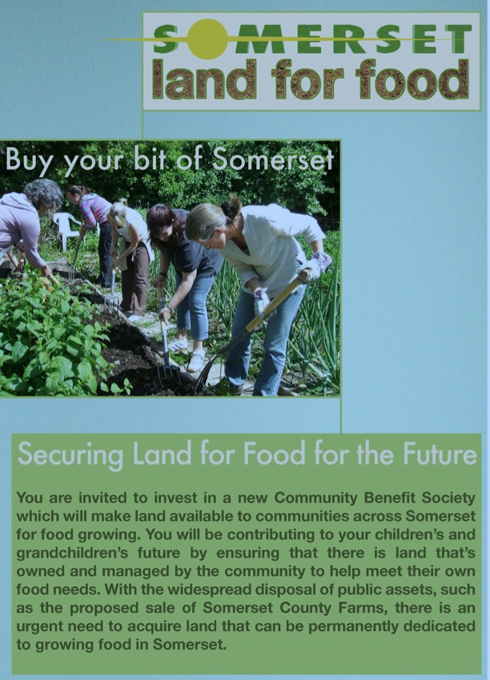
Community development finance instruments
Somerset Land for Food community share issue
People buy shares in CBS
That investment provides capital for groups to buy land
Land is rented by growers
Rental income pays dividends (2%) and secures more land purchase
Option for growers to buy after 5 years
More info: www.communitylandtrusts.org.uk
Notes:
16

Slide 17
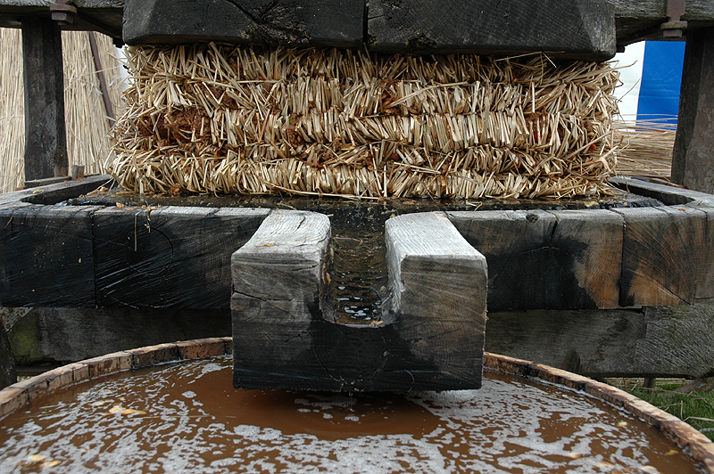
The End: Na sdravi

Slide 18
Some further reading
Butler Flora, C. and Bregendahl, C. (2012) Collaborative Community-supported Agriculture: Balancing Community Capitals for Producers and Consumers. International Journal of Sociology of Agriculture and Food 19 (3): 329-346.
Franklin, A., Newton, J., and McEntee, J. (2011) Moving beyond the alternative: sustainable communities, rural resilience and the maintreaming of local food. Local Environment, 16 (8): 771-788.
Keech, D., Alldred, S. and Snow, R (2009) An analysis of seven CSA enterprises. Making Local Food Work Discussion Paper. Soil Association, Bristol.
Henderson, E. and Van Eyn, R. (2008) Sharing the Harvest: A Citizen's Guide to Community Supported Agriculture. Chelsea Green Publishing, White River Junction.
Guthman, J., Morris, A. and Allen, P (2006) Squaring Farm Security in Two Types of Alternative Food Institutions. Rural Sociology 71 (4): 662-684
Schnell, S (2007) Food with a farmer’s face: CSA in the United States. Geographical Review 97 (4): 550-564.
DeLind, M. (1999) Is This a Women’s Movement? The Relationship to Gender of Community Supported Agriculture in Michigan. Human Organisation 58 (2): 190-200
Notes:
18

Slide 19
Group exercise: CSA critique
Divide into 4 groups. Think about the CSA story.
Group 1 & 2 – Consider three key general strengths of the CSA models we have described as you see them. What main benefits do they offer?
Group 3 & 4 – CSAs seem a good idea but they are not the mainstream of farming. Please provide 3-5 critical points about associated difficulties or weaknesses of CSA.
10 mins and 5 mins feedback per group.

