Slide 1

2022-2023 Spring Term
Green transition from international and European perspective
Decarbonisation & Business
Lecture 1 │30 March 2023
Marina Olshanskaya & Aleksandra Novikova

Slide 2


Lecturers
MARINA OLSHANSKAYA
BRATISLAVA
Environmental economist with 20+ years in de-carbonization in business
Designed de-carbonization programmes in 30+ countries worth 250+ mln $ and 20 mln tCO_{2-eq}
Senior Advisor to the UN, World Bank, EBRD, and European Union
ALEKSANDRA NOVIKOVA, PhD
BERLIN
20+ years in analysing and financing energy transition and climate actions
Carbon accounting and modelling decarbonization pathways for 25+ countries and all sectors
Lead author of the IPCC awarded the Nobel Prize for Peace in 2007

Slide 3
Course outline
Lecture 1. Intro to corporate decarbonisation: understanding drivers
Lecture 2: GHG emission management: understanding corporate carbon footprpint
Lecture 3: Science-based decarbonisation targets and roadmaps
Lecture 4: Climate risks assessment and disclosure

Slide 4
Lecture 1.
Intro: why decarbonisation & business?

Slide 5
Decarbonisation: definition
Measures leading to reduction of greenhouse (GHG) emissions of an organization
Climate change mitigation is a bit broader term, also includes nature-based solutions (enhancement of carbon stock)
Corporate GHG emission inventory = carbon footprint
Improving energy efficiency and renewable energy – the most common examples of decarbonisation measures

Slide 6
Why decarbonisation is important for businesses?
Meet requirements of regulators and financiers
Access international capital markets
Become a market leader
Increase company’s value
Attract climate-sensitive customers
Boost employees’ motivation

Slide 7
The science is clear
Achieving global net zero carbon is the only solution to global climate change:
Limiting human-induced global warming requires as a minimum reaching at least net zero CO2 emissions, i.e. the level at which anthropogenic CO2 emissions are balanced by removals of CO2

Slide 8
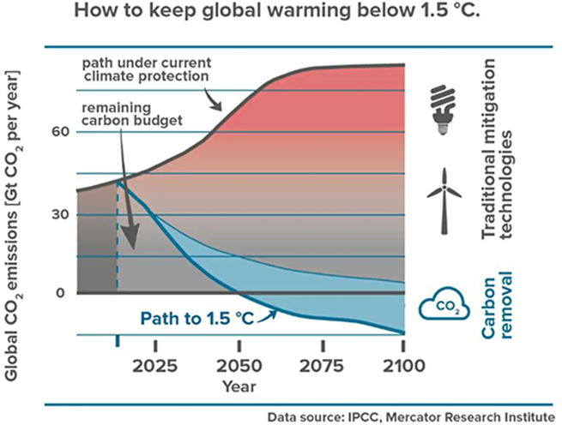
Paris Accord goal: to stay within 1,5C

Slide 9
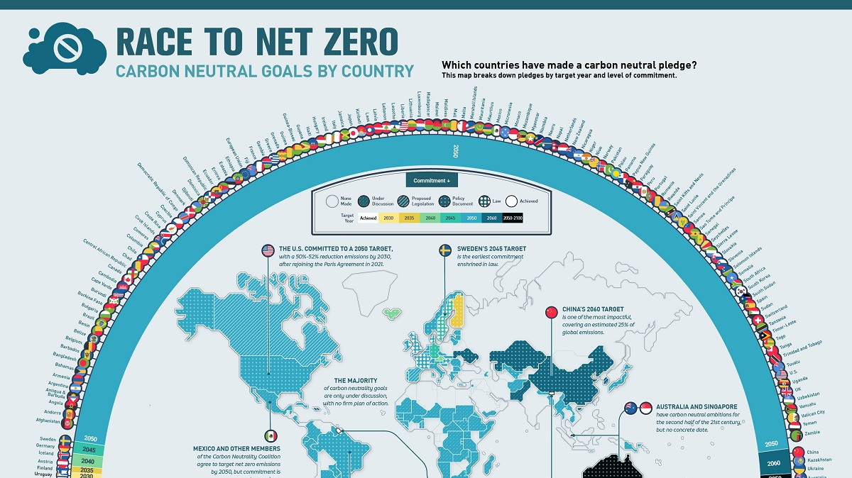
Notes:
Source: https://www.visualcapitalist.com/sp/race-to-net-zero-carbon-neutral-goals-by-country/

Slide 10
PARIS ACCORD: NET ZERO CARBON EMISSIONS BY 2050 GLOBALLY
Nation and sub-national net-zero carbon objectives and policies
Corporate net-zero carbon commitments

Slide 11
PARIS ACCORD: NET ZERO CARBON EMISSIONS BY 2050 GLOBALLY
EVERY BUSINESS will have to learn how to manage its
carbon footprint and create value from climate actions

Slide 12
Global leaders are already doing this
Net zero carbon commitments by 200 Fortune Global companies push net zero obligations along their entire value chain – like a snowball
Source: https://www.naturalcapitalpartners.com

Slide 13
Climate change was a key theme in Davos 2020
Central Banks have been called on to contribute to fighting climate change
Wall Street is incorporating a new risk metric when evaluating companies: climate resiliency
At Amazon, more than 8,700 workers have signed an open letter to CEO Jeff Bezos demanding development of a plan to get to zero emissions

Slide 14
Financial Market and Investors require
Since 2017, more than 370 investors with over $35 trillion in assets collectively under management are engaging companies to:
Implement a strong governance framework: board’s accountability and oversight of climate change risks and opportunities;
Take action to reduce GHG emissions across the value chain, consistent with the Paris Agreement’s goal;
Provide enhanced corporate climate disclosure
Singapore Stock Exchange
Minimal climate reporting for all issuers from 2022
Full climate reporting and decarbonisation plan for issuers from financial, agricultural and food sectors from 2023 and for issuers from transport, construction and industrial sectors from 2024

Slide 15
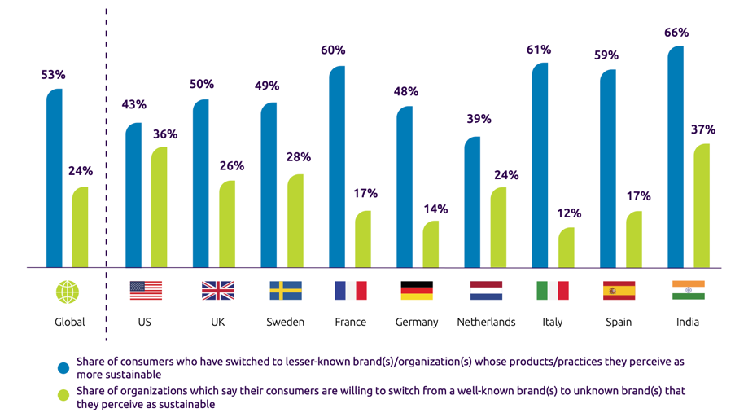
Consumers want to be able to make a difference in saving the planet
72% are personally concerned about their environmental footprint.
66% choose to purchase products or services based on their “environmental friendliness.”
Source: Capgemini Research Institute, Sustainability in Consumer Products and Retail Survey, March 2020, N=7,520 consumers

Slide 16
Impact of EU Climate Regulations on Business

Slide 17
2021 EU Climate Law
Achieve carbon neutrality by 2050
Intermediate target: at least 55% net reduction in GHG emission by 2030
EU countries are legally obliged to reach both the 2030 and 2050 climate goals
Focus on:
  Green finance standards
  EU emission trading system
  Climate-friendly innovation
  Fairness and cost-effectiveness

Slide 18
EU Emission Trading System
ETS is a cornerstone of the EU’s climate policy and its key tool for reducing GHG emissions cost-effectively
It is the world's first major carbon market and the biggest one
Limits emissions from around 10,000 installations in the power sector and manufacturing industry, as well as airlines operating between these countries
Covers around 40% of the EU’s total GHG emissions.

Slide 19
EU CBAM
EU Cross Border Adjustment Mechanism (CBAM) is designed to function in parallel with the ETS to expand its functioning on imported goods
All exporters have to report on carbon footprint of their product from 2023
Covered sectors: electricity, cement, steel, aluminium, oil refinery, paper, glass, chemical and fertilisers. These sectors represent 94 per cent of industrial CO2 emissions of the European Union
From 2025, EU importers will have to buy carbon certificates corresponding to the carbon price that would have been paid if same goods have been produced in EU

Slide 20
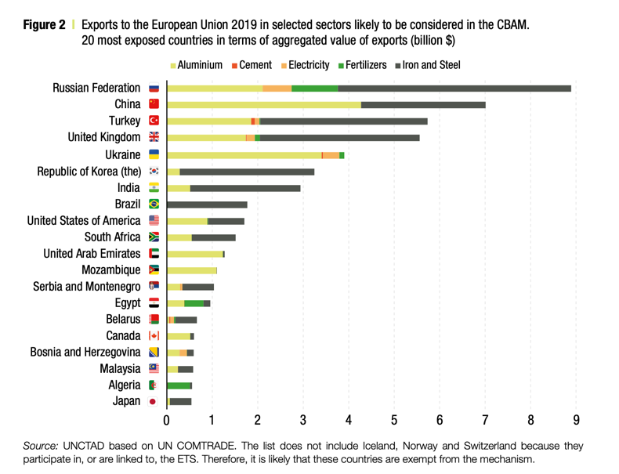
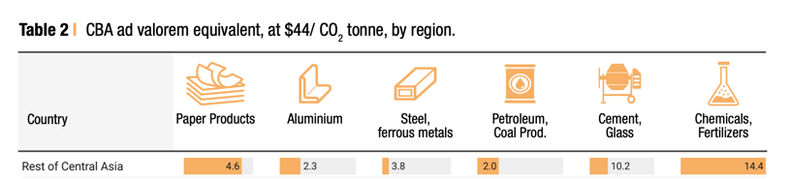
EU CBAM: implications for exporters

Slide 21

EU climate finance commitments
At least 20% of EU 2014-2020 budget to climate actions
  The European Structural and Investment Funds (ESIF) represent over half of the EU budget.
In 2014, the EC adopted an approach based on the Rio Markers to identify the climate-relevant share of the ESIF 2014-2020 disbursement
  Climate mitigation can either be a “principal”, “significant” or “untargeted” objective of a policy action. Accordingly, the spending will be accounted for as 100%, 40% or 0% climate-relevant.
At least 30% of EU 2021-2027 budget to climate actions based on EU Taxonomy

Slide 22
Evolution of green/climate finance rules: from minimal disclosure to mandatory climate portfolio targets

Slide 23
EU Green Finance Regulation - background
In 2016, High-level expert group on sustainable finance (HLEC)
In 2018, Action Plan on Sustainable Finance
Key challenges
Actions
No common definition of 'sustainable investment'
EU classification (taxonomy) for sustainable activities
Risk of ‘greenwashing’ of investment products
Standards and labels for ‘green’ financial products give investors certainties
Banks and insurers often give insufficient consideration to climate and environmental risks
Capital requirements should reflect exposure to climate change and environmental risks
Investors often disregard sustainability factors or underestimate their impact'
Clarify institutional investor duties to consider sustainable finance when allocating assets
Too little information on corporate sustainability-related activities
Enhancing non-financial information disclosure
Source: EC factsheet on Sustainable Finance EU
Notes:
As announced in its communication on Capital Markets Union – Accelerating reform, the European Commission established a High-level expert group on sustainable finance (HLEG) in December 2016. The HLEG comprised 20 senior experts from civil society, the finance sector, academia and observers from European and international institutions. The group was mandated to provide advice to the Commission on how to steer the flow of public and private capital towards sustainable investments identify the steps that financial institutions and supervisors should take to protect the stability of the financial system from risks related to the environment deploy these policies on a pan-European scale.
The recommendations of the High-level expert group on sustainable finance form the basis of the action plan on sustainable finance adopted by the Commission in March 2018.
The action plan sets out a comprehensive strategy to further connect finance with sustainability. Its key actions include
establishing a clear and detailed EU classification system – or taxonomy – for sustainable activities. This will create a common language for all actors in the financial system establishing EU labels for green financial products. This will help investors to easily identify products that comply with green or low-carbon criteria introducing measures to clarify asset managers' and institutional investors' duties regarding sustainability
strengthening the transparency of companies on their environmental, social and governance (ESG) policies. The Commission will evaluate the current reporting requirements for issuers to make sure they provide the right information to investors introducing a 'green supporting factor' in the EU prudential rules for banks and insurance companies. This means incorporating climate risks into banks' risk management policies and supporting financial institutions that contribute to fund sustainable projects To discuss its action plan, the Commission organised a high level conference on 22 March 2018.
In May 2018, the Commission adopted a package of measures implementing several key actions announced in its action plan on sustainable finance. The package includes:
A proposal for a regulation on the establishment of a framework to facilitate sustainable investment. This regulation establishes the conditions and the framework to gradually create a unified classification system ('taxonomy') on what can be considered an environmentally sustainable economic activity. This is a first and essential step in the efforts to channel investments into sustainable activities.
A proposal for a regulation on disclosures relating to sustainable investments and sustainability risks and amending Directive (EU)2016/2341. This regulation will introduce disclosure obligations on how institutional investors and asset managers integrate environmental, social and governance (ESG) factors into their risk management processes. Delegated acts will further specify requirements on integrating ESG factors into investment decisions, which is part of institutional investors' and asset managers' duties towards investors and beneficiaries.
A proposal for a regulation amending the benchmark regulation. The proposed amendment will create a new category of benchmarks comprising low-carbon and positive carbon impact benchmarks, which will provide investors with better information on the carbon footprint of their investments.
In addition, from 24 May to 21 June 2018, the Commission has been seeking feedback on amendments to delegated acts under the Markets in Financial Instruments Directive (MiFID II) and the Insurance Distribution Directive to include ESG considerations into the advice that investment firms and insurance distributors offer to individual clients.
The Commission intends to clarify how asset managers, insurance companies, and investment or insurance advisors should integrate sustainability risks and, where relevant, other sustainability factors in the areas of organisational requirements, operating conditions, risk management and target market assessment. It will do it either by amending existing delegated acts under the UCITS Directive 2009/65/EC, the AIFM Directive 2011/61/EU, the MiFID II Directive 2014/65/EU, the Solvency II Directive 2009/138/EC and the IDD Directive 2016/97, or by adopting new delegated acts under the same Directives. Directorate-General for Financial Stability, Financial Services and Capital Markets Union sent a formal request to EIOPA and ESMA for technical advices in this respect.
On 28 September 2018, the Commission requested EIOPA for an opinion on sustainability within Solvency II, in particular relating to those aspects that concern climate change mitigation.
On 1 February 2019 the Commission requested advice from ESMA, EBA and EIOPA on undue short-term pressure from the financial sector on corporations. This Call for advice is a part of action 10 from the action plan on financing sustainable growth that aims at fostering sustainable corporate governance and attenuating short-termism in capital markets.
On 18 April 2019, the European Parliament endorsed the legislation setting the building blocks of a capital markets union, including the regulation on disclosures relating to sustainable investments and sustainability risks.

Slide 24
EU Green Finance Regulation Landscape
The Commission’s action plan on sustainable finance has triggered several legislative initiatives on mandatory climate and ESG practices for financial institutions and large companies in the EU:
Non-financial Reporting Directive (NFRD) / Corporate Sustainability Reporting Directive
Sustainable Finance Reporting Directive (SFRD)
Capital Requirements Regulation (CRR)
EU Taxonomy Regulation
Taxonomy regulation –
Article 8
CRR
disclosure of prudential information on ESG risks
NFRD and
COM non- binding GL on climate- related reporting
SFDR and Joint
ESAs RTS

Slide 25

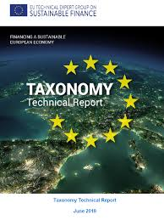
EU climate disclosure and reporting regulations
Corporate Sustainability Reporting Directive (CSRD)
  50,000 large companies, including all financial institutions, must disclose climate information, Paris-alligned carbon emission reduction targets and actions
EU Taxonomy Regulation
  Mandates all financial institutions to disclose how and to what extent their activities are associated with environmentally sustainable economic activities
European Banking Authority
  Pillar 3 requires financial institutions to disclose quantitative information and KPIs on climate change mitigating measures

Slide 26
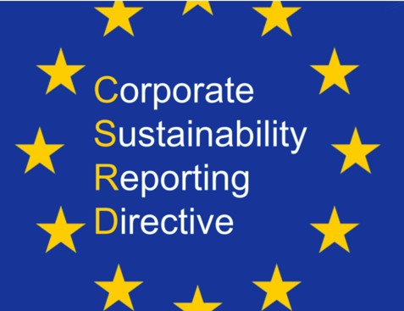
Key regulations: CSRD
EU Corporate Sustainability Reporting Directive (CSRD):
publicly listed companies, large non-listed companies, financial institutions and even larger SMEs (from 2025) have to disclose climate information, decarbonisation targets and actions to reduce carbon emissions in line with objectives of Paris Accord
50,000+ EU and non-EU entities with 150 mln EUR+ turnover in EU
Adopted by EU Parliament in November 2022

Slide 27
EU taxonomy regulations
EU Taxonomy of environmentally sustainable economic activities
  Based on NACE statistical framework of economic activities
  A list of economic activities with performance criteria
  (emission intensities and/or energy use) for their contribution
  to 6 environmental objectives*
  Currently focused on substantial contribution to climate mitigation
Barrier: No common definition of 'sustainable investment'
Taxonomy Technical report (414 pp)
  Full methodology
  Use cases and case studies
  67 economic activities assessed across the sectors agriculture, forestry, manufacturing, energy, transportation, water andwaste, ICT and buildings
*Environmental objectives
Climate change mitigation
Climate change adaptation
Sustainable use and protection of water and marine resources
Transition to a circular economy, waste prevention and recycling
Pollution prevention and control
Protection of healthy ecosystems
Notes:
One of the most ambitious current international projects aiming to standardize the definition of climate finance is the work of the Technical Expert Group (TEG) "Sustainable Finance" of the European Commission. In June 2019, the TEG submitted a draft report (EU TEG 2019) for public consultation. The report defines sustainable finance in the form of a taxonomy for the area of climate finance. It defines sectoral threshold values, which a financed project (e.g. in the aluminum or steel sector) must comply with in order for the corresponding financing to be considered "sustainable finance". According to the proposals of the European Commission, it is planned to establish a "Sustainable Finance Platform", which will continuously develop and adapt this taxonomy in the coming years, also beyond climate financing for other important sustainability dimensions.
How can the Taxonomy be used by investors?
■ Expressing investment preferences;
■ Selecting holdings;
■ Designing green financial products;
■ Measuring the environmental performance of a security or product;
■ Engaging with investees

Slide 28
Key regulations: European Banking Authority
European Banking Authority (ITS Pillar 3 Disclosures) require banks to
  disclose and show how climate change exacerbate other risks within institutions’ balance sheets and how institutions are mitigating those risks
  disclose the extent of their alignment with the green taxonomy, financed carbon emissions, exposure to fossil fuel companies excluded from sustainable climate benchmarks, and progress towards net zero goals
  Establish Green Asset Ratio (GAR) and Book Taxonomy Alignment Ratio (BTAR) targets

Slide 29
Initiatives in the financial sector
Net Zero Banking Alliance : 90 banks with US$ 66 trillion in assets committed to align their investment and lending operations with net zero emissions by 2050
1,069 financial institutions with assets of $194 trillion implements recommendations of the Task Force for Climate-Related Financial Disclosures (TCFD) established by the Financial Stability Board – Standard for Discloser/ Reporting
Notes:
Task Force on Climate-related Financial Disclosure (TCFD) was established in 2015 by G20 Finance Ministers and Central Bank Governors within the Financial Stability Board (FSB), and its chair at the time, Mark Carney, then Governor of the Bank of England.

Slide 30
From an Investment - to a Climate-bank
European Investment Bank (EIB)
EIB Board of Directors approved an ambitious new Strategy for Climate Action and Environmental Sustainability
Support €1 trillion worth of investments in climate action and environmental sustainability from 2021 to 2030;
Increase the share of the EIB’s financing dedicated to climate action and environmental sustainability to 50% by 2025;
Ensure Paris-alignment of all investment in energy and industrial sectors

Slide 31
EBRD has also committed to:
Make more than half of its investments green by 2025
Verify alliance of its operations with the goals of the Paris Agreement for both climate mitigation and adaptation, in order to ultimately:
Ensure that all EBRD-financed projects are fully aligned with the goals of the Paris Agreement by 2023

Slide 32
Why EU Green Finance Regulation important outside EU?
EU is an important source of finance for the EU neighborhood countries
EU financiers increasingly require from its partners within and outside EU compliance with high standards of corporate climate governance:
  Assessment of GHG emissions , direct and indirect
  Establishment of climate-related KPIs for portfolio and projects
  Demonstrating alignment of financed activities with Green Taxonomy
  Climate risk management: physical and transition
  Establishment of corporate climate governance policies

Slide 33
Key take aways
Global climate change goal – net zero carbon emission by 2050
Every business will be affected by requirements to achieve net zero: regulators, clients, financiers, shareholders, or general public
Successful businesses must learn how to make value from climate actions

