Slide 1
Justice & Home Affairs
Justice Cooperation in the EU
Assigned readings for this session:
Peers (2011), pp. 655-675, 855-860
Mitsilegas (2008), pp. 153-169
Carrera, Mitsilegas & Stefan (2021), pp. 8-20
Eurojust
European Public Prosecutor
Principle of mutual recognition
European Investigation Order
European Arrest Warrant
European Judicial Network
European Freezing order

Slide 2
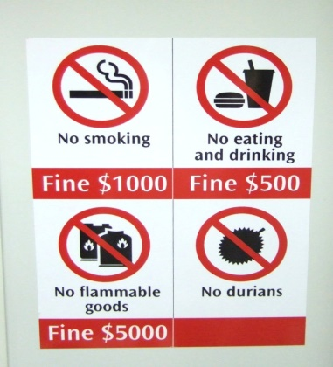
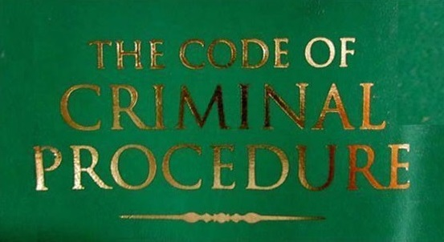
Common justice policy
Defining justice cooperation
cooperation between national judicial authorities (judges, public prosecutors, investigative judges, and such) involved in criminal proceedings with cross-border elements, such as requests for extradition, transfer of evidence and/or the execution of judicial decisions from another country (arrest warrant, search warrant, sentence)
(Supranational) establishment of common standards and rules (in EU context: harmonization or approximation of national ‘substantive criminal’ rules)
Justice cooperation is mainly facilitated by ‘criminal procedural law’:
A wide set of rules and procedures that govern all stages of a criminal proceeding, from criminal detection, investigation to prosecution.
At the international or inter-state level of judicial cooperation, ‘procedural’ instruments include:
- extradition;
- mutual assistance in transferring
evidence;
- transfer of sentences;
- transfer of sentenced persons; and
measures concerning proceeds of crime (i.e. freezing,
confiscation, seizure of acquisitions of crime)
Subject of common justice policy in the EU concerns mainly ‘substantive criminal law’:
a wide set of common definitions and standards of criminal conduct, as well as the definition of the level and nature of penalties

Slide 3
Competence issues
Before Lisbon, there were the following issues:
competence issues in the field of substantive criminal law
first-pillar competence to establish common rules on criminal conduct and sanctions: only since 2005
no first-pillar competence to establish common rules on criminal sanctions (2007)
competence issues in the field of procedural criminal law
reluctance to establish common rules on procedural law
introduction of mutual recognition principle (Tampere 1999) as an alternative solution (to approximation/harmonisation)

Slide 4
Issues on substantive criminal law
In 2005, ECJ ruled that adoption of criminal law measures in first pillar was a necessary element of Community legislation
Before Lisbon (2009):
exclusive third pillar competence
enforcement of community rules through criminal law would be more effective if there is criminal law competence in Community first pillar , however …….
… resistance by member states
In 2007, ECJ indicated that Community competence does not extend to deter-mination of penalties
Since Lisbon Treaty, the EU can (on the basis of ordinary legislative procedure):
• not only establish minimum rules on definition of criminal offences and sanctions in relation to cross-border crime (terrorism, organized crime, trafficking in human beings, drug trafficking, etc.) – see article 83(1) TFEU;
• but also enforce through criminal law in traditional fields of Community action (environmental protection, consumer protection, food safety, subsidies, agriculture etc.) – see article 83(2) TFEU

Slide 5
Examples of EU legislation on substantive rules
Framework Decision 2002/475/JHA on combating terrorism
Framework Decision 2004/757/JHA laying down minimum provisions on the constituent elements of criminal acts and penalties in the field of illicit drug trafficking
Directive 2008/99/EC on the protection of the environment through criminal law
Framework Decision 2008/913/JHA on combating certain forms and expressions of racism and xenophobia by means of criminal law
Directive 2009/52/EC on sanctions and measures against employers of illegallly staying third-country nationals
Directive 2014/57/EU on criminal sanctions for market abuse (market abuse directive)
Directive 2013/40/EU on attacks against information systems

Slide 6
Issues on procedural criminal law
Tampere (1999) mutual recognition of judicial decisions as the 'cornerstone' of judicial cooperation
national concerns about pressures from “Europeanisation” to change deeply entrenched procedures
difficulty of harmonisation due to highly different approaches and to ‘what is possible’ and ‘what is not possible’ under national procedural laws
Underlying idea: instead of harmonizing, EU’s role is ‘merely’ facilitating horizontal exchange of decisions taken by national authorities (judiciary & prosecution) by ‘fast-tracking’ it
Mutual recognition: ‘fast-tracking’ exchange of national legal decisions by:
Limiting grounds for refusing a legal decision from another member state (e.g. public policy or security reservations or exclusion fiscal, or political offences)
notably, limiting “double criminality” condition (which requires the act in question to be a crime in both the requesting and requested state) ;
facilitating common rules on processing applications, costs, languages, and use of standard forms
setting strict time limits to comply with (or refuse) another state’s decisions

Slide 7
2002
EAW
today
European Arrest Warrant (2002)
Framework Decision 2002/584/JHA
first mutual recognition instrument
EAW replaces traditional extradition procedure
Key features of EAW
extradition (‘surrender’) should take place even if the act is not a criminal offence in the requested state ('double criminality' rule)
member state is obliged to extradite a person charged with a 'political offence'
states cannot refuse extradition of own nationals
many other opt-outs, derogation and reservations are excluded
subject to time constraints: 60 days max (‘normal’ extradition takes on average 9 to 18 months)
EAW in practice: exponential increase of its use

Slide 8
Other instruments based on mutual recognition
Before introduction mutual recognition principle, based on treaties
Since introduction ‘mutual recognition’ procedures of judicial cooperation have been 'fast-tracked’ such as:
extradition (EAW);
freezing of evidence;
executing confiscation of proceeds of crime;
transfer of evidence (European Investigation Order – EIO- );
transfer of sentenced persons;
exchange of criminal records; and so on

Slide 9
Issues on procedural criminal law
Tampere (1999) mutual recognition of judicial decisions as the 'cornerstone' of judicial cooperation
national concerns about pressures from “Europeanisation” to change deeply entrenched procedures
difficulty of harmonisation due to highly different approaches and to ‘what is possible’ and ‘what is not possible’ under national procedural laws
Underlying idea: instead of harmonizing, EU’s role is ‘merely’ facilitating horizontal exchange of decisions taken by national authorities (judiciary & prosecution) by ‘fast-tracking’ it
Mutual recognition: ‘fast-tracking’ exchange of national legal decisions by:
Limiting grounds for refusing a legal decision from another member state (e.g. public policy or security reservations or exclusion fiscal, or political offences)
notably, limiting “double criminality” condition (which requires the act in question to be a crime in both the requesting and requested state) ;
facilitating common rules on processing applications, costs, languages, and use of standard forms
setting strict time limits to comply with (or refuse) another state’s decisions
Since Lisbon, there is now also (limited) competence for adopting harmonization measures in the field of criminal procedure (article 82(2) TFEU)
This competence is limited to three sorts of procedures: admissibility of evidence; rights of individuals in criminal procedure; rights of victims of crime

Slide 10
Institutional arrangements in judicial cooperation
1998
EJN
2002
Eurojust
2020
EPP
EPP: European Public Prosecutor
EJN: European Judicial Network
EPP vs. OLAF
Task and role of Eurojust
EPP’s role and function
EJN’s Role and function
Eurojust
Article 86 TFEU, as provided in Treaty of Lisbon, gives the Council the power to establish (by unanimity) a European Public Prosecutor
Currently, the idea is to extend its competence also to combating terrorism.
It operates as one single office with a decentralised structure organised at two levels.
Central Office composed of European Chief Prosecutor and College (with one European Prosecutor per participating Member State),
At decentralised level European Delegated Prosecutors located in Member States
created by Joint Action 98/428/JHA (1998); amen-ded by Council Decision 2008/976/JHA in 2008
a network composed of ‘Contact Points’ (a prosecutor or judge) designated in each member state
So far it is OLAF (anti-fraud agency of the Commission) that investigates fraud against EU budget, corruption and other serious misconduct against EU’s financial interests
created by Council Decision 2002/187/JHA (2002); amen-ded by Council Decision 2009/426/JHA in 2009
Eurojust is considered an interim step between a network of coordinated prosecution of crimes and a centralized European prosecutor carrying out prosecution
its activities are threefold:
to coordinate national investigations and prosecutions;
to improve cooperation between national authorities, in particular by facilitating multilateral judicial cooperation and mutual recognition; and
to support in other ways the effectiveness of national investigations and prosecutions
Its competence is limited to the field of defending (hence prosecuting) criminal conduct that is harmful to the financial interests of the EU
EPP is responsible for investigating, prosecuting and bringing to judgment the perpetrators of offences against the Union’s financial interests
Commission submitted proposal establishing an EPP in 2013
Council reached agreement in 2017
through direct bilateral contacts and information exchange (necessary for preparing EEWs, EAWs, EIOs, JITs, etc.)
advises which member state should exercise jurisdiction over cross-border offences
main role of ‘Contact Points’: to facilitate cross-border judicial cooperation in criminal matters
EPP became operational in 2020

Slide 11
Leading statement for in-class debate of tomorrow:
The EU should not have more CT (counter-terrorism) powers.

Slide 12
Leading statement for in-class debate of today:
The EU should have its own EU Criminal Code and EU Criminal Procedure Code.

Slide 13
END
Santino Lo Bianco PhD
Email: s.lobianco@hhs.nl

