Slide 1
Basics of Social Science Inquiry
GLCb1008 Basics in social research methodology

Slide 2
Aim of this lecture
Role of science and scientific research
Types of explanation
Qualitative and quantitative research
Research ethics
Where to look for sources?

Slide 3
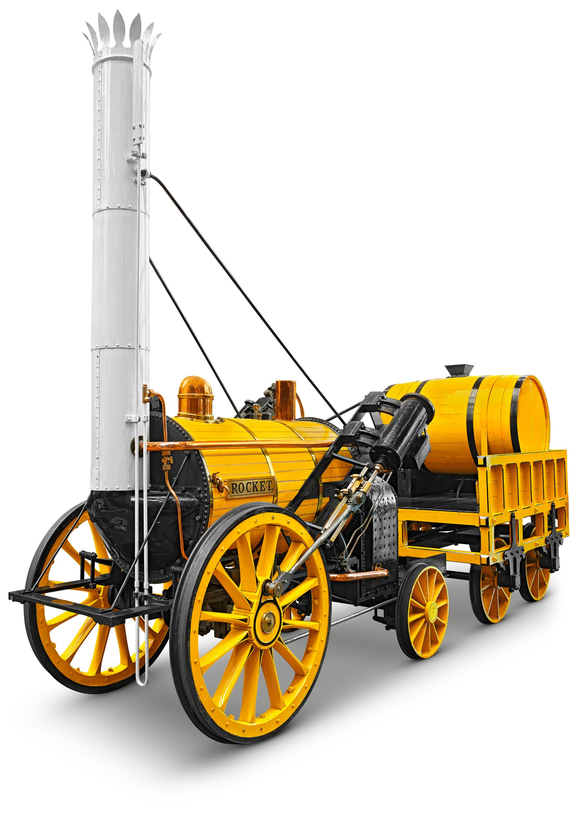
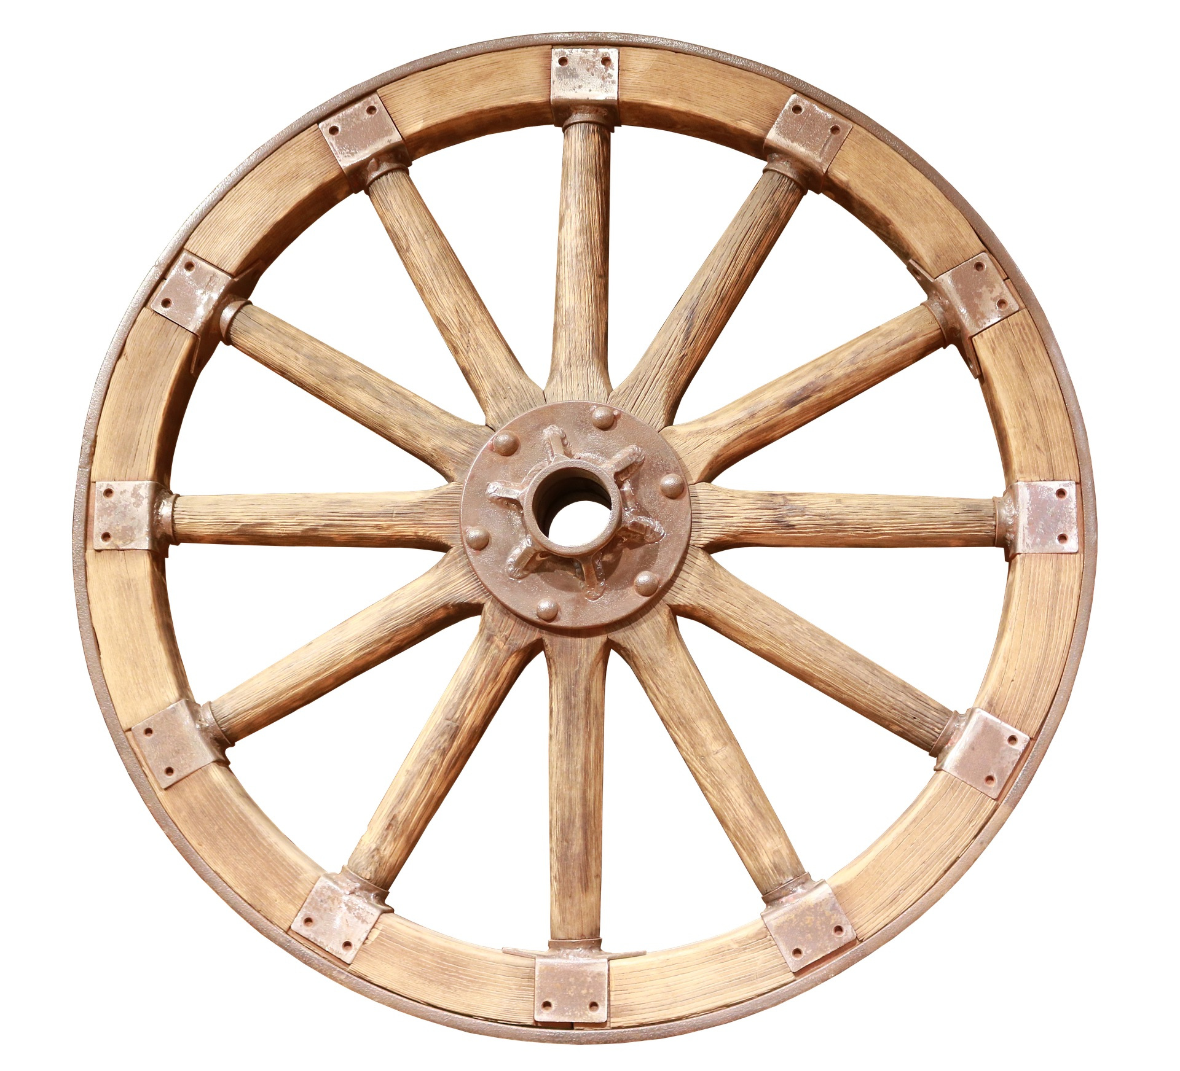
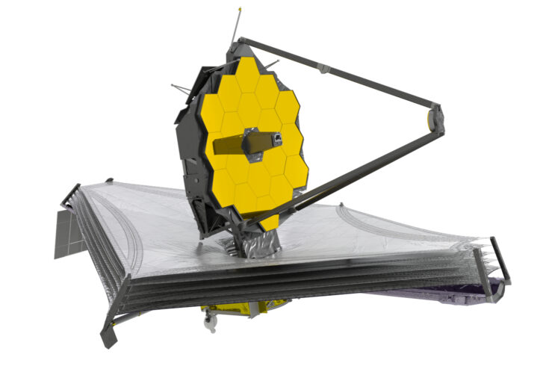
Imagine a World Without Science

Slide 4
What is Science?
There is no single definition
Even scientists differ in their views (not to mention all the other people)
A way of learning and understanding the world around us:
Conscious
Deliberate
Rigorous

Slide 5
Are Sharks Dangerous?
Most people think they are but how do they know?
Direct experience (observation)
How many people have met a shark in an ocean?
Other ways
Acquiring information for other sources
Traditions, authorities
A question of trust

Slide 6
The Way of Science
Very often scientists lack a direct experience too
Application of specific criteria (unlike traditions)
Two pillars of scientific assertion
Logical support – what we claim needs to make sense
Empirical support – what we claim cannot contradict the reality
Now what about the sharks?

Slide 7
What is Knowledge Good For?
We use knowledge (not only) to anticipate what comes next
Causal reasoning
Factors in the present affect some phenomenon in the future
A cause and a consequence
Probabilistic reasoning
Causal patterns are probabilistic
A cause does not always lead to the expected consequence

Slide 8
Studying Hard Increases Your Grade
We may expect that:
Reading the literature
Attending the lectures
Asking questions
Studying before the exam
will eventually improve your grade
Does it mean that everyone following this advice will obtain an A?

Slide 9
The Role of Science
Makes the concepts of causality and probability more explicit
Provides precise techniques to work with these concepts
Outperforms basic human inquiry
Adopting scientific approaches makes our predictions less inaccurate
Avoids making predictions without any understanding
Ever heard about the Dunning-Kruger Effect?

Slide 10
The Role of Science
Science also aims to eliminate common errors in human inquiry
Inaccurate Observations
Overgeneralization
Selective observation

Slide 11
The Basics of Social Science
Concerns the social reality
Generally lower trust of the public
Key features:
Theories
Data collection
Data analysis
→ tools to observe and understand our field

Slide 12
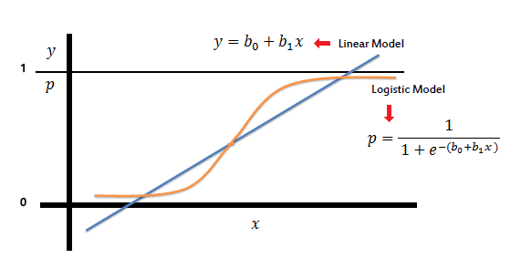
One but not the Same
Two different approaches with a similar goal
Quantitative research:
Large number of observations
Less amount of data per observation
Typical aim is to test theories
Associated issues – experiments, surveys, statistics

Slide 13
One but not the Same
Two different approaches with a similar goal
Qualitative research:
Small number of observations (even one)
A large amount of data per observation
Detailed knowledge of the analysed case
Typical aim is to generate theories
Associated issues – case studies, small-N studies, interviews, focus groups

Slide 14
Let’s Design a Research
Civic Participation of Poor People
Some issues we could investigate
Are poor people active citizens?
What are the ways poor people participate?
What are their motivations to (not) participate?
Many goals, many ways to follow

Slide 15
Quantitative Approach
Are poor people active citizens?
Questionnaire:
Representative sample of adult population of a country (N ≈ 1,000)
Questions on various ways of participation (demonstrations, boycotts, petitions, community service etc.)
Questions on further issues (not just the income)
In the end we may find that people with the lowest income are 4.7 times less likely to sign a petition compared to the wealthiest citizens

Slide 16
Qualitative Approach
What are their motivations to (not) participate?
Interviews
A non-representative sample of low income people (N ≈ 20)
Face-to-face interviews, 60-90 minutes each
Detailed questions to understand the motives and goals of participants concerning civic participation
In the end we may find that most of our respondents stopped any participation after they lost their jobs and had to focus on their individual needs rather than some communal goals

Slide 17
Quantitative or Qualitative?
Thompson (2004):
‘Only a few sociologists would openly deny the logic of combining the strengths of both quantitative and qualitative methods in social research. . . . In practice, however, [..] social researchers have regrettably become increasingly divided into two camps, many of whose members know little of each other even if they are not explicitly hostile.’
It is not a competition!
Both require a solid training in methods
Mutual dependence (see next lectures)
Mixed method research

Slide 18
Ethics in Research (basics)
A key issue in planning any research
How to approach participants of the research?
Milgram’s experiment
Stanford prison experiment

Slide 19
Ethics in Research (basics)
Main features:
Voluntary participation
No harm to the participants
Anonymity and confidentiality
Deception
Informed consent
What if ethical features collide with main goals of our research?

Slide 20
Information Sources
Primary sources
Interviews, focus groups, surveys, experiments
Secondary sources
Books, articles, conference papers
Open resources by public institutions
Large datasets with various availability
Do you know where to search?

