Slide 1
Theory and Social Research
PMCb1005 Basics in social research methodology

Slide 2
Aim of this lecture
Role of theory
Inductive and deductive research
Causality
Variables

Slide 3
What is NOT a theory
Theory is not just another opinion
Theory is not a belief
Theory is not a philosophy
Theory is not a preference

Slide 4
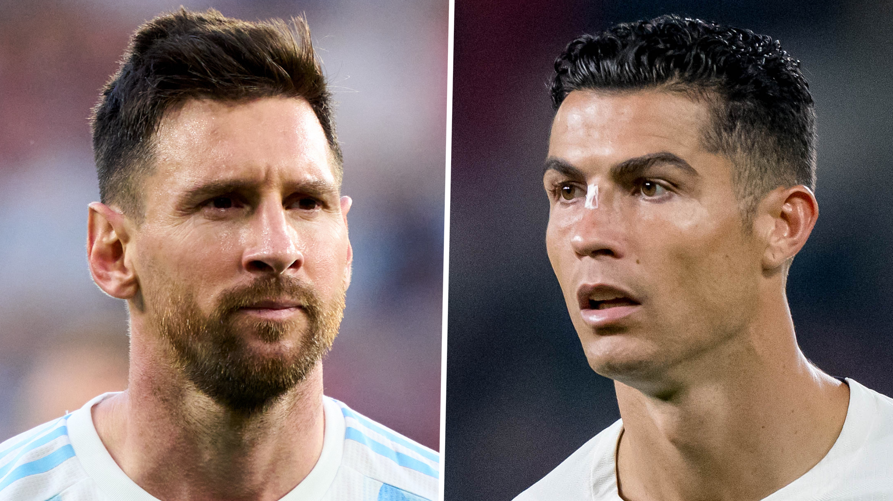


Theory
It states and presumes what is and not what should be
Theories cannot settle normative debates about values
Lionel Messi or Cristiano Ronaldo?
Star Wars or Star Trek?
Pizza without pineapple or pizza with pineapple?

Slide 5

Mirror, Mirror on the Wall, Who's the Fairest of Them All?
How would an ordinary (magic) mirror come to its answer?
What if the mirror was a scientist?

Slide 6
It is all about regularities
The aim of social research is to seek patterns in social world
Similar but not the same as natural sciences
Despite differences among individuals, social regularities exist

Slide 7
Objections to social regularities
The charge of triviality
  Is social science the Captain Obvious among sciences?
Exceptions
  Do not forget the probabilistic logic we have to use
People can interfere
  Our observations do not aim to anger the social scientists
  Some warnings however remain – the Enron case and business talk

Slide 8


Slide 9


Slide 10
Individuals or aggregates?
Difference between what we observe and what we study
Ambition to find social regularities
Ambition is not to understand every human being’s behaviour
This brings us back to theories

Slide 11
Theory
A systematic explanation for the observations that relate to a particular aspect of life (Babbie)
A theory about a substantive issue or phenomenon; its function is to describe and explain (Punch)
General statement that describes and explains causes and effects of phenomena (Van Evera)

Slide 12
Elements of theory
Laws
Variables
Explanation
Hypotheses

Slide 13
Theory
‘Nothing more than a set of connected
causal laws or hypotheses’
Van Evera 2000, p. 12

Slide 14
Variables
Basic elements we use in science
Sets of attributes
Their values are likely to vary (vs constants)
Unlimited number of examples
  Age, partisan affiliation, unemployment rate, eye colour, e-mail address, Olympic medals, temperature, speed

Slide 15
Variables
Important to distinguish
Independent variable
  The expected cause within a causal relationship we analyse
  Also called explanatory (they explain an outcome)
Dependent variable
  The expected consequence within a causal relationship we analyse
  Also called response/outcome variable

Slide 16
Variables
Identify the independent (IV) and dependent (DV) variables
There's no smoke without fire
Higher unemployment reduces political trust towards elites
Attending lectures leads to better score in the final exam

Slide 17
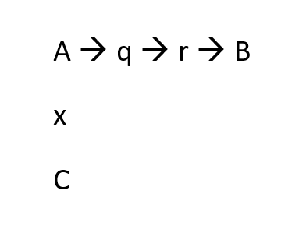
Variables
Other types of variables
Intervening variable
  Placed between IV and DV
  Eating a lot of sugar → toothache → more intense mouth hygiene
Condition variable
  Affects the size of effect the IV has on DV
  Rising unemployment (IV) decreases trust towards elites (DV) but only if the state does not offer substantial social benefits to the unemployed

Slide 18



Slide 19
Causality
The relationships of variables based on logic of causes and consequences
Criteria:
  Association
  Time order
  No spuriousness
Causal effect – how a change in IV affects the value of DV
Causal mechanism – explanation of the causal effect

Slide 20



Causality

Slide 21
What is a good theory?
Large explanatory power
  Large effect of IV on DV
  Less restrictions concerning conditions of the causal effect
Parsimonious theory
  Uses small number of variables to explain the effect
Friends or enemies?

Slide 22


What is a good theory?
Satisfying and clearly framed
  Satisfies peoples’ curiosity
  Does not point to a familiar cause
  We lost the match because we scored less points
  I won the Nobel prize because the Nobel Committee decided so
  Describes the effect in a clear and transparent way
  Campaigns affect voting behaviour
  Waking up early prolongs life

Slide 23
What is a good theory?
Falsifiable
  There are (potential) data to test the theory
  No ability to test → no scientific theory
Explains important issues
  So what?
Has prescriptive richness
  Allows to presume consequent development
  Especially accounts for IVs we can control and manipulate
  Eating too much sugar damages your teeth
  More math classes in schools increase financial abilities of the society
  Heavy rainfalls decrease turnout in elections

Slide 24
Working with theories
Generating theories
  Outliers – what do usual causes not work here?
  Extreme cases – why is the effect so small/large here?
  Unknown causes
  Counterfactual analysis (https://www.youtube.com/watch?v=0lpY0Kt4bn8)
Testing theories
  Experiments
  Observation

Slide 25
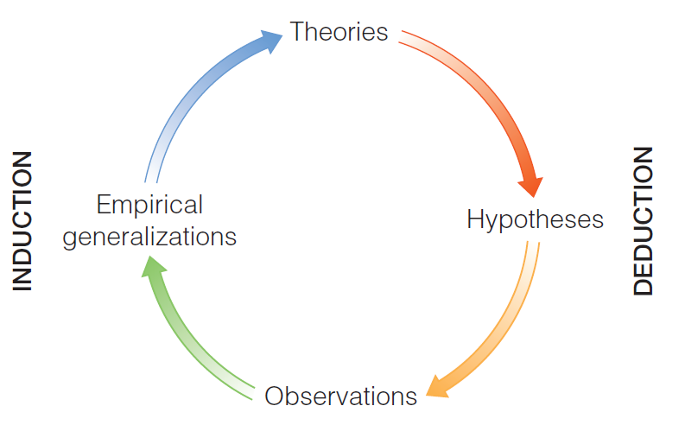
Inductive and deductive research
(Babbie 2016 / Wallace 1971)

Slide 26
Inductive research
From particular to general
A search for patterns and regularities
Starts with questions, ends with theories
Typically associated with:
  Generating theories
  Qualitative research
  It is not a rule!

Slide 27
Deductive research
From the general to the specific
Starts with a theoretically built pattern (theory)
Sets specific hypotheses
Uses data to test whether the hypotheses (theory) fit the reality
Typically associated with:
  Testing theories
  Quantitative research
  It is not a rule!

Slide 28
Inductive approach | Deductive Approach
Questions, observation, data collection | Theories → hypotheses
Search for regularities and patterns | Testing hypotheses
Generalization, new theories | Confirmation/rejection of theories

