Slide 1
Survey – theoretical outline
GLCb1008 Introduction to Methodology of Social Sciences
Jiří Navrátil
jiri.navratil@fss.muni.cz

Slide 2
Lecture outline
Context of survey design
Sampling
Data collection
Asking questions

Slide 3
Explanation vs. understanding
Idiographic (deterministic): understanding, revealing motives, reasons, justifications…
Idiographic method – problem with zero
Nomothetic methods (probabilistic): explanation, identifying causal relationships

Slide 4
Two logics of research process
(de Vaus 1996: 21)

Slide 5
Main types of research strategies
Experiment (small N)
Case study (small N)
Comparative design (small N)
Longitudinal design (small/large N)
Cross-sectional design (large N)

Slide 6

Social survey
Probabilistic/nomothetic logic
Deductive logic
Cross-sectional design (large N)

Slide 7
Cross-sectional studies
More than 1 case (in fact large N) in one time frame
Collection of quantifiable data on the characteristics („variables“) of these cases
Logic of correlation between and among varibles
Typically – social survey/questionnaire (but other data collection methods available too)
Variables are not manipulated

Slide 8
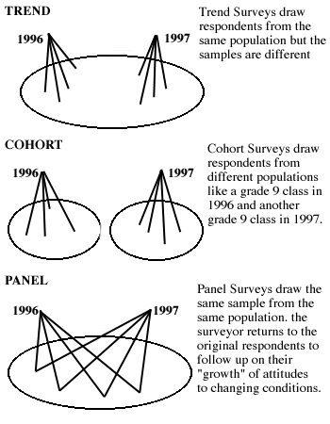
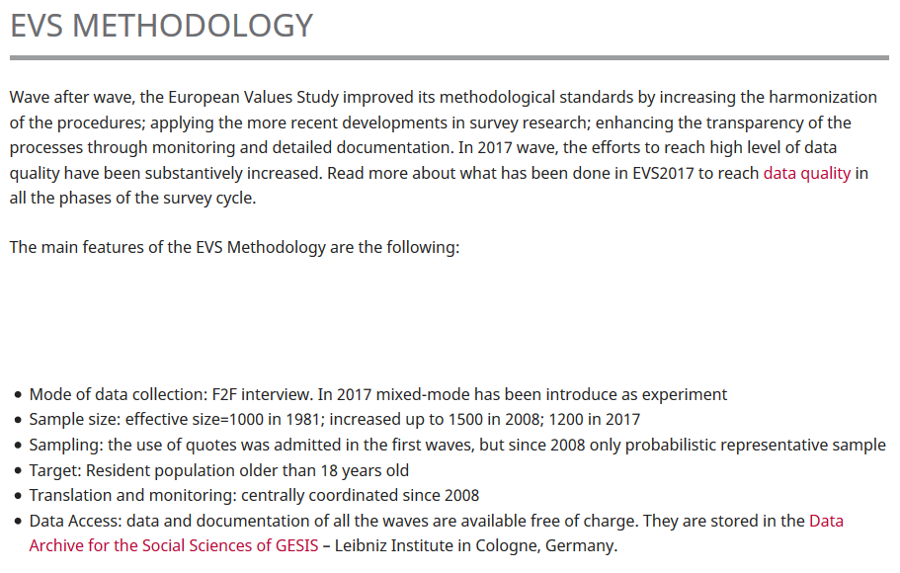
Time frame for cross-sectional studies

Slide 9

Sampling
Population – all units (individuals, nations, organizations, cities …) from which we select sample and to which we refer with the results
Can we handle whole population? ( census …)
Sample – part of units selected for analysis
Probability sampling (logic of chance) vs. Non-probability (purpose)

Slide 10

Random sample
Standard type of sampling in large N
Representativity – known and unknown characteristics of population
Option of statistical inference from the sample to the population
Types of random sample: simple, systematic, stratified, multi-stage

Slide 11
Simple random sample

Slide 12
Systematic random sample

Slide 13
Multi-stage cluster sample

Slide 14
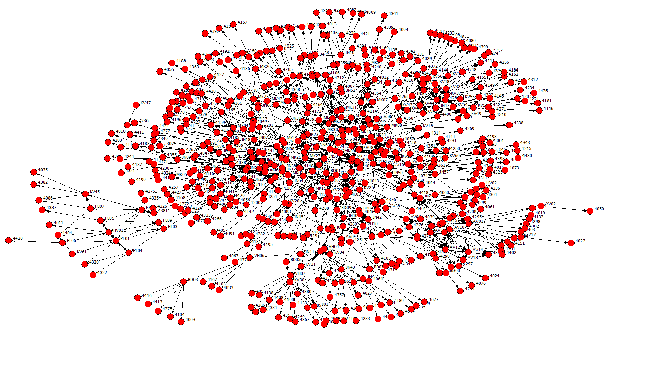
Non-probability sampling
convenience sampling – who do you succeed to get in the sample (street distribution, relatives, friends, social media)
purposive sampling – focusing at target group within population (study of student environmental activists – looking for the most visible ones at the faculty)
snowball sampling – members of population are hard to reach (subcultural or social movement studies)

Slide 15
Non-probability sampling
Quota sampling – when we know the characteristics of target population (typically: sex, education, ethnicity, age)
Example: Czech adult population (attitudes towards the conflict in Ukraine)
bydliště | kvóta
Hlavní město Praha | 122
Středočeský kraj | 129
Jihočeský kraj | 61
Plzeňský kraj | 55
Karlovarský kraj | 27
Ústecký kraj | 76
Liberecký kraj | 42
Královéhradecký kraj | 52
Pardubický kraj | 49
Kraj Vysočina | 48
Jihomoravský kraj | 112
Olomoucký kraj | 59
Zlínský kraj | 55
Moravskoslezský kraj | 113
pohlaví | kvóta
muž | 490
žena | 510
věk | kvóta
18 - 24 | 80
25 - 34 | 150
35 - 44 | 190
45 - 54 | 180
55 - 64 | 190
65 + | 210
vzdělání | kvóta
ZŠ | 136
SŠ bez maturity | 326
SŠ s maturitou | 351
VŠ | 187

Slide 16
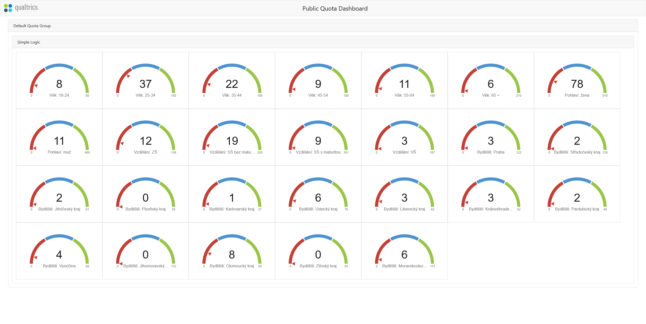
Example of quota sampling

Slide 17
Sample size
Absolute, not relative size of sample is important
Increasing sample size – decreasing possibility of sampling error (random sampling)
https://www.surveymonkey.com/mp/sample-size-calculator/

Slide 18
Types of data collection

Slide 19
Data collection
Online tools
https://www.kobotoolbox.org/
https://www.surveymonkey.com/

Slide 20
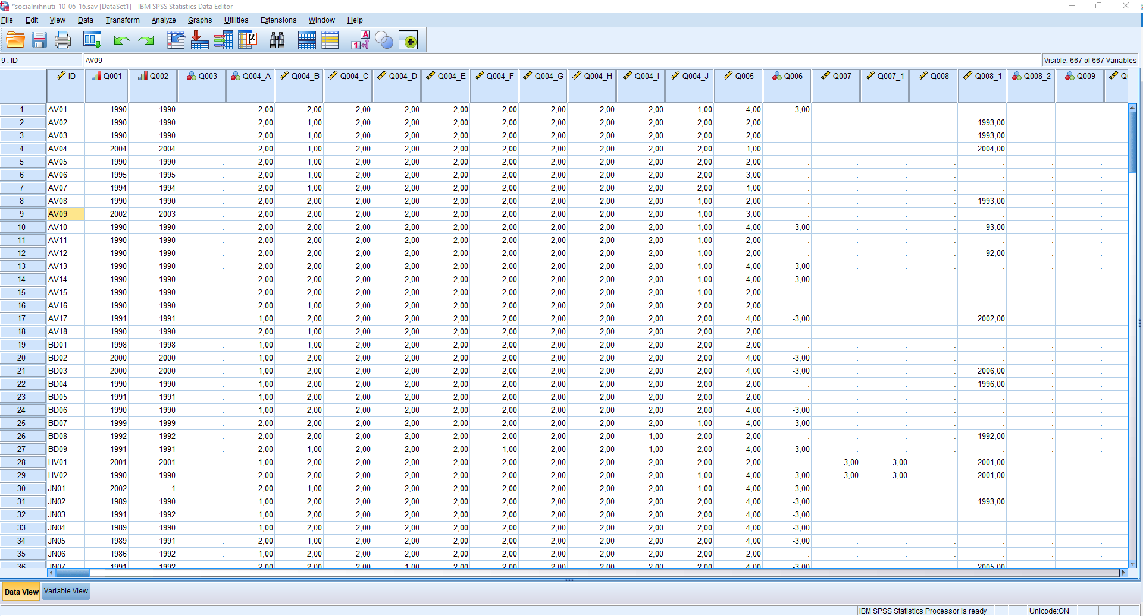
Data matrix (column = variable; row = case)

Slide 21
Modes of survey administration compared

Slide 22
Types of questions
Open-ended vs. Closed questions (time, validity, reliability, comparability, clarification, easiness, spontaneity, exhaustiveness)
Personal factual, others factual, informant factual, attitudes, beliefs, normative values, knowledge

Slide 23
How to design the questions
Follow research question!
Be specific! (What is your opinion about contemporary party politics?)
Avoid ambiguous questions! (How often do you eat fast food?)
Avoid long questions! (On a scale of 1-10, how likely are you to recommend political party you voted for in last elections to a friend or colleague who works in a similar industry as you do?)
Avoid double-barrelled questions! (Do you think that students should have more classes about history and culture?)
Avoid leading questions! (Do you think that our country is a true democracy?)
Think about filters and conditions! (What movie did you see in a cinema last month?)
Avoid using jargon and technical terms! (What is your opinion of the efficacy of the Twitter´s new search algorithm?)
Think about the respondent´s capacities, memory and knowledge! (When did you drink alcohol for the first time?)
Always do the piloting!
Use existing questions!

Slide 24
References
Bryman, Alan. 2012. Social Research Methods. Oxford: Oxford University Press.
Blaikie, Norman. 2000. Designing social research: the logic of anticipation. Cambridge: Polity Press.
Biemer, Paul P., Robert M. Groves, Lars E. Lyberg, Nancy A. Mathiowetz and Seymour Sudman (eds.). 1991. Measurement Errors in Surveys. New York: John Wiley & Sons.
De Vaus, David A. 1996. Surveys in Social Research. London: University College London Press Limited.
Dillman, Don A. 2007. Mail and Internet Surveys. The Tailored Design Method. New York: John Wiley & Sons.
Fowler, Floyd J. 1995. Improving Survey Questions: Design and Evaluation. Thousand Oaks: Sage Publications.
Groves, Robert M., Floyd J. Fowler, Mick P. Couper, James M. Lepkowski, Eleanor Singer and Roger Tourangeau. 2004. Survey Methodology. New York: John Wiley & Sons.

