Slide 1
Small-N design – theoretical outline
GLCb1008 Introduction to Methodology of Social Sciences
Jiří Navrátil
jiri.navratil@fss.muni.cz

Slide 2
Lecture outline
Context of small-N designs
Case study
Comparative method
Process tracing

Slide 3
Main types of research strategies
Experiment (small N)
Case study (small N)
Comparative design (small N)
Longitudinal design (small/large N)
Cross-sectional design (large N)

Slide 4
Main aspects of research strategies

Slide 5
Main aspects of research strategies

Slide 6
Main aspects of research strategies

Slide 7
Main aspects of research strategies

Slide 8
Case study
Research on a contemporary phenomenon in a real-world context; the phenomenon is often not clearly delineated
many variables are examined, and different data sources are used, often preceded by theoretical consideration of what and how to analyze
Case: a more/less closed system in time and (social) space (individual, organization, institution, event, community ...)

Slide 9
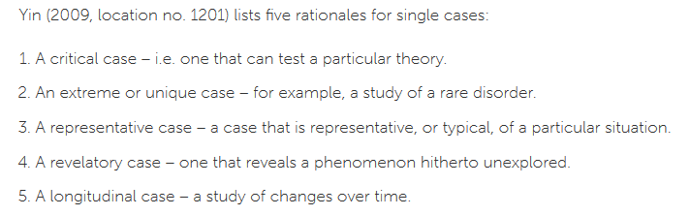
Case study: sampling criteria
Sampling strategies
Maximum variation
Homogeneous
Critical case
Theory based
Confirming and disconfirming cases
Snowball or chain
Extreme or deviant case
Typical case
Politically important case
Random purposeful
Stratified purposeful
Criterion
Opportunistic
Combination or mixed
Convenience
Miles and Huberman (1994: 28)
  unique case study (detailed analysis of the case) – e.g. homelesness in Brno
  instrumental case study (more general knowledge) – e.g. homelesness in the Czech Republic
  collective case study (multiple cases representing a phenomenon, population or circumstance - sometimes an attempt to generate theory) – e.g. homelessness in big post-socialist cities

Slide 10
Case sampling and generalization (Rohlfing 2012)
Generalizations must always take into account the relationship between the case and the population

Slide 11
Relationship to theory (Blaikie)
Types of case studies:
- configurative-idiographic - understanding
- disciplined-comparative – theory application
- heuristic – theory seeking
- plausibility probes – theory development
- crucial-case – theory testing

Slide 12
Comparative method
Functional equivalent of the experiment
Study of contrasting cases using identical methods
Method of controlling for the effect of variables in research with a small number of cases (by selecting cases we transform variables into constants, thus controlling for the effect of alternative variables)
It is a cross-sectional design for small N
e.g. Durkheim analysis of suicide: official statistics (large N) across countries (small N)

Slide 13
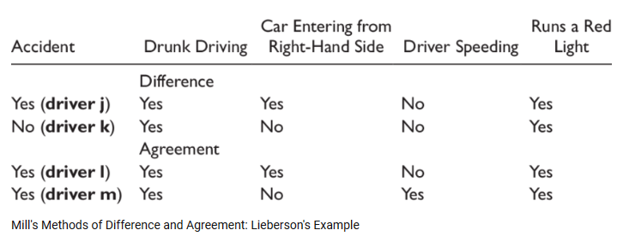
Mill's method of difference and agreement
Effect
Potential causes

Slide 14
Case-oriented strategy in comparative settings (Ragin)
Combination of causal analysis, interpretative analysis and concept formation
Designed to uncover patterns of invariance and constant association, using cross-tabulation of cause(s) and effect and accounting for deviant cases; no probabilistic relationships!
If only one case deviates – explanation is doubted
Cases are considered as whole entities, not as collection as variables (e.g. Weber´s analysis of protestant ethics)
Stimulation of dialogue between ideas and evidence

Slide 15
Process tracing
Beyond correlations between independent variables (Xs) and outcomes (Ys)
Aiming to unpack the causal relationship between them and trace causal mechanisms
A causal mechanism -“a complex system, which produces an outcome by the interaction of a number of parts“
Single case research design
E.g. analysis of how particular social protest emerges

Slide 16
How?
within- case inferences about the presence/absence of causal mechanisms vs. cross- case inferences about causal relationships
Vs. congruence method: based on the value of the independent variable (X), researchers test whether the prediction about the outcome that should follow from the theory is congruent with what is found in the case, investigated either temporally or other across aspects of the outcome(s) (e.g. higher crime rate in economically deprived localities)
Congruence investigates correlations between X and Y, whereas process-tracing investigates the workings of the mechanism(s) that contribute to producing an outcome (e.g. how exactly is economic deprivation linked to crime?)
Process- tracing case studies are usually presented as a stepwise test of each part of a causal mechanism, especially in the theory- testing variant (e.g. economic downturn, perception of this downturn, conflict between social norms and achievable goals, social ties, social norms reassessment, illegal activity)

Slide 17
Variants of proces tracing
theory- testing: deduces a theory from the existing literature and then tests whether evidence shows that each part of a hypothesized causal mechanism is present in a given case (theory-centric)
theory- building- inferring that a more general causal mechanism exists from the facts of a particular case (theory-centric)
explaining- outcome – come out with a minimally sufficient explanation of a puzzling outcome in a specific historical case (case-centric)

Slide 18
Theory-testing
causal mechanism is hypothesized to be present in a population of cases of a phenomenon, the researcher selects a single case where both X and Y are present, and the context allows the mechanism to operate, the goal is to evaluate whether evidence shows that the hypothesized causal mechanism linking X and Y was present and that it functioned as theorized
"democratic peace theory“ - democracies are hesitant to engage in armed conflict with other identified democracies:
democracies are in general more peaceful in their international relations);
democracies do not go to war with other democracies
more democratic states in the international system makes the international system more peaceful

Slide 19
Theory-building
building a theory about a causal mechanism between X and Y that can be generalized to a population of a given phenomenon, starting from a situation where we are in the dark regarding the mechanism

Slide 20
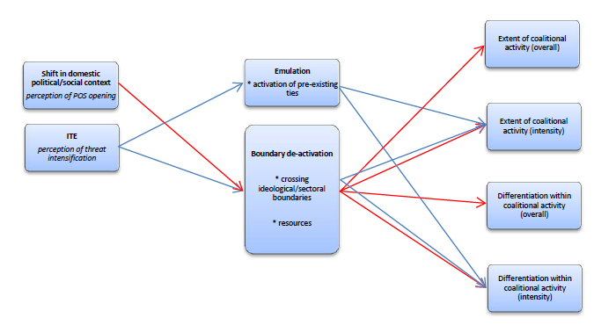
Explaining outcome
the aim is to craft a sufficient explanation of the outcome, instead of studying mechanisms that cause war (Y), the analysis would focus on explaining a particular outcome such as war in Ukraine

Slide 21
Overview

Slide 22
References
Bryman, Alan. 2012. Social Research Methods. Oxford: Oxford University Press.
Blaikie, Norman. 2000. Designing social research: the logic of anticipation. Cambridge: Polity Press.
Biemer, Paul P., Robert M. Groves, Lars E. Lyberg, Nancy A. Mathiowetz and Seymour Sudman (eds.). 1991. Measurement Errors in Surveys. New York: John Wiley & Sons.
De Vaus, David A. 1996. Surveys in Social Research. London: University College London Press Limited.
Dillman, Don A. 2007. Mail and Internet Surveys. The Tailored Design Method. New York: John Wiley & Sons.
Fowler, Floyd J. 1995. Improving Survey Questions: Design and Evaluation. Thousand Oaks: Sage Publications.
Groves, Robert M., Floyd J. Fowler, Mick P. Couper, James M. Lepkowski, Eleanor Singer and Roger Tourangeau. 2004. Survey Methodology. New York: John Wiley & Sons.

