Slide 1
Qualitative research – theoretical outline
GLCb1008 Introduction to Methodology of Social Sciences
Jiří Navrátil
jiri.navratil@fss.muni.cz

Slide 2
Testing vs. understanding
Quantitative
deductive logic
the goal is to test a hypothesis
limited scope of isolated information about many units/individuals (reduction of reality to variables)
allows generalization of conclusions to a wider population
Qualitative
Inductive/abductive logic
the goal is theory formulation (hypothesis/concept generation)
lots of information about a small number of units/individuals (case reduction)
attempt to capture reality in its complexity
generalization to population is impossible - it is about understanding

Slide 3
What is characteristic of qualitative research?
The focus of research attention is the human being, people (it can also be locations, formations where people live and work)
The problem we set out is never completely bounded, we are always clarifying it in our research
We study the phenomenon that is the subject of our research interest in its natural context

Slide 4
What is characteristic of qualitative research
Research starts with fewer cases (individuals, NGOs, …)
Interactive and developmental aspect of the research (important for describing the research process and interpreting the data) (something new/unexpected is happening?)
Openness to new, unusual, atypical situations and possibilities
Consistent description of our research process (what, why and how I did it) - field notes
Typical research methods: etnography/participant observation, qualitative interviewing, focus groups, language analysis, text analysis

Slide 5
Main steps of qualitative research

Slide 6
Main focus of qualitative research
Seeing through the eyes of actors under study (social constructivism, face-face interaction, participation in the mind of other people)
Capturing context (thick description)
Emphasizing process
Flexibility and limited structure
Concepts + theory grounded in data

Slide 7
Reliability and validity in qualitative research
External reliability (replication) - weak
Internal reliability (inter-researcher) - weak
Internal validity (observation-ideas) – strong
External validity (generalization across settings) – weak
But:
Alternative criteria for evaluating qualitative research (trustworthiness - + authenticity)

Slide 8
Sampling
Case study „style“ (extreme/deviant case, typical case, … etc.)
Sampling both context and particiants
Often purposive sampling (theoretical sampling, generic purposive sampling, snowball)
Theoretical sampling – theoretical saturation (no new data emerging in relation to category + category is well developped + relationships among categories are well established)

Slide 9
Basic types of qualitative research
Case study (?)
Ethnographic approach
Grounded theory
Phenomenological research

Slide 10

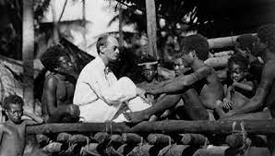
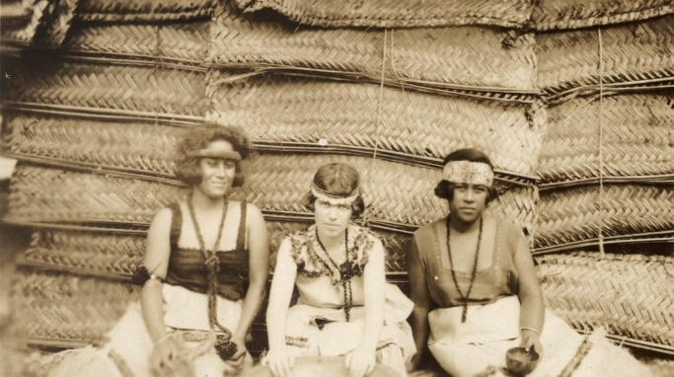
Ethnographic Research
  It is similar in nature to the case study, but with more emphasis on everyday experience.
  It also differs from the case study:
  - Longer stay in the "field", more identification with the environment under study
  More flexible strategies
  Ethnographic writing
  Example: William F. Whyte: "Street Corner Society" (1955) - Study of groups, gangs of young Italian immigrant youth in Boston

Slide 11
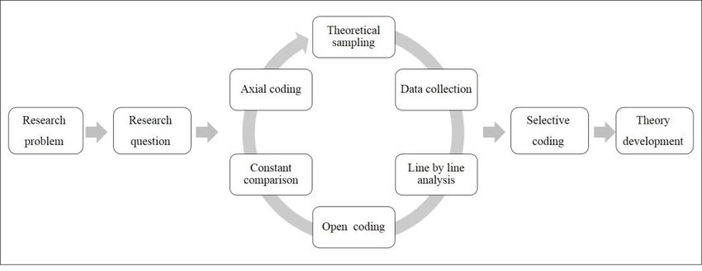
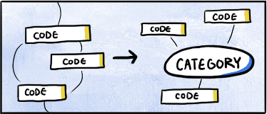
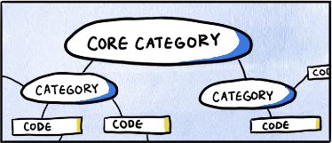

Grounded theory
It is not really a theory but a research strategy (Glaser and Strauss 1967).
↓
Absence of predefined hypotheses
Begins with exploration, tends towards the generation of new theories (i.e., exploration)
Theory grounded in data - search for structure that emerges in the data
Analysis uses software to sort, link and code different parts of the text/recording
Example: study of remarriage, study of tax avoidance

Slide 12


Phenomenological research
  Phenomenology - deals with the study of the experiential individual, uncovering the "commonplaces" and habitual ways of perceiving in our lives
  Seeking to understand an individual with a particular experience whose meaning we want to explore (membership of a political party, relationship to religion, stay in hospital/prison)
  Aiming to understand the subjectivity of existence, gaining insight into human motivations and actions, seeing through conventional knowledge and prevailing assumptions
  Seeking to enter the inner world of the other person in order to understand the meanings they ascribe to the phenomenon under investigation
  The essence of the research is to capture the essence of the lived experience through the description and interpretation of the lived experiences that the respondent describes to us
  It is usually conducted using unstructured interviews
  Example: Berger, Luckmann: The social construction of reality; Berger - the interconnectedness of the social construction of the world and religion (internalization and legitimization of the world order that gives meaning to human action)

Slide 13
References
Bryman, Alan. 2012. Social Research Methods. Oxford: Oxford University Press.
Blaikie, Norman. 2000. Designing social research: the logic of anticipation. Cambridge: Polity Press.
Biemer, Paul P., Robert M. Groves, Lars E. Lyberg, Nancy A. Mathiowetz and Seymour Sudman (eds.). 1991. Measurement Errors in Surveys. New York: John Wiley & Sons.
De Vaus, David A. 1996. Surveys in Social Research. London: University College London Press Limited.
Dillman, Don A. 2007. Mail and Internet Surveys. The Tailored Design Method. New York: John Wiley & Sons.
Fowler, Floyd J. 1995. Improving Survey Questions: Design and Evaluation. Thousand Oaks: Sage Publications.
Groves, Robert M., Floyd J. Fowler, Mick P. Couper, James M. Lepkowski, Eleanor Singer and Roger Tourangeau. 2004. Survey Methodology. New York: John Wiley & Sons.

