Slide 1
Introduction
Lucie Konečná
GLCb2026 Africas Contemporary Security Challenges
22/2/2023

Slide 2
Assessment
Form of assessment | Max. Points
Presentation | 20
Final exam | 40
Each student will prepare a presentation. The topic is chosen by the students themselves, but they should do a detailed case study of one African country (their choice) in which they will focus on one specific security problem such as terrorism, internal conflict, influx of refugees, piracy, etc. The presentation itself should take approximately 20 minutes and will take place in the last three classes of the course. Assignment of students to dates will be made at the end of March and the schedule will be uploaded to the information system. The presentation will be graded 0-20 points.
The final exam will be in the form of a written test, which will absorb the assigned literature and lecture materials. A total of 40 points can be obtained from the final exam.
Assessment and marking:
A 60 – 56 points
B 55 – 51 points
C 50 – 46 points
D 45 – 41 points
E 40 – 36 points
F 35 and below

Slide 3
Teaching Schedule
Lecture 1 (22nd of February): Introduction to the course
Lecture 2 (1st of March): Conflicts in Africa
Lecture 3 (8th of March): Terrorism in Africa
Lecture 4 (15th of March): Organised Crime
Lecture 5 (22nd of March): Migration, Influx of Refugees, HIV/AIDS and Female Security
Lecture 6 (29th of March): Weakening and Failing of the State
Lecture 7 (5th of April): Urbanization and Land Issues
Lecture 8 (12th of April): Food and Water Security
Lecture 9 (19th of April): Piracy
Lecture 10 (26th of April): Students' Presentations.
Lecture 11(3rd of May): Students' Presentations.
Lecture 12 (10th of May): Students' Presentations.

Slide 4
Compulsory Readings
Schneckener, Ulrich. Spoilers or Governance Actors? Engaging Armed Non-State Groups in Areas of Limited Statehood. p. 3-26. (2009).
Williams, Phil. Violent Non-State Actors and National and International Security. (2008): https://www.files.ethz.ch/isn/93880/vnsas.pdf
Rotberg, Robert. Failed States, Collapsed States, Weak States: Causes and Indicators (2006) https://www.brookings.edu/wpcontent/uploads/2016/07/statefailureandstateweaknessinatimeofterror_chapter.pdf
Swain, Ashok. Understanding Emerging Security Challenges Threats and Opportunities. Routledge. 2013.
Emerson, Stephen and Hussein, Solomon. African security in the twenty-first century Challenges and opportunities. Manchester University Press. 2018.

Slide 5
General Info About Africa – Population (2020)

Slide 6
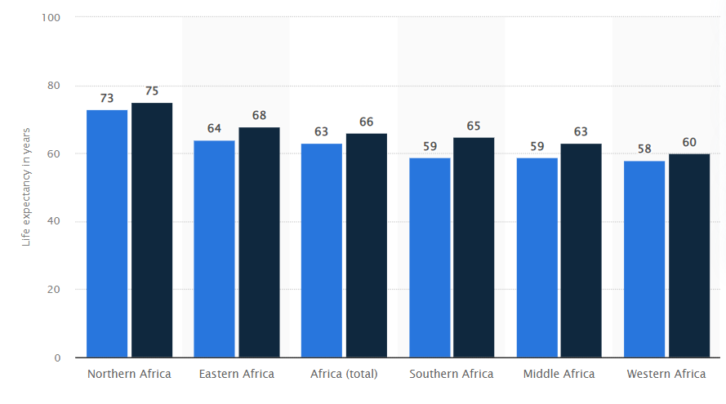
General Info About Africa - Population

Slide 7
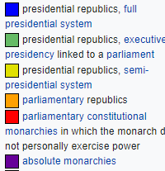
General Info about Africa – Form of Government

Slide 8
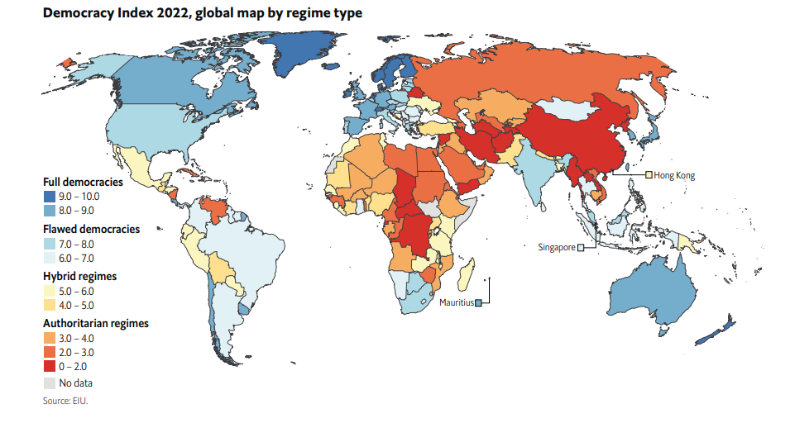
General Info about Africa – Level of Democracy

Slide 9
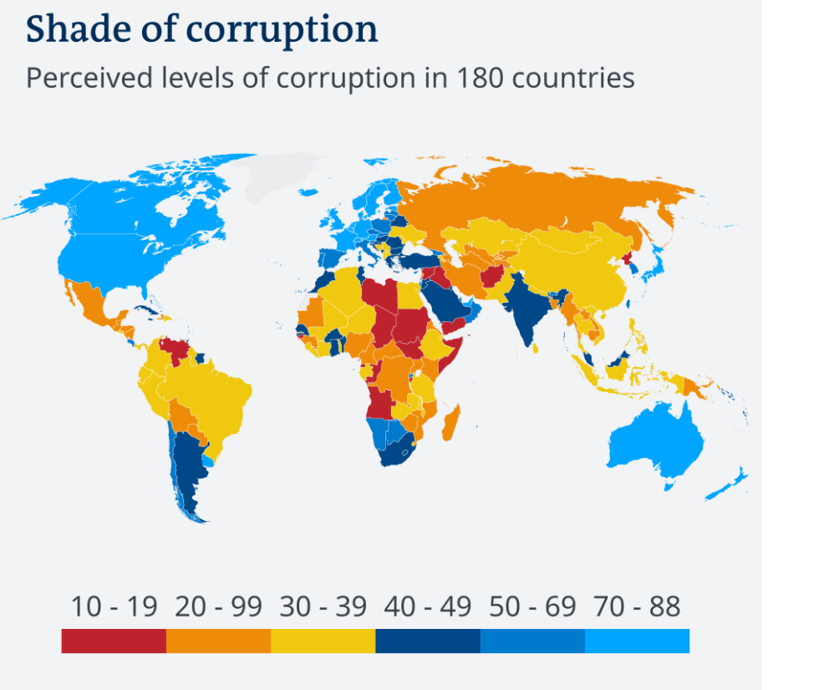
General Info about Africa – Corruption

Slide 10
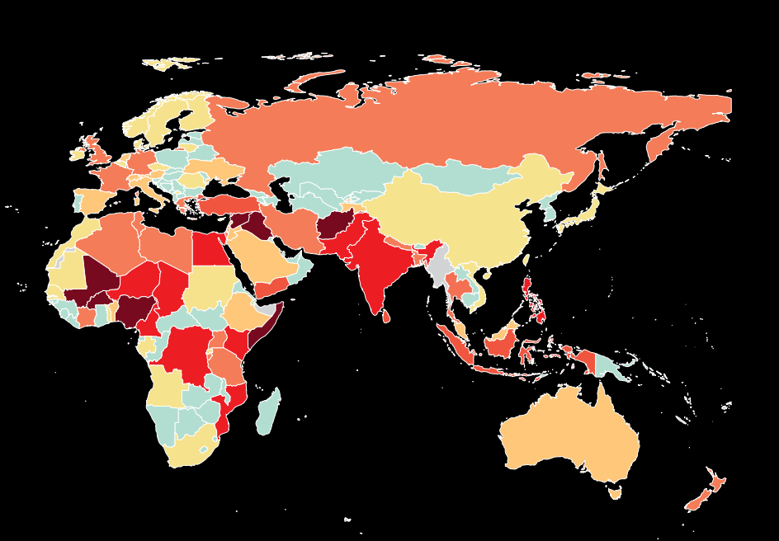
General Info about Africa - Terrorism

Slide 11
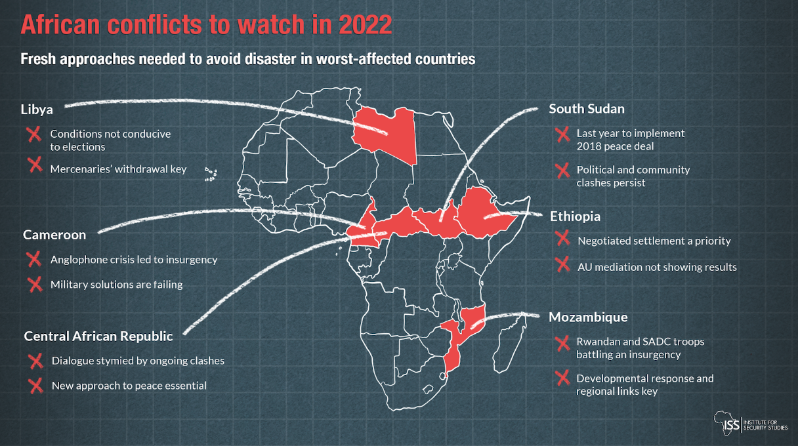
General Info about Africa - Conflicts

Slide 12
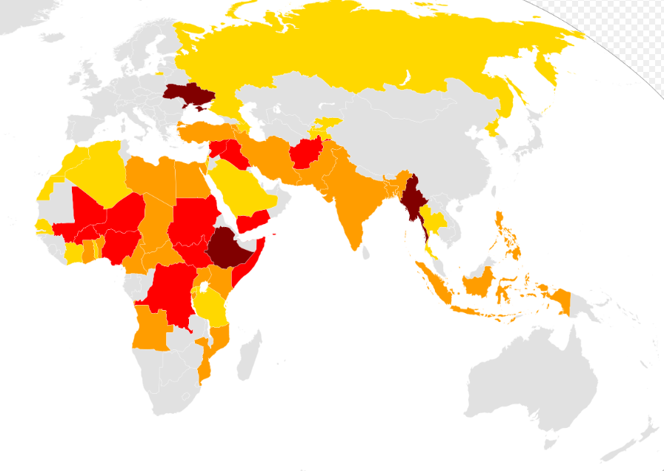
General Info about Africa - Conflicts

Slide 13
Short Quiz
1. Which African country currently has the highest incidence of HIV in the population (26% of the total population)?
2. According to the FSI, which African country has the worst performance and is often labeled a failed state?
3. Which two terrorist groups committed the most terrorist attacks in Africa in 2022?
4. Which African country hosted the largest number of refugees in 2022?
5. Which African country recorded the highest number of piracy attacks in 2022?
6. Do you know which African city is the most populous?
7. There are two states in which more than 90% of the urban population lives in slums. Do you know which states those are?
8. Which countries are currently in dispute over the Grand Ethiopian Renaissance Dam?

Slide 14
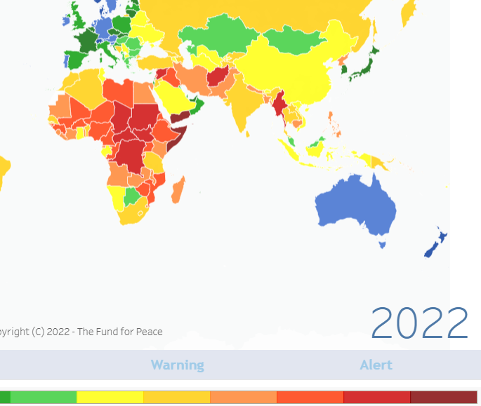
General Info Africa - HIV

Slide 15
Thank you for your attention

