Slide 1
Mediation fundamentals II
IREn5020 Mediation training for IR
dr. Martin Chovančík

Slide 2
Content
Dynamics of negotiation
Effective mediation requires understanding perception and escalation
Which facets to reinforce, which to dissuade and which to attempt dissipation
Goal setting
Experiential dynamics
1 exercise with debrief

Slide 3
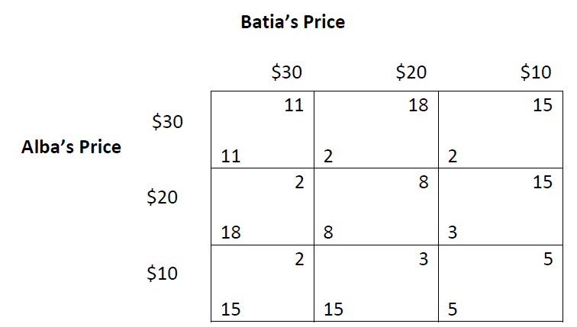
Oil pricing exercise
Alba (A - team) and Batia (B - team)
Competition, no collaboration, MAXIMISE
End-of turn bids
15 minutes for instructions and initial conference
4 minutes per round
Failure to bid reverts to previous bid
Only enter your final bid

Slide 4
Results of exercise
Round | Alba | Batia
1
2
3
4
5
6
7
8
Total profit
Are you satisfied with the results?
Do you feel you maximized adequately?
Could your group have been more efficient in making decisions?

Slide 5
Debrief
each group
next 5-10 minutes discuss the process you have been using for decision-making
develop two or three specific rules you are prepared to recommend and defend as facilitating wise and efficient group decision-making
choose reporter
deliver the “guide”

Slide 6
Debrief – goal setting
What was your initial goal?
What strategy did you adopt to achieve it?
Did the strategy change? When and why? Impact of further rounds?
What message do you believe you were sending the other team with a bid of 20?
Someone from the other team – is this the message you perceived?
Which rounds were the most “impactful”?

Slide 7
Debrief – goal setting
Think about scenarios in which mediation is called for – after which round would you think this usually occurs?
Clarity of communication
Competitive mistrust
Regaining trust and confidence building
Varied perception of “long term profit”
Impact of breaches 1,2,3
What would be the impacts for mediation?
Talks about talks
Communication opening
CBMs
Managing expectations
Embody trust

Slide 8
Debrief - inter-group relations
When you add this all together, we now have negotiations founded upon low trust, irrationality, and displeasure. There is no negotiation book or training program, no matter how profound the ideas they offer, that is going to fix those issues.
One of our biggest problems is a lack of trust in other people. For 20 years, Professor Karen Walch at Thunderbird School of Global Management has conducted an ongoing negotiation study among her global students, asking them to answer questions regarding how cooperative and trusting they are personally, and how they feel about their counterparts.
“What we’ve generally found so far is that 40% of people tend to believe that they are cooperative and trusting,” says Professor Walch. “Yet, when asked about the counterpart, people tend to believe that the other party is just looking to win. It’s this type of mentality that causes negotiators to take a defensive strategy, which often leaves a lot of value left on the table.” Low trust makes collaboration impossible!
Compounding this problem is the fact that people are irrational. We tend over value how much we like or dislike the person we’re negotiating with, rather than objectively looking at the deal. As Nobel Prize-winning psychologist Daniel Kahneman proved, our decision-making is largely guided by emotions and intuition.
Jensen 2013

Slide 9
Debrief – inter-group relations
Explain the forces for collaboration and competition.
What was the response to a breach of trust? What was the debate in your group.
Compare the first, second, or third (if these cases occurred) breaches of trust
Does the game really end after the rounds are complete? Repercussions?

Slide 10
Debrief - inter-group relations
Multiple mechanisms occur naturally in negotiation
Selective perception
Affirmation of pre-existing biases
Assignment of (for us) negative behavior to the other party’s negative basic character
Self-fulfilling prophecy
Expectation of reaction causes said reaction by hedging against it
The other party then “confirms” the original expectation of the first party thereby reinforcing the initial perception
This also works without confirmation (when perception isn’t actively disconfirmed)
Autistic hostility
Distrust of communication and isolated narratives
Creates more hostile intra-group dynamics
Impact on mediation?
Bias cannot be eliminated but can be managed
Cannot always lend credence to communication
Isolation busting
Affords GRIT
GRIT - Graduated And Reciprocated Initiatives In Tension Reduction
Appeal for one party concession to invoke the psychological impulse for reciprocity in other party
Make it not look like weakness or backhanded strategy

Slide 11
Results after 12 rounds
Round | Alba | Batia
1
2
3
4
5
6
7
8
Total profit
9
10
11
12
Total profit

Slide 12
Debrief – intra-group dynamics
Did everyone in the group agree with every choice? How was dissent dealt with?
Did the group form coalitions at any point or remained fluid?
What decision making process/rules/guidelines were adopted if any? If you were to formulate best practices now – what would they be?
How did you choose a representative?

Slide 13
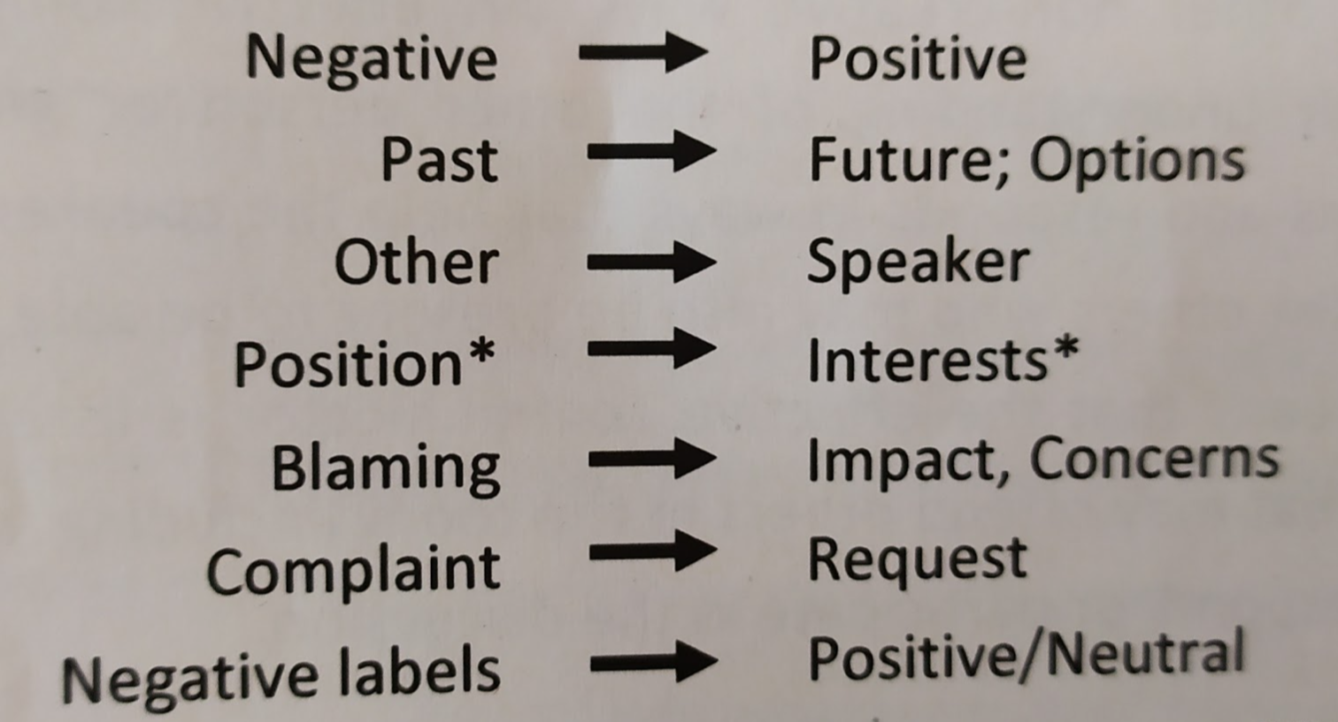
Debrief
Psychologically, the parties become more angry, fearful and emotionally aroused
They develop negative attitudes toward the other party, blaming them for the deterioration and attributing hostile intentions to them
The parties' capacity for empathy and trust is undermined, and they shift toward zero-sum thinking
Extremely hard to detach person from issue in emotional investment
Impact on mediation?
Affirmation questions, reframing
Code of interaction
Issue refocus
Hostility target
INCLUSION

Slide 14
Debrief – representatives
Representatives – what did you discuss, what was your agreement, and how firm was the commitment?
Did your group honor the commitment? Why yes or why not?
As representative – what was your main source of stress?
What strategy did you choose to convince your own team?

Slide 15
Debrief - representatives
How did you entice cooperation? Did you promise something? Did you know your team can keep that promise?
Promises are costly, but create a sense of indebtedness, how about flattery, recognition, agreement
Did you threaten?
Irrevocable mutually harmful commitment
Regardless of party power signaling commitment to a destructive course shifts responsibility for positive outcome to other party
Constituency issues – how to convince your own group?
Impact on mediation?
Outward coordinated communication
Multiple-track talks
Help enlarging the pie
“Intermediaries/mediators provide greater protection against image loss and information loss than is found in back-channel meetings, because it is even less clear whether they represent the thinking of the people who sent them.“ Pruitt&Rubin 1986:158.

Slide 16
Nothing is agreed until everything is agreed
What does this rule do?
Why may it be useful to mediators?
Build trust between the parties, trust of parties in the process/rules, trust in the mediator, trust of the parties in their representatives,
Avoids strong-arming
Compromise builder in multi-issue talks
Packaging

