Slide 1
Mediation simulation skills
IREn5020 Mediation training for IR
dr. Martin Chovančík

Slide 2
Content
Debriefing water exercise
Kinds of mediators
Typology
Mediation styles
Mediator personality
TKI
Explanation on variants
Mediation emotional concerns
5 core concerns
Pair exercise on core concerns
Tools

Slide 3
Water crisis debriefing
This is an exercise that is supposed to be frustrating ☺
LOGISTICS from the Teacher’s package: “Game instructions require 30 minutes to read. Negotiations require approximately two hours.”
There is never enough time
In the debriefing, focus on takeaways on:
Ambivalence and differing perceptions
Repeating dynamics
What you may do differently as mediator

Slide 4
What was most challenging about the negotiation? (Setting aside the unclarities you experienced)?
no idea about the intentions of the other participants
it was not clear why a certain party argued for something, and whether it was indeed his instruction that this is a line he can not cross, or if s/he simply decided to negotiate hard and compromise less as a part of their own personal strategy. Bluffing?
finding at least a tiny bit of a common ground not only between parties of Israel and Palestine, but even between our Palestinian group itself
the party that I was expecting that would be on my side wasn´t completely
I felt like nobody fully understood what I demanded
I felt shared ownership was the best option for guarantees and I could not find any optional offer or any additional step that would help me to give guarantees and reach the agreement in the end. I felt I was in a dead-end where I had no other options
Takeaways – perpetual fog of war and how to lift it; principle-agent relationship

Slide 5
How clear were you on your BATNA going in – did you establish one on paper for yourself? How about aspirations?
one idea about building our own small well in out territory. This project could be suggested to Moriah company. I mean split that huge project to several smaller. I strongly doubted the success of the negotiations, and I was convinced of this again when I realized that the instructions from the other side were not to allow the Palestinians to control the project.
I don't feel like I prepared BATNA in my head till I was sure about others positions
I had the best possible outcome in my head, I knew where I can compromise and what could I give up if necessary.
Honestly, I saw that the Palestinian side has the only option to trust us just on our words. But as you said, proper water amount pumped that increased step-by-step would be a great solution.
I did not really consider BATNA too much as I focused more on trying to make the agreement happen and did not consider not reaching an argument… the instructions stressed that it was very important for the water commissioner to reach and agreement
My BATNA was that no well would be build and I would secure water from the already existing wells that would not dry up, but I still needed additional water that this project would grant me since farmers were already losing crops to dry winters.
Takeaways – absolute necessity of BATNA prior to negotiations/mediation

Slide 6
What informed your negotiation strategy if no BATNA? What informed a choice of your allies?
I was counting on the fact that the well would not be built without my approval, so I had some leverage. If I did not have this leverage, I would be willing to make more concessions. I believed that I was in a better position than my allies so I would be able to secure most of my interests. (landowner)
I wasn´t entirely sure who was my ally because the party that should have been my ally behaved more in favour of the opposite party, on the other hand the party I expected to be more in favour of the Palestinian side was helping my side. This was quite confusing and although I went along with it I cannot say that I would understand…
My negotiation strategy was to get at least one part of Israeli group on my side so he would be able to maybe persuade the others to step down on their demands at least a little. I felt like sometimes we didn't quite understand each other even among allies as from time to time it was more like repeating ourselves instead of trying to bring a new argument that could help our negotiations. (Mayor PLE)
it seemed like a rational project from which everyone could benefit, BATNA informed me mostly that it should be in the interest of both sides to reach an agreement
I don't have a single strategy for the simulation. I wanted to understand intentions of the rest. In spite of this, I was sure about my minimal requests and I adhered to this throughout the entire process. It seems to me that the overall tiredness of the participants and a close impasse in negotiations turned out to be the most influential on the result.
Takeaways – intra-party dynamics; track two and three; and party unity are always issues

Slide 7
How did you know which information to divulge/share and which to keep?
I tried to keep an "ace up the sleeve" until the very end if I could not persuade them without it. The ace up the sleeve being a confidential information about the eastern aquifer… only when it seemed that no agreement could be reached was when I shared this information in a bilateral talk with the farmer's representative
..non-negotiable conditions to my allies, however I didn't want my "enemies" to know them instantly. First I wanted to get as much information as possible and based on that I would want to negotiate face to face with someone that I can possibly share more sensitive informations with - only with someone I could percieve as possible ally.
throughout the process I just went with the strategy of divulging information that can help me and I kept the information that if divulged could be used against me.
helping us to know what kind of information could be used against us.
Takeaways: Trust-building, limits communication in the light of positions vs. interests
How much do our “weaknesses” divulge about our interest? And how much of that is a distancing form what we would be judged for or taken advantage of?

Slide 8
Was it (info and strat) (and how) altered by the mediator?
The mediator did set a positive mood and somehow managed to deescalate any rising conflict by changing the topic to another issue needed to be resolved
Sometimes I felt like the mediator shut someone down and after that I didn't want to share that much in front of everyone. This however didn't affect the negotiation overall that much, as when part of our group was shut down, others would speak for him as we prepared a plan for negotiation beforehand and any of us could propose it. (Mayor PLE)
the mediator did a great job staying unbiased and he made sure that we stay on topic and he "fact-checked" when either side tried to make an unrealistic demand, or did not know the current situation about the water levels

Slide 9
What type of role (based on lit.) was played by the mediator?
I think mostly Facilitative mediation was played by the mediator as he was trying to promote negotiations and so, however, I remember several examples of evaluative mediation when he tried to make fairness determinations and explanations of other kinds of topics (about the rights, idea of new well in Palestinian side, or even the example of being strict and direct to the parties).
The mediator should have perhaps been more focused on trying to change the narrative - creating an activist transformative-narrative mediation. He did definitely increase the communication between disputing parties and deescalated any rising conflicts by setting an order in the debate and giving everyone a fair shot, while trying to divert focus when stuck, but I did not see him trying to change the narrative. He more likely presented a facilitative mediation..
I believe he was quite neutral, he worked mostly as a facilitator maybe at the end he was forcing a little bit more on the agreement because of the time pressure which influenced the Palestinian party to almost accept a deal with which they weren´t fully happy but I believe it was mostly because of misunderstanding the fact that we thought we just must close a deal before the end of the time frame.
The mediator only served as a facilitator, guiding the discussion at times and setting the agenda of when to discuss what, but it did not seem that he took on a more invested approach in the sense that he would try to coerce or incentivize each side, or by perhaps giving his guarantees that some obligations will be fulfilled by each side.
Takeaways – some didn’t read the lit., but more importantly the parties can vest a role onto the mediator

Slide 10
Did the mediator have to earn your trust? Was there anything he/she did to lose that trust?
In our case, his behavior did not cause any negative reaction.
I simply trusted him to try and lead us to a decision which both sides would agree with. If anything, I would feel that the other party (Palestine) would have reasons not to trust him, because as was mentioned after the simulation, there were some concerning details which were kind of unfair to the Palestinian side (water prices, water quotas etc) favoring the Israeli side, and the mediator did not address these
First I didn't feel like he needs to earn my trust, as I trusted him from the beginning, however this was a little bit shattered when he shut one of my allies down, as I started feeling he might be more inclined to help and propose solutions better for the other side.
I was glad when mediator stepped in into her question regarding the technical issues of the well as I didn´t have the information. However if he would not do that I would have been most certainly capable to tell that myself. Mediator did not lose my trust during the mediation.
My trust came gradually since I could feel like being heard and felt that he was trying to be the best he could and as much impartial as possible. I do not believe/remember he did anything in this exercise that would make me lose my trust in him, contrary to what I expected, and he did offer to give groups privacy when needed.
I was the one who asked for the mediator, he had my trust from the beginning, but at the end, when we discussed the shared ownership issue, he stated and promoted that shared ownership is the only way to reach the agreement, he stepped on the Palestinian side and imbalanced the process.
Takeaways – impartiality is easy to use even through procedural matters, time and format a your friends

Slide 11
How did the result of negotiations differ from your expectations?
My expectations were probably far too optimistic and naive, I expected that everything could be easily resolved and it seemed from the instructions that the new well will benefit all, and therefore if Palestinian fear is overcome thanks to guarantees, there should be no reason not to agree since the new well could provide 18MCM
From firstly optimistic thought that we might be able to "clear" whole project, I went through transition and was glad that we were able to come to conclusion in at least one part of the negotiation.
I expected to come to a full agreement that all sides would agree to, while not meeting all my interests but at least my vital needs (wishful thinking).
I expected to reach an agreement on more points than that, but I did not think we could negotiate the full package. I expected agreement at least on 2 points of issues.
I expected more alliances and more negotiation. The lack of understanding of the exercise made it "simple" to agree on some things and "hard" on others.
Takeaways – expectation management is part of a mediator’s role

Slide 12
How did you discover the interests and concerns of the other parties? Did the mediator assist in identifying interests? Did you assume you knew some or all of them?
I discovered the interests of the other party thanks to the mediator at the beginning when he demanded all sides to introduce themselves and establish their interests, I learned about their concerns sequentially during the negotiation process and mainly by the end, when I had the opportunity to talk to a single side of the opposing party. I assumed I did know some but not all interests.
I believe that the concerns of the parties were quite clear as they vocalized them. Regarding the interest I was not that sure. With some people it was quite obvious and they made clear what they want, some people were less clear. Paradoxically I felt that I knew better what the opposite delegation wants than what my own delegation´s interests are.
What might be interesting is that I was more sure of the interests of Israeli parties than I was of my allies as we mostly discussed more of a short term parts of negotiations and I mostly assumed only the parts of the negotiation that we were in. This was contrary to our "enemies" as their interests seemed pretty clear.
I believe the palestinian side was quite straight forward in specifying their interests, it quite often seemed that the Israeli side made the proposals and the Palestinian side only raised their objections - which were mostly in fact their concerns/interests.
Takeaways – Are we really talking about interests or initial bargaining positions?

Slide 13
How much back-channel communication was held? Would you have preferred more?
I would have liked to have had separate meetings more.
I would definitely prefer more communication with the other party, preferably with each member alone in order to better understand everyones interests and possible solutions.
On the contrary. I enjoyed negotiation between all parties far more, and at the same time I felt like we were able to move forward far easier when we were all negotiating, as when mentioned before, I felt like in back-channel people were more or less repeating themselves and I didn't feel the need to discuss things we already discussed with the same result over and over again.
Not too much, and maybe I would have preferred a little bit more, but on the other hand it was also fine that the whole negotiation was transparent and discussed in the general meeting quite a lot which meant that usually everyone was on the same page
Even though we have our own interests and slightly different goals we needed to look united and know what we want to pursue. In the end the Palestininan side almost agreed on the deal even though Margaryta disagreed and if we had more time we would probably be able to persuade them into the agreement because we would be able to use as advantage the fact they weren´t united.

Slide 14
Was a mediation needed or redundant? Why (and try to envision the real-world situation)?
I think that the mediation was absolutely needed. First of all, the mediator did a great job and he was able to point out our mainpoints, so instead of arguing between each other, we were able to react on some points with much bigger clarity. Also, without the mediator the negotiation could go quite "hot" and the mediator was needed to "slow things down" a little bit
It was probably better that it was mediated, I could even imagine a little bit more invested and "enforcing" mediator. Not in the sense of coercing the parties, but perhaps if more power was given to the mediator by both sides, it could be possible to overcome the mutual distrust between the Israel-Palestine sides
I think that the mediation was valuable and he helped but he wasn´t entirely needed. I can imagine going through the negotiation even without mediator
Takeaways – think of when parties usually reach for mediation; different contexts call for different types of mediators; mediator roles need not be stationary BUT must be approved by all

Slide 15
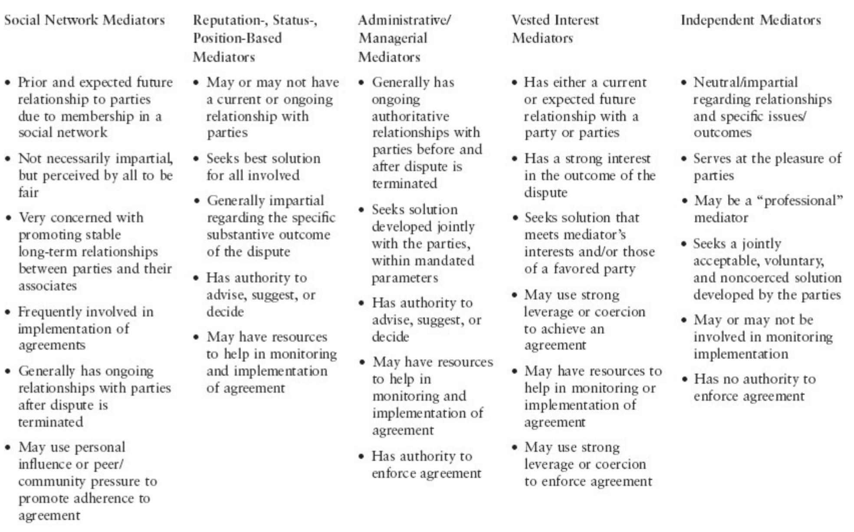
Mediator types

Slide 16
Mediator styles
Facilitation or communication
Ensure parties have all relevant and correct information
Properly identify overlap and interests
Provide venue/structure
Have no substantive input on agreement or enforcement
Formulation
All above AND
Redefine issues to better outline overlap
Conceive and propose new solutions to parties
“Procedural tactics” in issue selection, sequencing, or temporal constraints
Make use of packaging solutions
Manipulation
All above AND
Use of leverage to move parties along to a solution
Guarantees but also compensation
Expanding from zero-sum options and altering cost-benefit calculations

Slide 17
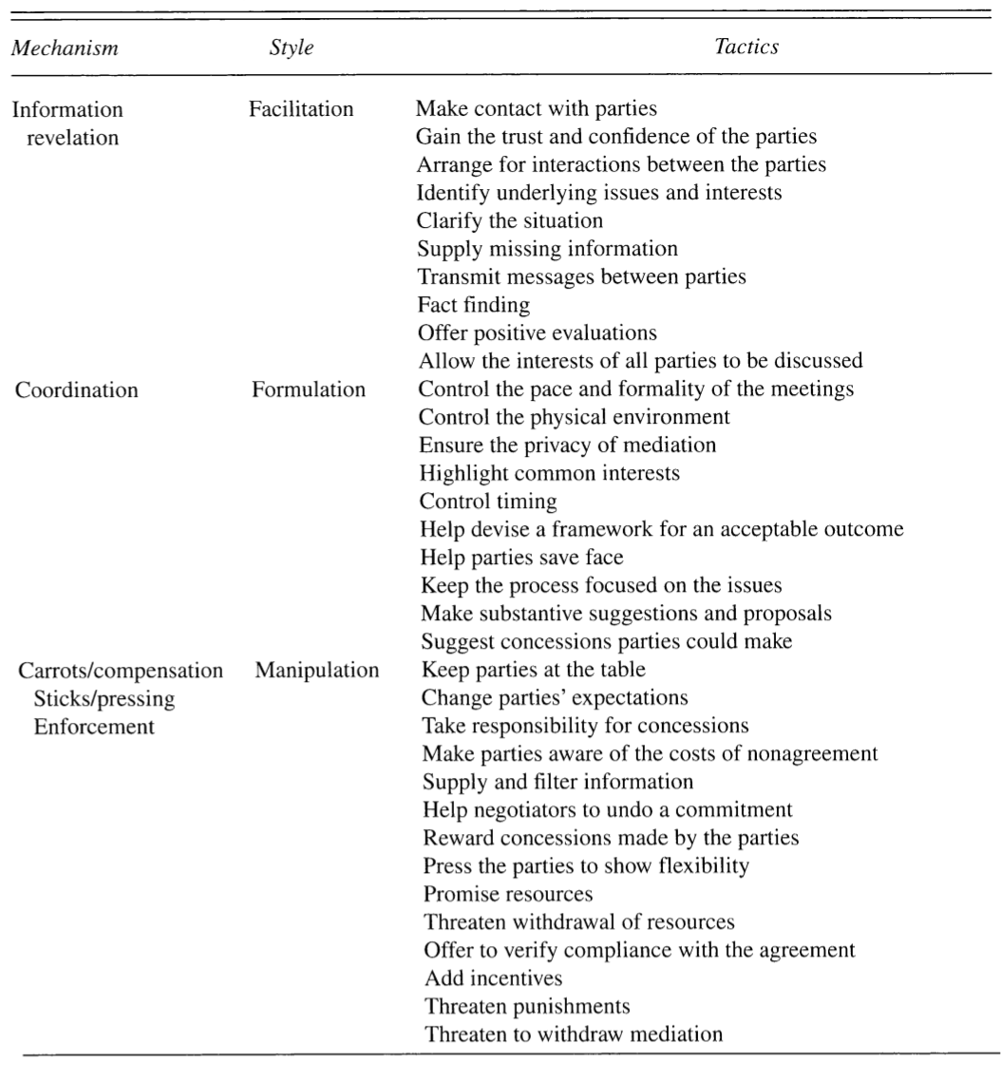
Mediator styles
What effect would you expect on a sustainable agreement from the various styles?
Beardsley et al. 2006

Slide 18
Mediation and conflict management styles
How one behaves in their own “conflicts” is extremely relevant to mediation to:
Identify one’s own reaction to conflict and self-check (as mediator) and adapt
Have increased awareness of conflict modes of others (parties and representatives)
Identify, use, and leverage conflict styles of parties to move mediation forward
A balance between ASSERTIVENESS and COOPERATIVENESS
One or two modes are typically dominant
Each has upsides and downsides
Thomas Kilmann Conflict Mode Instrument

Slide 20
Thomas Kilmann Conflict Mode Instrument
Take the test - https://psycho-tests.com/test/conflict-mode
Don’t think of a purely workplace/colleague or simulated conflict
Go much more personal, think of situations from personal life, or situations where you have a truly vested interest
Your results are private, you don’t need to share them
There is no way to return to pages, so once you hit next, you can’t go back
Take your time, do not rush, envision real-life situations
Approx. 30 minutes

Slide 21
TKI - COMPETING
Accentuates asymmetry but may make positive use of it
Quick decisions may be suboptimal, but are quick and prevent stalling
Has a significant toll on relationships and trust
Handling Competing:
Focus on persuasive rather than dictation approach
Avoid exaggerations, precision is key
Crystal clear communication of intentions/interests (not just positions)
There is little latitude for degrading behavior, loss of temper, or blaming
Use of warnings but not threats (hold much more explanation)

Slide 22
TKI - COLLABORATING
Requires openness and investment, but brings vulnerability and escalation risk
Time and effort consuming, but worthwhile
Extremely trust-dependent but accentuates the mutual nature of a problem
Handling Collaborating:
While highly desirable it has very limited use in mediation
Should only be elicited for absolutely key issues
Created vulnerability may be exploited and derail the process
“WE” language and focus on potential positive shared outcomes
Conversation starts with interests not positions

Slide 23
TKI - COMPROMISING
Compromises are great until they aren’t – satisfies majority but leaves frustration and resentment
Quicker but less optimal than collaboration
Relationships remain unharmed but do not deepen, agreements may be fuzzier by not evaluation and mirroring actual interests
Handling Compromising:
Even partial compromises are often not an option (vital issues)
Commitment to reciprocity and compromise needs to be established from both parties first – very hard transition from a previous conflict mode
Encourages temporary solutions thus presenting a dangerous agreement (sustainability)
Fairness is key and should be an external/objective criterion (e.g. expert)

Slide 24
TKI - AVOIDING
Issue may be delayed or sidelined, but it isn’t moot in a relationship and continues to “fester” hardening positions
Allows prioritization of issues, but degrades others especially in asymmetry
Avoiding issues prevents open communication of interests but may speed up agreement
Effectively a lose-lose as neither party’s interests are met, but may be required for emotions to cool down
Handling Avoiding:
Clearly sequencing or sidelining issues for a set amount of time for greater priority or lesser emotionality is useful (while still dangerous)
Useful to come to joint agreements on what can be avoided and left to posterity
Clear BATNA and WATNA prior to engaging (and their clarification outside of interaction) are key

Slide 25
TKI - ACCOMMODATING
Helpful, builds social capital by aiding, but sacrifices own interests
Accentuates relevance of future relationship (or co-existence) as more important, but builds asymmetry
A repeat pattern of accommodation may lead to quick exploitation
May offer a quick solution, but leaves dissatisfaction
Handling Accommodating:
Immensely impactful and useful as admission of being wrong on a joint issue (especially public)
A small full concession for one party may be a huge win for another
Despite both, an agreement should be sought on long-term goals to prevent a misuse pattern
Active listening and apology without growing defensive is a sought tool

Slide 26
At the table – Beyond reason
The conflict modes and styles respond differently to emotionality
No mediation or negotiation is devoid of emotions
“Correct” identification and handling allows mediator to
Sidestep emotional traps
Diffuse the situation
Rephrase, reframe, reorient focus (while doing so without loss of trust)
While negative emotions and their expression may be limited by procedure and protocol, this is most often insufficient
A mediator plays a crucial role in reframing the words, checking for clarity, decreasing the tone, all the while affirming understanding of stated words

Slide 27
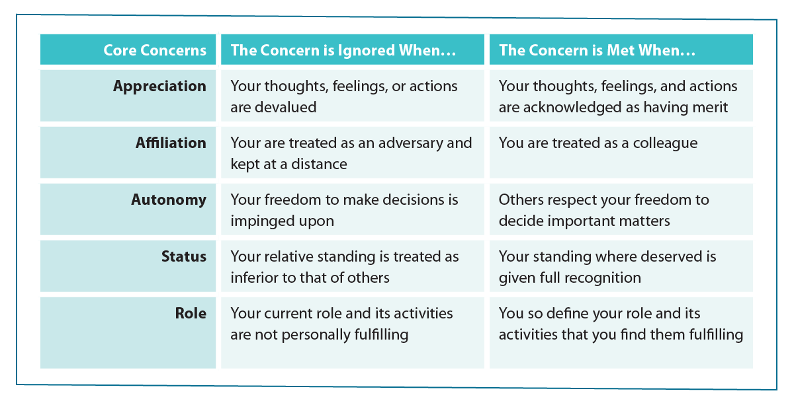
Beyond reason Five core concerns

Slide 28
Beyond reason exercise
General Core Concerns
Appreciation | Desire to feel understood and honestly valued. Lost when merit of other is depreciated or one’s own is not communicated well. When issues outside of topic are dragged out, personal attacks.
Affiliation | Lost when othering and exclusion, ostracizing and marginalization. Non-inclusion in decision, or failure to recognize commonality. Communication of incompatibility.
Autonomy | Maintaining or increasing one’s own autonomy at the expense of another’s autonomy. Cornering or non-consultation on options or decisions.
Status | Belittling, degrading, or simply elevating one’s opinion by using one’s status all diminish the status of others and trigger an emotional response.
Role | Pigeonholing into a role preventing self-actuation or self-determination. Prolonging a standing which should have been a temporary role into a permanent setting or prevention of fulfillment.

Slide 29
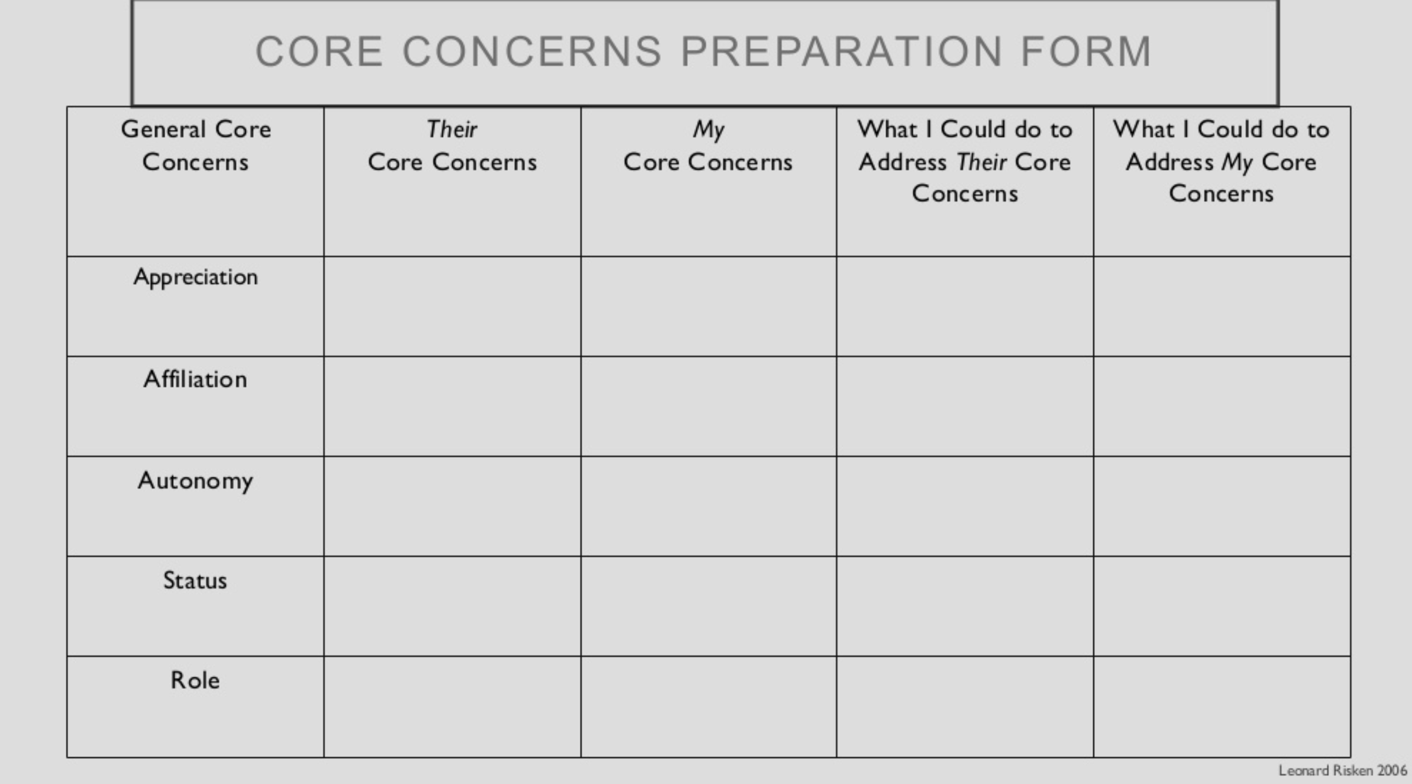
Beyond reason exercise
Separate in groups of 2
Take 2-3 minutes to think of a situation
Personal (don’t feel you need to share anything intimate if you don’t wish to)
Fight/quarrel/heated emotions
You were emotionally invested
You feel had been mishandled
Open the Word document in chat
Describe the situation to the group/partner
Together fill in the document for your situation
Reverse roles – entire exercise is 30 mins

Slide 30
Beyond reason exercise – share insight
Have you uncovered any element you completely overlooked during the argument/situation?
Have you found an appropriate solution to that specific concern?
What would it have taken for you to recognize that in the moment?
What manner of reminder/clarification would you have found acceptable from a third party in the situation?
Imagine the fight at a mediation table – what tools does a mediator have? (and remember she/he may easily offend or lose trust for the same reasons)

Slide 31
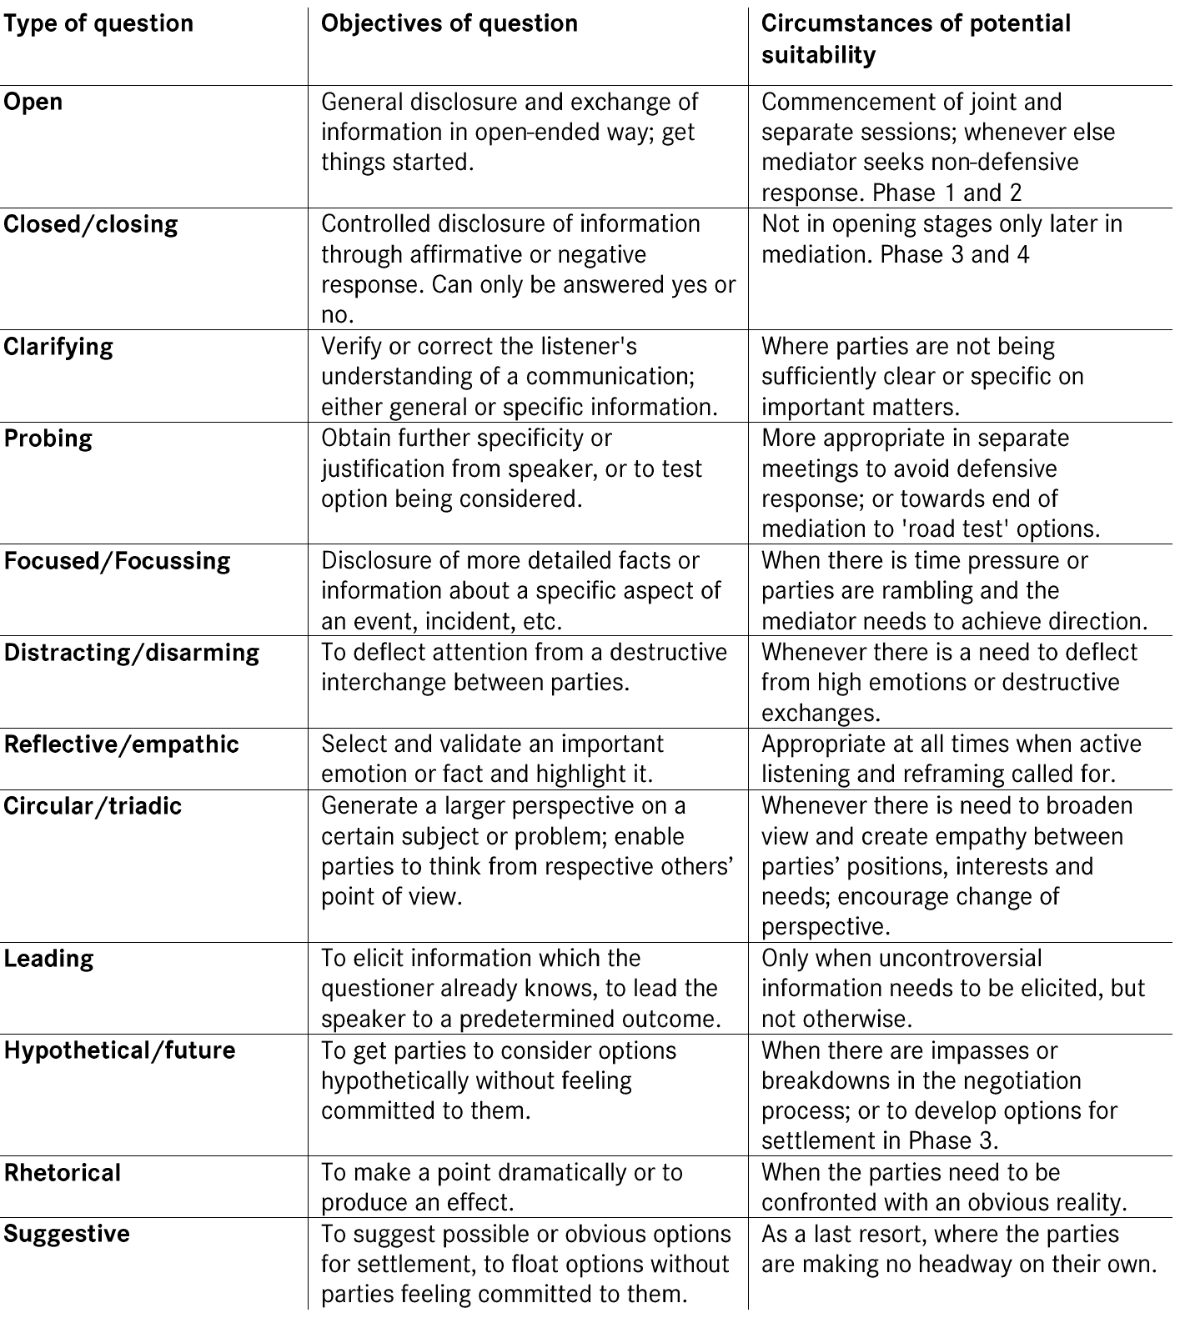
Guiding questions
The power of a question
At their disposal, the mediator has a broad selection of questions
And access to re-framing

Slide 32
REFRAMING
Slow down
De-escalate
Detoxify and de-personalize
Communicate empathy
Ensure clarity and understanding
Show understanding
Focus the speaker on the message
Draw attention to needs/fears and interests
Validate concerns
You seem to be most concerned about…
If I understand you correctly, then you think…
So you’re saying that…
From what I understand, you were frustrated with the option…
Could you kindly clarify what we need to understand better…
Is this what you’d like to see happen…
Avoid triangling, the objective is to bring more clarity, understanding, and not become a target

