Slide 1
Part III: POLITICS AND MEMORY Part IV: THE MEMORY LANDSCAPE OF EUROPE

Slide 2
RESEARCH PAPER
Topic on Thursday
Find a topic: Preferably in Central and Eastern Europe
Find a question
Make an argument

Slide 3
Research Paper: Question Needs to be specific
Question:
What is official narrative of Poland toward Lithuania and what is the political significance of that? What is political significance of memory culture in Slovakia toward Czechia? What is the memory of regime in Serbia towards the Srebrenica massacre?
What is the memory regime in Croatia surrounding the Ustase?
How has Putin’s discussions os Stalin changed over time?
What are different Czech narratives around the expulsion of Germans?

Slide 4
Choose a particular case, time, etc.
This can be an example: a particular speech; it can be a particular museum; it can be a film, it can be a novel
It can offer a broader view, but be clear how you are doing it: Who is important to the discussion, why did you choose them
It can be more empirical: selection of articles from one or two newspapers, laws, etc.

Slide 5
Possible Methods:
Methods:
Interpretive Methods: How do you identify the narrative and its significance?
In reading an account: Who are the actors? Who is the we? What are the limits to the we? Who is the other? What characteristics are given to the ”we” and the “others”? What is the relation between the we and the others? Who did what to whom? What is the reason given for why they did it? What value is given to the actions?
Interpreting significance: consider the speaker, consider the audience, consider the context: what is happening, what events are happening at the time, what actions has the speaker done, etc.
More empirical: Content analysis---Look at selections of newspaper aticles, speeches, etc over time.

Slide 6
Example:
Putin on the Munich Agreement (in response to Polish arguments that Molotov-Ribbentrop Agreement helped start WWII):
“in case of the Munich betrayal that, in addition to Hitler and Mussolini, involved British and French leaders, Czechoslovakia was taken apart with the full approval of the League of Nations. I would like to point out in this regard that, unlike many other European leaders of that time, Stalin did not disgrace himself by meeting with Hitler who was known among the Western nations as quite a reputable politician and was a welcome guest in the European capitals.

Slide 7
Outline
Abstract- 200 words
Contains question
Why it is important
How you are going to approach the question
What is you conclusion
Introduction: Quick background, question, importance, argument
Background: Explain a little about the event and the case
Discussion of which concepts from the literature you are using for analysis
The analysis
Conclusion

Slide 8
REVIEW
National Identity plays important role in how states define interests and strategies
National Identity linked with memory and narratives
Collective memory associated with memory community
States and nations construct a narrative, a selective and often inaccurate account of history to help illustrate the origins, character and boundaries of the “memory community”
These narratives and the associated definitions of identity become embedded in the state institutions

Slide 9
THE POLITICAL WORK OF MEMORY
HELPS TO FORM, REINFORCE POLITICAL COMMUNITY
EXPLAINS AND LEGITIMATES POLITICAL STRUCTURES AND ACTIONS
FREQUENTLY REMOVES, EXPLAINS OR JUSTIFIES NEGATIVE EVENTS
FRAMEWORK TO INTERPRET CURRENT EVENTS, POLICIES
DISCOURAGES DISSENT
CREATES SCAPEGOATS

Slide 10
Constructing the “Master Narrative”
Methods of Organizing and Elaborating Collective Memory
• Emplot events in an affectively charged and mobilizing narrative;
Collective victories, collective trauma
• Create sites and monuments that present palpable relics;
Create school curricula that introduce children to the narrative
• Create visual and verbal signs as aids of memory;
• Create and repeat commemoration rites that periodically reactivate the memory and enhance collective participation.

Slide 11
POLITICS OF MEMORY
Different narratives exist in any society
Those who can get other people to believe in a particular narrative have an advantage
Therefore, memory is contested
Malinova: “Politics of memory comprises public activity of various social institutions and actors aimed at the promotion of specific interpretations of a collective past and establishment of an appropriate sociocultural infrastructure of remembrance, school curricula, and, sometimes, special legislation.

Slide 12
AN EXAMPLE: WORLD WAR I
Wars not only fought on the battlefield
In Germany many different interpretations of the reasons for the war and Germany’s loss
The war was a result of centralized, unchecked power by governments backed rich industrialists and financiers fighting for increased access to markets.
The war was an attempt to protect the nation from attack. Germany lost because of betrayal of Marxists and Jews who “stabbed the country” in the back.

Slide 13
How does politics of memory work?
The role of the memory agents who help construct the narrative
The resources and access they have to disseminate the narrative
The credibility of the memory agents
The way this resonates among the people
How does it fit with existing narratives
How does it help explain their circumstances
How does it appeal to emotions

Slide 14
The Framework of Bernhard and Kubik
Official Memory “entwined with power.”
Actor-Centered Approach
An “instrumentalist “ approach
Constrained by Culture: “the weight of the past”
Or, in other words, institutionalized notions

Slide 15
An Actor-Centered Approach
Mnemonic Warriors
Mnemonic Pluralists
Mnemonic Abnegators
Mnemonic Prospectives

Slide 16
Mnemonic Regimes
The Definition of a “Memory Regime”
The concept of "memory regime" in this study refers to a set of cultural and institutional practices that are designed to publicly commemorate and/or remembera single event, a relatively clearly delineated and interrelated set of events, ora distinguishable past process. We are particularly interested in official memory regimes, that is, memory regimes whose formulation and propagation involve the intensive participation of state institutions and/or political society (the authoritie sand major political actors such as parties, who are organized to hold and contest state power)…. The whole set of official regimes existing in a given country in a givenperiod can be called the official field of (collective or historical) memory.
TYPES OF MEMORY REGIMES
FRACTURED
UNIFIED
PILLARIZED

Slide 17
Examples:
POLISH MEMORY REGIMES ON MOLOTOV-RIBBENTROP PACT?
POLISH MEMORY REGIMES ON POLISH PARTICIPATION IN HOLOCAUST?
UKRAINIAN MEMORY REGIME ON HOLODOMOR?
CZECH MEMORY REGIME ON EXPULSION OF GERMANS?
SLOVAKIAN MEMORY REGIME ON JOSEF TISO?

Slide 18
Questions?
Does instrumentalism work as an assumption?
What role does culture, history play?
How do memory regimes change?

Slide 19
Berthold Molden:
“hegemony is the ability of a dominant group or class to impose their interpretations of reality—or the interpretations that support their interests—as the only thinkable way to view the world. The dominated groups come to accept the interests of the dominant ones asthe natural state of the world. Hegemony thus establishes one particular narrative as a quasi-natural universality and delegitimizes alternative forms of reasoning. It is the successful creation of this powerful common sense of reality that includes most people in a social group while sapping those who think—or remember—outside the box.

Slide 20
Memory as a Layering of Contingent Sediments
What does it mean?
“These sedimentations constitute the discursive strata where the contingent origins of memory and historical narration are hidden.”
The political is “constituted through the rediscovery of these sediments in the “moment of antagonism where the undecidable nature of the alternatives and their resolution through power relations becomes fully visible” (p. 34–35).
EXAMPLE?

Slide 21
Memory Culture
“any sign, word, or memory can be multivocal and can be put to use differently by different speakers, according to their experience, context,and needs”.
“A memory culture is defined by the frames of historical reference common to certain communities of experience and/or tradition who share a critical mass of content, patterns of interpretation, and rituals of collective memory.”

Slide 22
Ruling groups achieve this only by blocking out the fact that historical events might always have turned out different or by claiming that any different outcome would be a worse-case scenario. They stabilize power by the successful establishment of a supposedly teleological and linear historical narration. This constitutes a characteristic of collective remembrance:“Collective memory can be described as a layered field of sedimentations which’s contingent origin in the dispute of competing definitions of the past has been forgotten, after a certain version of the past had imposed itself and become hegemonic” (Marchart, 2005: 25).

Slide 23
The material dimension of memory
“dialectic of experience and discourse,”
There is always a connection between historical experience, the structural context of power relations, and the history politics of a time. It corresponds to the relationship between history as the event or process that is experienced, memory cultures as the given structure, and the concrete agency of those who want to maintain or change this cultural framework as well as those who just live in it passively.
The diversity of experience leads to diversity of memory

Slide 24
Memory Culture as a Field of Agency
Memory as a narrative social construction involves studying the narrator and the institutions that grant or deny power to the voice of the narrator and authorize him or her to speak, since as Pierre Bourdieu notes, the effectiveness of performative speech is proportional to the authority of the speaker. (Jelin,2003: 23)
The politics of history and official discourses of memory produced by the elite’s ideological apparatus can be—but do not always have to be—cutoff from real experience. Counter-memory on the other hand—while possibly also constructed asan idealist myth—is more likely to have to rely on a material basis of experience, given its lack of strong media support and other amplifying and reifying tools.
Civil Society provides an arena to act

Slide 25
The Three Narratives
The Western Narrative: The Good War
Nazism as key evil
Holocaust as prime signifier as evil
Lesson. “Never Again”. Human Rights
Soviet/Russian Narrative
Fascism as key evilSoviet forces carry brunt
Holocaust part of Fascism evil
Post-Communist
Two occupations
Holocaust external

Slide 26
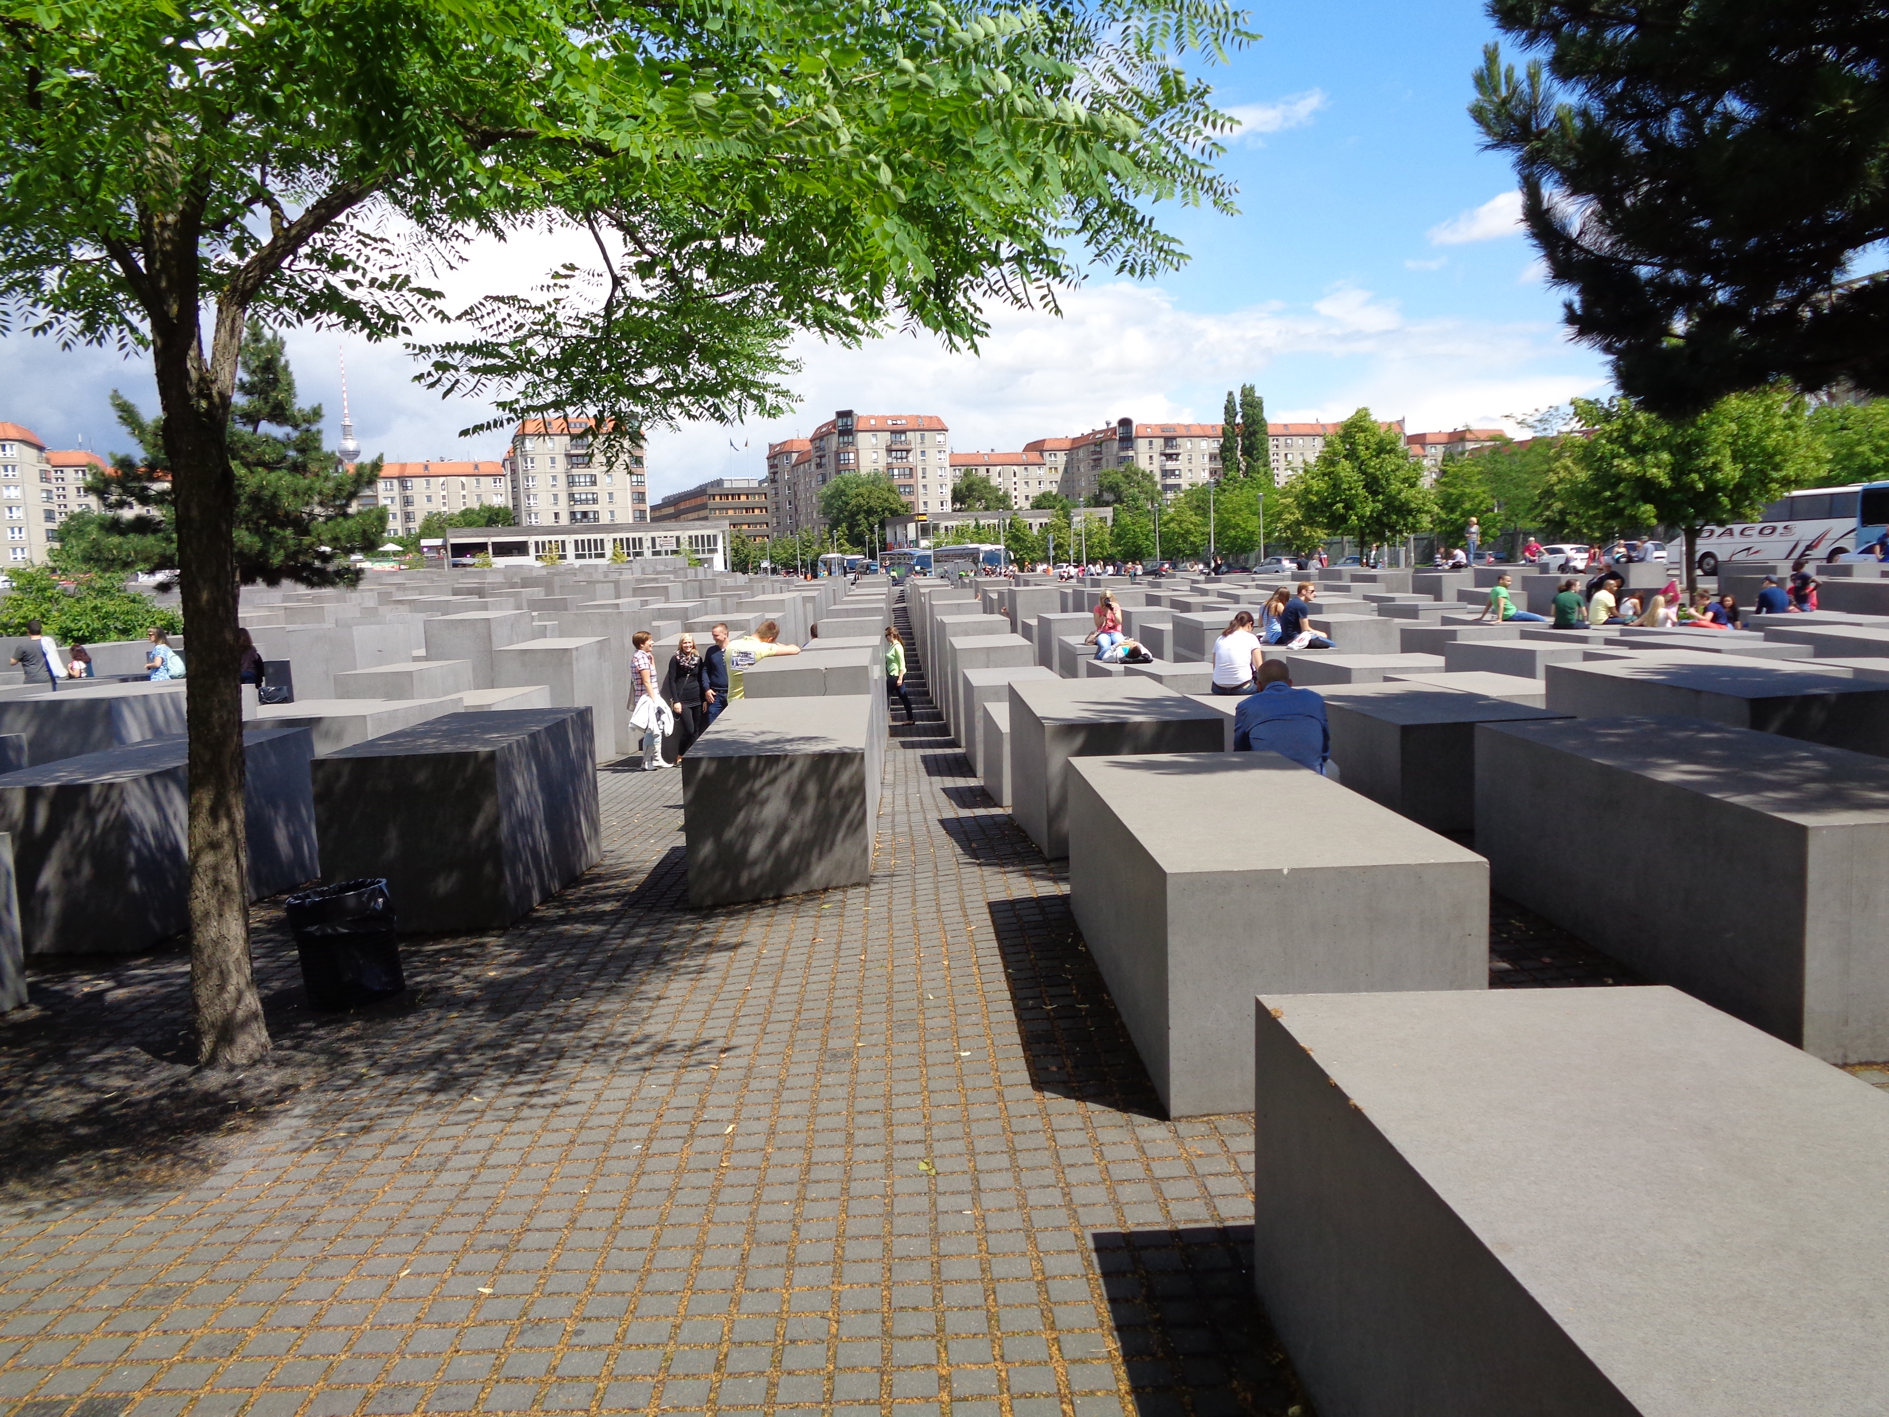
Building a “Common European” Identity
The project for deepening integration
The Single European Market and Maastricht in 1992
Redefining Europe’s democratic mission after the end of the Cold War
Two World Wars and the Holocaust as a Negative Foundational Narrative
Quote from the “House of European History” website
The generation of people who experienced the tragedies of the 20th century and went on to build the European Communities is disappearing. https://historia-europa.ep.eu/sites/default/files/assets/qa_en_2017.pdf
STILL…
National narratives
Remained pre-eminent
https://www.balcanicaucaso.org/eng/Areas/
Europe/The-House-of-European-History-178791

Slide 27
How does the Holocaust become the “founding myth of the EU”?
THE STOCKHOLM DECLARATION: 2000
What do we mean by “founding myth”?
Why does European Union need a founding myth?
How does the end of the Cold War affect European search for founding myth?
Why does Holocaust become an “entry ticket” into the EU?
Yugoslavia?
Decontextualization? Deterritorialization?

Slide 28
The Eastern Europe after the Cold War
Need to redefine national identity
Reject Communism and Soviet Domination
Seen as aberration
The desire to ”Return to Europe”: NATO, EU
Some resentment against EU demands on political, cultural issues
Fear of losing sovereignty again

Slide 29
Tensions between narratives West and Central
There are problems with the Western narrative
For many, WWI memory not about pointless slaughter, but about liberation
World War II was not seen as a “good war” against Nazism, but dual occupation
Authoritarian leaders of interwar regimes embraced by nationalists

Slide 30
Challenges To Post-Communist Narratives (Subotić)
Eastern European quest for national identity source of insecurity
Finding a usable past: Masaryk, Tiso, Ustase
Preferred narratives: victory over evil, resister of evil, victim of evil
Holocaust Challenges
Murders occur on Eastern European territory
The diminution of national victimhood
The question of collaboration, economic benefits
Resentments
Western European countries not forthcoming about own complicity
Western European accepted division of Europe after war

Slide 31
What are the implications?
By seeing communism as an aberration, go to earlier history
Usually not much better
Empowers the right wing
Hungary and Orban
The Croatian History

Slide 32
Maria Malksoo
Emphasis on Holocaust—Search for unattainable universality
Eastern European perspective as subaltern, “reclaiming history”
Disruption of European Memory project
Construction of new transnational vision of communism
Memory Institutes
Celebrating “Heterocentrism”

