Slide 1
Campaign for abolition of slave trade
Kateřina Fridrichová

Slide 2
Question
What had to happen in order for Great Britain to start enforcing abolition of the slave trade on the international scene?
In the society
In the political spehre
On the international scene?

Slide 3
Actors
Suffering population:
African slaves transported to colonies.
(White slaves in Mediterranean)
Opressors:
Interconnected economic system: African chieftians – slavers – slave owners supported by the countries (taxes, etc.)
Powerful economic lobby
    Originally also strong in political representation in British parliament (plantation owners, traders) - London Society of West India Planters and Merchants
    Portugal – the entire African economy based on slave trade – no motivation for abolishing it

Slide 4
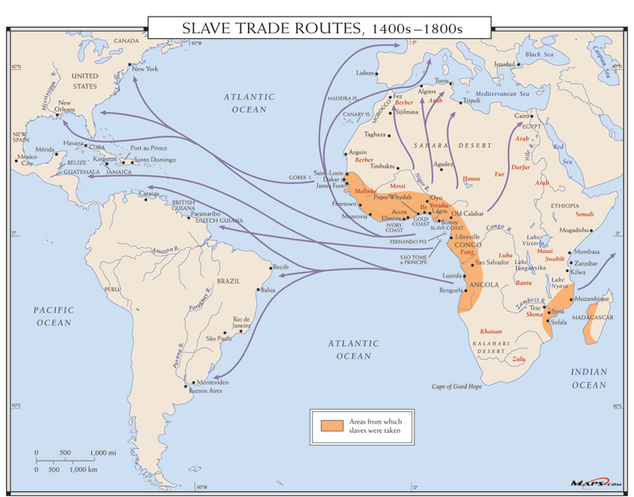
”for 366 years, European slavers loaded approximately 12.5 million Africans onto Atlantic slave ships. About 11 million survived the Middle Passage to landfall and life in the Americas”
“[...] in 1781 [...] captain of a Liverpool slave ship threw more than 130 African slaves overboard and tried to claim insurance for them. The claim was disputed by the ship’s insurance company, and the ensuing court case brought what people already knew about the brutality of the slave trade into the open. In doing so, it turned the tide against the trade.”
During the 1790s, 771,000 slaves were imported into the European colonies in the West Indies, the United States, and Brazil, just slightly below the all-time peak in the 1780s, and in 1805 sugar production reached a new high of 310,000t.

Slide 5
Intervening power
Great Britain
1772 – ruling that chattel slavery is not supported anywhere in common law (Sommersett case) lead to freeing of the rest slaves on British islands:
The state of slavery is of such a nature that it is incapable of being introduced on any reasons, moral or political, but only by positive law The state of slavery is of such a nature that it is incapable of being introduced on any reasons, moral or political, but only by positive law [statute], which preserves its force long after the reasons, occasions, and time itself from whence it was created, is erased from memory. It is so odious, that nothing can be suffered to support it, but positive law. Whatever inconveniences, therefore, may follow from the decision, I cannot say this case is allowed or approved by the law of England; and therefore the black must be discharged.], which preserves its force long after the reasons, occasions, and time itself from whence it was created, is erased from memory. It is so odious, that nothing can be suffered to support it, but positive law. Whatever inconveniences, therefore, may follow from the decision, I cannot say this case is allowed or approved by the law of England; and therefore the black must be discharged.
1807 - The Slave Trade Act made it illegal for British ships to carry enslaved peoples between Africa, the West Indies and America. In addition, ship owners were unable to purchase insurance on vessels carrying slave cargo.
No international network of mutually shared values – homegrown movement to abolish slavery
  Multiple means of wide society engagement – marches, leaflets, badges, petitions, pledges not to buy certain goods
1833 – the emancipation of all slaves in British colonies

Slide 6
International society
No law or moral agreement that slavery is wrong
Britain as a supreme maritime power – target of resentiment from other states
  In the context of Napoleonic wars and post-Napoleon situation
  Continental blockade during the war
  Vienna congress and negotiation of post-war order – maritime rights kept off the negotiatons
  Attempts of Britain to institutionalize right of search through the system or bilateral treaties

Slide 7
Means of intervention
Attempt to secure treaties with states to supress slave trade and get the right to search their ships
  declaratory statements signed with United States (1808), France (1815), Spain (1817), Portugal (1817), Brazil (1826)
1816 – Admiral Exmouth ordered to visit Tripoli, Tunis, and Algiers to negotiate the release of the white slaves
  The Dey of Algiers did not agree; Lord Exmouth returned and it resulted in day-long bombardement of Algiers (the British and the Dutch were almost without ammunition)
  Relatively high number of casualties
Britain started to implement right to search unilaterally
  1839 – Portugal
  1849 – 1842 – permitted armed expedition to civilize region in Niger (failed)
  1849-50 Brazil (intensification of pressure, raids)

Slide 8
