Slide 1
Slovakia Before 1989
POLb1135 Slovak Politics

Slide 2
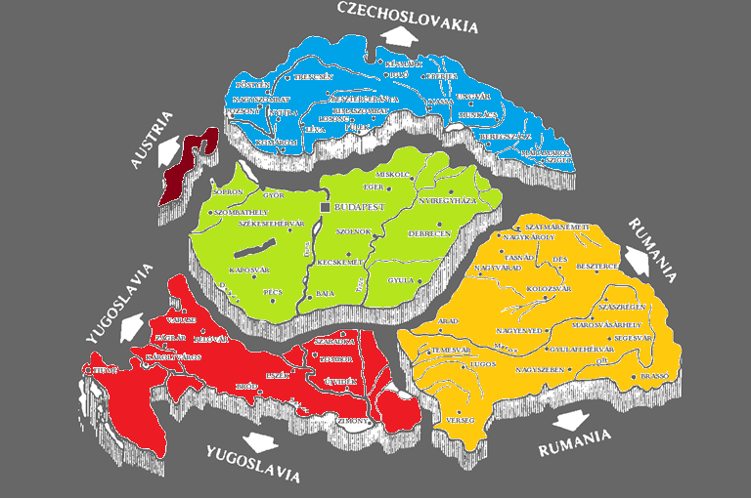
Before 1989

Slide 3
Hungarian Rule (Since 10th Century)
1867 – dualization of Austria-Hungary → negative stance against minorities
National oppression:
  Press legislation
  Abolishment of Slovak high schools
  1875 - dissolution of Slovak Motherland („Matica Slovenská“)
Aim – creation of one nation without ethnic fragmentation

Slide 4
Slovak Party „System“
Political conditions:
  No universal suffrage – only 7 per cent of people in 1918
  Manipulations of elections
  High barriers for achieving mandates
  Low citizen participation and activity
The result – nearly for the whole period until 1914 there was only one party representing the Slovaks

Slide 5
Slovak Party „System“
Slovak National Party (SNS, 1871):
  Elite protestant party
  Limited resources
  Internal plurality – Agrarians, the catholic Slovak People’s Party (SLS, gained independence in 1913)
Less than 10 MPs in Parliament (out of 435) → minimal impact on the country’s politics

Slide 6
The First Czechoslovak Republic (1918-1938)
Two nations in different situation
Higher development of the Czech part:
  Economy and standard of living
  Level of education
  Character of political parties
Czechoslovakism - the idea of one Czechoslovak nation

Slide 7
Population of Czechoslovakia (1921)
Nationality | Amount | Share (in %)
Czech | 6,780,000 | 50.2
Slovak | 1,990,000 | 14.7
German | 3,123,000 | 23.1
Hungarian | 745,000 | 5.5
Other | 880,000 | 6.5
Sum | 13,510,000 | 100

Slide 8
Population of Czechoslovakia (1921)
Nationality | Amount | Share (in %)
Czechoslovak | 8,770,000 | 64.9
German | 3,123,000 | 23.1
Hungarian | 745,000 | 5.5
Other | 880,000 | 6.5
Sum | 13,510,000 | 100

Slide 9
The First Czechoslovak Republic
The political system:
  Parliamentary democracy (PR electoral system)
  Universal suffrage
  Citizen freedoms
Oligarchic bodies
Changes in the international situation in the 30s → degeneration of Czechoslovak democracy

Slide 10
Political Parties in Slovakia
System of one party changed to plurality
Czech parties:
  Changed names from „Czech“ to „Czechoslovak“
  Only limited success in Slovakia
Parties of ethnic minorities:
  Hungarian and German
  Oriented towards „their“ minorities
  Mostly opposed to the idea of Czechoslovakia

Slide 11
‘Authentic’ Slovak Parties in CSR
Parties from the past as well as new parties
Gained votes mostly in Slovakia
Parties divided into two groups:
  Autonomists – seeking Slovak autonomy
  Centralists – accepting CSR
The strongest actor – SLS - renamed to HSLS (Hlinka Slovak People’s Party)

Slide 12
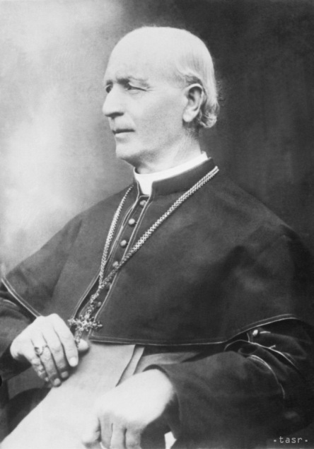
Hlinka Slovak People’s Party
Leader – Andrej Hlinka (Catholic priest)
Ideology:
  Catholic and conservative values
  Never fully accepted liberal democratic ideas
Highest electoral support in Slovakia
Radicalization in the 30s

Slide 13
Results of Elections
Political Party | 1920 | 1925 | 1929 | 1935
HSLS | 18.1 | 34.3 | 28.2 | 30.1
Agrarians | 18.7 | 17.4 | 19.5 | 17.6
Communists | - | 13.9 | 10.7 | 13.0
Social Democrats | 39.4 | 4.3 | 9.5 | 11.4
Hungarian parties (Sum) | 10.7 | 14.6 | 15.9 | 14.2
Czech parties (Sum) | 2.3 | 6.4 | 11.6 | 9.7

Slide 14
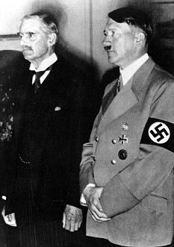
Munich Agreement (1938)
Beginning of The Second CS Republic
Degeneration of democracy in CSR
Czech lands:
  Two party system
  No real competition
Slovakia:
  More straightforward decline of democracy
  Hegemony of HSLS

Slide 15
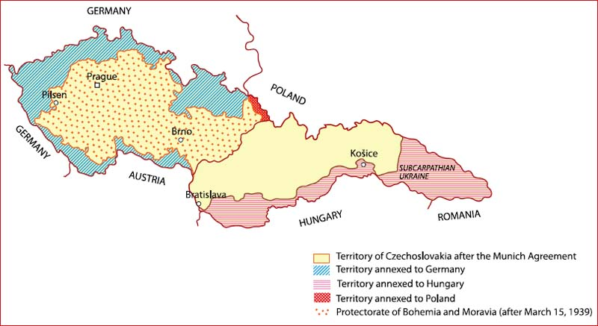
Munich Agreement (1938)

Slide 16
Autonomy of Slovakia
October 1938 – an official request by HSLS:
  Signed by most Slovak parties
  Refused by Social democrats and Communists
November 1938 – Constitutional law granting autonomy to Slovakia:
  Slovak Assembly
  Slovak Government

Slide 17
Autonomy of Slovakia
Hegemony of HSLS
Other parties:
  Forced to merge with HSLS
  Social democrats and Communists were abolished
Authoritarian tendencies of HSLS
Democracy refused as „complicated“

Slide 18
Elections to Slovak Assembly (1938)
„The one and only“
A clear sign of non-democratic tendencies:
  Single candidate list
  Separate electoral rooms for different ethnic groups
  Manipulative techniques
  Violation of secret vote
  Planned sanctions on people casting blank lists
Results – HSLS receives 97.3 per cent of votes

Slide 19
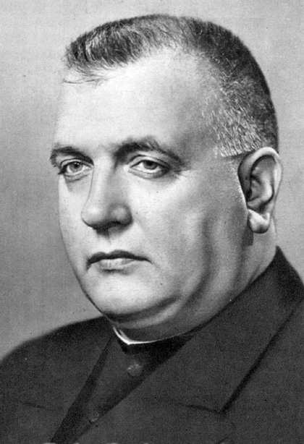
The Wartime Slovak State (1939-1945)
Satellite of the Third Reich
Non-democratic regime
President – „doctor“ Jozef Tiso

Slide 20
The Wartime Slovak State
Clear dominance of executive power
Overlap of state and the party – Tiso as president and leader of HSLS
Parliament (Assembly) without any real power
Para-military forces – the Hlinka guard

Slide 21
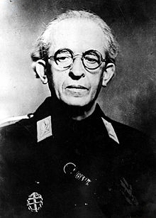
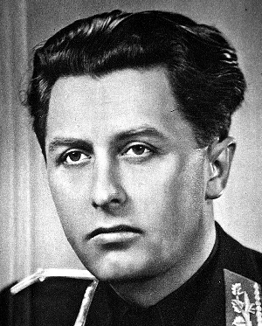
The Wartime Slovak State
Two wings of HSLS:
1. Conservative and more moderate (Tiso):
  Catholic and corporatist ideas
  2. Radical (Tuka, Mach):
  Inspiration in Nazi Germany
  Connection with Hlinka Guard

Slide 22
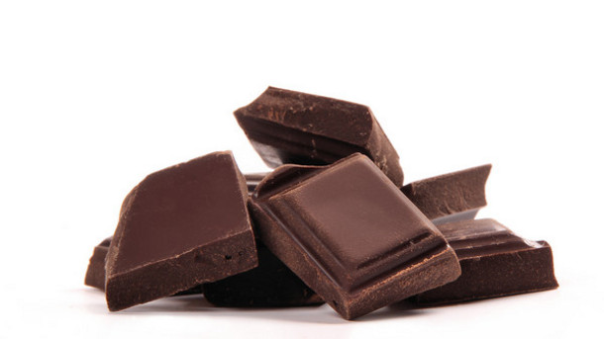
1939 - 1940
Authoritarian regime
Catholic, conservative, corporatist values
Weaker position of HSLS’s radicals
Depicted (even now by some parties) as „The smiling Slovakia“ despite the nature of the regime
Reaction → Hitler’s request for a change

Slide 23
1940 - 1942
Radical wing of HSLS gained power
Conservative wing led by Tiso overpowered them but only by adopting their techniques
Tiso gained the title „Leader“ („Vodca“; equivalent to German „Führer“ used by Hitler)
Antisemitic laws, deportation of Jews (58 thousand in 1942) – 2/3 of Jews living in Slovakia

Slide 24
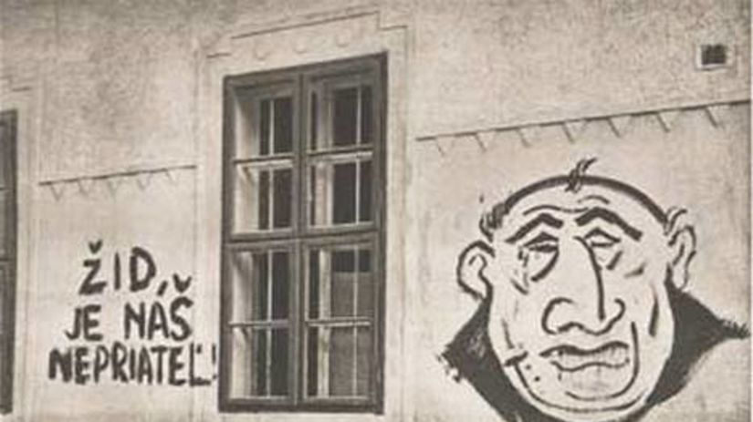
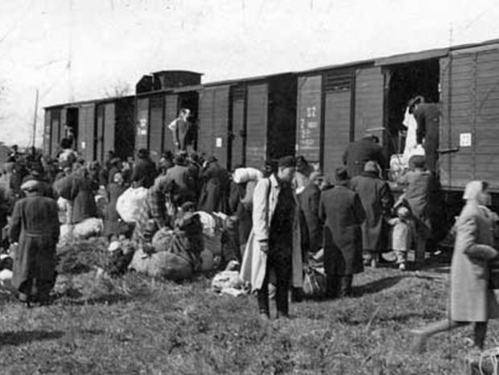
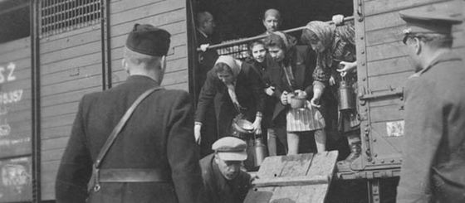

Slide 25
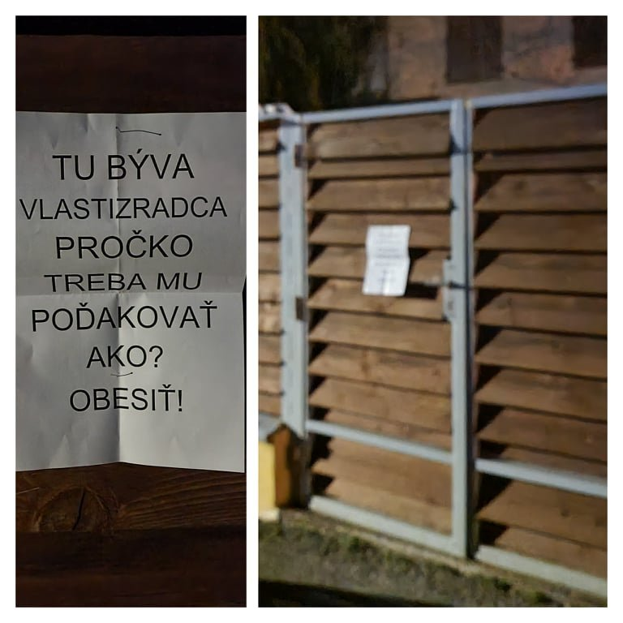
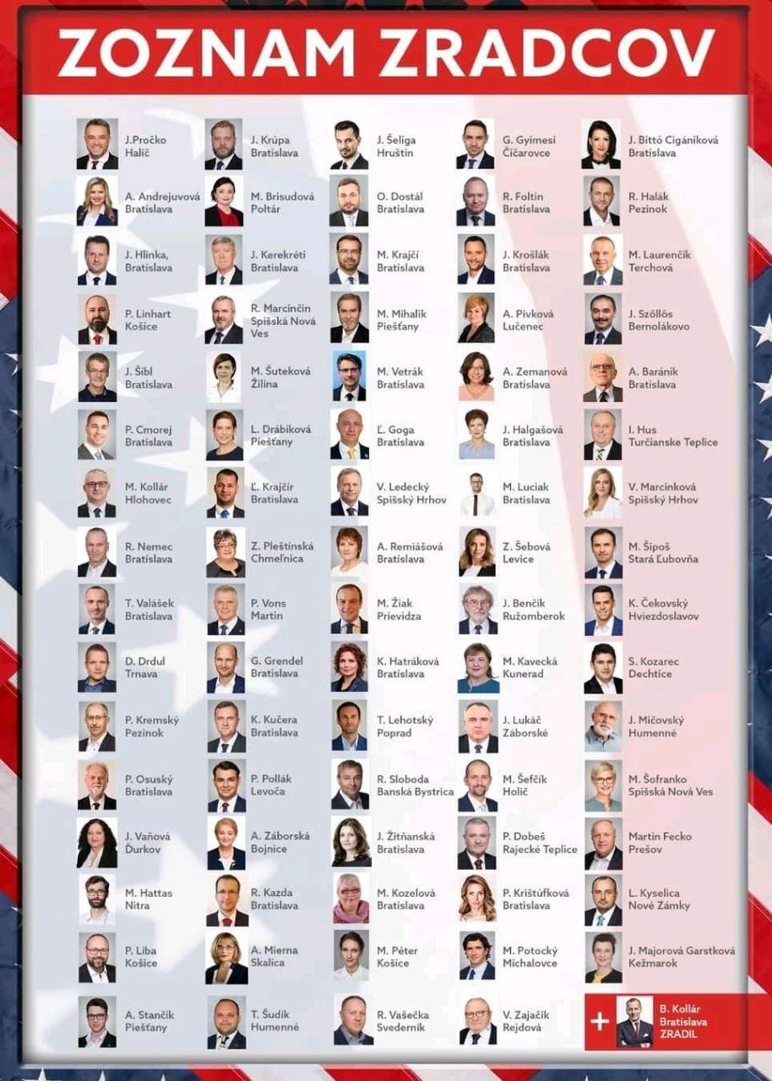
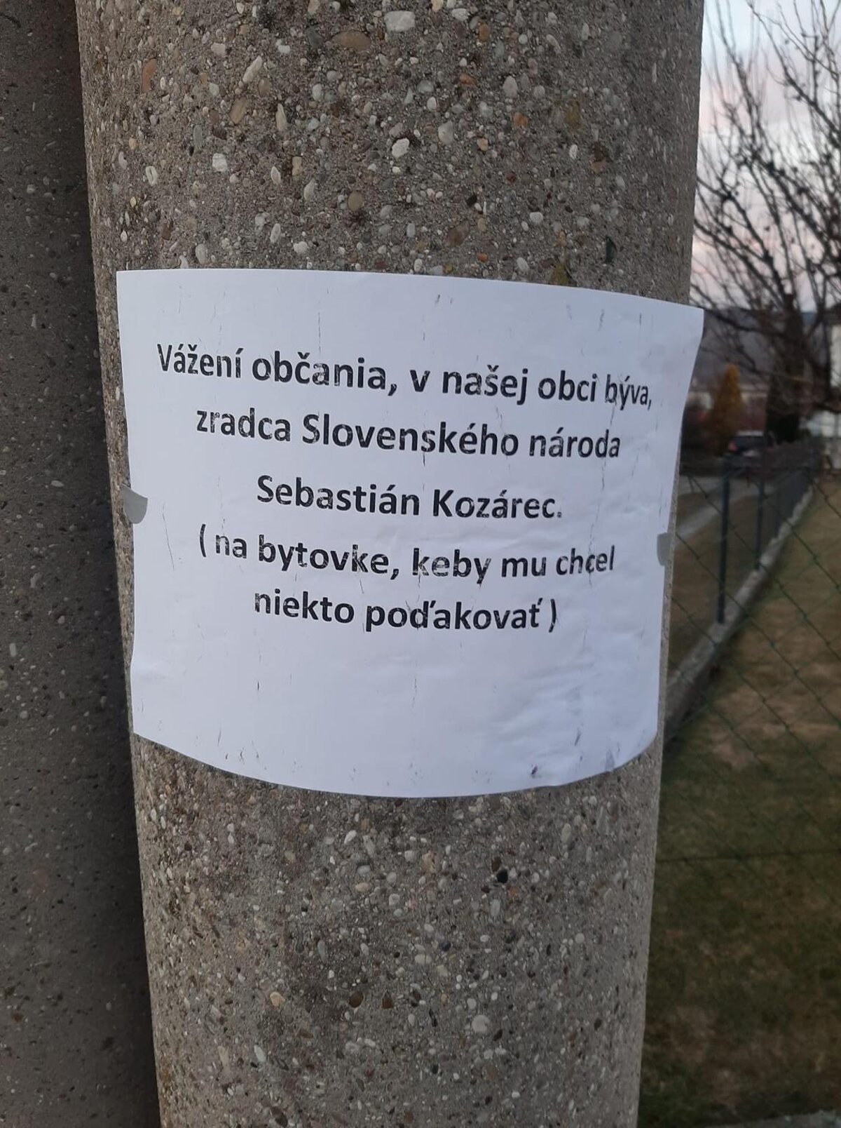
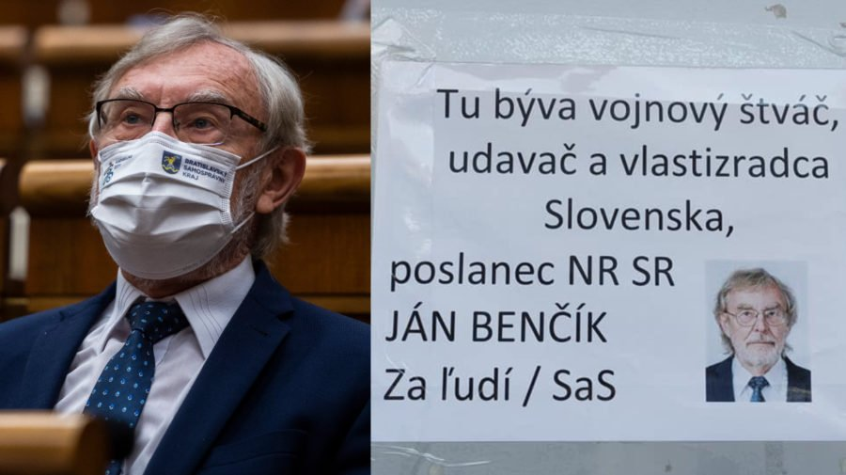

Slide 26
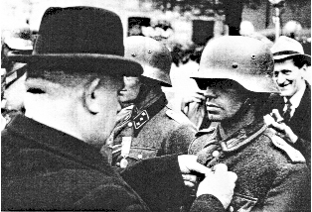
The erosion after 1942
Main reasons:
  Turnover in the Second World War
  Lower trust of the society
1944 – Slovak National Uprising – suppressed by German forces
1944-1945:
  Slovakia under total control of Germany
  Terror, revenge on partisans, restoration of deportation of Jews

Slide 27
After the World War II
Third Czechoslovak Republic (1945-1948)
Only a fiction of a democratic system
Problematic features:
  Dominance of the executive power (decrees)
  Retribution justice
  Limited plurality of the party system - only a few parties were allowed to exist (no German or Hungarian party)
  Limited political competition among parties

Slide 28
Party System in 1945-1948
National front:
  Umbrella organization with parties as members
  Decided which parties may exist
  All parties had to follow the same political program (nationalization of property, pro-USSR foreign policy)
Slovak parties:
  Communist party of Slovakia (KSS)
  Democratic Party (DS)
  Two other marginal parties

Slide 29
Democratic party (DS)
Created by members of several former parties (SNS, Agrarians etc.)
Civic and non-socialist party
Protestant party vs. Catholic nation → Catholics added on candidate lists (two thirds)
Ideas about the position of Slovakia → Czech parties including Slovak communists diminished the influence of Slovak political institutions

Slide 30
Elections 1946 – free and fair?
Czech lands |  |  | Slovakia
Party | Votes (%) | Seats | Party | Votes (%) | Seats
KSC | 40.2 | 93 | DS | 62.0 | 43
CSNS | 23.7 | 55 | KSS | 30.4 | 21
CSL | 20.2 | 46 | SS | 3.7 | 3
CSSD | 15.6 | 37 | SP | 3.1 | 2

Slide 31
After 1946 elections
Rising power of communists
Infiltration of the state’s power components – army, police, secret service, trade unions
These trends were more straightforward in the Czech part of the state
February 1948 – end of this time period

Slide 32
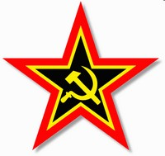
Communist rule (1948-1989)
Totalitarian regime
  Terror
  Planned economy
  Sharp restrictions on human rights and freedoms
Country and society fully under control of KSC
Formal existence of „opposition“ parties and elections
Formal liquidation of Slovak political institutions (1948, 1960)

Slide 33
Results of ‘Elections’
Year | Votes (in %) | Blank lists
1948 | 86.60 | 994,419
1954 | 97.89 | 182,928
1960 | 99.86 | 12,775
1964 | 99.94 | 6,040
1971 | 99.81 | -
1976 | 99.97 | -
1981 | 99.96 | -
1986 | 99.97 | -

Slide 35
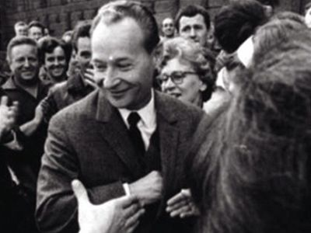
1960s and the Prague Spring
Alexander Dubček as the first Slovak selected for the chairman of KSC
„Socialism with a human face“
Two nations with different aims:
  Czechs – political reforms
  Slovaks – federalization of the country

Slide 36
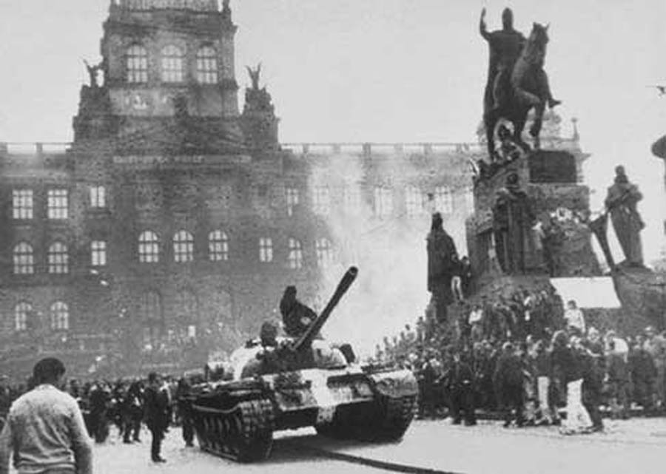
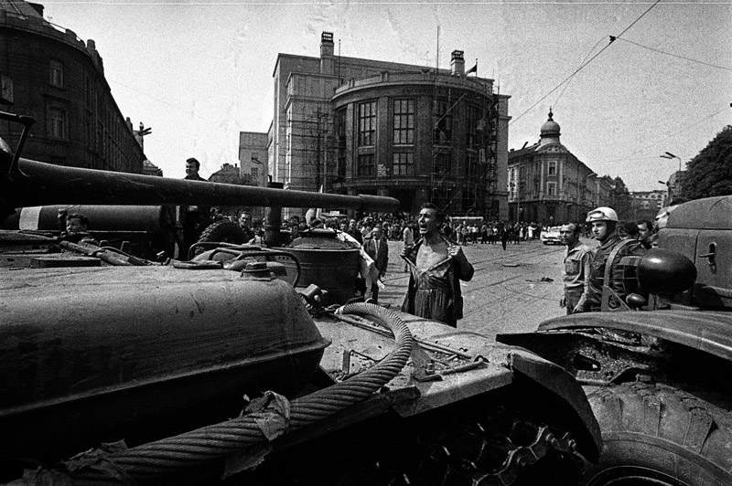
1968 – End of Prague Spring
Czechoslovakia invaded by armies of the Warsaw Pact
Stop to any liberalization for the next 20 years

Slide 37

After 1968
Federalization (1970):
  Creation of national governments and parliaments (Slovak National Council continued in its existence)
  Ban of majoritarianism
→ Only formal changes – real politics remained unchanged
Normalization (1969-1989):
  Restoration of the regime „before 1968“
  Sanctions against large groups of society
  Higher intensity in Czech part of the federation

Slide 38
Legacy for the Period after 1989
Specifics of the communist regime in Slovakia:
  „Moderate“ version of the regime when compared to Czech lands
  Achievement of federalization (despite its formal character)
  Economic modernization – industrialization, urbanization
Effects:
  Weaker dissent movement
  Higher acceptance of several principles of the communist period
  More sympathy towards the „middle way“ → support of less radical economic reforms after 1989

