Slide 1
Nationalism and Extremism in Slovak Politics
POLb1135 Slovak Politics

Slide 2
Preamble of the Constitution
„We, the Slovak Nation,
bearing in mind the political and cultural heritage of our predecessors, the experience gained through centuries of struggle for our national existence, and statehood…“
„…together with members of national minorities and ethnic groups living on the territory of the Slovak Republic“

Slide 3
Why so Much Nationalism/Extremism?
Slovakia as multiethnic country
Historical tensions and legacies
Recent development
  Financial crisis
  Migration crisis

Slide 4
Hungarian Minority
Around 450 000 citizens
Concentrated in southern part of Slovakia but this land does not form a solid region
Important issues:
  Historical bondage to the territory
  Once a dominating nation
  Self-awareness
  Strong attachment based on ethnicity

Slide 5
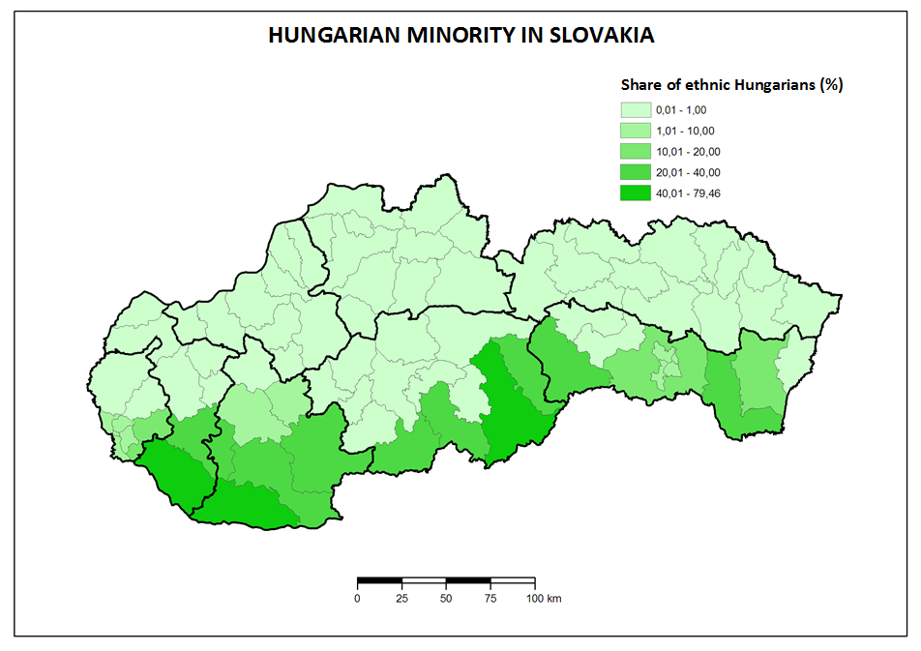

Slide 6
Hungarian Parties in Slovakia
Four stages:
  1990 – 1998 – cooperation of three independent parties
  1998 – 2009 – integration into a single party (SMK)
  2009 – 2021 – split and competition of SMK and Most-Hid
  2021 – integration into a single party (Alliance)

Slide 7
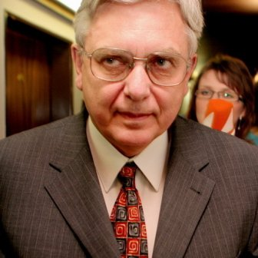
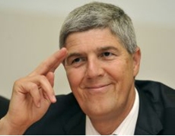
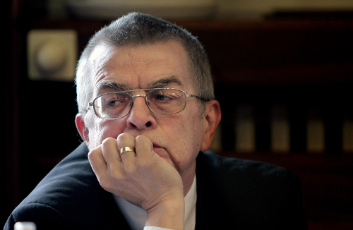
1990 - 1998
Coexistence:
  „Hawks“
  Miklós Duray
Hungarian Christian Democratic Movement:
  „Moderates“
  Béla Bugár
Hungarian Civic Party:
  „Liberals“
  László Nagy
1994 election – together as the Hungarian Coalition (MK)

Slide 8

1998 - 2009
1998 – Mečiar’s electoral reform against coalitions → MK transforms to Party of Hungarian Coalition (SMK)
Participation on executive power in both governments led by Mikuláš Dzurinda
Internal tension after elections 2006
2009 – group led by Bugár leaves SMK

Slide 9

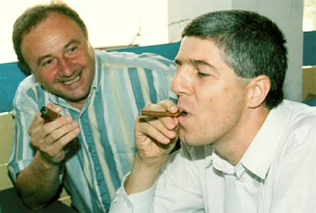
2009 - 2021
Competition of two parties:
  SMK
  The Bridge (Most-Híd)
Ethnic outbidding
Most-Híd took the earlier power position of SMK
SMK stays out of parliament
Unsuccessful effort to cooperate

Slide 10
Since 2021
A second attempt of full integration
Most-Hid, SMK and a third less relevant party
March 2021 – announcement of Alliance party
April 2021 – 5 per cent in polls

Slide 11
Why are Hungarians an Issue?
Primary features:
  Reflection of historical issues in present time (Treaty of Trianon, Beneš decrees)
  Changing intensity of mutual tension
3 models of relations:
  International (Hungary – Slovakia)
  Domestic (Slovakia – Hungarian minority)
  National (Hungarian minority – Hungary)

Slide 12
Trianon
Occasional topic for the radicals
Relevance of the topic neutralized with entry of Slovakia and Hungary to the EU
„Does anyone understand that since Trianon we do not have our home? Todays Hungary is not a real home even for those who live there, but it is only a „residual“ country“
Miklós Duray, 2006

Slide 13
Autonomy
A topic stressed more in the 90s than in the present
Different understanding of the word „autonomy“ and its content by Hungarian politicians
Autonomy of culture and schools vs. territorial autonomy
Approval of Hungarian politicians not to open this topic allowed them to participate on government after 1998

Slide 14
Hungarian Exterritorial Laws
„In a legal sense, in accordance with the Constitution, I want to act as the head of the government of all the citizens of this 10 million strong country, but inspirit and sentiment as the prime minister of 15 million Hungarians.”
József Antall, Hungarian Prime Minister in early 90s
„14-15 million Hungarians can do much more than 10 million”
Viktor Orbán, current Hungarian Prime Minister

Slide 15
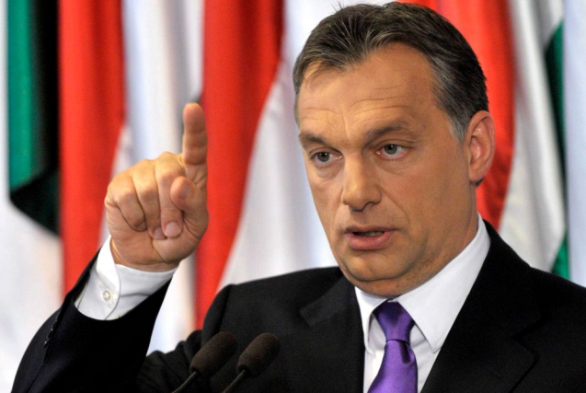
Hungarian Exterritorial Laws
Foreign IDs (2002):
  Available for „minority“ Hungarians except from Austria
  Financial advantages directly from Hungary
  Some SMK officials got these IDs
Dual citizenship (2010):
  Possibility to gain also a Hungarian citizenship
  Slovakia adopted a counter-law leading to abandoning the Slovak citizenship
  Until 2012 – about 200 thousand requests (minimum from Slovakia)

Slide 16
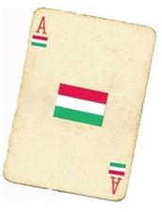
Anti-Hungarian Nationalism
Playing with the so called „Hungarian card“
Various ways of usage:
    Electoral campaign
    Daily politics
    Reactions on Hungarian political actions
    Suitable way how to overlay other negative problems

Slide 17

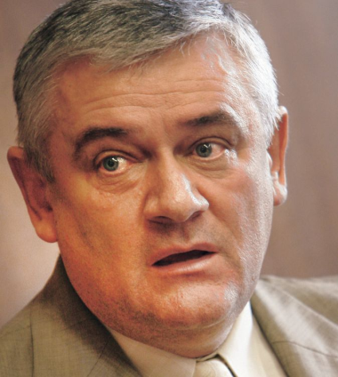
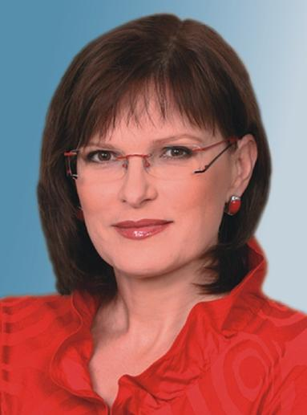
Slovak National Party
Created in 1990, claims a link with historical SNS
Radical right party:
  Nationalism, xenophobia
  Topics – Hungarians, Roma, LGBTI, against NATO, reserved towards EU
Main leaders until 2012:
  Ján Slota
  Anna Belousovová

Slide 18
Slovak National Party
Development:
  Early years – searching for identity → radicalization since 1994
  2001 – separation, Slota creates the True SNS (PSNS)
  2003 – unification after unsuccessful 2002 election
Position in the system:
  Participation in governments: 1994-1998 (PM Mečiar), 2006-2010 (Fico), 2016-2020 (Fico/Pellegrini)
  Since 2020 not in parliament

Slide 19
SNS Electoral Campaign
2006:
  We are Slovaks. A Slovak government for Slovaks (name of the manifesto)
  After 8 years of SMK in the government
2010:
  Higher intensity of hatred due to decline of party support
  Hungarians as a threat and as an enemy of the country
  Racial hatred included

Slide 20
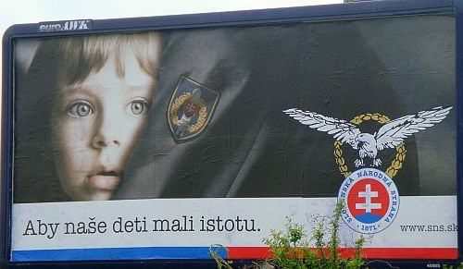
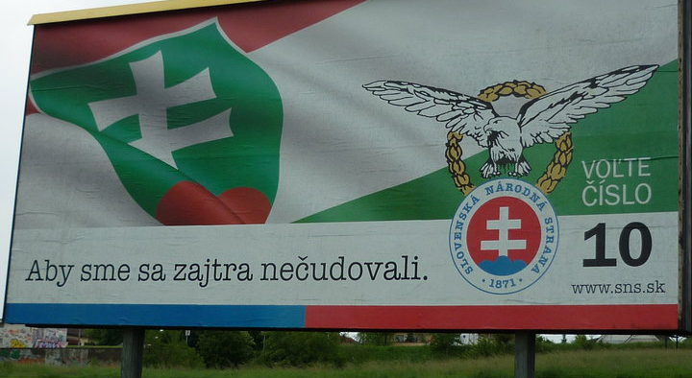
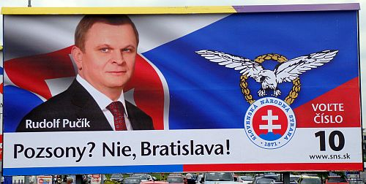
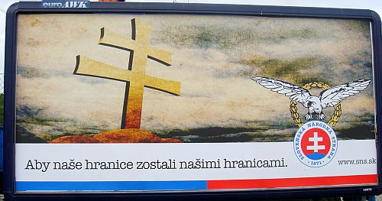

Slide 21
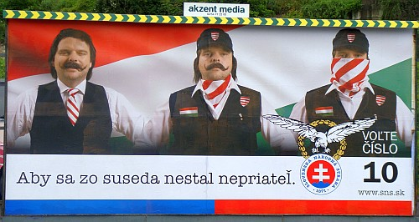

Slide 22
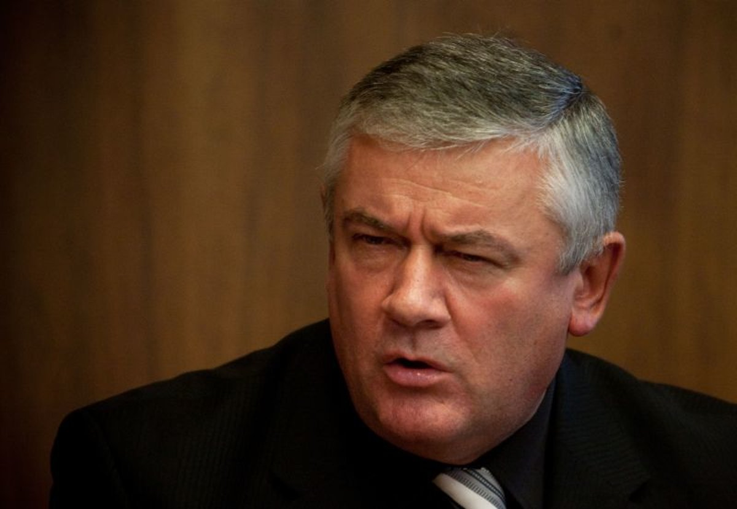
Ján Slota
  The most visible representative of Slovak nationalism until 2010
  Very offensive language towards various social groups
    Hungary, its history, symbols and politicians
    Hungarian minority
    Roma minority
    LGBTI
    Slovak politicians including prominent members of SNS
    Media
    The list continues…

Slide 23
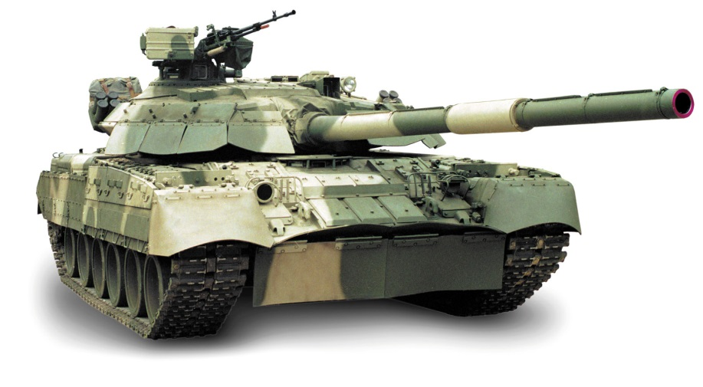
The Tank Attack on Budapest
  Most „popular“ incident
  Occurred in 1999 on a meeting of HZDS where he was a guest
  Slota called for a tank attack on Budapest
  „We will not leave it like this, we will go in tanks and we will flatten Budapest“

Slide 24
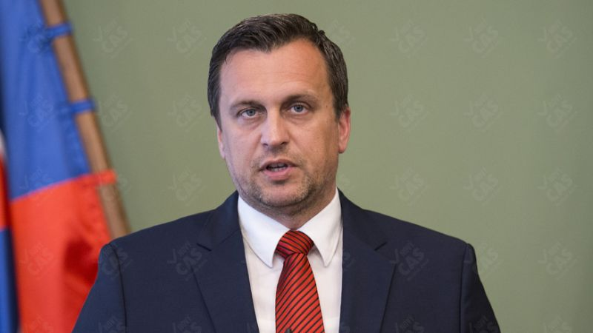
SNS Today (After Slota)
  The party officially proclaims to be ‘different’ and ‘renewed’
  Leader – Andrej Danko
  Many representatives from the 90s remained in the party
  2016-2020 in government with Hungarian party Bridge
  After 2020 election not in parliament
  Integration attempts in 2023 with far right and communists

Slide 25
Roma Minority in Slovakia
  Unclear proportion of the population
  Official census:
    1991 – 75 802 (1,4 %)
    2001 – 89 920 (1,7 %)
    2011 - 105 738 (2,0 %)
    2021 – 67 179 (1,2 %)
  Real estimations around 400 000
  Geographically concentrated in Central and Eastern Slovakia

Slide 26
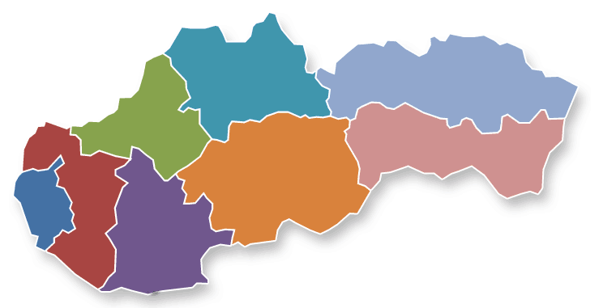
40,76
2,14
0,54
34,5
14,68
2,88
0,73
3,77

Slide 27
Roma Minority in Slovakia
  Very bad public image
  Associated features from the majority’s point of view:
    Lack of education
    Unemployment
    Poverty
    Bad living conditions and habits
    Crimes and misuse of public money

Slide 28
Surveys – „Who would you not accept as your neighbor?“
Category | 2006 | 2008
Drug addict | 84,9 | 88,6
Roma | 72,8 | 82,4
Convicted felon | 58,8 | 71,3
Right-wing extremist | 62,0 | 66,8
Muslim | 49,5 | 54,7
Homosexual | 38,8 | 51,2
Immigrant | 35,2 | 41,5
Person of a different race | 28,8 | 39,5
Jew | 21,5 | 29,0
Disabled | 6,0 | 8,7

Slide 29
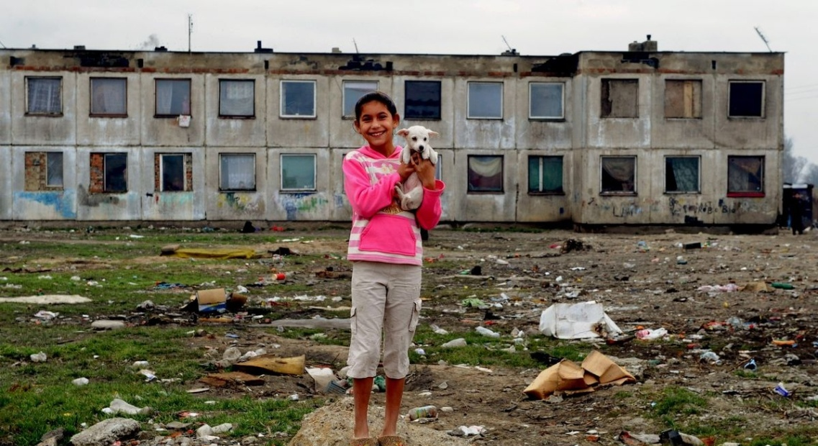
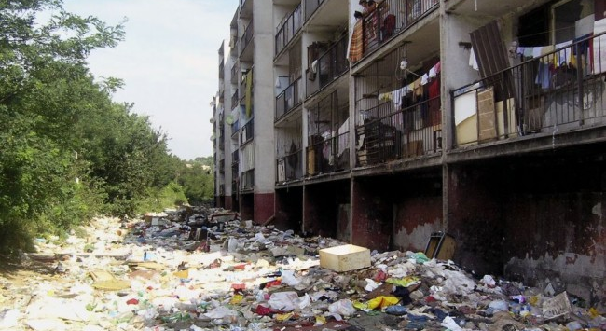
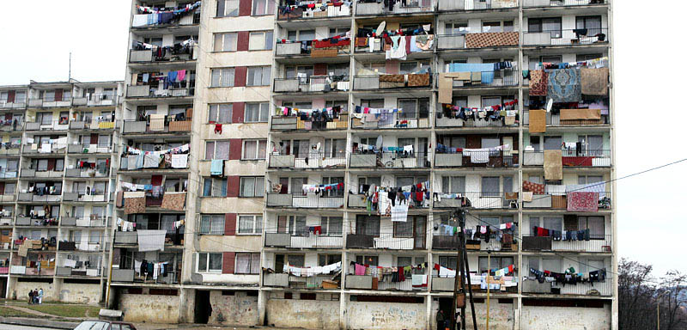
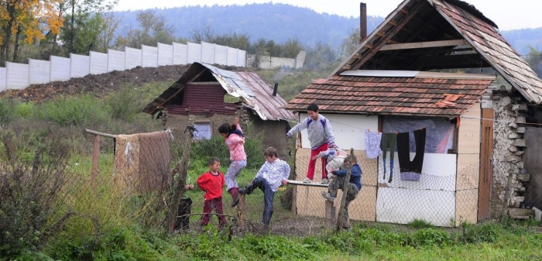

Slide 30
Roma Minority and Politics
  No relevant Roma political party
  Attempts to create such parties end without any success
  Compared to Hungarian minority:
    Low attachment to the territory
    Never being a dominating nation in the land
  Further reasons:
    Lack of organizational skills
    Non disciplined voters (low turnout; regular attempts to buy their votes)

Slide 31
Roma Minority as a Topic for Nationalists
  Mostly stressed by SNS in the past
  Ideas even beyond the principles of democracy and human rights
  Examples:
    Reservations (as Native Americans in North America)
    „A small courtyard and a big whip“

Slide 32
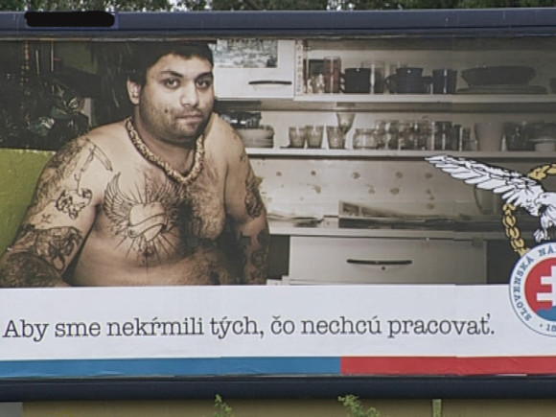
SNS campaign in 2010

Slide 33


People`s Party – Our Slovakia (LSNS)
Leader – Marian Kotleba
Emerged in 2010
Previous links with Slovak Brotherhood:
  Electoral failure in 2006
  Dissolved in 2008

Slide 34
Ideology
Slovak Brotherhood:
  Various topics
  Slovak wartime state, Hungarians, Roma, NATO…
LSNS:
  Modification of the profile
  Primary focus on Roma minority
  Other topics rather secondary
  Change after 2012

Slide 35
LSNS and Roma Minority
Party`s framing of the minority:
  Asocial parasites
  Gypsy terrorists
LSNS blames the mainstream parties for being passive and for keeping the majority unprotected
Trips to towns with Roma settlements
Kotleba’s purchase of land with an illegal settlement

Slide 36
Performance in Elections
Initially only minor success in national elections:
  2010 – 1,3 %
  2012 – 1,6 %
Change in 2013 regional election:
  Kotleba scored second in the first round
  In runoff Kotleba won over SMER’s incumbent

Slide 37
Performance in General Elections

Slide 38
Support of LSNS

Slide 39
Breakthrough in 2016 Election
LSNS gained 8 per cent (more than 200 000 votes) and entered parliament
Five times more votes than in 2012 election
The party won among young people
Rise of extremism or adoption of protest image?
  Besides racial hatred, LSNS adopted new topics
  Immigration, populism, anti-elitism, anti-EU, vaccine hesitancy

Slide 40
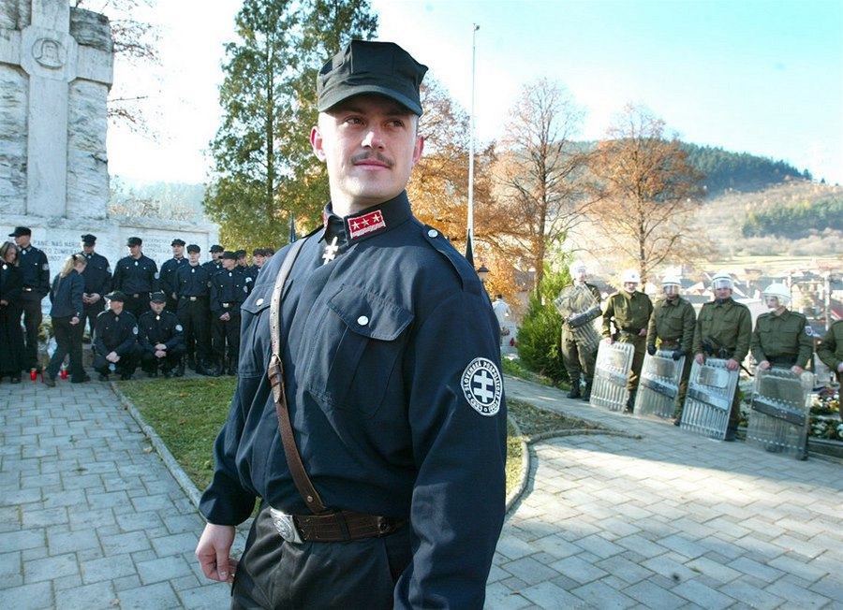
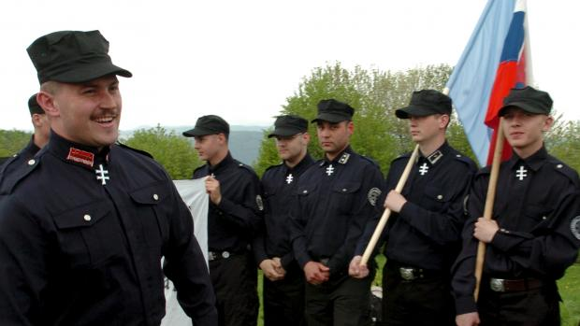
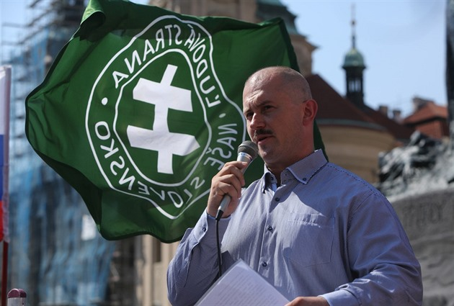
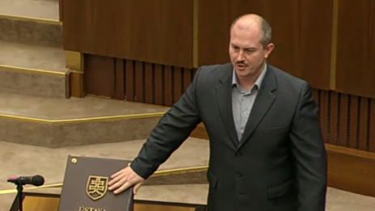
From Uniforms to Suits

Slide 41
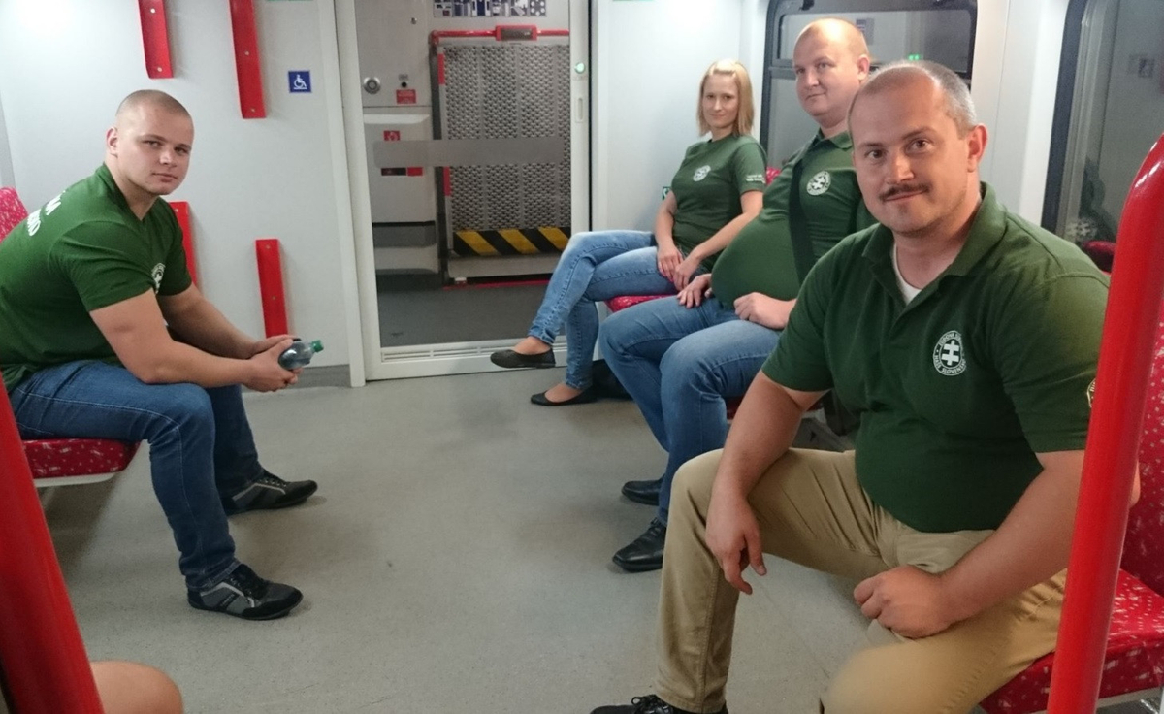
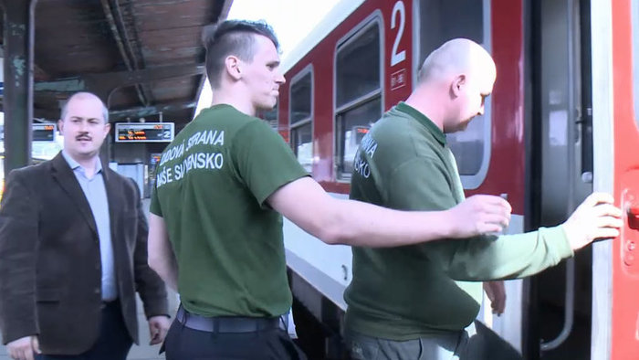
2016 - 2020
LSNS started to send patrols to trains into regions with higher share of Roma
Network of alternative media to mobilize people
Proclaimed stress on conservative values and lives of decent and working people

Slide 42
If you want to know more
From Trivialized Neo-Nazis to Parliament: Explaining the Electoral Success of the Extreme Right Party ĽSNS in Slovakia (2021)
Petr Voda, Alena Kluknavská, Peter Spáč
https://www.tandfonline.com/doi/abs/10.1080/10758216.2020.1869909

Slide 43

Split of LSNS
Change of party rules in January 2021 → Kotleba reinforced his leadership position
Several prominent members left LSNS to establish their own party The Republic
LSNS below 5 per cent in polls

Slide 44
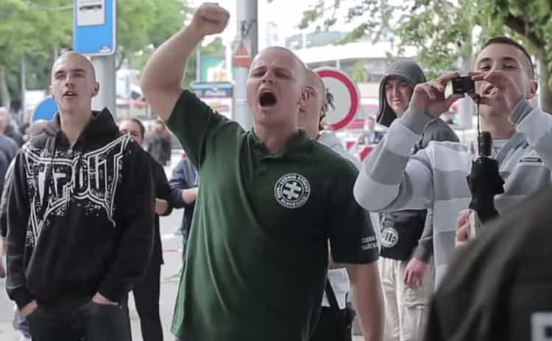
The Republic
Officially claims to protect traditional, national and Christian values and to fight against corruption
Questionable difference between Republic and LSNS
Support up to 10 per cent

