Slide 1
International security regimes
Security Systems and Actors, April 2, 2024
Vendula Divišová, vendula.divisova@mail.muni.cz

Slide 2
Outline
Definition of international (security) regime
Functions of international regimes
Difference between organization and regime
Emergence of international regimes
Examples of international security regimes
Nuclear non-proliferation regime
Open Skies Treaty

Slide 3
International regimes: definition
liberal neo-institutionalism - attempts at explaining international cooperation
Stephen Krasner (1983, 1985): „implicit or explicit principles, norms, rules, and decision-making procedures around which actors‘ expectations converge in a given area of international relations.“
„Principles are beliefs of fact, causation, and rectitude.“
„Norms are standards of behavior defined in terms of rights and obligations“
„Rules are specific prescriptions or proscriptions for action“
„Decision-making procedures are prevailing practices for making and implementing collective choice“

Slide 4
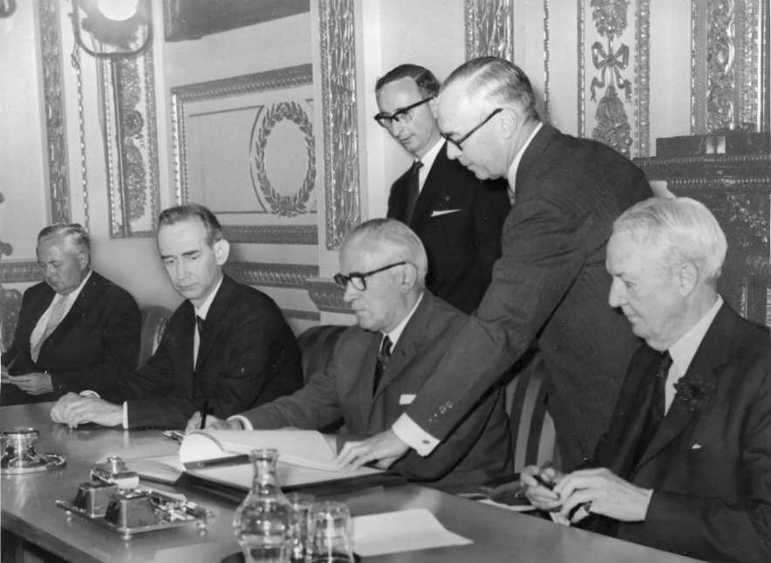
International regimes: example
Nuclear non-proliferation regime (NPT)
PRINCIPLES
„proliferation of nuclear weapons would seriously enhance the danger of nuclear war“
NORMS (the expectation of non-proliferation)
„Each nuclear-weapon State Party to the Treaty undertakes not to transfer to any recipient whatsoever nuclear weapons or other nuclear explosive devices or control over such weapons or explosive devices directly, or indirectly“

Slide 5
International regimes: example
RULES
„Each Non-nuclear-weapon State Party to the Treaty undertakes to accept safeguards, as set forth in an agreement to be negotiated and concluded with the International Atomic Energy Agency in accordance with the Statute of the IAEA and the Agency's safeguards system, for the exclusive purpose of verification of the fulfilment of its obligations assumed under this Treaty with a view to preventing diversion of nuclear energy from peaceful uses to nuclear weapons or other nuclear explosive devices“
PROCEDURES
„Any Party to the Treaty may propose amendments to this Treaty.“ (…)

Slide 6
International regimes: definition
criticised as being too vague
Keohane → a “lean“ definition:
„Regimes are institutions with explicit rules, agreed upon by governments, that pertain to particular sets of issues in international relations.“
regimes are issue-specific (limited number of topics and problems)
different types of regimes (security, economic, human rights… )

Slide 7
International regimes and states
states as principal actors in world politics - rational actors seeking to maximize their national self-interest
regime theory: states‘ interests are not necessarily conflictual → common interests
states motivated by absolute gains (x relative)
both conflicting and common interests → states mutually adjust their policies = cooperation
in regimes states might even sideline their national interests
x realists - relative gains, regimes determined by power distribution

Slide 8
International security regimes: function
regimes as a way of solving the security dilemma and anarchical conditions of the IS
security enhancement
greater predictability and uncertainty reduction
confidence-building (e.g., verification mechanisms)
development of communication channels
easier access to information
problem-solving
reduction of costs

Slide 9
International regimes x international organizations
Organizations
formal structure, legal status
often multiple shared interests and goals among member-states
can be part of a regime
Regimes
express interests of states in case of absence of international organization
does not have a capacity to act
less institutionalized
narrow focus (issue-specific)

Slide 10
Emergence of international regimes
2 possible scenarios:
regime does not exist + neither is its existence needed = a non-regime situation
independent decision-making of sovereign entities under anarchical conditions
a situation, under which regime emerges + interest in its existence and continuance = a regime situation
all actors are willing, based on a selfish rational calculation, to give up independent decision-making in favor of joint decision-making
arises in case of common interest or common aversion

Slide 11
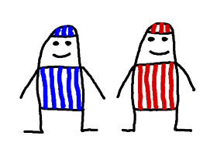
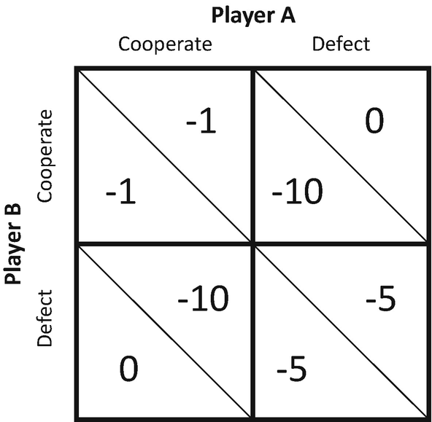
Emergence of international regimes
Common interest
when the independent decisions of actors lead to an equilibrium state that is suboptimal for all participating actors (Prisoner‘s dilemma)
establishment of an international regime as a guarantee that the counterparty will not cheat and will cooperate in the future
e.g., arms races
https://www.youtube.com/watch?v=t9Lo2fgxWHw

Slide 12
Emergence of international regimes
Common aversion
if the actors' strategies are not to achieve the same outcome, but all agree that there is at least one potential outcome to be avoided
cooperation does not achieve the best possible outcome, but prevents the worst possible outcome
e.g., traffic conventions

Slide 13
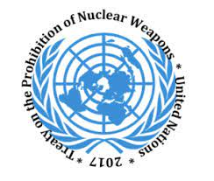
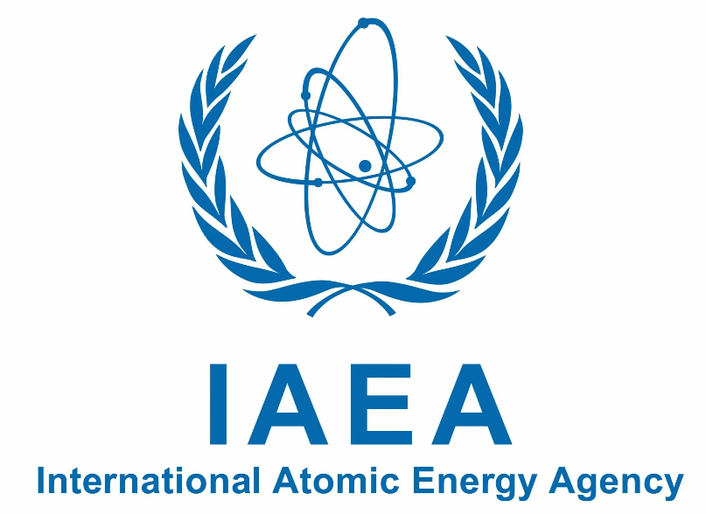
Example 1: Nuclear non-proliferation regime
aim - stopping nuclear proliferation + disarmament
a set of interrelated treaties and organizations
Treaty on the Non-Proliferation of Nuclear Weapons (NPT)
Comprehensive Nuclear-Test-Ban Treaty (CTBT) VIDEO
Intermediate-Range Nuclear Forces Treaty (INF)
New START
Treaty on the Prohibition of Nuclear Weapons (TPNW)
treaties establishing nuclear-free zones
specific norms and rules (bans, control mechanisms)
includes interational organizations (e.g., IAEA)

Slide 14
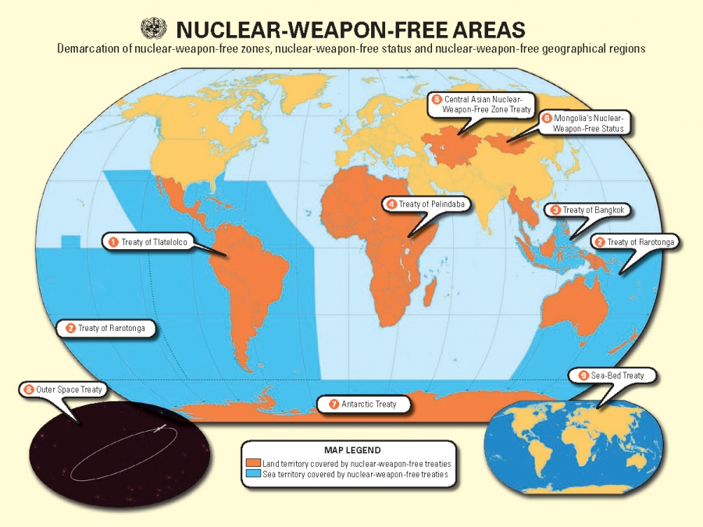

Slide 15
Example 2: Open Skies Treaty
2002 - entered into force
permits each state-party to conduct short-notice, unarmed, reconnaissance flights over the others' entire territories to collect data on military forces and activities (based on quota)
obtained information available to all parties
32 members in total, US (2020) and Russia (2021) withdrew
The Open Skies Consultative Commission (OSCC) - responsible for implementation

Slide 16
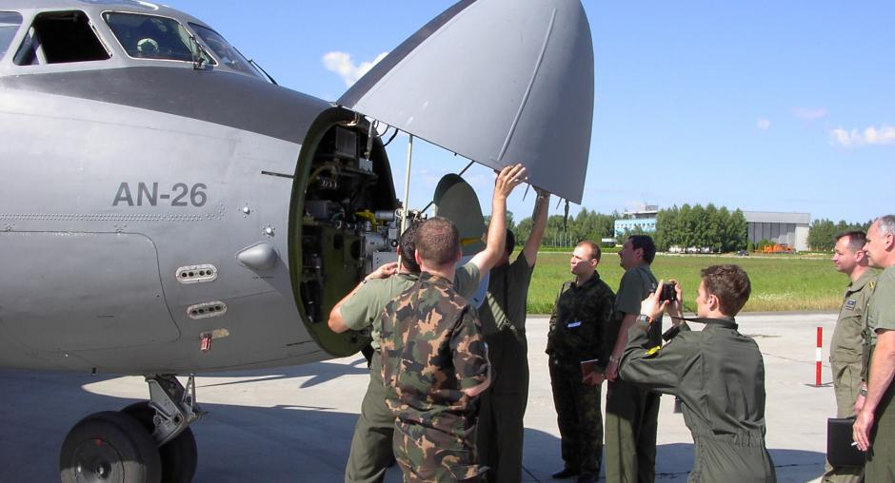
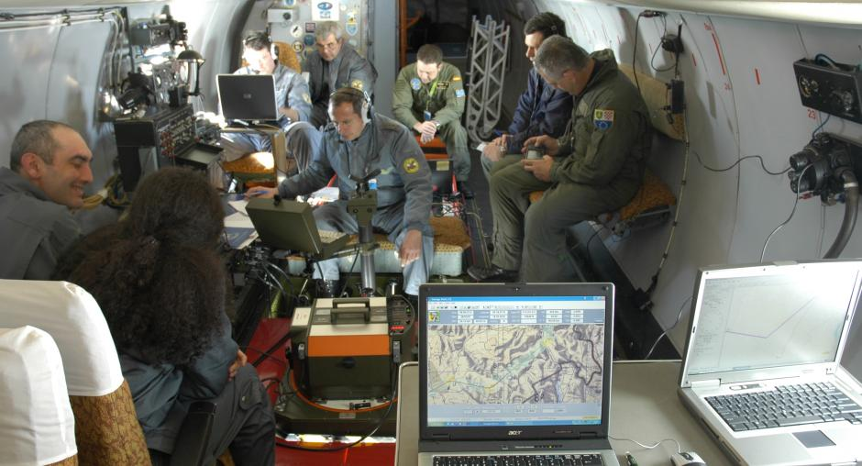

Slide 17
Group discussion
Have we entered an era of international regimes' erosion? Can this process be stopped in the near future?
Can you identify examples of regime situations? (What new regimes are needed in the area of international security?)

