Slide 1
Violent Non-State Actors (VNSA) and Contemporary Armed Conflicts
Lucie Konečná
CDSn4005 Security Systems and Actors
23/4/2024

Slide 2
Conflict - Definition
An armed conflict is a contested incompatibility that concerns government and/or territory where the use of armed force between two parties, results in at least 25 battle-related deaths in one calendar year.
Conflict: clash between two actors who have incompatible interests.
Necessary features of conflict according to Holsti (1991):
a) Actors of the conflict
b) Area of the clash (incompatibility)
c) Tension
d) Conflict behavior
War: o Intensity and duration of fighting o What territory and to what extent it is affected o The size of the involvement of the armed forces o The extent of the population affected by the conflict o Organization and continuity
Civil War Criteria: a) Organized military actions
b) At least 1000 victims per year
c) Participation of the armed forces of the government (state actor)
d) Effective resistance from opposition forces (5%)

Slide 3
Conflict - Typology
Based on:
a) strength/intensity - low, medium, or high intensity conflict (war).
b) used means: violent, non-violent (armed, unarmed).
c) causes: territorial, ethnic, religious, constitutional, ideological, economic, etc.
d) location (geographical level): international, transnational, national
e) actor - non-state/sub-state, intrastate, and interstate
intrastate conflict (civil war vs. intercommunal war)
extrastate conflict
Types of conflict internationalization
Typology of actors:
a) primary, secondary, external (tertiary)
b) spoilers
c) participants vs. conflicting parties

Slide 4
The Bloodiest Conflicts of the 21st Century
The bloodiest conflicts of the 21st century
DRC (1998 – 2003) | 2,5 – 5 mil
Afghanistan (2001-2014/21) | 170 00
Iraq (2003-2011) | 200 000 - 1,2 mil
Syria (2011 -) | 500 000
Yemen (2014 -) | 500 000
Darfur (2003 -) | 400 000
Nigeria (2009 -) | 200 000
Somalia (1991 - ) | 500 000
Tigray War (2020-2022) | 400 000 – 800 000
Ukraine (2022-) | 150 000 – 500 000

Slide 5
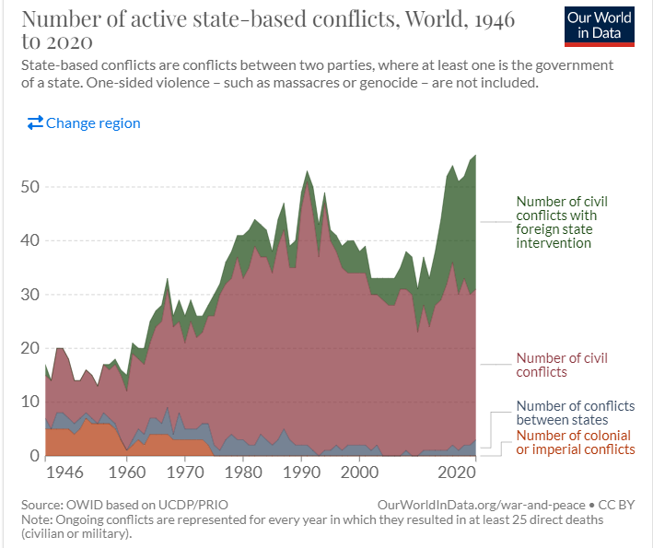
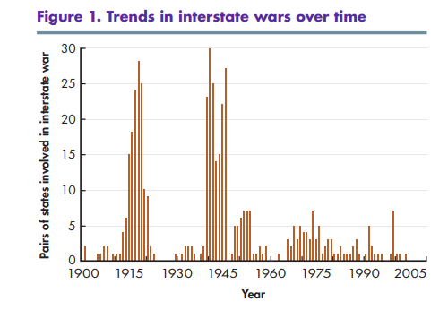
Contemporary Conflict Trends
1. A decrease in the number of interstate wars and an increase in the number of intrastate and substate wars,
2. Internationalization of national/intrastate conflicts
3. Engagement of foreign units that are motivated by the economic and strategic interests of their countries
4. An increase in identity conflicts
5. An increase in conflicts involving VNSA
6. An increase in civilian casualties

Slide 6
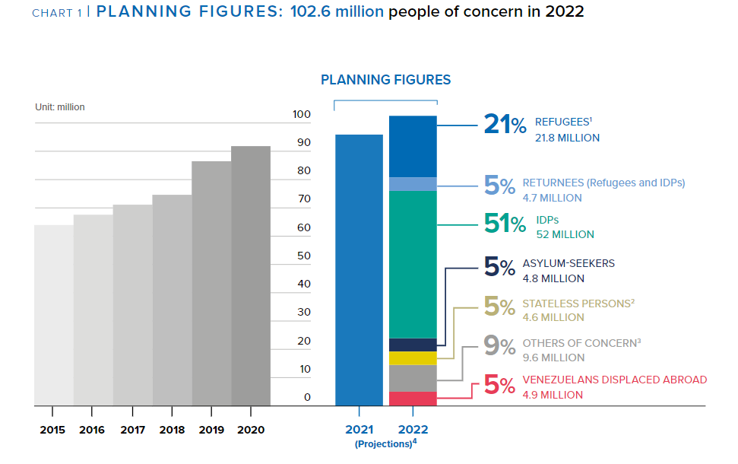
Contemporary Conflict Trends
7. Increasing numbers of refugees and internally displaced persons
8. Development of humanitarian activities and aid
9. Technologization of war and information warfare
10. Privatization of conflicts
11. Brutalization of conflicts
12. Extending the duration of conflicts

Slide 7
VNSA - General Info
Primary, secondary, and tertiary conflict actors
Intrastate, Interstate, and Non-state/Sub-state conflicts
Violent Non-State Actors:
a) use violence to achieve their goals
b) are not integrated within formalized state structures
Violence that involves violent non-state actors is often described as unconventional
Violent non-state actors involved in a low-intensity conflict may prefer the status quo over negotiation and mediation because their power is much lower

Slide 8
Factors Affecting the Rise of VNSA
End of Cold War and the emergence of a globalized world
Socioeconomic factors and absence of goods and services
Repressive politics
Poverty and income inequality
Weakness of security institutions
State collapse
Individual explanations (rural vs. urban, age, education, socio-economic status, unemployment, socio-psychological level)

Slide 9
Typology of War Participants
1. Members of the armed forces according to international law:
Combatants – members of regular or irregular armed forces
Non-combatants - not intended for combat duties (medics, clerics).
2. Civilians
Real fighters in modern wars:
Conventional soldiers/army
Insurgents, guerrillas and rebels/partisans
Terrorists
Mercenaries, PSC/PMC
Foreign volunteers
Warlords
Child soldiers
Paramilitary units and death squads
Militias
Marauders

Slide 10
VNSA Typology according to Williams
Rebels/Insurgency
Militia
Paramilitary units
Terrorist groups
Warlords
Criminal organizations and gangs
Motivations and purpose
Strength and scope
Funding and access to resources
Organizational structure
Role of violence
Relationship between VNSA and state
Functions VNSAs fulfill for members and supporters

Slide 11
VNSA Typology according to Ezrow
Insurgents
Warlords and Marauders
Paramilitary units
Terrorist Organizations
Private security companies
Organized crime and gangs
Motivation
Strategy and tactics
Funding and access to resources
Organizational structure
Scope and power
Victims
Legitimacy and popularity

Slide 12
VNSA Typology according to Schneckener

Slide 13
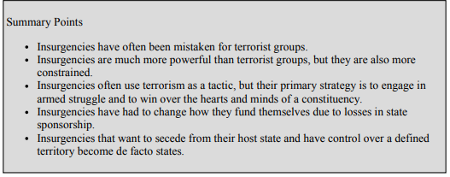
Insurgency and rebels
The primary raison d'être of these groups is to achieve some political goal
Territorial control
Strategy - irregular attacks and war of attrition
Hierarchical structure, in recent years there has been decentralization
A threat to the legitimacy of the state
Four basic types: liberationist, separatist, reformist/revolutionary, and religious/traditional.

Slide 14
Insurgency

Slide 15
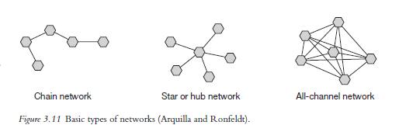
Terrorist Organizations
A deliberate form of politically motivated violence
Lack of territorial character
Low threat to state legitimacy (very little public support)
Strategy - psychological impact, shock a wide audience, attacks mainly on civilians
Structure - currently mainly network
Arquilla a Ronfeldt (2001) - Networks and Netwars: The Future of Terror, Crime, and Militancy
Zelinsky a Shubik (2008) – hierarchy, franchise, venture capital, a brand

Slide 16
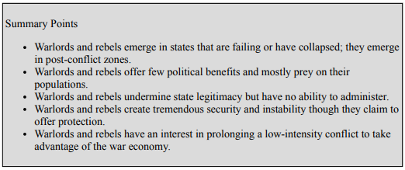
Warlordism
Primarily economically motivated violence
Strong territorial character
Hierarchical structure - headed by a charismatic leader
A threat especially to weak states
Strategy - marauding terror, unpredictable and random violence

Slide 17
Organized Crime and Gangs
Economic motivation
Often transnational
Hierarchical and network structure
Strategy - use of violence to achieve economic goals, attempt to avoid media attention, violence especially in times of uncertainty
The effort to subvert the structures of the state - they do not want to completely destroy the state

Slide 18
Private Military Companies
Economic motivation
Territoriality is related to the type of task/contract
Hierarchical structure
Strategy - they do not have long-term strategies, it always depends on the contract
Can threaten the state's monopoly on the use of violence, ineffective as a long-term solution
Executive Outcomes, Blackwaters/Academi, Wagner Group
United Nations Mercenary Convention 2001 (The convention extends on the Geneva Conventions Protocol I which in Article 47(1) states that a mercenary cannot be a lawful combatant or prisoner of war)
Mercenaries: foreigner, independence – not a member of the army, economic motivation, obscure recruitment, short-term/ad hoc tasks, engaged in combat
Military Providing Firms, Military Consulting Firms, Military Supporting Firms

Slide 19
Class Participation- Discuss the following points:
Which factors do you think have contributed to the increase in the deployment of Private Military Companies?
What type of VNSA do you think represents the biggest threat to the Czech Republic? Why?
Do you know some examples of interstate conflicts after 1990 from Asia, America, Africa, and Europe?
Do you know any other contemporary conflict trends that have not been mentioned?

Slide 20
Thank you for your attention

