Slide 1
April 8, 2024

Slide 4
Chapter 9 – Can we overcome the obstacles?
What are the main obstacles?
In 3 sentences, describe to a friend the main take home message of the book.

Slide 5
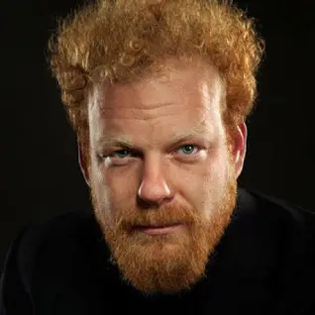
Economics
The Czech economist Tomas Sedlacek, who was President Vaclav Havel’s economic adviser
Also, wrote: Lilith and the Demons of Capital: The Economics on Freud's Couch
Courage:
https://www.gloriabenedikt.com/courage-1

Slide 6
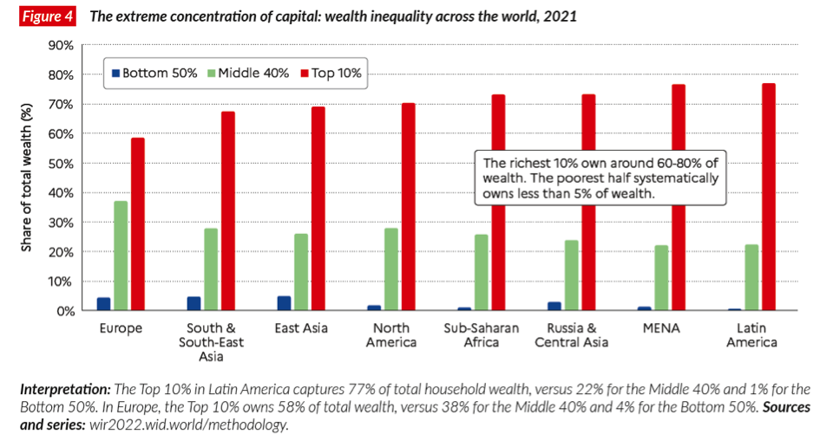
Capital in the Twenty-First Century
French economist Thomas Piketty’s claims a fundamental feature in society is that income inequality will increase over the long term given current economic approaches. His scenario is alarming: extreme concentration of wealth by a relatively small group of super-capitalists and super-managers

Slide 7
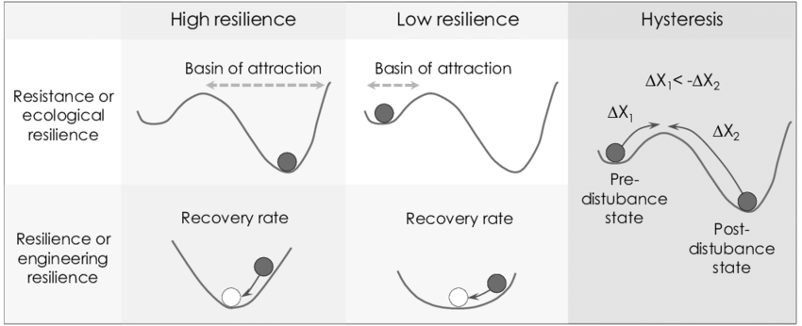
Economic models are often misleading
They assume a general equilibrium with one maximum outcome
Complex systems often (always) have multiple stable states thereby some luck and other circumstances are involved (rule-makers).

Slide 8
Biophilia
Great art and science reflect a deep understanding of fundamental values and worthy objects. There has been a focus on commercial values and money, not on cultural and natural values. That has made most people more restless and unhappy because real happiness is rooted in culture and nature.

Slide 9
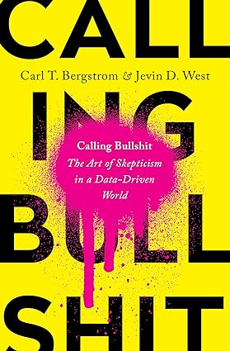
Misinformation
Climate denialism
Evolution
In spite of these facts, religious fundamentalists have been able to persuade more than 42 million Americans to believe that the Earth is only 7,000 years old! Incredible, but true.
What else?
Bergstrom, C.T., West, J.D., 2020. Calling Bullshit: The Art of Skepticism in a Data-driven World. Random House. Boland, G.S., 2010. Challenges

Slide 10
Summary action plan
All industrialized countries with a gross national product (GNP) per capita greater than $20,000 per year pay 0.8% of GNP, increasing by 0.04% per year, as aid to the developing countries.
Ten per cent of this support is applied for family planning.
Forty per cent of the support is used to improve education, including agricultural education, and with particular emphasis on the education of girls and women.
To sufficiently control pollution, 2.5% of the production value, or maybe more, must be allocated.
A resource-based, revenue-neutral Pigovian tax of 8% on average is implemented.
A massive investment, 10% of GNP, is made in education, innovation, and research in the industrialized countries, which has a positive impact on the production and the application of the three Rs and thereby on natural resources maintenance.
Do not increase overall agricultural area but increase the yield on the existing areas by a considerable, yet still realistic, increase in agricultural efficiency.
Ensure that nature is kept intact.
Shift from quantitative to qualitative production
A (fast) shift to renewable energy is compulsory due to disastrous consequences of global warming resulting from the emission of greenhouse gases.
Reprioritize policies toward other more encompassing goals than simply economic growth. All major decisions require environmental and social considerations in addition to an economic evaluation.
Change the economic structure such that activities that promote community sustainability are rewarded. Rein in all the unserious gambling and the exorbitant profits on the financial markets. Reduce tax on work and increase tax on financial profits.

Slide 11
Summary
Ecosystems are very good at maintaining at the carrying capacity with substantial but not growing production.
Current economics emphasizes increasing production—in addition to supporting all the existing built structure.
Quantitative growth is an early immature stage according to ecological succession.
How growth is viewed in ecological versus societal systems is one of the main conflicts and leads to much of the tension in resolving environmental management.
the business-as-usual approach of chasing perpetual economic growth is failing. It is not sustainable on our finite planet, and it is not solving the problems of unemployment, poverty, and inequality – in contrast to what economists and politicians claim.

Slide 12
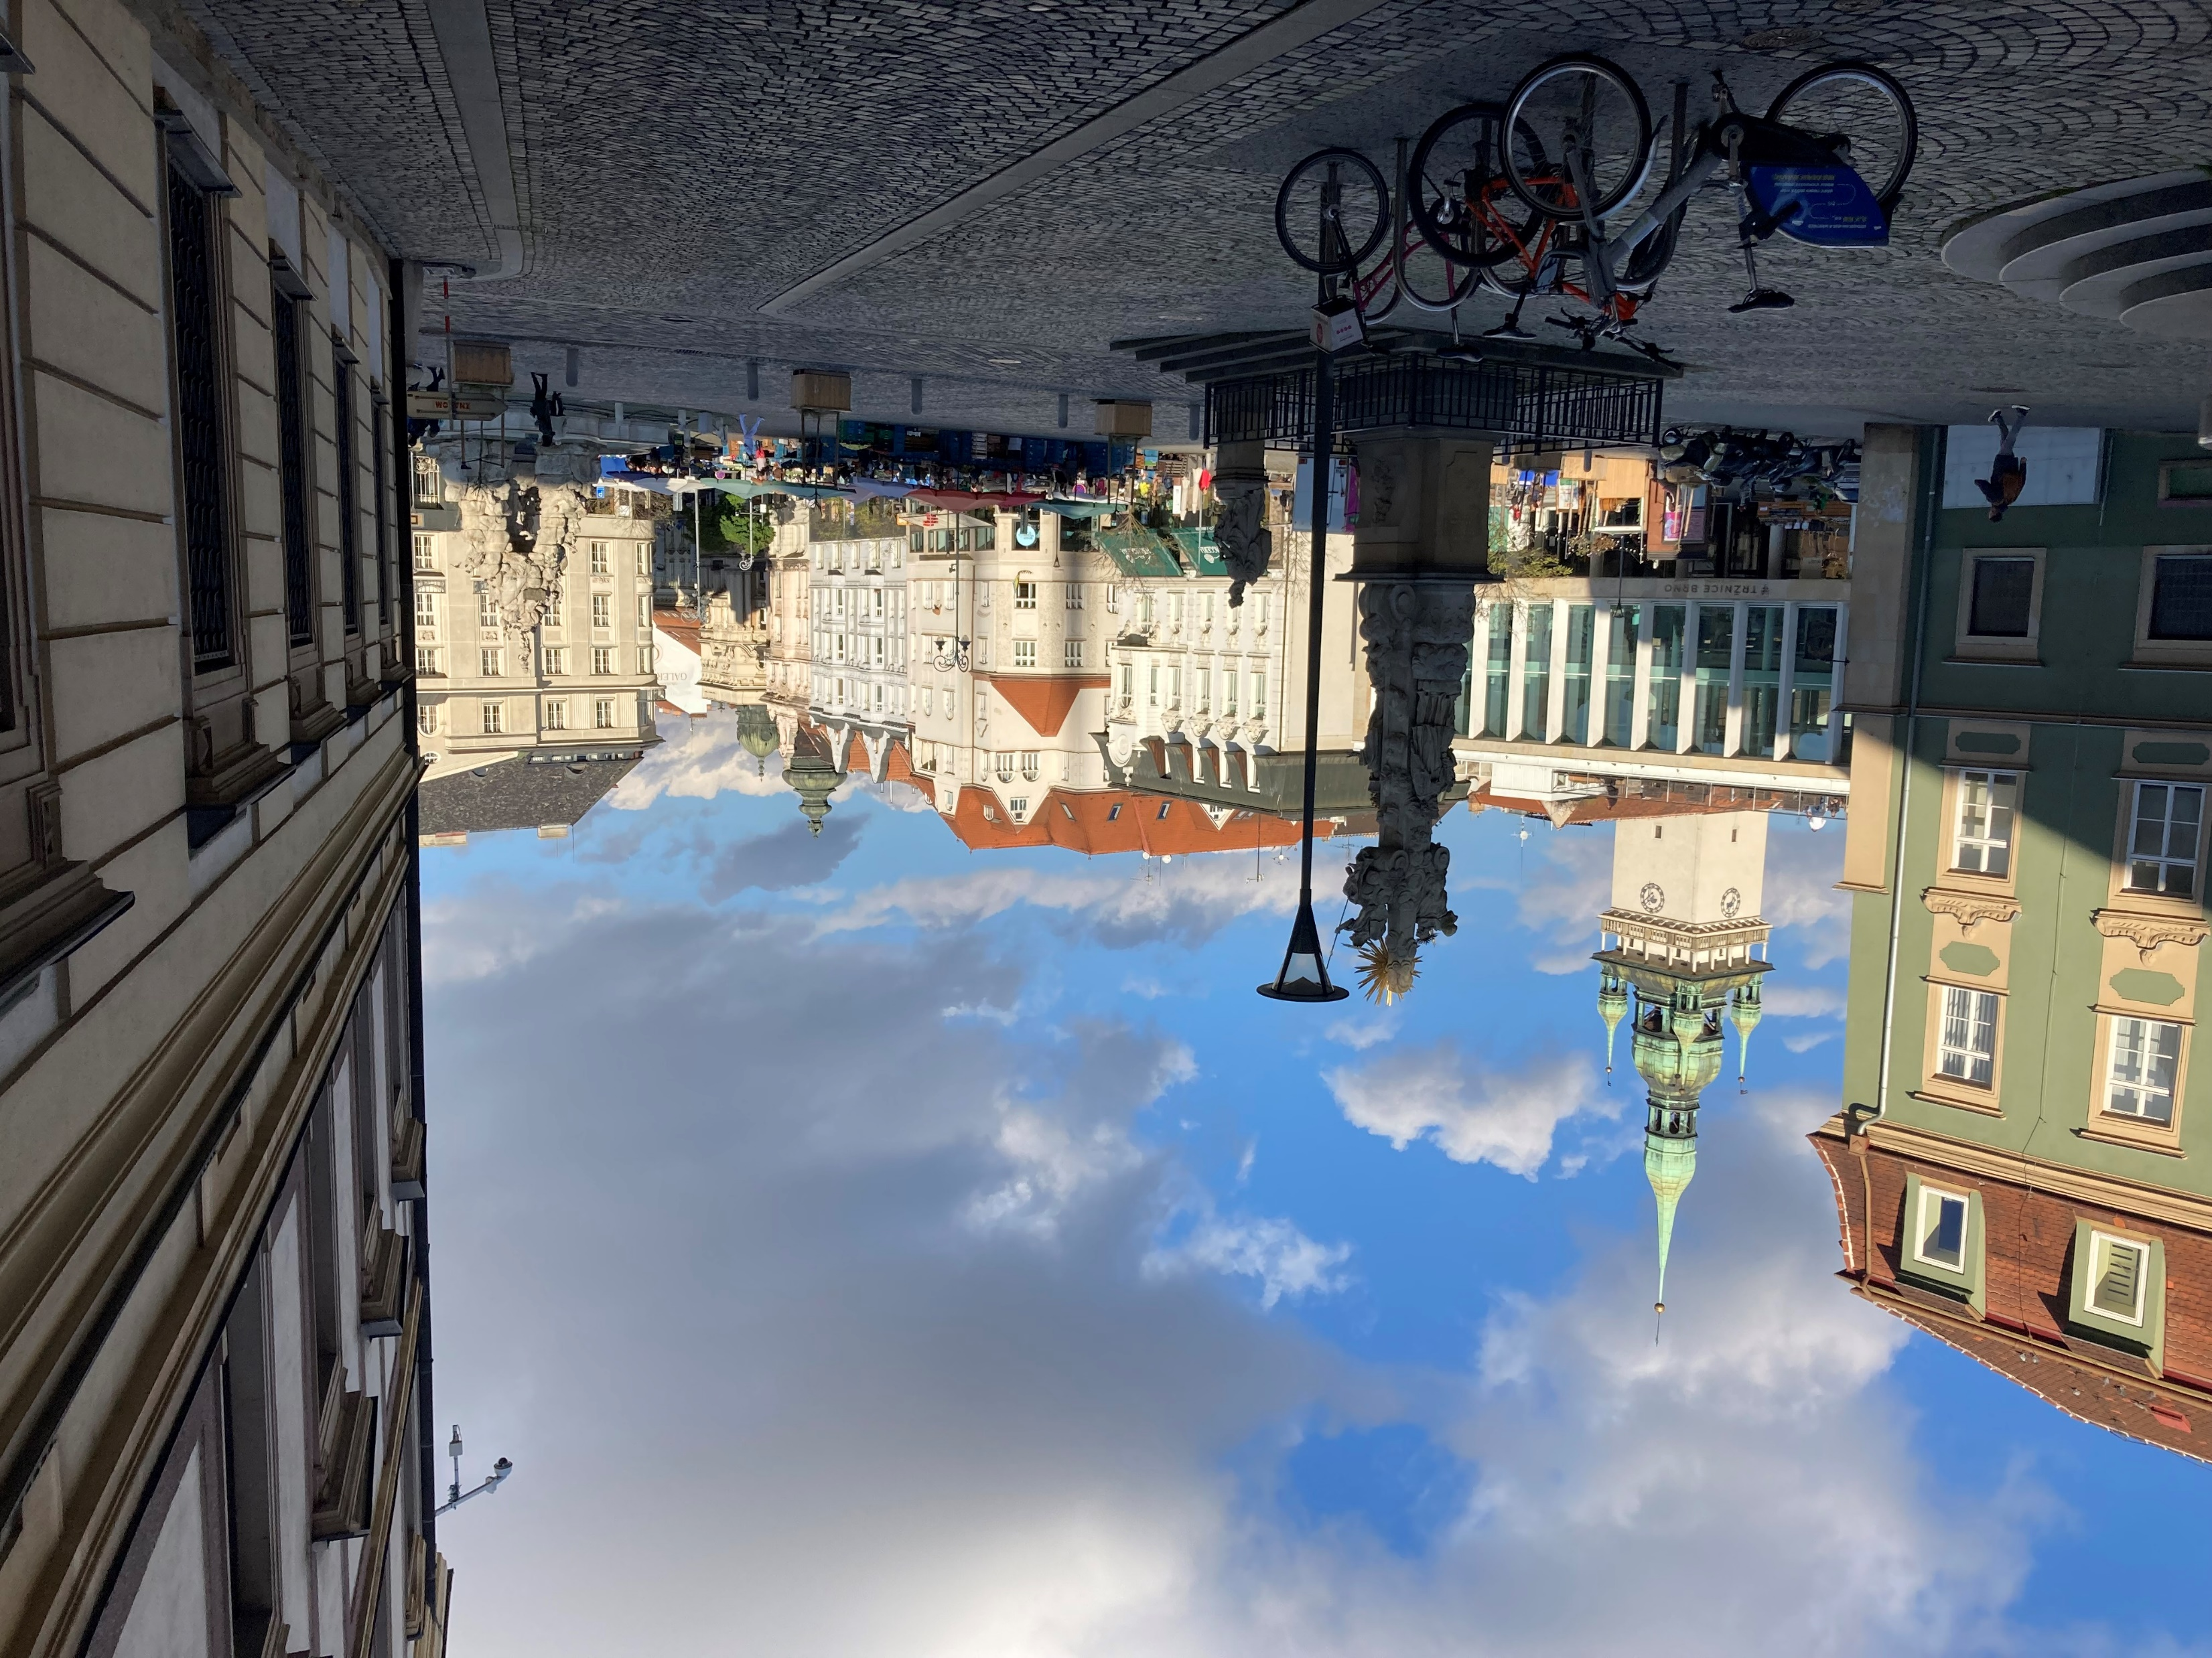
THANK YOU FOR YOUR ATTENTION

