Slide 1
Lecture 1.2: Understanding systems

Slide 2
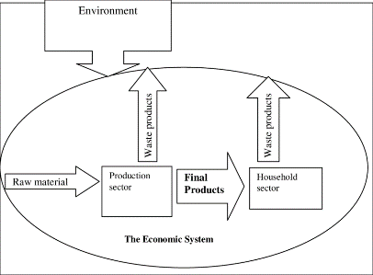
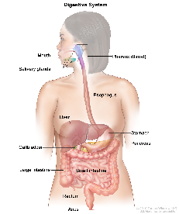
Understanding SYSTEMS!
A set of inter-relationships between components or parts that function together to act as a whole
A system is simultaneously both a system and a part of a larger system
Economic system
Digestive system
Computer system

Slide 3
Hierarchical Representation of Systems
Hierarchical levels can be identified by a stronger set of interactions within a hierarchical level than between levels.
Level n+1
Level n
Everything possess both self-assertive (when functioning as a system) and integrative tendencies (when being a part in a system)
Level n−1

Slide 4
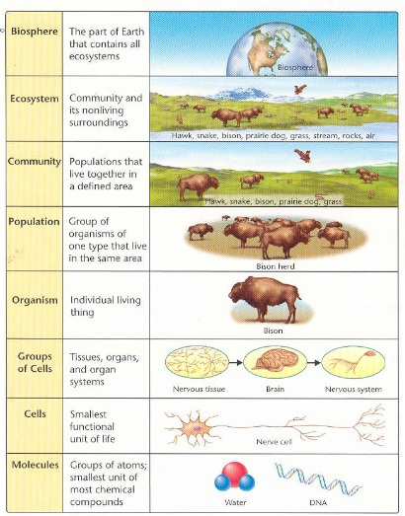
Hierarchy
A system is simultaneously both a system and a part of a larger system
Something that is both a part and a whole has been called a “holon”, the basic part—wholes of a hierarchy

Slide 5
Old perspective, dichotomy between system and environment
System
Environment
New perspective, system is focus of two environments
Where does it come from?
Where does it go?
Input Environment
H
Output Environment

Slide 6
Thermodynamic (energy) systems-
Energy is the ability to do work
Forms of energy: potential, kinetic, thermal, chemical, electrical, etc.
1st Law of Thermodynamics:
energy cannot be created or destroyed
2nd Law of Thermodynamics:
energy goes from a high quality to a lower quality during each energy transformation; while energy is conserved, it’s ability to due work decreases

Slide 7
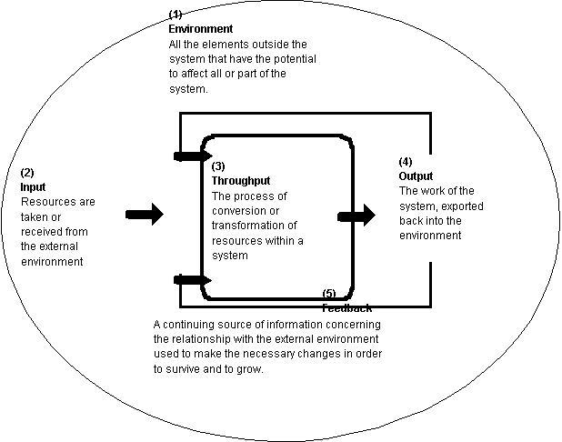
OPEN SYSTEMS are characterized by the continual input, throughflow, and output of matter and energy –
ALL ENVIRONMENTAL SYSTEMS ARE OPEN SYSTEMS

Slide 8
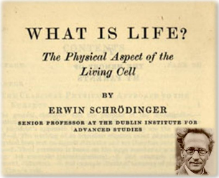
What is life?
Biological systems build structure (they grow) and maintain (metabolize) complex structures within their boundaries by diverting high-quality energy and exporting low-quality.
“The device by which an organism maintains itself at a fairly high level of orderliness consists in continually sucking orderliness from its environment” –Schrödinger. 1944. What is life? p.73.

Slide 9
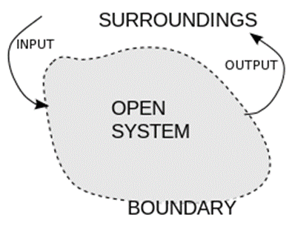
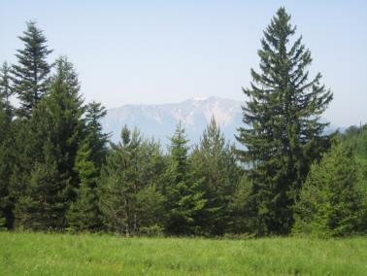
A system is an assemblage of parts that function in some way as a whole
Establish a system boundary
What are the parts inside the system?
How are they connected?
Receives inputs
Generates outputs
When outputs become inputs that is feedback –
posses capacity for self-organization (growth) and self-regulation (stability)

Slide 10
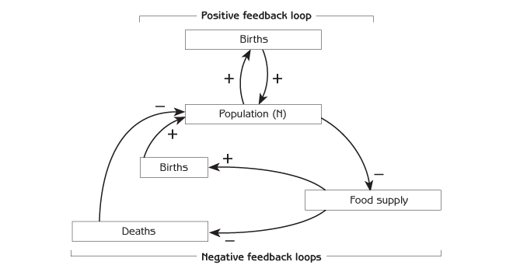
FEEDBACK as a consequence of interconnections
Ecological Systems possess capacity for
(a) self-regulation: negative feedback - deviation damping, stabilizing
(b) self-adaptation: positive feedback - deviation-amplifying, destabilizing

Slide 11
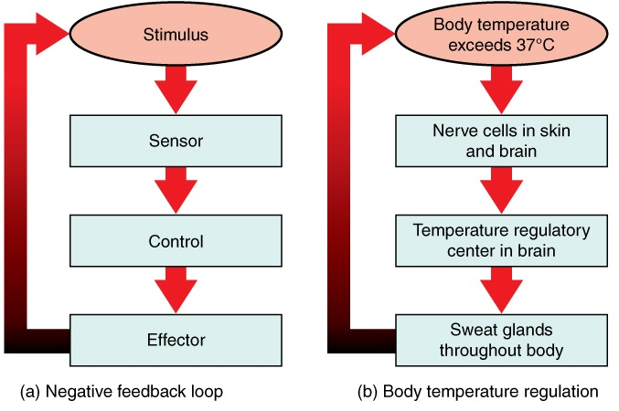
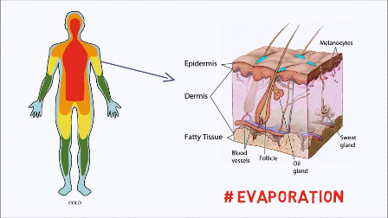
Stabilizes body temperature

Slide 13
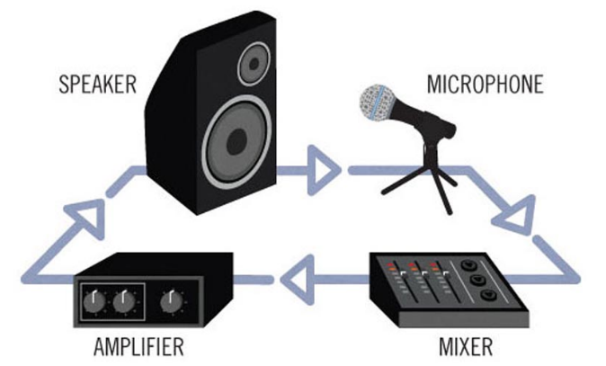
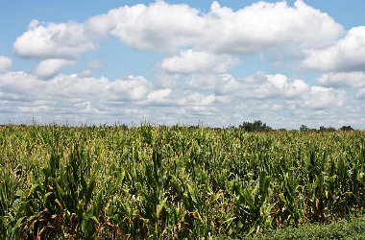
Positive feedback – when the signal is amplified and moves the system further from its original condition
Biological growth is a positive feedback
Sound system
→

Slide 14
All system dynamics are an interplay of positive feedbacks that grow and change the system and negative feedbacks that stabilize and maintain the system
For example:
Negative feedback
Positive feedback

Slide 15
Input-Output models – Box and arrow models
Flow
Amount/time
X
Storage
amount
X
World population
(people)
Input
Output
Births
People/year
Deaths
People/year
X
Water in bathtub
(liters)
Faucet
Liters/second
Drain
Liters/second
X
Students at MU
X
Students at MU
Graduation
Students/year
Graduation
Students/year
Matriculation
Students/year
Matriculation
Students/year
Leave university
Students/year
Transfer
Job

Slide 16
Input Output models
Flow
Amount/time
X
Storage
amount
X
World population
(people)
Births
People/year
Deaths
People/year
X
U.S. Population
Births
People/year
Deaths
People/year
Immigration
People/year
Emigration
People/year

Slide 17
Input Output relations
Flow
Amount/time
X
Storage
amount
Storage increases
Input>output
Storage decreases
Input<output
Storage remains same level
Input=output

Slide 18
Input Output relations
Flow
Amount/time
X
Storage
amount
Input>output
Deaths
X
U.S. Population
335,000,000 people
Births
4,130,550
People/year
2,797,250
People/year
1,015,050
People/year
Net migration
Change in population = Births + Net migration – deaths
4,130,550 people/year +1,015,050 people/year – 2,797,250 people/year = 2,348,350 people/year
New population at time t = initial population + change in population * years (t)
335,000,000 people + 2,348,350 people/year * 1 year = 337,348,350 people

Slide 19
Input Output relations
Flow
Amount/time units
X
Storage
Units of some amount
Input<output
U.S. Oil reserves (2020)
43.8 billion barrels
0
barrels/day
9.5
Million barrels/day

Slide 20
Input Output relations
Flow
Amount/time units
X
Storage
Units of some amount
Input=output
Bank Account
$3000
Income
$1,000/ mo
Expenses
$1,000/ mo
When input = output, this is called steady state system
The system is changing but balanced

Slide 21
Practice making some input-output models of systems of your choice
Can you quantify the flows and compare input and output?

Slide 22
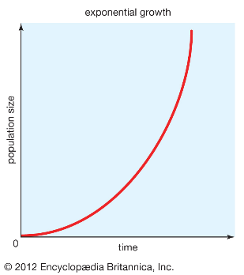
Exponential growth
Growth at a constant rate
$$\frac{dN}{dt}=rN$$
Where N is the population size, dN/dt is the change in population over time, r is the constant rate of growth
Exponential growth grows unbound

Slide 23
Exponential growth
$$\frac{dN}{dt}=rN$$
Solving for N gives the following:
$$N_{t}=N_{0}e^{rt}$$
Where N_{t} is the population size at time t, and N₀ is the initial population size (at time zero), and e is the exponential. e is a number = 2.71828…

Slide 24
Exponential growth
$$N_{t}=N_{0}e^{rt}$$
Example:
N₀ = $1,000
r = 3%/year = 0.03/year
t = 30 years
Step 1: multiply r*t = 0.9
Step 2: take e^{(rt)} = 2.4596
Step 3: multiply by N₀
N_{t} = $2,459.6
What if you wait 40 years? N_{t}=$3,320.1

Slide 25
Exponential growth
$$N_{t}=N_{0}e^{rt}$$
Example:
N₀ = 7,800,000,000 people
r = 1.03%/year = 0.0103/year
t = 80 years
Step 1: multiply r*t
Step 2: take e^{(rt)}
Step 3: multiply by N₀ = 17,780,880,195 people

Slide 26
Exponential growth
$$N_{t}=N_{0}e^{rt}$$
Example:
N₀ = 255,000,000 people
r = 1.03%/year = 0.0103/year
t = 2020 years
Step 1: multiply r*t
Step 2: take e^{(rt)}
Step 3: multiply by N₀ Nt = 276,994,516,015,121,465 people

Slide 27
More practice problems – calculate the following:
1. $e^{2}$
2. $e^{0.25}$
3. $e^{3.75}$
4. $e^{rt}$, where r=0.1/day & t=10 days
5. $e^{rt}$, where r=0.05/day & t=50 days
6. $e^{rt}$, where r=5%/month & t=50 months
7. $e^{rt}$, where r=7%/year & t=25 years
8. $e^{rt}$, where r=0.0375/hour & t=1 day
9. $N_{t}=N_{0}e^{rt}$, where N₀= 50 mice, r=1%/year & t=10 years
10. $N_{t}=N_{0}e^{rt}$, where N₀= 200 bacteria, r=0.002/second & t=2000 seconds
11. t, where N₀= 1,000,000,000 humans, r=0.01/year & N_{t}= 2,000,000,000 humans

Slide 28
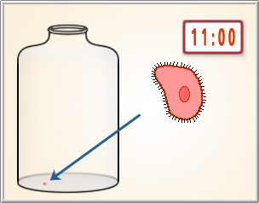
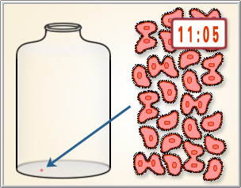
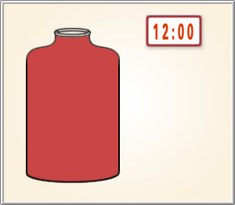
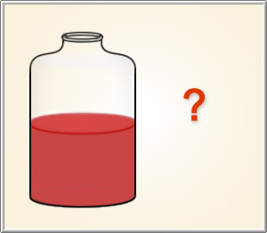
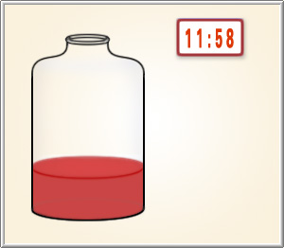
Exponential growth – unbound growth in the context of resource constraints
Jar is half-full at 11:59

Slide 29
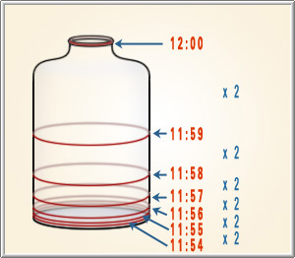
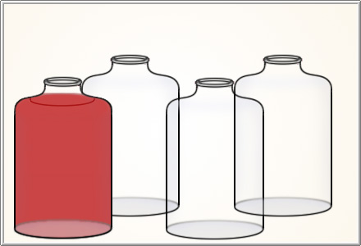
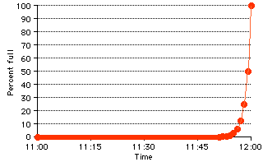
Exponential growth

Slide 30
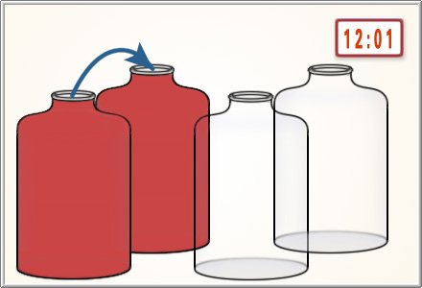
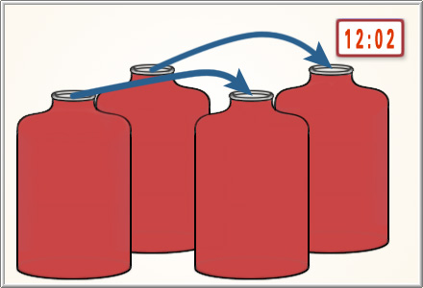
Exponential growth

Slide 31
Exponential Growth quotes
The greatest shortcoming of the human race is our inability to understand the exponential function.
Albert A. Bartlett
Our principal constraints are cultural. During the last two centuries we have known nothing but exponential growth and in parallel we have evolved what amounts to an exponential-growth culture, a culture so heavily dependent upon the continuance of exponential growth for its stability that it is incapable of reckoning with problems of non-growth.
M. King Hubbert
Anyone who believes exponential growth can go on forever in a finite world is either a madman or an economist.
Kenneth E. Boulding

Slide 32
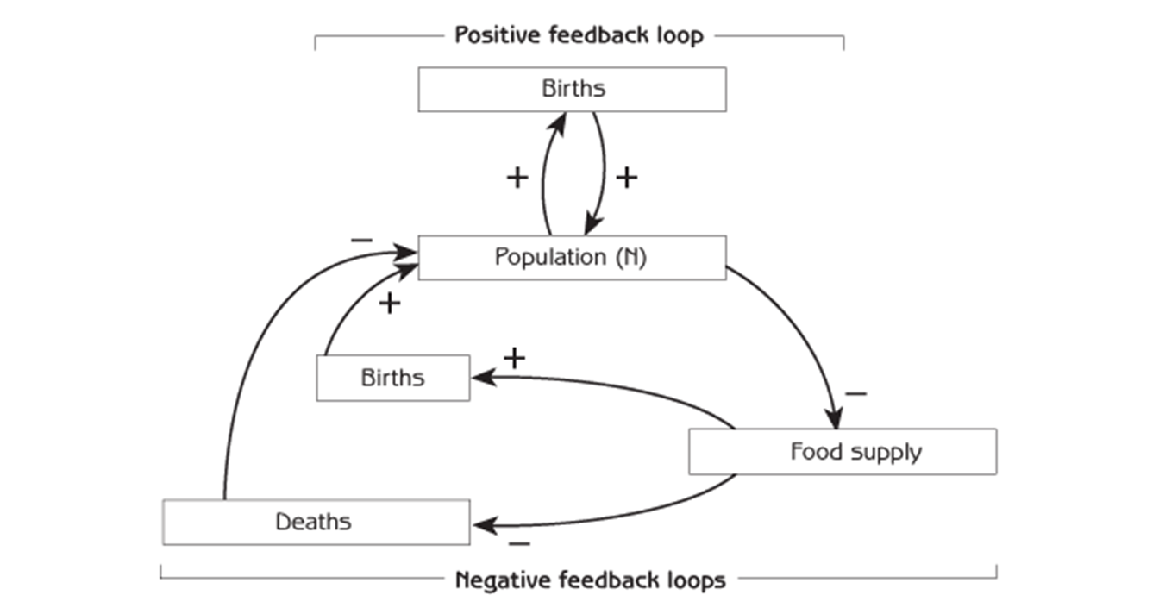
Population Regulation
When population increases, food supply (per individual) decreases
When population decreases, food supply (per individual) increases
When food supply increases, births increase and deaths decrease
When food supply decreases, births decrease and deaths increase

Slide 33
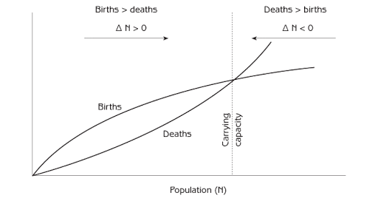
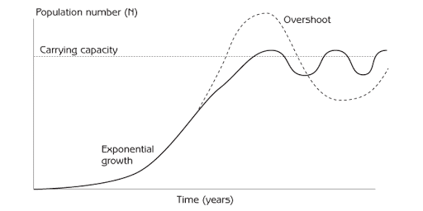
Population change to carrying capacity

Slide 34
Things to think about
Think of examples of positive feedback at different levels of social organization in your social system. Draw diagrams to show circular chains of effects.
Think of examples of negative feedback at different levels of social organization in your social system. Draw diagrams to show circular chains of effects.
Think of examples in your nation or community that illustrates:
Using positive feedbacks to make desired changes
Positive feedback that generates undesired changes
Negative feedbacks that keeps things the way people want them to be
Negative feedbacks that obstructs efforts to change things people consider undesirable

Slide 35
Things to think about
Habits of a systems thinker

Slide 36
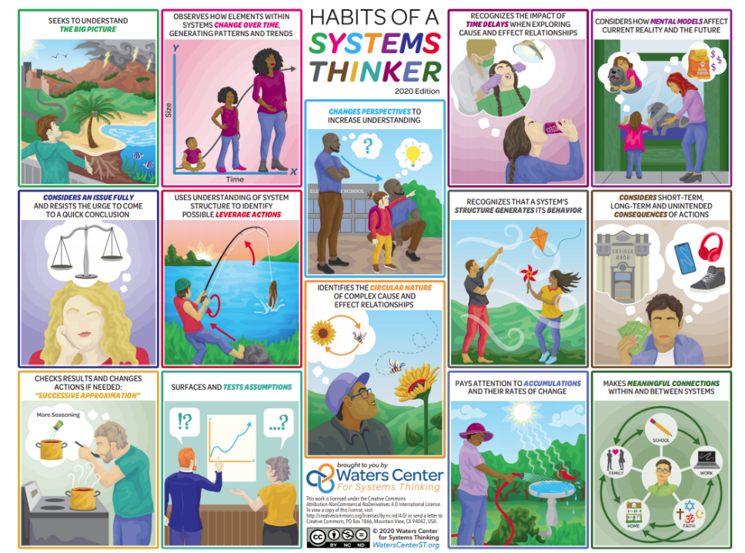
https://waterscenterst.org/systems-thinking-tools-and-strategies/habits-of-a-systems-thinker/

