Slide 1
What is Sustainability?

Slide 2
Sustainable Development
“development that meets the needs of the present generation without compromising the ability of future generations to meet their own needs”
Our Common Future/ Brundtland Report, 1987

Slide 3
Goal
Some of the most threatening environmental problems are caused by widespread poverty
To develop?
Or
To sustain?
Development is based on utilizing/ squandering our biological capital

Slide 4
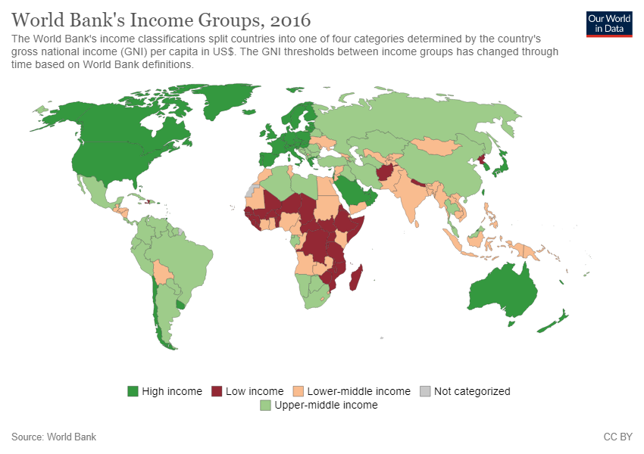

Slide 6
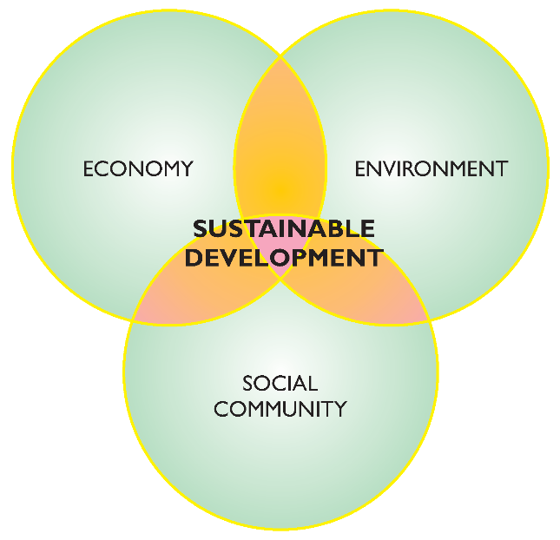
Three pillars of SD
?
?

Slide 7
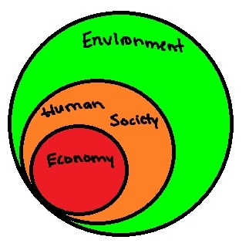
Environment is foundation for all aspects, others are subsets
Nested hierarchy is more appropriate than Venn diagram

Slide 8
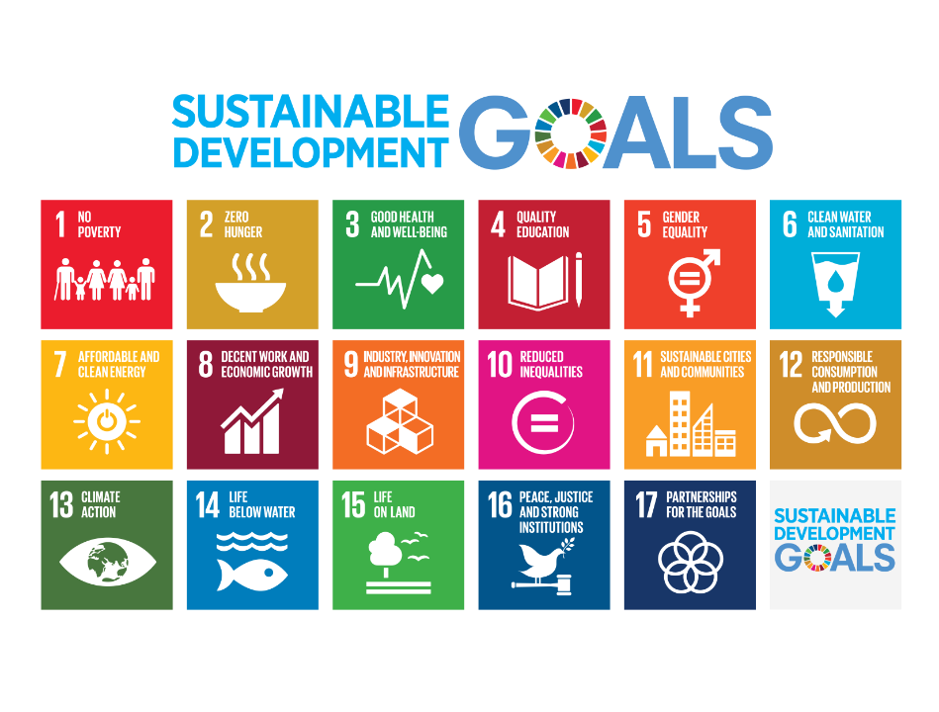
Adopted September 2015 – also called Agenda 2030

Slide 9
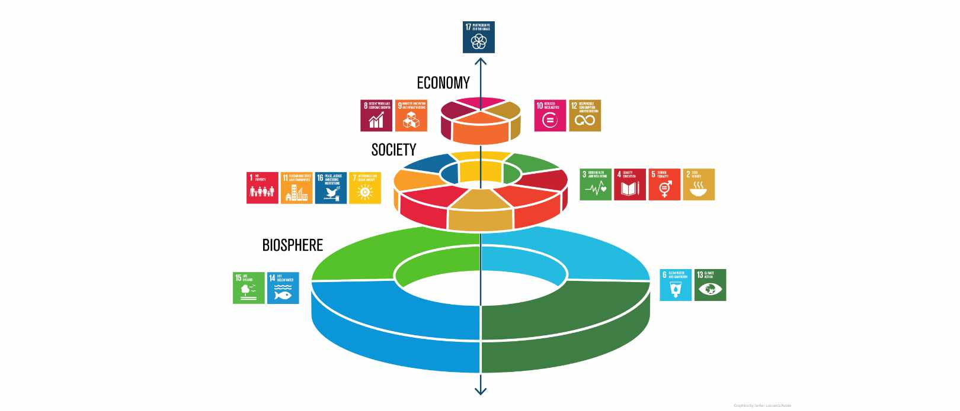

Slide 10
Sustainable Development vs Sustainability
Sustainable Development: “development that meets the needs of the present generation without compromising the ability of future generations to meet their own needs” – Our Common Future/ Brundtland Report, 1987
Sustainability: a system’s ability to create and maintain self-organizing processes
What are “our needs”?

Slide 11
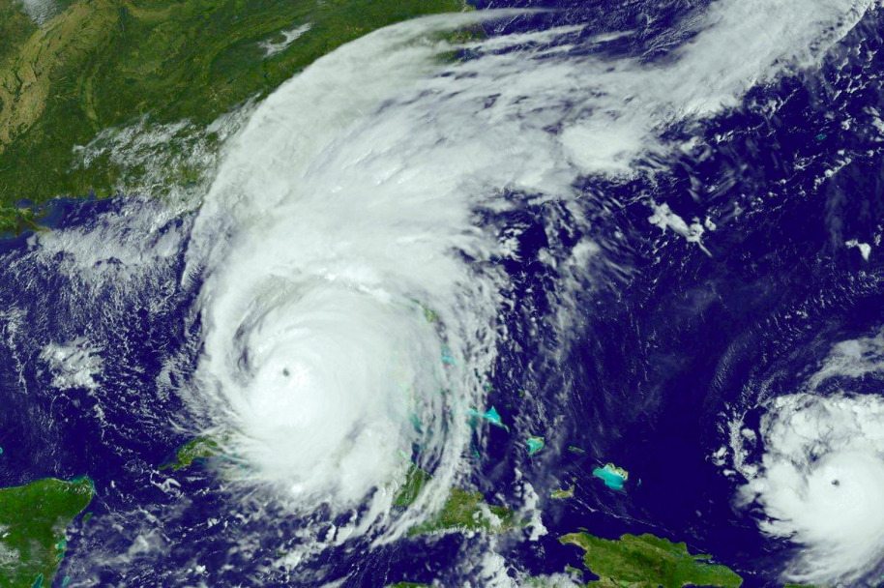
Hurricane
https://en.wikipedia.org/wiki/Hurricane_Irma

Slide 12
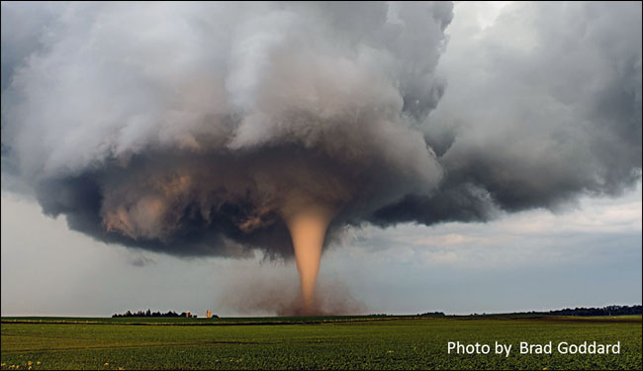
Tornado
https://www.weather.gov/safety/tornado

Slide 13
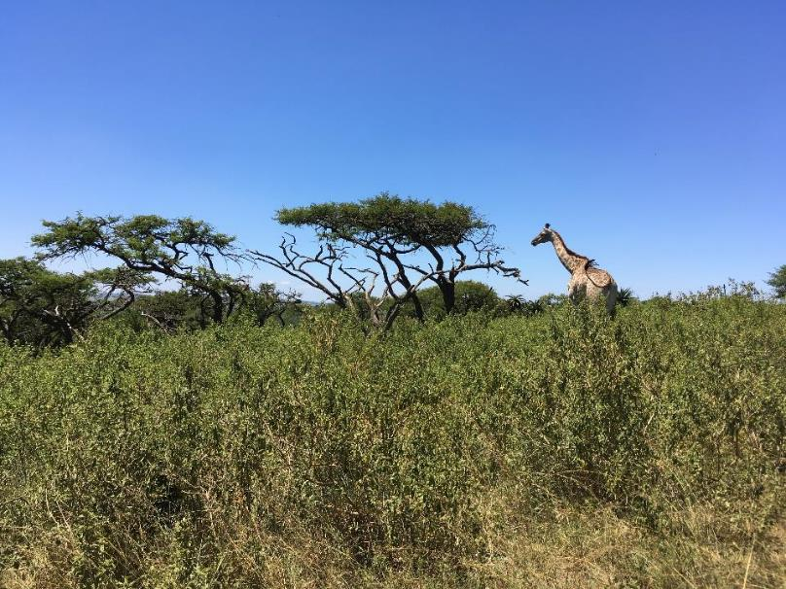
Ecosystem

Slide 14
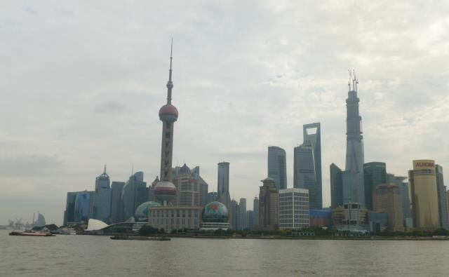
City

Slide 15
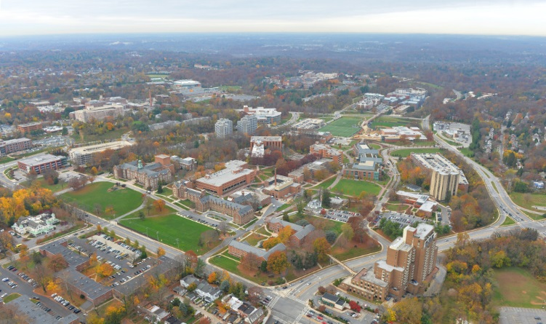
Campus

Slide 16
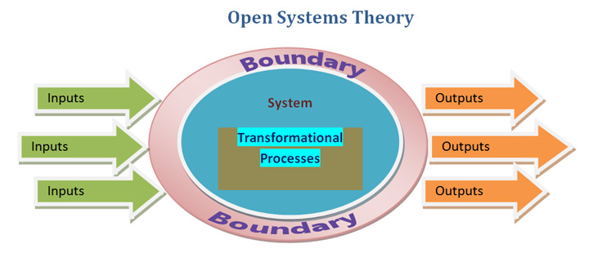
All are open systems with energy driving and maintaining the processes
All import, reuse, and export resources (water, wood, waste, minerals, metals, materials, etc.)

Slide 17
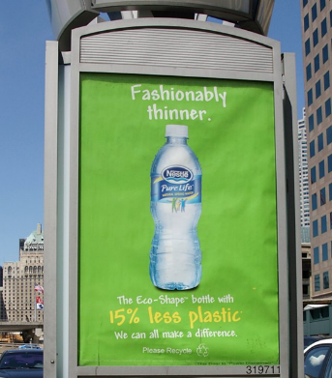
Misuse of the term sustainable
Adjective that means “green” or “eco-friendly”
“A little better for the environment than the alternative”
Doing “better” is not enough
Greenwashing
Reducing unsustanability

Slide 18
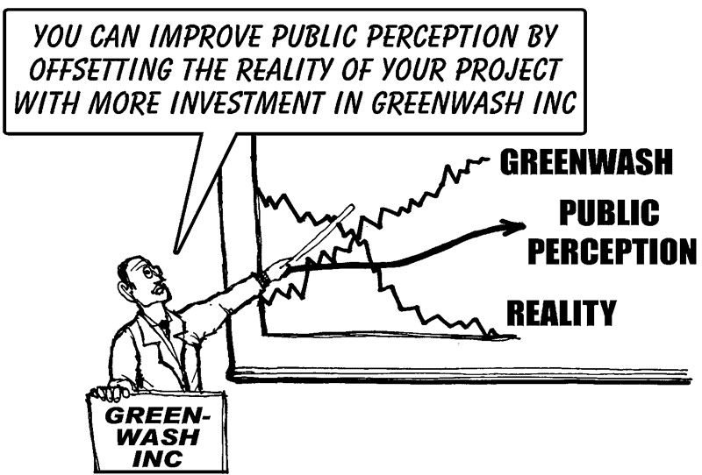

Slide 19
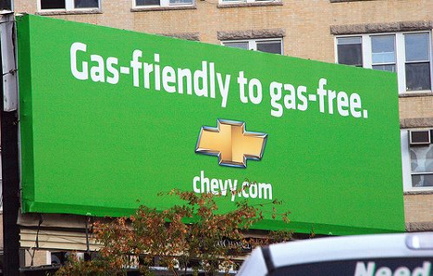
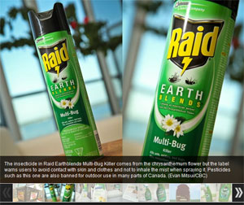
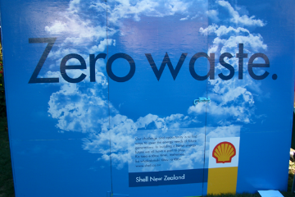
Any examples in advertising that you have seen?

Slide 20
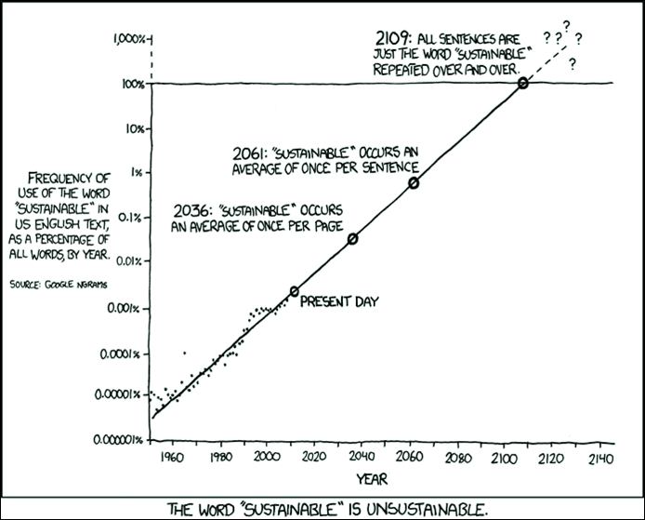
Sustainababble!

Slide 21
Taking inventory who’s responsible?
Producer responsibility
Consumer responsibility

Slide 22
What are we tracking?
If development is not sustainable, is it development – why so many bad decisions?

Slide 23
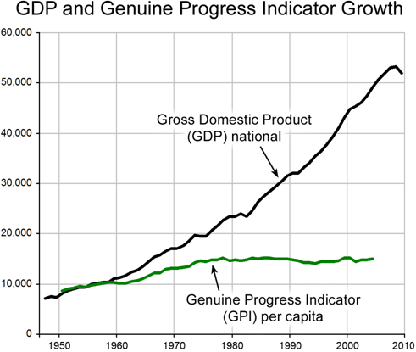
What are we tracking?
Economic indicators get most of the attention in media and by politicians
Triple Bottom line:
Environmental, Social, & Economic Development

Slide 24
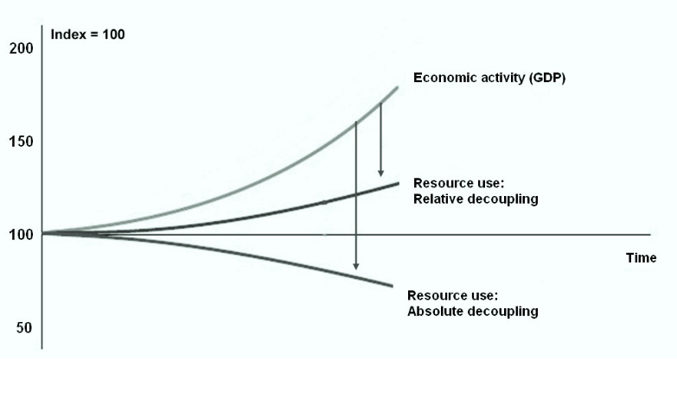
Technology will save us: Decoupling –greater resource efficiency

Slide 25
Decoupling –greater resource efficiency
Being more efficient saves resources.
If you save resources, namely energy, what are ways that you use the savings?

Slide 26
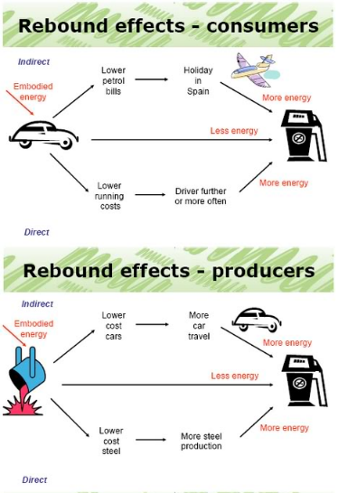
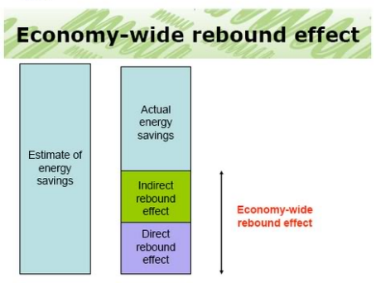
Decoupling –greater resource efficiency leads to rebound effect
Do more with less

Slide 27
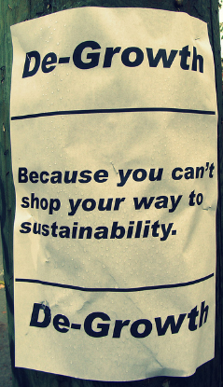
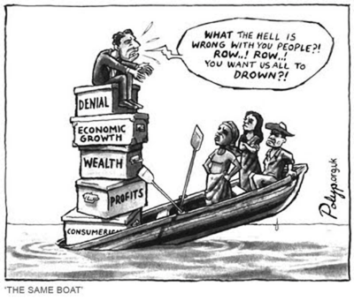
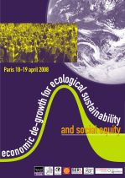
degrowth
Reduce scale to fit within planetary boundaries
Do less

Slide 28
Degrowth
Can you think of an example where people might be willing to do less?
Can you think of an example where doing less can improve overall well-being, health, or happiness?

Slide 29
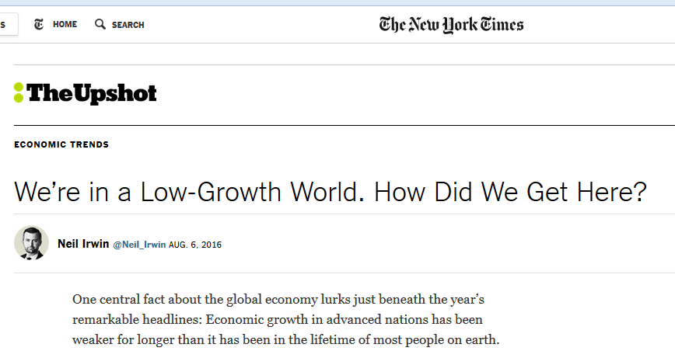
No mention of natural resources or environment
It increasingly looks as if something fundamental is broken in the global growth machine — and that the usual menu of policies, like interest rate cuts and modest fiscal stimulus, aren’t up to the task of fixing it (though some well-devised policies could help).
www.nytimes.com/2016/08/07/upshot/were-in-a-low-growth-world-how-did-we-get-here.html?hp&action=click&pgtype=Homepage&clickSource=story-heading&module=first-column-region&region=top-news&WT.nav=top-news&_r=0

Slide 30
Is sustainability still possible?
“Growing human populations are eating more meat, using more carbon-based energy, shouldering aside more natural resources, and tapping into more renewable and nonrenewable commodities than ever before.”
“If humanity fails to achieve sustainability, when, and how, will unsustainable trends end?”

Slide 31
Is sustainability still possible?
Why has it proved so hard to conform human behavior to the needs of a life-supporting future?
Our political and economic institutions evolved before anyone imagined the need to restrain human behavior out of concern for the future.

Slide 32
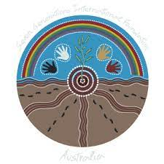
Great Law of the Iroquois
In every deliberation, we must consider the impact on the seventh generation (~140 years into the future)
What is the purpose of expressing concern for the consequences of decision-making down to the seventh generation from their own?
We don’t inherit the earth from our ancestors, we borrow it from our children

Slide 33
Guidance for answers
Western insight into the needed physical and ethical transformations

Slide 34
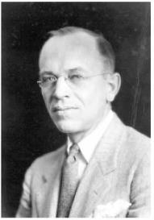
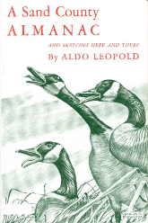
Aldo Leopold
Forest Service and Wisconsin professor, eloquent and passionate writer of our duty to protect balance of nature: humans should extend to nature the same ethical sense of responsibility that we extend to each other.
A Sand County Almanac (1949) – regarded as the most influential book on conservation ever written.
“The land ethic simply enlarges the boundaries of the community to include soils, waters, plants, and animals, or collectively: the land.”

Slide 35
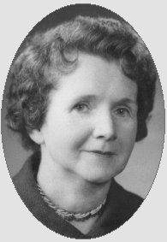
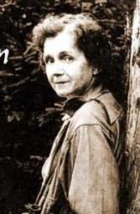
Rachel Carson
1960s – The modern environmental movement is born
1962 Silent Spring
Carson, writer and marine biologist, told how chemical use on farms, forests, and gardens, poison the environment. Insects were dying (not just the pest species) which meant no food for the birds. No birds, no bird song – a silent spring
Public awareness that humans are damaging environment

Slide 36
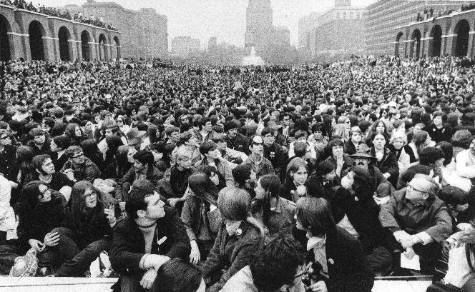
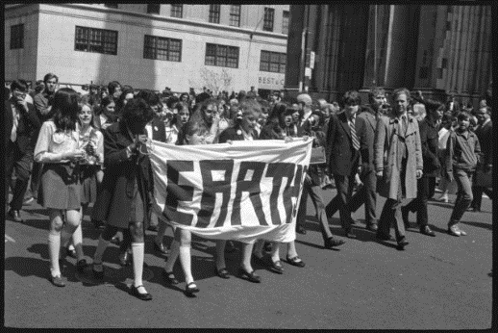
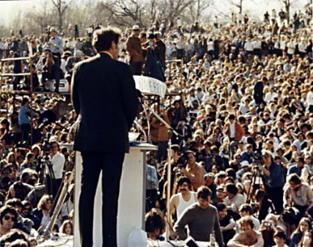
1st Earth Day 1970

Slide 37
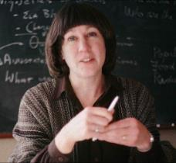
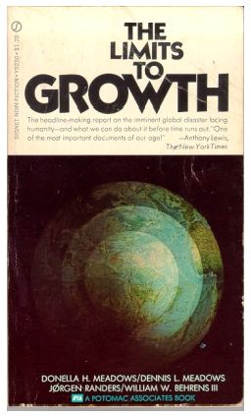
Donella Meadows and Club of Rome
1972

Slide 38
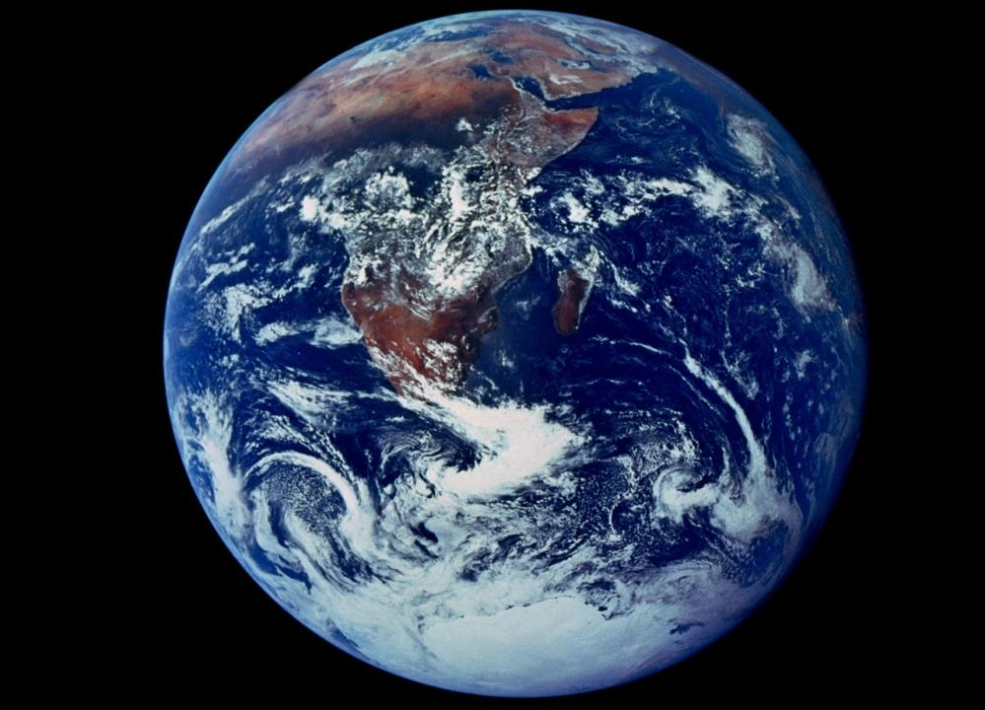

Slide 39
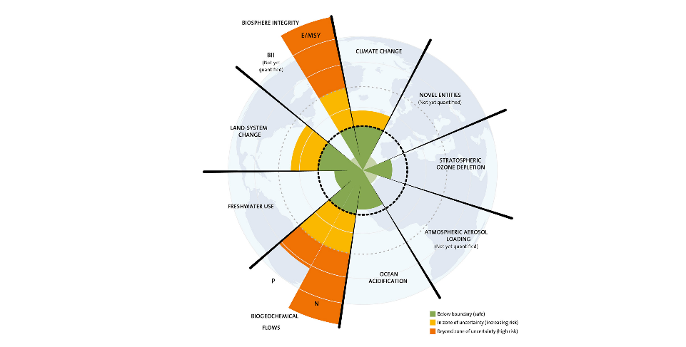
Planetary Boundaries – Stockholm Resilience Centre
2009

Slide 40
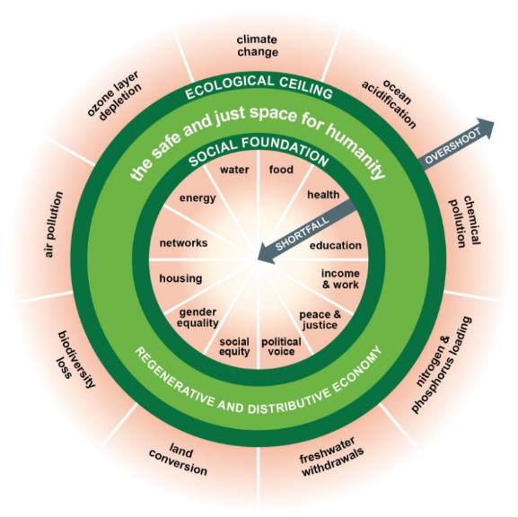
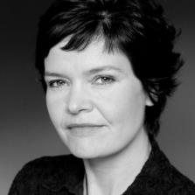
Donut Economics – Kate Raworth
2012

Slide 41
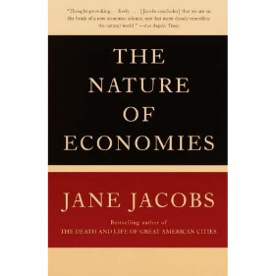
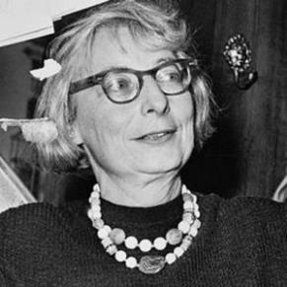
Limits to Growth
“Natural principles of chemistry, mechanics and biology are not merely limits. They’re invitations to work along with them.”
Jane Jacobs
2000

Slide 42
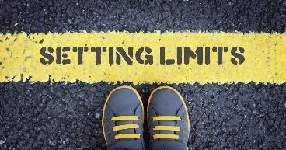
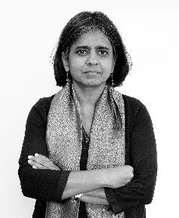
“There are limits. Let’s celebrate the limits, because we can reinvent a different future.”
Sunita Narain
This Changes Everything 2015

Slide 43
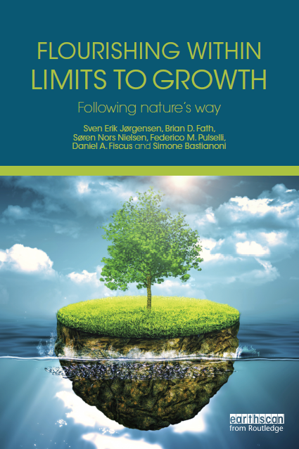
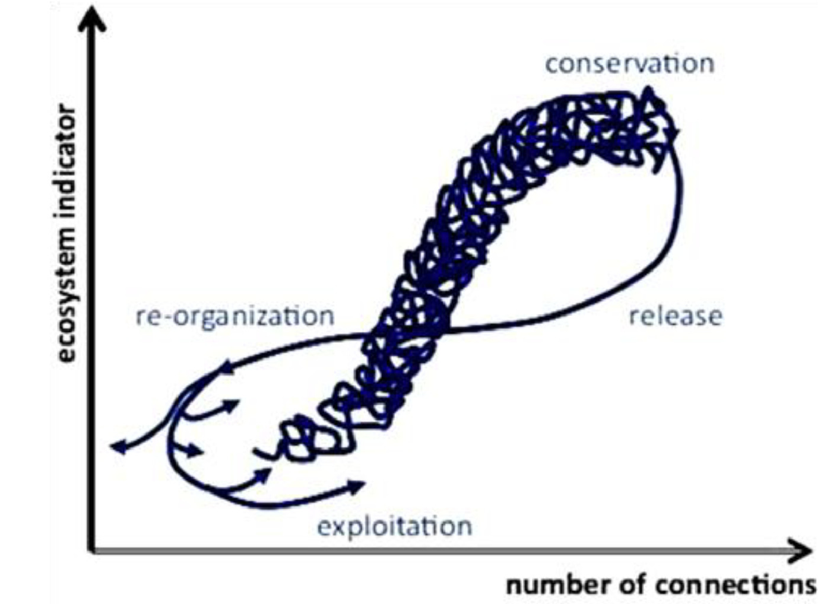
Ecosystems do quite well under constraints, let’s learn from them
There is a right time to grow, it is just not always
2015
clubofsiena.eco-soft.dk

Slide 44
Steps forward
Identify a shared common vision that respects planetary boundaries
Enhance built environment by mimicking natural processes
Systems thinking at all levels of decision-making
Define sustainability and measure/monitor if current trends are heading toward or away from these trajectories
Generational leadership initiates transformative change

Slide 45
Conclusions
Change our dominant paradigm
Use systems thinking and ecosystem thinking
Address the root causes of environmental problems
Ask yourself where does stuff come from: Food, clothes, electronics, water, energy
Where does it go when I flush it or throw it “away”?
See connections, make connections
Care about yourself, care about place
Enlist a cadre of excited, eager, and enthusiastic colleagues to explore, discuss, improve, spread, and implement these ideas!
HAVE FUN!

Slide 46
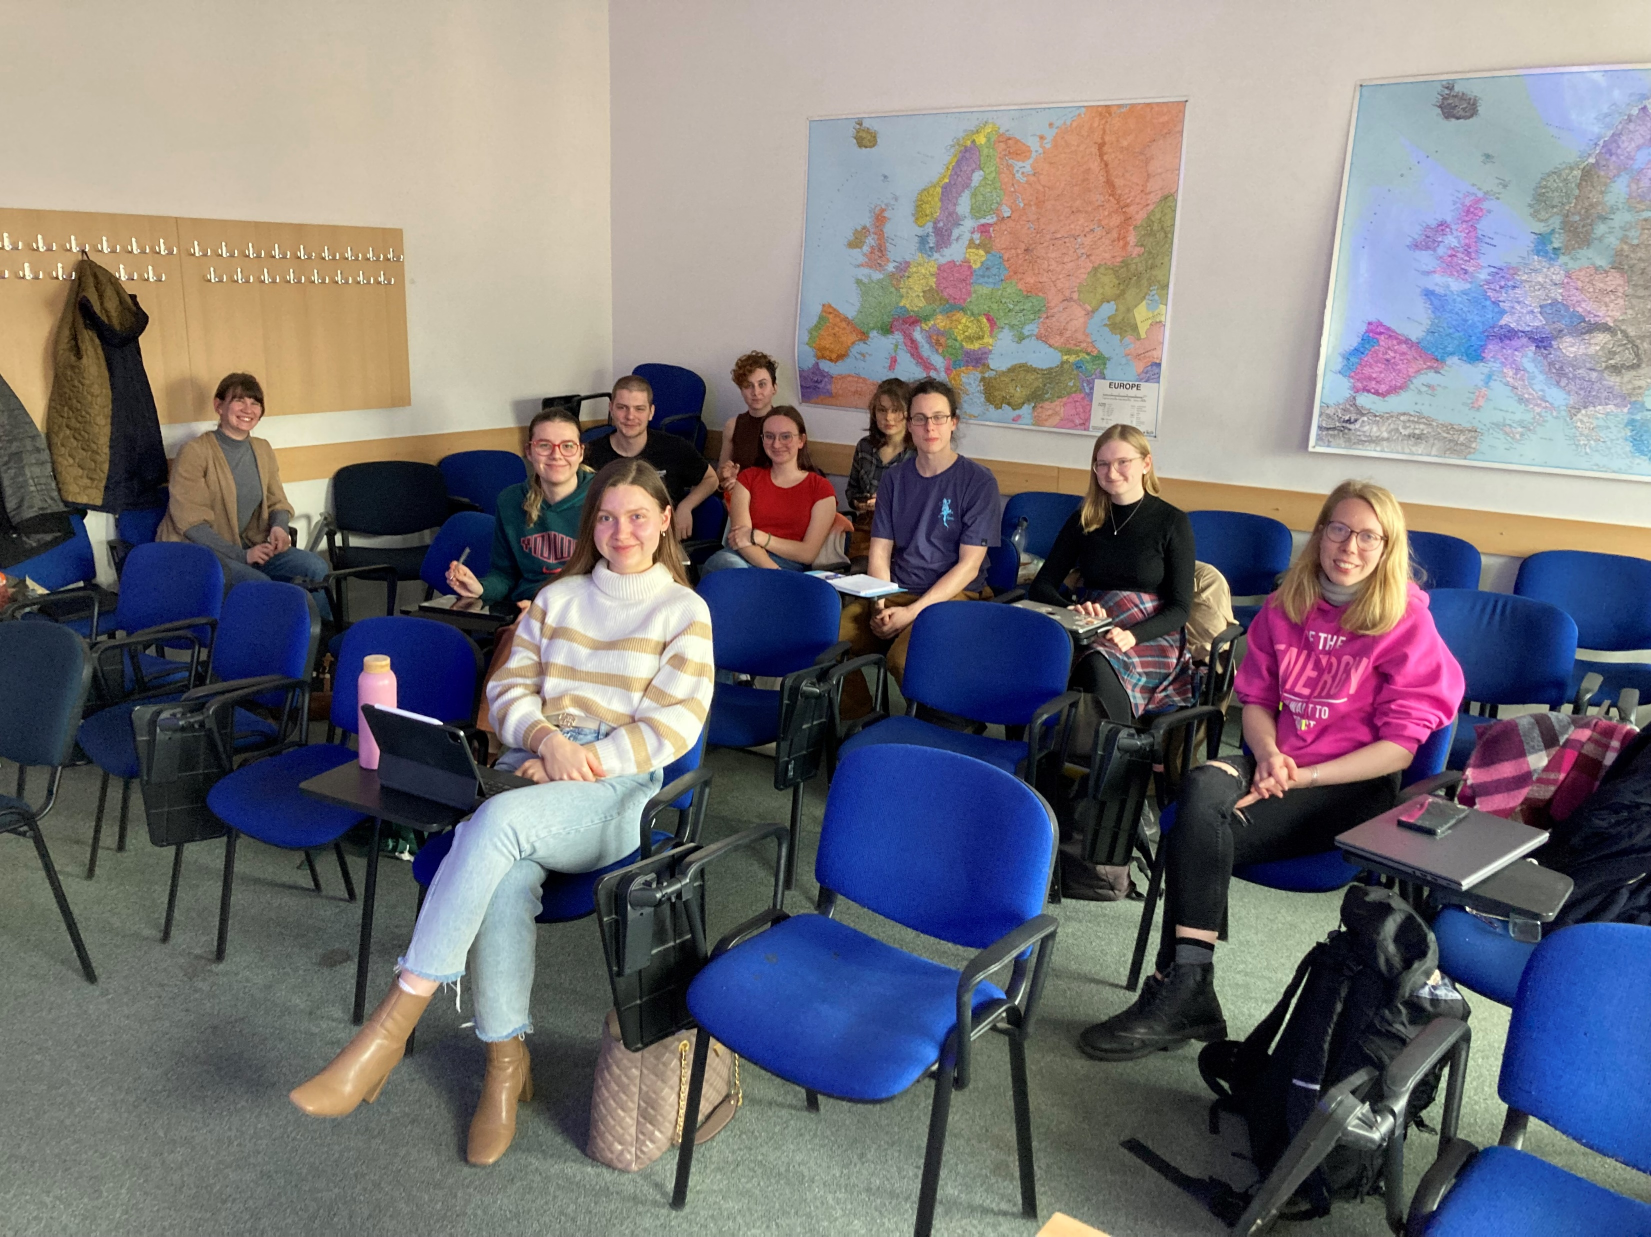
THANK YOU FOR YOUR ATTENTION

Slide 47
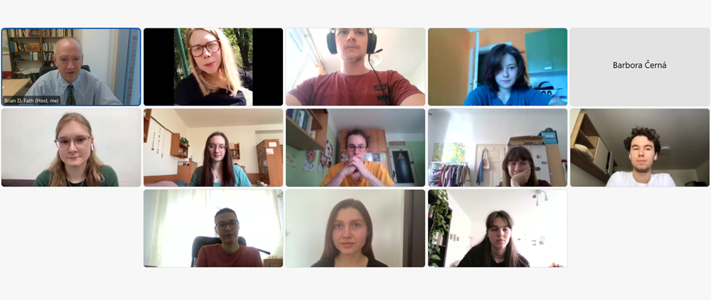
Second group photo

Slide 48
