Slide 1
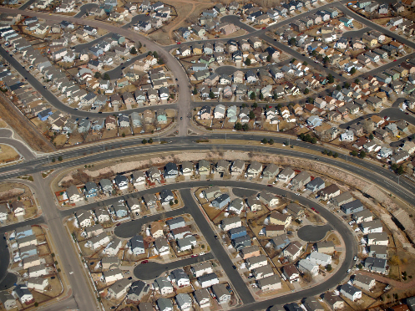
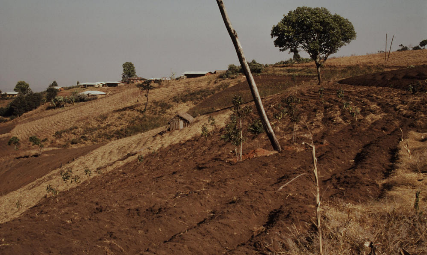
We witness unsustainable human-ecosystem interactions
How could people make such serious mistakes in the past and why does society continue to repeat such mistakes today?

Slide 2
We witness unsustainable human-ecosystem interactions
How could people make such serious mistakes in the past and why does society continue to repeat such mistakes today?
Is it inevitable that the environment must be degraded to satisfy human needs?

Slide 3
Drivers of Unsustainability
HUMAN POPULATION INCREASE
Agriculture
Shelter
Mobility
Stuff
Use
Energy and
Material Resources
causes
Land use change
Habitat loss
Deforestation
Alter biogeochemical cycles
Climate Change
Eutrophication
Acid precipitation
Ozone Depletion
Smog
…
Leads to

Slide 4
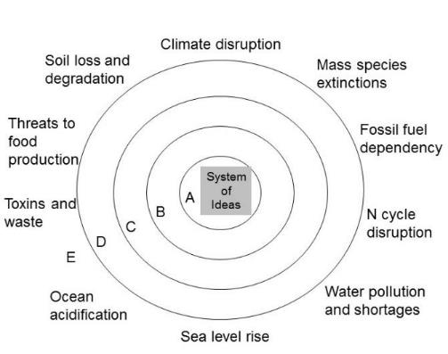
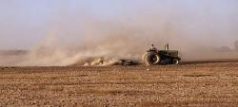
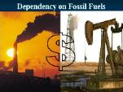
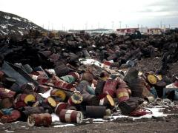
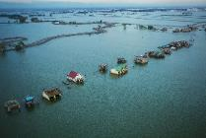
Environmental (and Social) problems are symptoms of deeper failures
Soil erosion
Are mostly symptoms of a deeper flawed relationship with nature and ourselves
Today’s problems were yesterday’s solutions
Toxins and waste
Water pollution
Sea level rise

Slide 5
Why environmental resources have been poorly conserved in the past?
Nature’s rate of return of ecosystem services leads us to over exploitation
Living off the flow is too slow, for how we want to grow
Poor understanding of growth, exponential growth
Externalities – distort the prices and price signals
Indirect cost not paid for by producer and consumer as part of a transaction
When a decision (for example, to pollute the atmosphere) causes costs or benefits to individuals or groups other than the person making the decision
Pressure for resource consumption
Economic and institutional growth paradigm
Victor Lebow (1955): our enormously productive economy demands that we make consumption our way of life, that we convert the buying and use of goods into rituals, that we seek our spiritual satisfactions, our ego satisfactions, in consumption
Marketing

Slide 6
1. “Low” growth rate leads to over exploitation
Nature provides constant production of new goods and resources (through ecosystem services such as primary production).
If this rate of production is lower than desired, we
Over exploit the resources (fisheries, forests, soils)
push the system to increase production – adding nutrients, water, protect from pests, etc.
Hardly occurs to us to manage our needs within this available production
living off the flows, not the capital

Slide 7
Unsustainability - some drivers
Human migration
Fitting in to a new area with varied ecological constraints
U.S. Prairies: perennial grasses, windy, polyculture substituted annual crops, monoculture
New technologies
Unknown environmental consequences
Social systems do not have the institutions on environmentally sustainable use
Culture may not have evolved a conservation ethic if it was unnecessary in the past (what may have worked then doesn’t work now)

Slide 8
Unsustainability - some drivers
Portable capital in a free market economy
Because the growth rate of the world economy is greater than the biological growth rate of most renewable natural resources, there are powerful economic incentives not to use renewable resources on a sustainable basis (Marten 2001, p.143).
Tragedy of the Commons
Garret Hardin (1968)
Benefit to the individual is greater than the loss which is shared by all

Slide 9
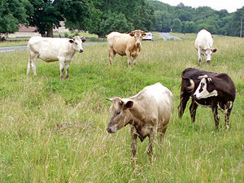
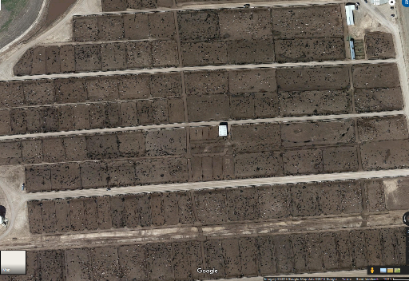
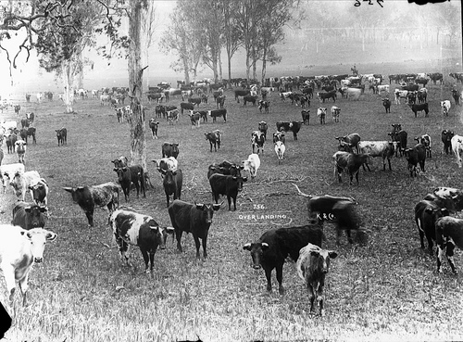
Within carrying capacity
Above carrying capacity
division of costs and benefits to herders is unequal:
individual herder gains all of the advantage,
disadvantage is shared among all herders using the pasture

Slide 10
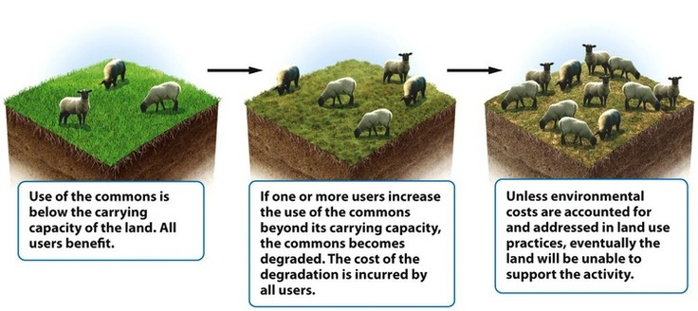
It’s a tragedy because under the current economic paradigm, the “right” choice for the individual degrades the environment

Slide 11
Response to Tragedy of Commons
Environmental Ethics that protects nature and the common goods
Privatize resources so risk and reward are coupled (doesn’t address off-site impacts, downstream, in airshed, etc.)
Some resources are not able to be privatized (oceans, air, groundwater, etc.)
Hardin proposed: “Mutual coercion, mutually agreed upon” – meaning democratically imposed (top-down) limitations
Ostrom proposed bottom-up community “collective actions” could effectively manage commons

Slide 12
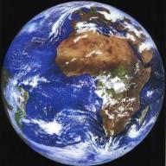
Socio-ecological fragmentation Real impacts of choice of system boundaries
Tragedy of the Commons
Humans win, environment degrades
Bounty of the Commons
Humans win, environment improves
Life
Environment
Figures by Dan Fiscus

Slide 13
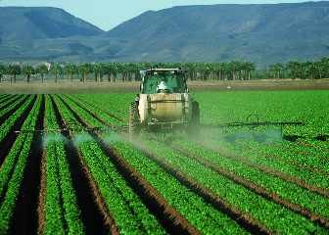
Large inputs to agricultural and urban ecosystems
There is an important relationship between inputs and sustainability
{Systems} are less sustainable over the long term if large quantities of human inputs are required to keep them functioning.
Creates dependencies, “control loops”
It is difficult to ensure that large inputs can be provided on a reliable basis
Most energy comes from fossil fuels
(Marten, 2001, p. 145)

Slide 14
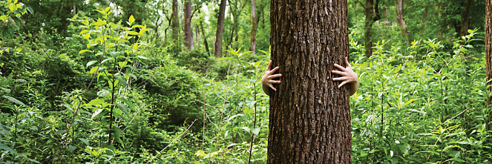
Urbanization and Alienation from nature
Inborn human need to learn about nature
Biophilia – the emotional need for nature
Access to nature during childhood is important

Slide 15
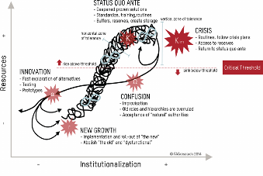
The rise and fall of complex societies
Complexity characterized by extensive differentiation and specialization
Growth and complexity form a positive feedback loop that makes them increase exponentially
When complexity is greater than the optimum more complexity can lead to less productivity
Dissolution begins
Downward positive feedback loops may eventually cause the system to be abandoned
Migration to new areas with new opportunities (reorganization)

Slide 16
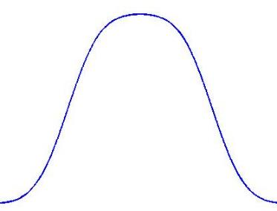
Collapse of Complex Societies (Tainter 1988)
Complexification is limited as a problem solving strategy.
“More complex societies are more costly to maintain than simpler ones… as societies increase in complexity, more networks are created among individuals, more hierarchical controls are created to regulate these networks, more information is processed …
increasing need to support specialists
not directly involved in resource
production, and the like”
(Tainter 1988, p. 91).
Benefit from Complexity
“Collapse is the appropriate response of the system”
Complexity

Slide 17
Precautionary Principle
Burden of proof on the doer not the receiver
If in doubt, then use less than the apparent maximum
However, this is counter to the prevailing ethos of the modern global economy, which rewards entrepreneurial boldness and portrays confidence in economic growth as an ultimate virtue (Marten, 2001, p 154).

Slide 18
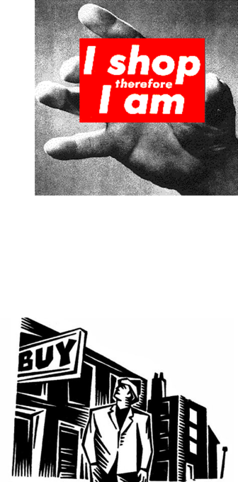
3. Pressure for resource consumption
Consumerism is a cultural pattern that leads people to find meaning, contentment and acceptance primarily through consumption of goods and services.
Equates high consumption with well-being and success
Defining success and happiness through how much a person consumes is not sustainable.

Slide 19
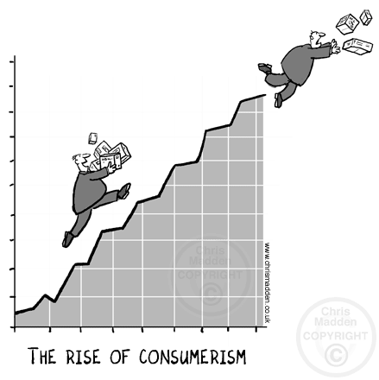

Slide 20
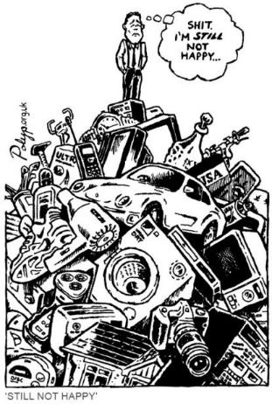
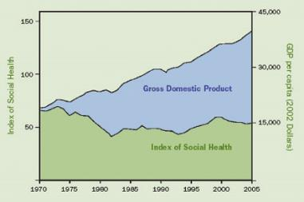
What is the purpose of growth?
We know that bigger does not always mean better, nor more happiness
Alternative well-being indicators tell a different story

Slide 21
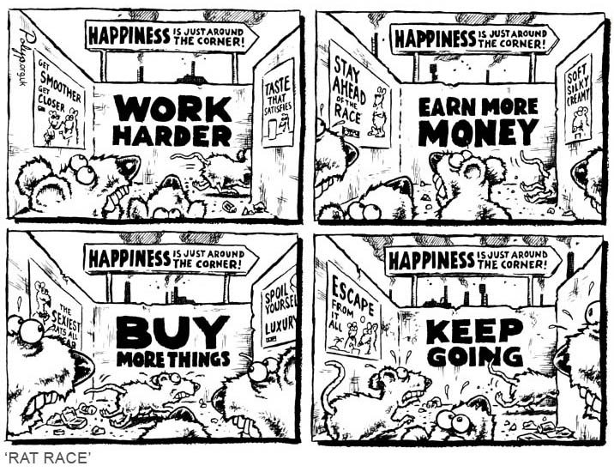

Slide 22
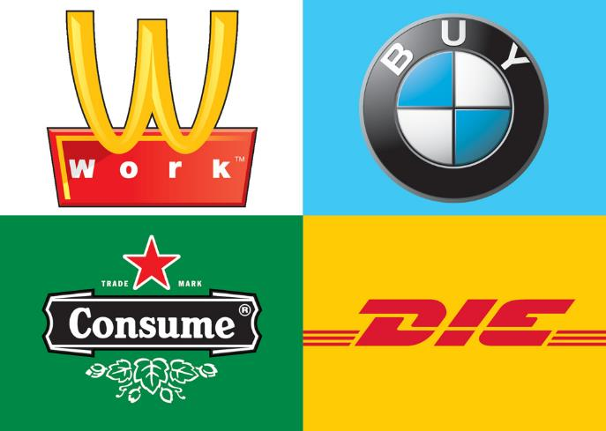
Cultural orientation did not just appear as a byproduct of growing incomes but was engineered over several centuries:
POSITIVE FEEDBACK – consumption – production cycle
Reinforced through exposure to cultural symbols

Slide 23
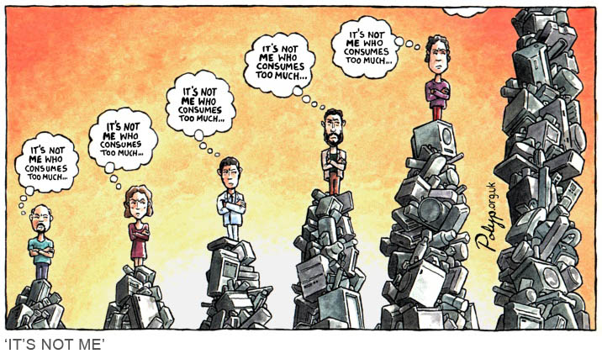
Memetic rivalries: Rene Girard
Our wants are socially constructed in competition (for status) with others.
We measure in terms of others, not absolutes

Slide 24
The challenge is “To live undestructively in an economy that is overwhelmingly destructive…” p. 20
“The responsible consumer slips out of the consumer category altogether.” P. 27
Wendell Berry, The Unsettling of America 1977

Slide 25
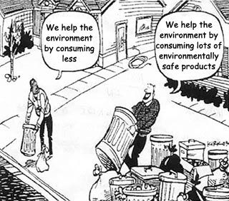

Slide 26
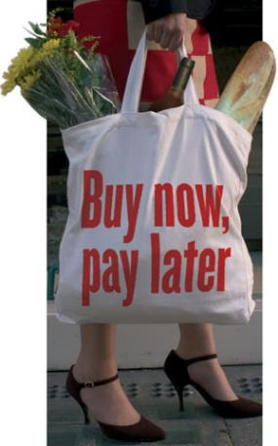
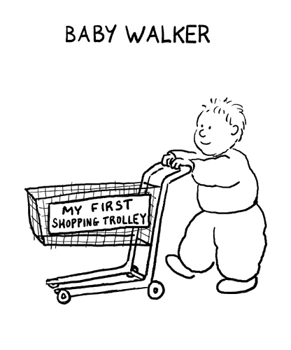
Business practices to entice consumerism:
Increase in consumer credit
Advertisement – particularly to youth

Slide 27
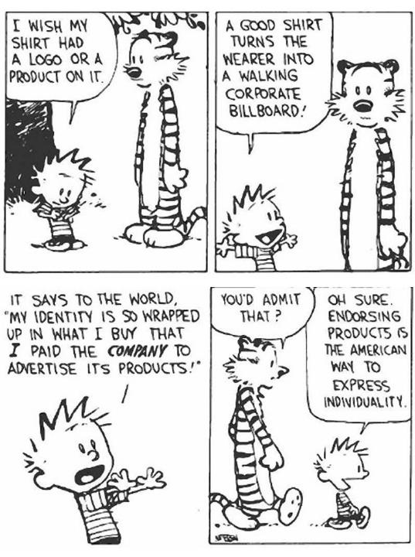

Slide 28
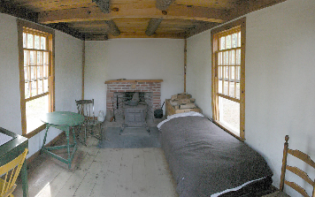
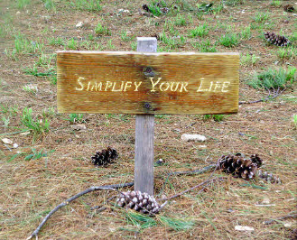
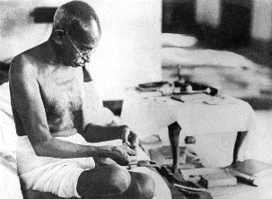
Early social customs actually blocked consumerism
Religion
Fasting
(Lent, Ramadan)
Poverty
Simple living
Limited credit
Preference for leisure time
How can we regain control over consumerism?
Thoreau’s bedroom
Gandhi spinning yarn

Slide 29
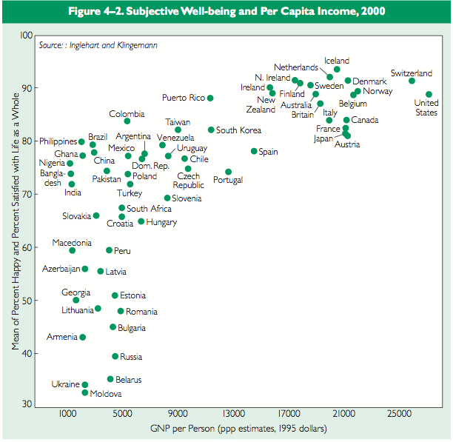
Why focus on GNP?

Slide 30
“The gross national product does not allow for the health of our children, the quality of their education or the joy of their play. It does not include the beauty of our poetry or the strength of our marriages, the intelligence of our public debate or the integrity of public officials. It measures neither our wit nor our courage, neither our wisdom nor our learning, neither our compassion nor our devotion to our country, it measures everything, in short, except that which makes life worthwhile.”
Robert F. Kennedy, 1968

Slide 31
Steps forward
Market corrections for externalities
Ecosystem Services now guiding policy decisions
Consider other “quality of life indicators”
Genuine Progress Index
Index of Sustainable Economic Welfare
Human Development Index
Gross Happiness Index
But the mindset of unlimited growth is deeply embedded – and flawed

Slide 32
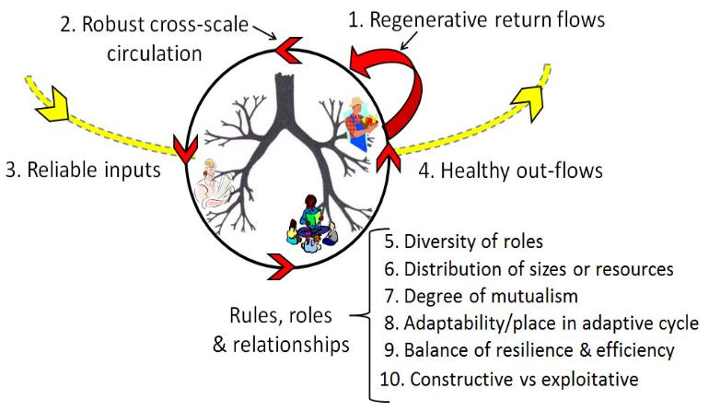
Similar to an Ecosystem Regenerative economy
Input, Output, and System Dynamics
4.
3.
1.
2.
Fath et al. 2019. Global Transitions. 1, 15–27.

Slide 33
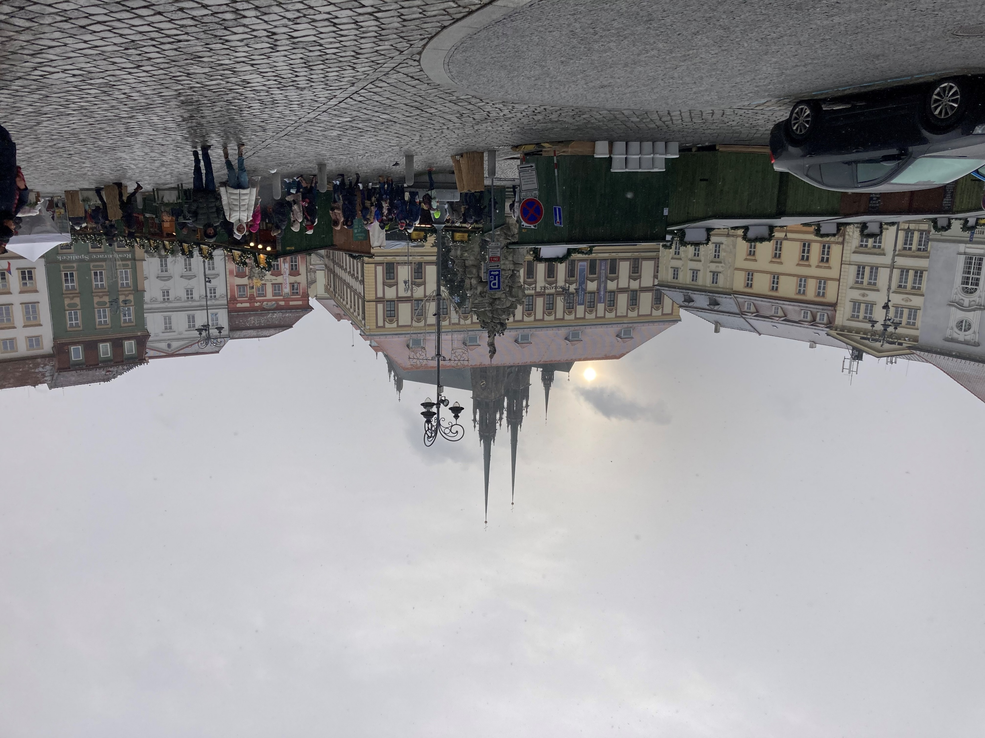

Slide 34
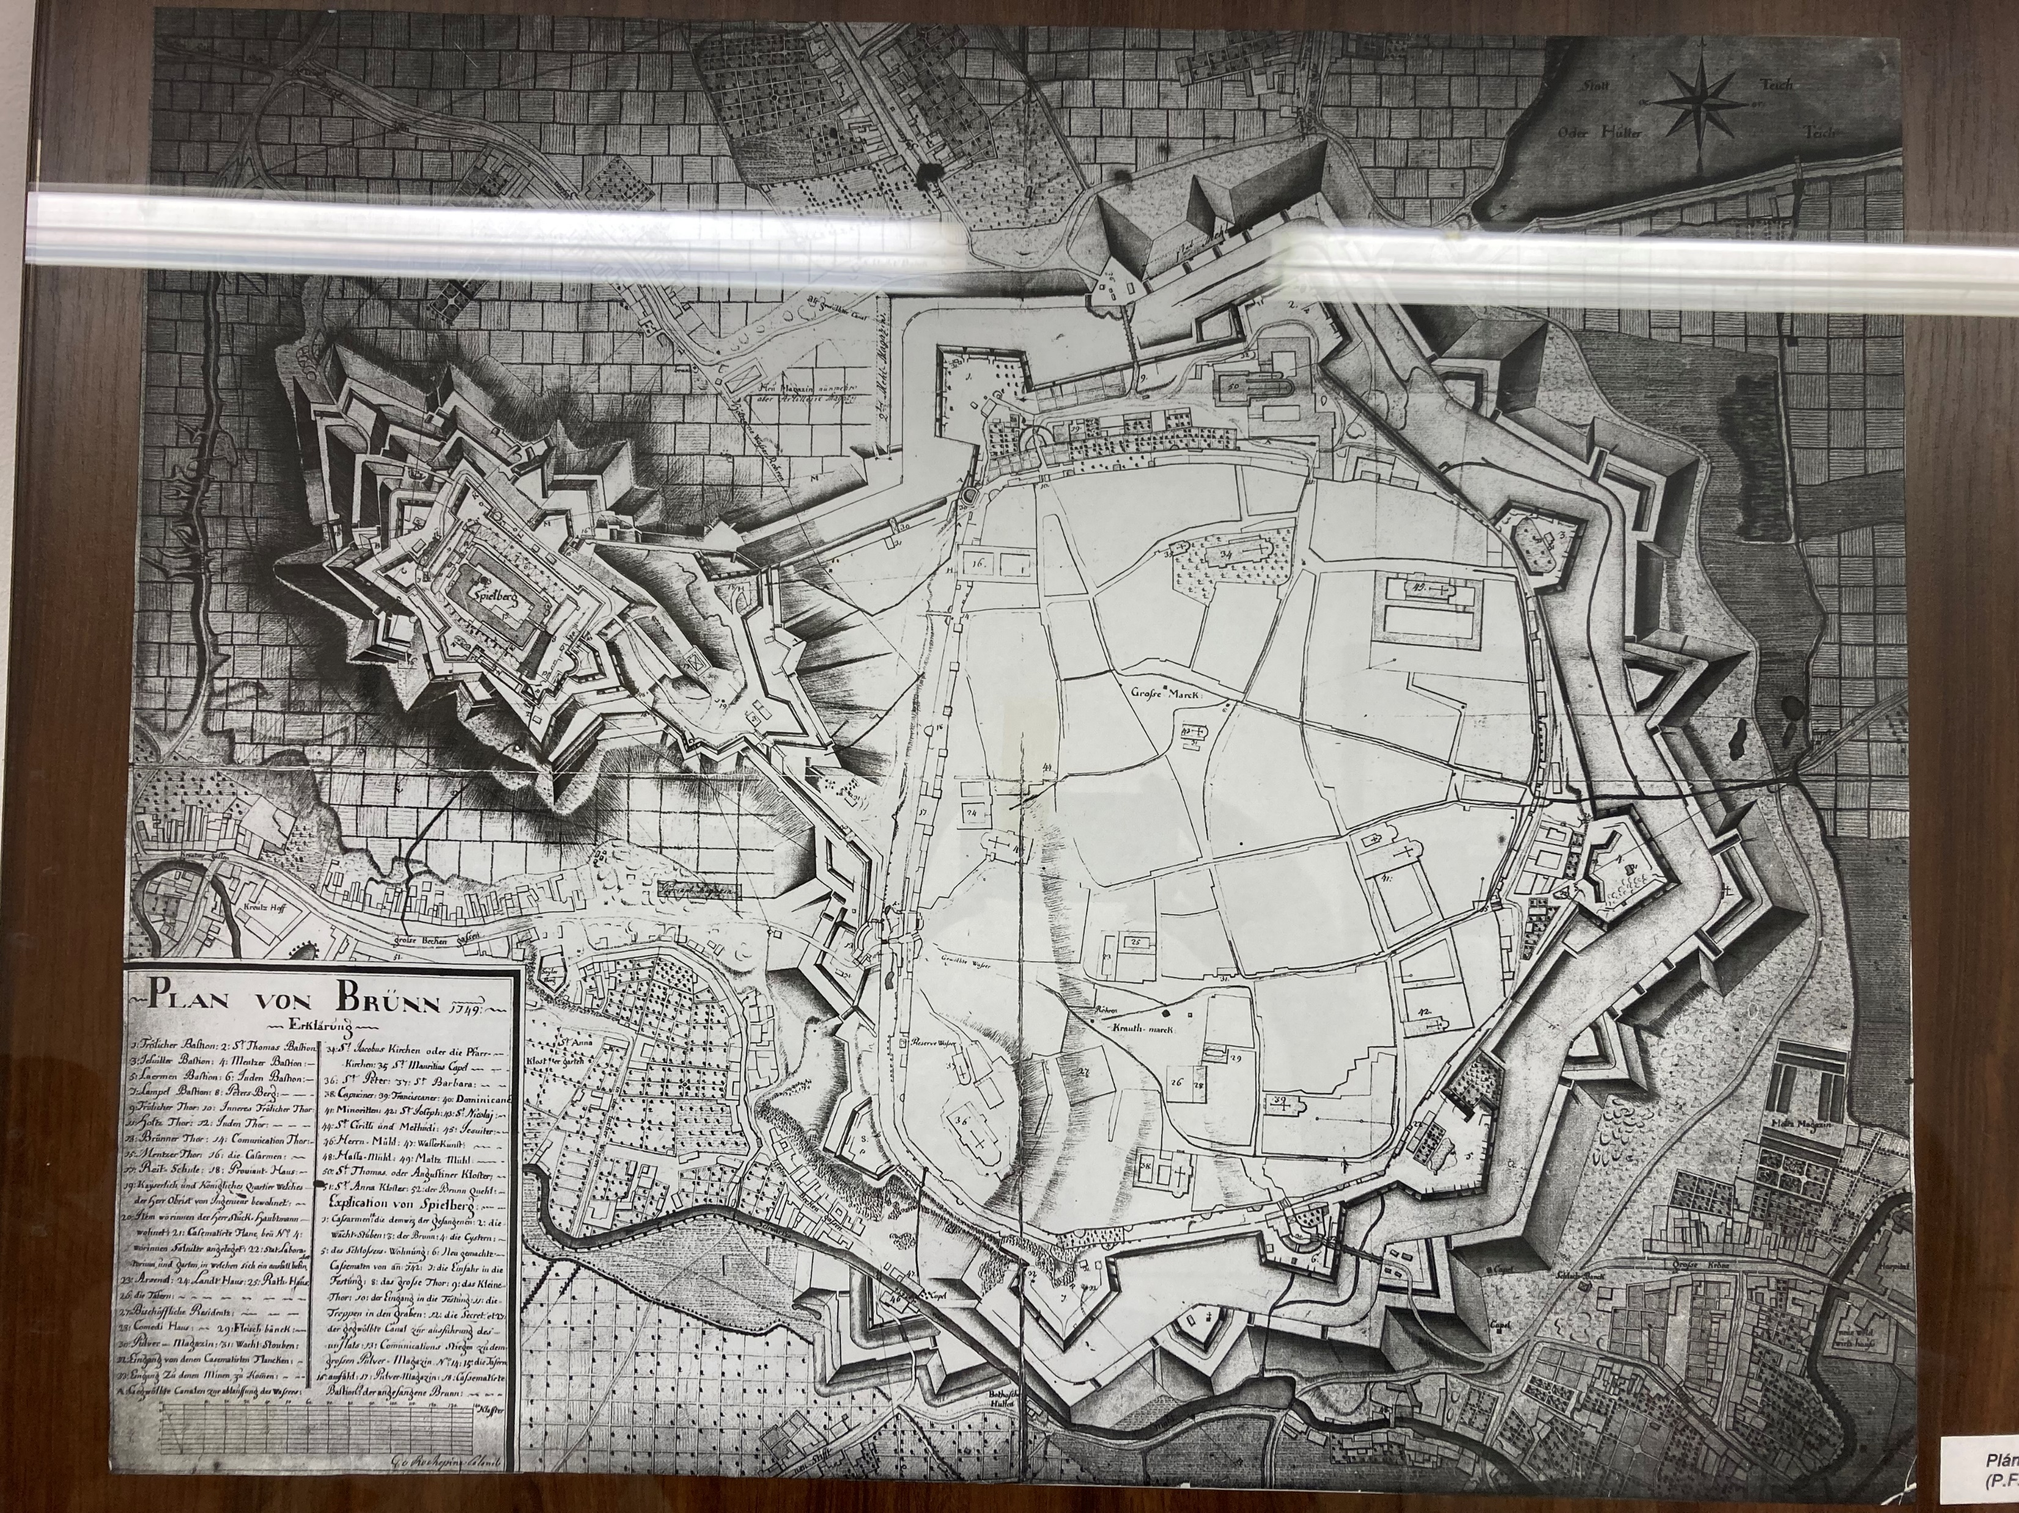
THANK YOU FOR YOUR ATTENTION

