Slide 1
Intro to theme
Video: Inequality: A persisting challenge and its implications
https://youtu.be/PQIrwVTrBWc

Slide 2
Inequality and social stratification
Connection between social stratification and inequality
Systematic inequality between groups of people = social stratification
Why social?
SS concerns the groups of people
Inequality is organized around groups with similar characteristic
Criteria delimit the inequality
wealth, income, prestige, power, gender, education, age
Rankings of groups change only very slowly
All societies are stratified societies

Slide 3
Three basic historical models of inequalities
Slavery—ownership of certain people
Caste—status for life
Class—positions based on:
economics
employment (paid jobs)
labor markets
Modern and postmodern societies
3
Notes:
Historically speaking, there are three major types of systems of social stratification: slavery, caste, and class. Let me briefly describe each type.
1. In slave systems, some peoples are considered less than human and are owned as property. Their legal rights are limited, certain relationships are prohibited, and as you might imagine, and social power is essentially nonexistent.
2. In caste systems, societal groupings are based on deeply held cultural ideals and boundaries. The Indian caste system exemplifies this societal form of stratification, having both cultural and economic impacts. Caste systems are rigidly based. They are characterized by hereditary status, endogamy, and social barriers and are sanctioned by custom, law, and religion.
3. Class systems are the stratification system we are familiar with. People are divided according to economic markers such as income, wealth, ownership, and so on. There are many different characterizations of what constitutes class, and we will be talking about these characterizations today.

Slide 4
Inequality dimensions
Economic inequality: wealth, money (rich vs. poor people)
measured by GINI coeff, Lorenz curve (advantages vs. disadvantages)
Social class inequality: occupations (labour market positions)
measured by EGP, ESeC (categories), ISEI, Prestigue scal (continuous)
Social status inequality: prestige, respect
measured by artificial socioeconomic indexes
Power inequality: influence, authority
measured by level of authority in paid job
The debate is over which type if inequality is the most important?
Three main dimensions of inequality:
Economic
Educational
Power

Slide 5
Two basic inequality concepts
Inequality of conditions
unequal distribution of income to people
differences in wealth and material conditions
different incomes means different chances to get different goods
Inequality of opportunity
unequal start positions
different start positions means different chances to get different levels of education, jobs and incomes
5
Notes:
Historically speaking, there are three major types of systems of social stratification: slavery, caste, and class. Let me briefly describe each type.
1. In slave systems, some peoples are considered less than human and are owned as property. Their legal rights are limited, certain relationships are prohibited, and as you might imagine, and social power is essentially nonexistent.
2. In caste systems, societal groupings are based on deeply held cultural ideals and boundaries. The Indian caste system exemplifies this societal form of stratification, having both cultural and economic impacts. Caste systems are rigidly based. They are characterized by hereditary status, endogamy, and social barriers and are sanctioned by custom, law, and religion.
3. Class systems are the stratification system we are familiar with. People are divided according to economic markers such as income, wealth, ownership, and so on. There are many different characterizations of what constitutes class, and we will be talking about these characterizations today.

Slide 6
Reproduction of inequality
Reproduction of social strata
In European countries children from the highest social classes have about 80% higher probability to attend university compare to children from the working class
IEO: inequality of educational opportunity
Children from highest social class have 70% probability to get married with the same social class partner
Homogamy: preferences for the same partner
Inequality is reinforced by:
socials mechanisms (system)
individual based actions (actor)

Slide 7
Two reasons of reproduction of inequalities
System: social reproduction
glass ceiling
social barriers
everyone wants the same
Actor: cultural reproduction
sticky floor
cultural values, attitudes
behavior
people want different things
Structuralism vs. Culturalism
explanation of inequalities

Slide 8
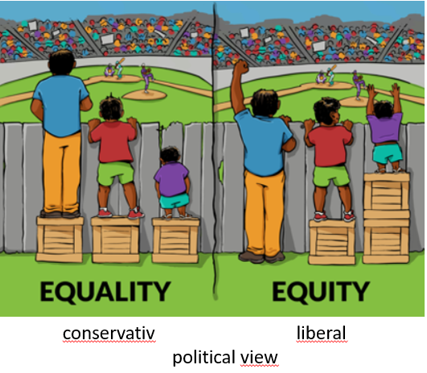
Equality vs Equity
Equality is the provision of equal access to resources and opportunities. Everyone gets the same thing, regardless of where they come from or what needs they might have.
Equity is the provision of personalized resources needed for all individuals to reach common goals. The goals and expectations are the same for all students, but the supports needed to achieve those goals depends on the students’ needs.
Notes:
Left: equal distribution of boxes, right = equal distribution of sightlines. So Equality is in both cases!!! But correct (from the case of watching a baseball game) is right panel! Sightline not boxes!
Equality is inferior to Equity! Equality does not need consider prevalence effect. E.g. The same one thing per household is equality but households differ by number of members. Equity is not equality of opportunity, conditions and so on.

Slide 9
Basic principles inequality reproduction
Cumulative advantage
Matthew effect
Advantages have tendency to strengthen itself
The same can be applied to disadvantages
Feedback loop
Compensatory advantage
Economic, cultural, social, family resources to face risks along the life course
Glass floor (vs. sticky floor)

Slide 10
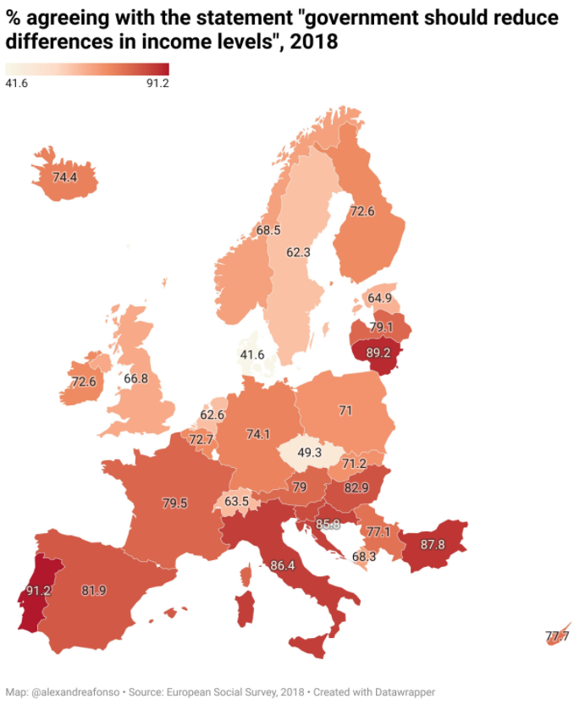
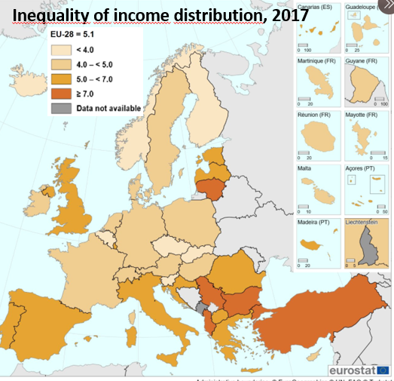
Proportion of respondents agreeing with the statement "government should reduce differences in income levels", %, 2018 (European Social Survey) and the level of income distribution inequality in Europe.

Slide 11
Legitimization of inequality
Inequality is needed (for instance in salaries) in order the talented people would be motivated for education that is necessary for different jobs (doctors, layers, other professionals)
Is it true or we just believe in it?
How large these differences in salaries should be?
What is ascription?
How does acriptive society work?
What is achivement?
How does meritocratic society work?

Slide 12
Should we strive for equal societies?
Richard Wilkinson and Kate Pickett (Penguin 2009)
British social epidemiologists
Argument
It is not the economic wealth of country (level of GDP) but the level of inequality inside the country which influence all social statistics in negative way.
Higher economic inequality = worse (general) quality of life no regards the wealth of society (GDP: gross domestic product)
There is a cost of inequality
prize that societies pay for inequality
Notes:
Photo Courtesy of AP Photo.

Slide 13
Should we strive for equal societies? (cont.)
Inequality influences inside the country :
life expectancy
health and social problems
infant mortality (deaths) per population
teenage first birth rate per population
level of abortions per population
homicides per population
prisoners per population
gender inequality
obesity level per population
educational attainment and IEO
percent of dropping out high schools
educational aspiration by social origin
social mobility (GGC)
child well-being
trust between people
level of anxiety of people
level of violence per population
mental health of people and drug use per population
proportion of happy people
level of social cohesion
Video YT: Richard Wilkinson
https://youtu.be/cZ7LzE3u7Bw
Notes:
Photo Courtesy of AP Photo.

