Slide 1
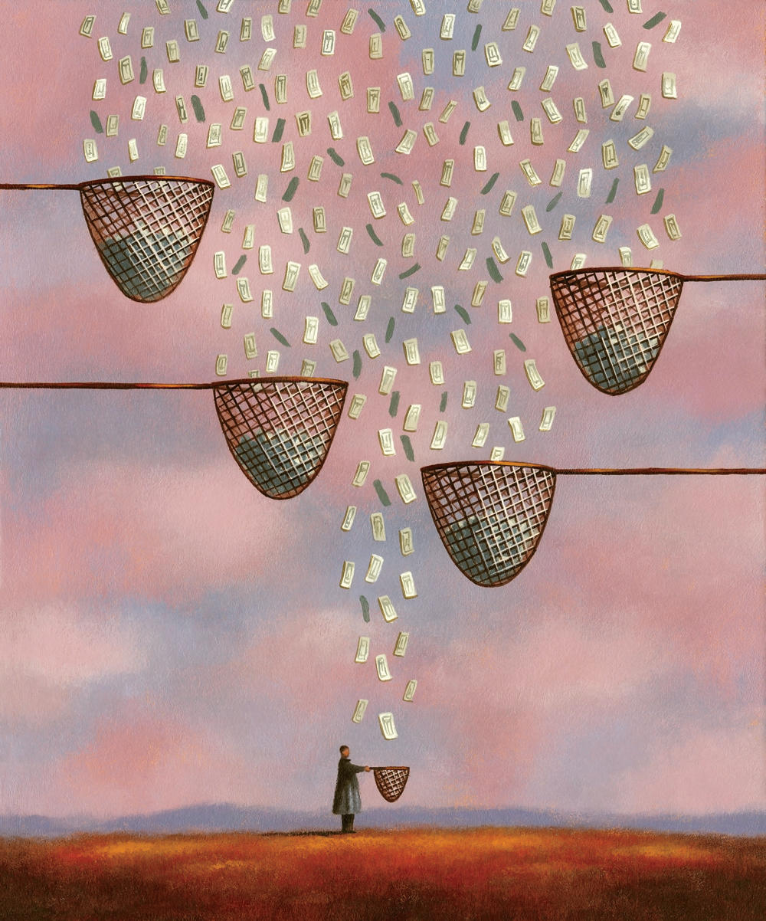
04. Inequality and politics
ESOn4022: Inequality and Society

Slide 2


Slide 3
Politics and inequality
Ruling classes use government-controlled means and resources (money, weapons, food, transport …) to extract surplus value from the efforts of categorically excluded subject populations
They redirect some of the surplus to activities from which the subject population does not benefit, although the ruling classes do – reinforcement of existing inequalities
Taxes , conscription, de-segregation, compensatory aid…
Democracy – more inclusive way of exploitation
Both democracies and autocracies – based on distinctions between inclusion and exclusion
Typically: property, ethnic divisions, licensing, certification of interest/service/advocacy groups, marriages…

Slide 4
Politics and inequality
Government generates inequality
Inequality impacts on government
intervention of governmental agents makes a large difference to inequality
So people regularly struggle over state control of major resources to get the at the expense of others (pensioners, owners, veterans, parents, …)
Typically categorial distinctions: legitimate vs. Illegitimate, deserving vs. underserving, …

Slide 5
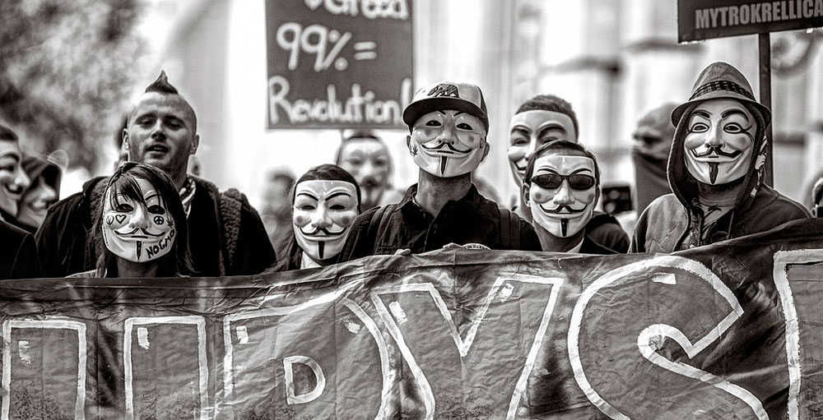
Social movements and inequality
social movement is a kind of campaign, parallel in many respects to an electoral campaign
WUNC (Worthy, Unified, Numerous, and Committed)
Articulation of inequality as unjust
Advocating weaker side of inequality
We vs. Them
Social movements challenge the exploitation by the elites and threaten drastic collective action by members of their own constituency
Worker´s movements, NSMs, OWS, BLM…

Slide 6
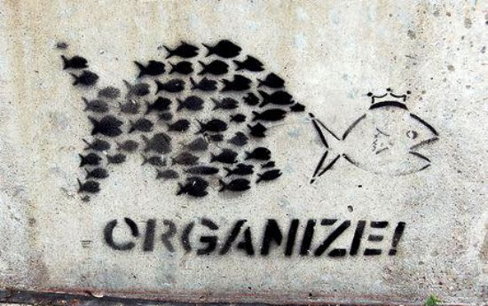
Social movement repertoire
creating associations and coalitions, organizing marches and demonstrations, circulating petitions, attending public meetings, shouting slogans, wearing badges, writing pamphlets, …
essentially symbolic, cumulative, and indirect
implicit threat to act in adjacent arenas: to withdraw support from public authorities, sustenance to a regime's enemies, to ally with splinter parties, to move toward direct action or even rebellion
Social movements take place as conversations—not as solo performances but as interactions among parties
The most elementary set of parties consists of an actor making a claim, the object of the actor‘s claim, and an audience having a stake in the fate of at least one of the first two

Slide 7
Conditions of acting collectively
Typically: the presence of solidarity, the construction of shared identities, the sense of grievance, the creation of sustaining organizations…
But most social movements remain far more contingent and volatile
Social movements center on the construction of categorical identities
Identities in general are shared experiences of distinctive social relations and the representations of those social relations: workers become workers in relation to employers and other workers
Construction and enforcement of unequal, paired categories

Slide 8
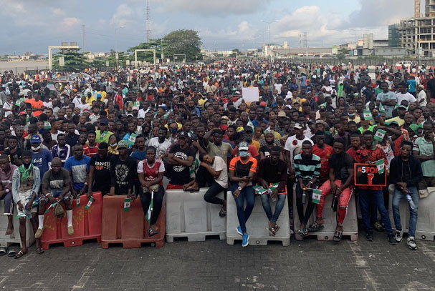
Political identities
Political identity = shared (collective) social relation in which one of the parties is a coercive authority (state, owner …)
Most political identities are also categorical rather than specific to a tie between two particular actors.
Political identities therefore alter as political networks, opportunities, and strategies shift.
The validation of political identities depends on contingent performances to which other parties' acceptance or rejection of the asserted relation is crucial.
That validation both constrains and facilitates collective action by those who share the identity.
Deep differences separate political identities that are embedded in routine social life from those that appear chiefly in public life (embedded and disjoined collective identities)

Slide 9
Why inequalities persist and when they change?
Exploitation ad opportunities as effective means of control of members of subordinated categories
Distinctions and categories become naturalized and normal
Exploited groups adapt to the structure of exploitation
Inequalities change when members of subordinate categories mobilize broadly and gain power

Slide 10
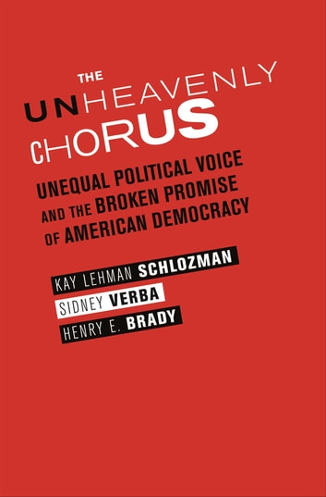
Inequality and collective action
Politically active individuals and organizations - huge investments of time, energy, and money to influence politics
Unions, professional associations, trade associations, and citizens groups, as well as organizations like corporations, hospitals, and universities
Some groups and individual citizens underrepresented in political system
Democracy is marred by deeply ingrained and persistent class-based political inequality
The well educated and affluent are active in many ways to make their voices heard, while the less advantaged are not
Political advantage is handed down across generations, recruitment to political activity perpetuates and exaggerates existing biases

