Slide 1
The gender-gap reversal in tertiary education in European countries
Tomáš Katrňák
Faculty of Social Studies
Masaryk University

Slide 2
Structure of presentation
Three main parts of presentation
  Introduction of recent educational expansion (EE) and gender-gap reversal (GGR)
    What is EE and what is GGR?
  Already-know consequences of GGR for contemporary societies
    What changes GGR brings to contemporary societies
  Possible reasons of GGR
    Why GGR happens when GGC has been established?

Slide 3

Part 1: Educational expansion and GGR

Slide 4
Educational expansion (EE)
The educational structures of European populations have undergone a significant change over the past 20 years
In 2000, the Bologna process was launched with the aim of increasing the proportion of people with tertiary education in EU countries
  New educational institutions arose, new study fields emerged, and the process was initiated of more people enrolling in university studies
The result was that from 2000 to 2020 the average proportion of young people (aged 25-34) in EU countries who had attained tertiary education increased from 25% to 41%.
Note: Tertiary education is indicated by ISCED (levels 5-8) for the 25-34 age group.
Source: Eurostat statistics (2022).

Slide 5
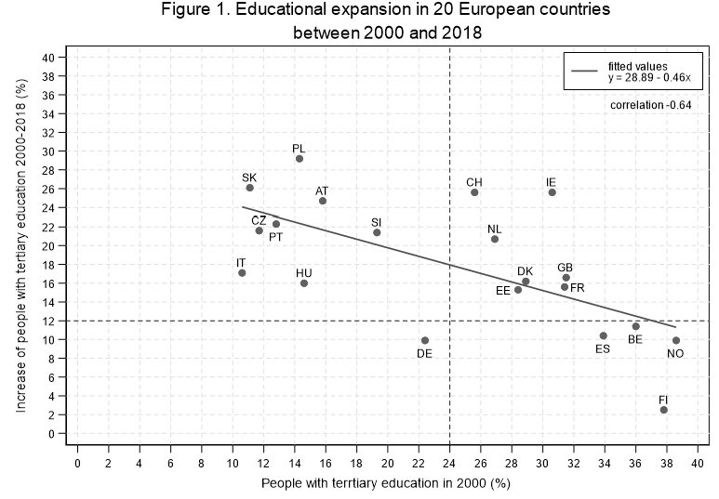
Negatively path dependency of recent EE
The recent educational expansion is negatively path dependent.
The rate of expansion is lower in countries where the proportion of people with tertiary education was already high in 2000, and vice versa.
Note: Tertiary education is indicated by ISCED (levels 5-8) for the 25-34 age group.
Source: Eurostat statistics (2022).
Notes:
The recent educational expansion in European countries has two distinctive features.
The first one is that educational expansion is negatively path dependent. The rate of expansion is lower in countries where the proportion of people with tertiary education was already high in 2000, and vice versa.
On agregated (country) level we can see this in this Figure
The initial point simply defines the result of educational expansion.

Slide 6
Gender gap reversal (GGR)
The change of the gender ratio in favor of women -gender-gap reversal (GGR)
Women’s odds of passing tertiary education transition increased faster than men’s
As their probability of completing their tertiary education
The shares of women with completed tertiary education then exceed those of men in almost all European countries
This trend is seen in many other countries
Diprete & Buchmann (2013) even talk about a global GGR phenomenon
Note: Tertiary education is indicated by ISCED (levels 5-8) for the 25-34 age group. GGR (the gender-gap reversal) shows the difference in proportions between men and women in 2020.
Source: Eurostat statistics (2022).

Slide 7
Pace of EE and the change of gender ratio
The pace of EE is important for the change of the gender ratio in favor of women
The greater level of EE, the more women benefit from it than men
This indicates that women are faster to take advantage of the educational opportunities connected with EE
Note: Tertiary education is indicated by ISCED (levels 5-8) for the 25-34 age group.
Source: Eurostat statistics (2022).
Notes:
The rate (pace) of tertiary expansion is important for the change of the gender ratio in favor of women and the subsequent GGR.
Figure demonstrates this
The intensity of the tertiary education expansion influences the size of the gender ratio in favor of women regardless of the proportion of men or women with tertiary education level.
Simply speaking: the greater the educational expansion, the more women benefit from it than men
This indicates that women do not push men from tertiary education
Compared to men, they are only faster to take advantage of the educational opportunities offered by the growth of educational tertiary levels

Slide 8
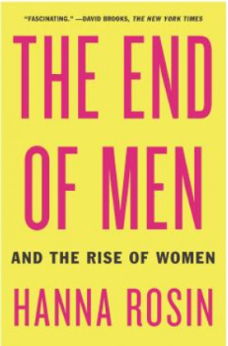
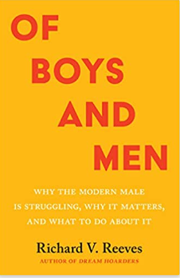
Do women take it all?
Women do not push men from tertiary education level
They are simply faster to take advantage of the educational opportunities offered by the growth of educational tertiary levels
Rosin (2012) describes the stagnation of American men who did not take the same advantage of educational opportunities in higher education as women.
Rosin argue that young men had given up on higher education and quietly disappearing from tertiary education compared to women.
Reeves (2022) follows up Hanna Rosin’s argument. He shows how boys were behind girls in education and struggling in colleges
Notes:
In 2013 the american journalist Hanna Rosin published the book with the title The End of Men (2013)
She describes the stagnation of American men who did not take the same advantage of educational opportunities in higher education as women.
She argue that young men had given up on higher education and quietly disappearing from tertiary education compare to women.
In 2022, the american sociologist Richard Reeves published the book Of Boys and Men.
He follow up Hanna Rosin’s argument.
He shows how boys were behind girls in education and struggling in colleges
He consider the societal consequences of GGR for American society.

Slide 9
Part 2: Already-known consequences of GGR
Educational homogamy and heterogamy (Esteve et al., 2012; De Hauw et al., 2017)
Marriage stability, divorce risks and gender roles (Van Bavel et al., 2018),
Reproductive decision making and fertility (Van Bavel, 2012).
Labor market positions (Goldin et al., 2006)
Gender gap in family earnings (Klesment & Van Bavel, 2017),
Parental approaches to children (DiPrete & Buchmann, 2006)
Inequality of educational opportunity (Katrňák, 2024)

Slide 10
Where have all young tertiary educated men gone?
Are GGC and GGR the same processes?
They are connected but:
  GGC generates lower gender inequality
  GGR generates higher gender inequality (albeit reversed)
Are the causes of GGC and GGR the same?
Why GGR still increases when GGC has been achieved?
What factors play a role in the increase of GGR?
Girls accept better some family dis-advantages (parental hypogamy, parental divorce, single-parent family, and birth-outside marriage)
What does it mean for the GGR and its future?

Slide 11
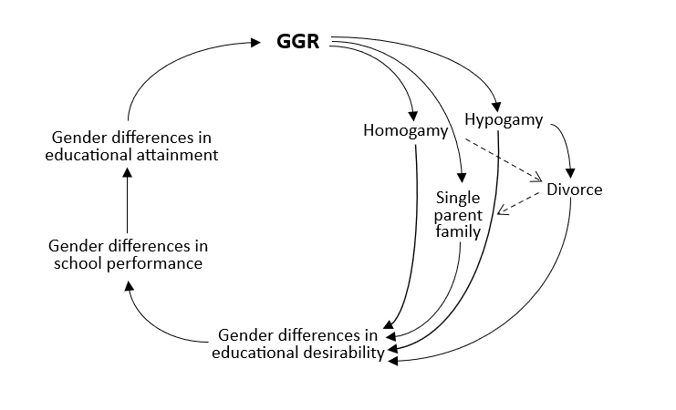
Is GGR a positive feedback loop?
Educational homogamy in higher educated parents increase GGR
Girls accept better some family dis-advantages (parental hypogamy, parental divorce, single-parent family, and birth-outside marriage)
When there is an increase of these family disadvantages in time, there is an increase of more girls compared to boys in higher education
Compositional argument in sociology

Slide 12
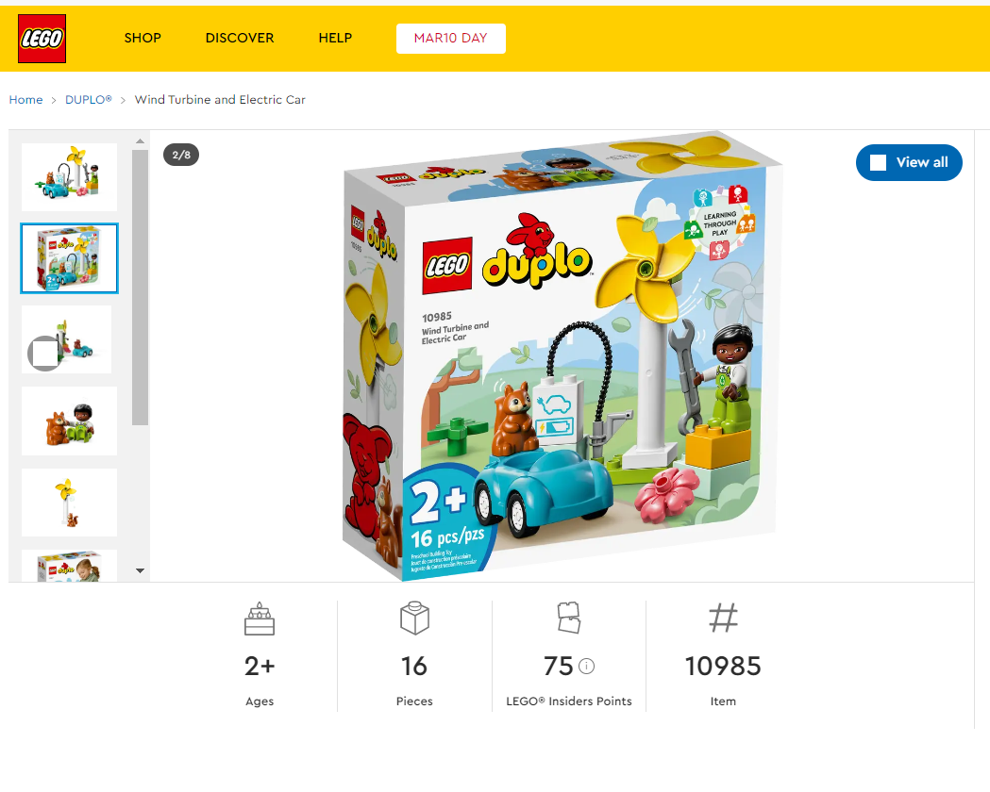
Future societies?

Slide 13

Of Boys and Men by Richard Reeves
YT video: https://www.youtube.com/watch?v=DBG1Wgg32Ok
Notes:
In 2013 the american journalist Hanna Rosin published the book with the title The End of Men (2013)
She describes the stagnation of American men who did not take the same advantage of educational opportunities in higher education as women.
She argue that young men had given up on higher education and quietly disappearing from tertiary education compare to women.
In 2022, the american sociologist Richard Reeves published the book Of Boys and Men.
He follow up Hanna Rosin’s argument.
He shows how boys were behind girls in education and struggling in colleges
He consider the societal consequences of GGR for American society.

