Slide 1
Inequality and Ethnicity
Introduction - why ethnicity?
What is ethnicity - definition
Brief review of theoretical discussion on the topic
Different groups, different situations
Discussion
Notes:
Western Europe has since long been an important immigration destination.

Slide 2
Question
What are the criteria of ethicity?

Slide 3
Difference between race and ethnicity
Race
Is not widely used in Europe, but still dominant in the US and UK
Refers more to physical aspects (skin color, other physical features etc.), recognized typically by other
Ethnicity
Used more in continental Europe
Seeks to reflect physical, social and cultural aspects

Slide 4
Ethnic group
An ethnic group may define themselves as different because of their language, religion, geography, history, ancestry, or physical traits.
Ethnicity entails identification with a given ethnic group, but it also involves the maintenance of a distinction from other groups.
Notes:
Who have different cultural and societal origin

Slide 5
Concept of (un)equal chances
From the sociological point of view equal chances means, that the family of origin does not influence destination of an individual.
Although the evidence from social research varies by country, minority group, and economic well-being indicators, there is a significant correlation between ethnicity and social disadvantages.
.
Notes:
Social environment determines individual opportunities. Family conditions such as number of siblings, parents' income, benefits in terms of cultural capital. In addition, residential conditions , the availability and quality of education, job opportunities and other features of the social context significantly affect the life chances of individuals and regardless of his talent and effort.
In modern societies the requirement of equality of opportunities is formally declared (in the Constitution).

Slide 6
Integration
Integration in both social and civic terms rests on the demand of equal opportunities for all. In socio-economic terms, migrants or ethnic groups must have equal opportunities to lead just as dignified, independent and active lives as the rest of the population.
Integration is successful when minorities and migrants become part of the core in all aspects of life: social, economic, political, cultural, and symbolic ones. Integration is not successful when minorities/migrants have problems penetrating the core of society.
Notes:
a word used by many but understood differently

Slide 7
Question
What are the main areas of socio-economic integration?

Slide 8
Assimilation, Integration, Inclusion
UNESCO (2019). Migration, displacement and education. Global Education Monitoring Report, p. 84.

Slide 9
Empirical evidence
Research on ethnic minorities in Europe agrees on the existence of labour market disadvantages for ethnic minorities.
Ethnic minorities typically have significantly:
- higher unemployment rates,
- lower labour income, and
- they are less likely to find and keep their jobs than the majority (general) population
Notes:
Yet, most of the existing

Slide 10
For more empirical data
https://www.oecd.org/els/mig/Main-Indicators-of-Immigrant-Integration.pdf

Slide 11
Ethnic disadvantages and socio-economic integration
Human capital theory
Social capital theory
Unfavourable attitudes (of employers or others)
Theory of reference groups and acculturation processes
Notes:
Turning to ethnic disadvanteges and socio-economic integration we find 4 explanations.

Slide 12
Human capital theory
The relevance of education, skills, experiences, and language fluency for access to the labour market.
Qualifications obtained in the receiving country are not recognised in the host society.
Immigrants from poor countries (low level of education, little language skills) may remain vulnerable.
Notes:
Their qualifications – obtained in the home countries – are not readily recognised by employers in the host society. In contrast, the 2nd generation will have greater, and more relevant HC in the LM of the receiving society, although those from poor origins, brought up in poverty areas may still suffer from drag effects and remain vulnerable.

Slide 13
Social capital theory (incl. the “Strength of Weak Ties“)
see Bourdieu, Granovetter
Greater emphasis on the resources embedded in social relations and community structure.
Immigrants/ethnic groups tend to have a rather restricted social circle of co-ethnics in the same position („ethnic capital“).
Not having effective job-search networks.
For further: Maani, S. „Ethnic networks and location choice of immigrants“. IZA World of Labor, 2016: 284. doi: 10.15185/izawol.284
Notes:
Even though „bonding“ social capital in culturally bounded minority ethnic communities may help co-ethnics to get by in their daily lives, a lack of „bridging“ social ties with them mainstream society may leave them permanently behind in accessing higher level jobs.
The dynamics of these ethnic social networks and co-ethnic social capital can be powerful tools in increasing employment participation as migrants use these networks to find employment. However, such ethnic social networks can be limiting - often helping people to get jobs in a limited set of sectors.

Slide 14
Unfavourable attitudes of employers
Statistical discrimination
please watch this short video:
https://www.youtube.com/watch?v=2E9HYDPXCgQ
Direct disrimination
Indirect discrimination
For evidence see the OECD link ↑ (Main Indicators of Immigrant Integration, part Social Inclusion, 2018:22-23)
Notes:
While the above theories look at ethnic disadvantage from the individual perspective of immigrants, this explanation applies to employers. Discrimination takes different forms. Employers may anticipate the desirability of a particular ethnic group as employees, reject candidates outright, or use exclusionary hiring practices.

Slide 15
Theory of reference groups and acculturation/assimilation processes
The first generation may be poorly educated and disadvantaged
The horizon of the second generation may grow broader: higher aspirations,
lower level of discrimination,
antidiscrimiantion legislation
Notes:
May help to explain the changing fortunes of various ethnic groups or generations. It assumes a generational and over-time change in the outlook.
These theories (explanations) are not mutually exlusive but complementary!

Slide 16
Three images of the long-term situation of ethnic groups
Optimistic
The example of the gradual reduction of gender differences, so it is hoped that similar processes may work on ethnic lines.
Pessimistic
It may take decades for minority groups to catch up, if they ever do. The link between the etnicity and social class (see rationally adaptive strategies)
Segmented
Notes:
Existing studies tend to provide three images of the long-term socio-economic situation of ethinc groups.

Slide 17
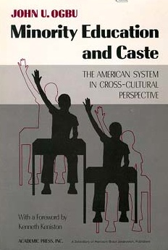
Segmented assimilation
See Portes&Zhou, Portes& Rumbaut
Different ethnic groups, different generations can achieve quite different outcomes
(eg. in the context of US different
pathways of Asians, Mexicans,
Black Americans).
The importance of specific cultural
factors in the case of various ethnic
groups.
Examples of voluntary and involuntary
minorities (Ogbu & Simons).

Slide 18
Different types of Minority Status
Indigenous minorities | Who are present for centuries but not assimilated
Voluntary (Immigrant) Minorities | Those who have more or less willingly moved (to a new country) because they expect better opportunities
Involuntary (Nonimmigrant) Minorities | People who have been conquered, colonized or enslaved
Refugees | Due to fear of persecutions outside their home country, seeking protection in other.
Dominant patterns of belief and behaviour as focus of analysis

Slide 19
Explanation of different outcomes
Concerning the relationship between assimilation process and social mobility, please see this video by Alejandro Portes:
https://www.youtube.com/watch?v=mLmKM4c3fJs
Time for Presentation

Slide 20
Seven principles of labour market integration for migrant youth (in the US)
1. The context of migration matters
2. Immigrant youth come in many types
3. Today's migrants are socio-economically diverse
4. Gender matters
5. Immigrant children are unlike their parents
6. Just as populations differ so too do institutional arrangements
7. The mechanisms linking immigrants and immigrant offspring to labor markets take various forms
Source: OECD Working Papers 2011/09
see References

Slide 21
To discuss
Give examples of relevant ethnic or immigrant groups in your country.
Give examples of policies/programmes aimed at eliminating/reducing discrimination or ethnically based disadvantages.

Slide 22
Number of foreigners in the Czech Republic according to the most frequent nationality
Absolute numbers
Ukraine
Slovakia
Russia
Poland
Germany

Slide 23
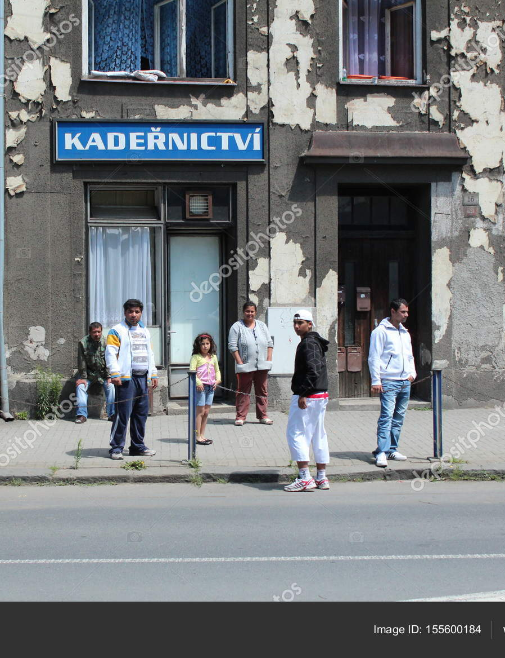
Social chances of the Roma in the Czech Republic
Notes:
According to what we know from the analysis and studies about the situation of the Roma in the CR, be a Roma (or to born into the Roma family) likely means social handicap for future life. Mentioned researches and studies show that Roma population in the Czech Republic faces systematic disadvantages in several areas. The most serious disadvantage is the one in the labor market. One of the main reasons leading to this situation is the low educational level Roma people attain.
Several reports of EU institutions and organizations refer to the continuing discrimination against Roma children in the Czech Republic’s education system.

Slide 24
Number of the Roma in CR and SR comparison between Cenzus and estimates
 | Data from Cenzus | Share of population | Qualified estimates | Share of population
Czech Republic | 33 000 (1991) 11 746 (2001) 13 150 (2011) 21 691 (2021) | 0.3 % - 0.1 % | 140 000 - 300 000 | 1.41 % - 2.9 %
Slovakia | 80 627 (1991) 89 920 (2001) 105 700 (2011) | 1.7 % - 2% | 480 000 - 520 000 | 9-10 %
Who states Roma mother tongues in the last Czech cenzus (2011): 40 370 (of which 5000 as single, the rest in combination mainly with the Czech or Slovak).
Notes:
Qualified estimates, however, show that there are many more Roma people than reported in the Czech population, and the data from the census therefore do not represent the overal Roma population. This table shows that the estimates of the number of Roma in comparison with census data considerably differ. Such a phenomenon can be observed across most European countries.
However, these estimates typically focus on areas with higher spatial concentration of the Roma population, which means that only the Roma people living in concentrated areas are accounted for. But it is known that a considerable fraction of the Roma population includes those who have assimilated, whose number is even more difficult to estimate.
It is known that the current Roma population in the Czech Republic shows a remarkable diversity. The difference can be seen from several aspects: the language, the customs, the econocmic activities and lifestyles.
This demonstrates the problem of defining who is Roma and who is not. A concept of an ethnic group.
24

Slide 25
The question of ethnic identification:
Discrepancy between:
Those who consider themselves to be Roma
Those who are considered as Roma by others.
The boundary of ethnicity is fuzzy, the classification depends on who does it.
Notes:
Various authors and expert estimates point out against the cenzus data that they not represent the total Roma population or that the official demographic data underestimate the size of the Roma population. Thus, we see that people who do not identify themselves as Roma, are still classified as by others (experts or researchers).
Problems with the definition of who and based on what criteria identify as Roma.
3. Groupness – „býti skupinou“: „This means thinking of ethnicity,race, and nation not in terms of substantial groups or entities,
but in terms of practical categories, cultural idioms, cognitive schemas, discursive frames,
organizational routines, institutional forms, political projects, and contingent events.“

Slide 26
Three different system of classification
Self-identification.
Classificaton by experts who deal with the Roma (teachers, officials, social workers, policmen etc.)
Classificaton by social researchers/interviewers – based on judgemnet „on-the-fly“.
The question of external, third party identification (TPI)
Notes:
The boundary of ethnicity is fuzzy, the classificaton depends on who does it.
All of them are real.
2. The Roma are those who need special attention, assistance or special policy instrument. People who are classified as Roma in this way tend to be related to a social or welfare problem. Moreover such definition mostly conflates poverty and Roma ethnicity.
3. More proper for detecting the assimilated or those Roma who live in consolidated conditions.

Slide 27
Census Data 2011 - Czech Republic
Gender | Non-Roma population | Roma nationality | Romanes | Roma Nat+tongue
men | 49,0 | 52,9 | 51,3 | 52,3
women | 51,1 | 47,1 | 48,7 | 47,7
 | 100,0 | 100,0 | 100,0 | 100,0
Average age
men | 39,0 | 26,6 | 31,4 | 31,3
women | 42,0 | 24,6 | 32,5 | 31,5
population | 40,5 | 25,7 | 31,9 | 31,4
Average number of children | 1,57 | 2,14 | 2,70 | 2,68
Marital status
single | 39,9 | 71,3 | 59,5 | 59,7
married | 42,4 | 20,1 | 27,1 | 28,0
divorced | 10,3 | 6,6 | 9,5 | 8,6
widowed | 7,3 | 2,1 | 3,9 | 3,6
Total | 100,0 | 100,0 | 100,0 | 100,0
Educational attainment
Less than 9th grade | 0,8 | 8,1 | 13,8 | 13,2
Primary | 18,0 | 53,4 | 65,8 | 59,3
Vocational training | 34,9 | 16,3 | 15,0 | 16,0
Secondary (with GCSE) | 33,0 | 12,1 | 4,0 | 6,5
Tertiary | 13,2 | 10,1 | 1,4 | 5,0
Total
Source of data: Czech Statistical Office (CZSO)

Slide 28
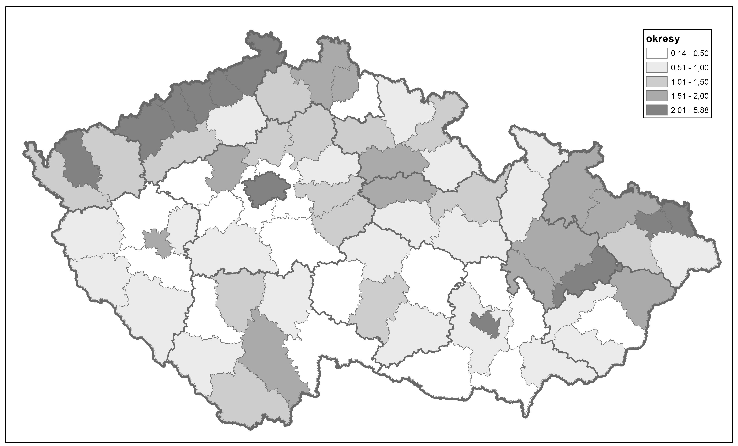
Distribution of the Roma population in the CR by districts – Cenzus 11
districts
Source: CZSO

Slide 29
© Jindřich Štreit

Slide 30
© Jindřich Štreit

Slide 31
© Jindřich Štreit

Slide 32
In the CR we clearly identify
Lower economic activity rate of Roma population
The Czech Roma often live concentrated – such areas labelled as ghettos
Low socio-economic status of the Roma – extent of dependency on social allowances/benefits.
The overall inferior social status of the Roma in Czech society.
Significantly lower school success of the Roma (especially from socially excluded localities) than that of the whole Czech population.
In Czech society, the topic of ethnicity and educational inequality is relevant almost exclusively to the Roma. Other ethnic minorities, such as Slovaks, Ukrainians, Vietnamese, and Russians, show a much smaller ethnicity effect as a determinant of educational inequalities compared to the Roma.
Notes:
The situation of a person in the labor market is immediately reflected in the quality of life or the living standard of his family. Regarding the standard of living of the Roma, one of its key indicators is the rate of dependency on social allowances/benefits. This rate varies around one fifth of all households in localities with lower proportion of Roma population up to two-thirds of all households dependent on social benefits in areas with a higher proportion of Roma population.
Low socio-economic status of Roma people reinforces the negative stereotypes majority population holds towards Roma people and that mass media significantly boost up (for example, recent media discourse on “inadaptable members”).
32

Slide 33
No Data – No Progress
„Hard-to-survey“ population (Font, Mendez, 2013; Kappelhof, 2015).
Initiatives of the European Union, as well as national governments to improve the collection of data relating to Roma.
Governments should collect ethnic data and use it for the purposes of analysing the state of equality

Slide 34
Sources
Galbraith, J. K. (2016). „Inequality: What Everyone needs to know“ (Chapter 3. Categorical Inequality, pp. 32-44). Oxford University Press.
Koopmans, R.; Veit, S., and Yemane, R. 2019. Taste or statistics? A correspondence study of ethnic, racial and religious labour market discrimination in Germany. Ethnic and Racial Studies, Vol. 42:16, pp. 233-252.
For more data:
UNESCO WIDE. https://www.education-inequalities.org /
OECD (2018). Equity in Education: Breaking Down Barriers to Social Mobility, PISA, OECD Publishing, Paris.
Equality data collection - European Commission (europa.eu)

Slide 35
Thank you for your attention!
35

