Slide 1
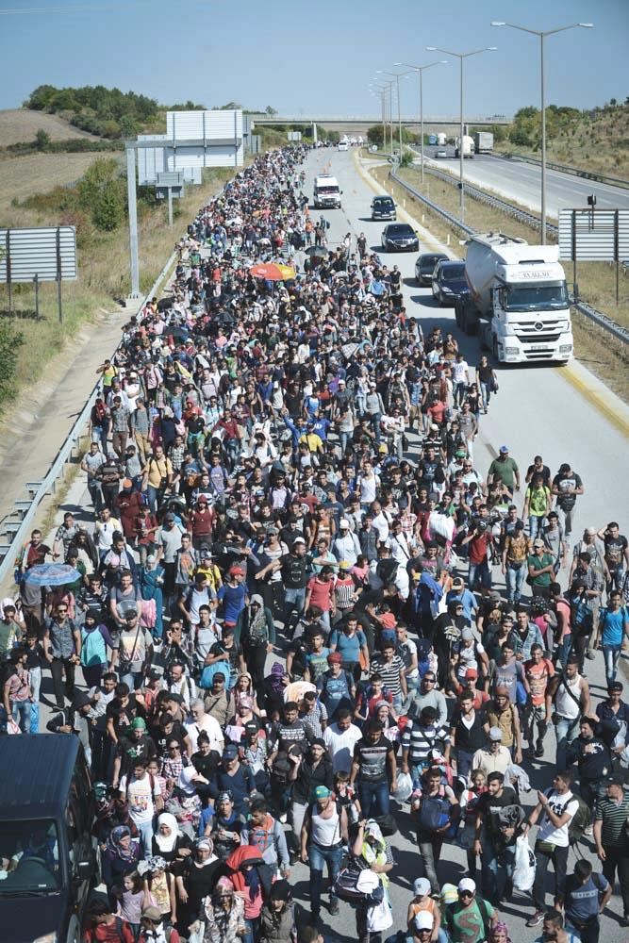
Justice & Home Affairs
Session 3
EU Asylum policy
Eurodac
Dublin II Regulation
Assigned readings for this session:
Peers (2011), 357-366
MEDAM (2017), pp 30-43
Scipioni (2018), pp. 1357–1375
Guiraudon (2018), 151-160
Rule of ‘first entry’
Dublin Convention
Non Refoulement principle
European Asylum Support Office (EASO)
Geneva Refugee Convention

Slide 2
EU Asylum Policy
Obligations under international law
and EU Asylum Objectives
EU objectives
to offer appropriate status to third-country nationals who need international protection on the basis of harmonised EU rules
The international legal context
the 1951 Geneva Refugee Convention and
the 1967 Protocol thereto
provide obligations under international law
which also serve as objectives of EU’s asylum policy
to ensure that the inter-national principle of ‘non-refoulement’ is observed

Slide 3
1990
Dublin
Convention
1997
Dublin Convention (1990)
key function: assigning member state responsibility for registering and hosting refugees
main aim: preventing ‘asylum shopping’

Slide 4
Dublin Convention
The Convention does not say that the first member state where an asylum seeker may pass through, has the responsibility to register and host the refugee.
Criteria for determining responsibility
‘Rule of first entry’
What the Convention meant in practice
It ‘merely says that only after all ‘prior criteria’ have been exhausted, the first member state becomes responsible
What it meant in practice:
only 4.2% of asylum applications were subject to ‘prior criteria’
71.4% of these requests were accepted
In short: 3% of the total asylum applications resulted in relocation to another member state
Prior criteria inter alia include:
family unity
applicant has residence permit from another member state
applicant has visa from another member state

Slide 5
1990
Dublin
Convention
1997
2000
Dublin Convention (1990)
key function: assigning member state responsibility for registering and hosting refugees
main aim: preventing ‘asylum shopping’
What it meant in practice
responsibility lies with country of first entry
the Convention induced asylum seekers to destroy travel documents
It entered into force in 1997 (due to ratification difficulties)

Slide 6
2000
Eurodac Regulation
2003
Eurodac Regulation (2725/2000)
establishing an integrated fingerprint database
took effect only in 2003 (due to technical difficulties)
its aim: comparing fingerprints for the effective application of Dublin Convention and its rules:
Impact in practice:
substantial increase in percentage of multiple asylum applications detected (from 7% in 2003 to 17.5% in 2008) _{Source: Peers 2010, p. 365}
actually ensures that the ‘rule of first entry’ is safeguarded

Slide 7
2003
Dublin II Regulation
2009
Dublin II Regulation (343/2003)
Main changes from Dublin Convention:
speedier procedure for transferring asylum seekers between member states
additional criteria related to family relationships (on top of family reunion), including:
the member state responsible for unaccompanied minors is the member state where a family member can take care of them
Now supported by Eurodac

Slide 8
Dublin II Regulation
The default criterion (still) is the member state where the asylum seeker submitted first his or her application
What the Dublin II Regulation means in practice
Overall 4.1% of asylum seekers were relocated under the Dublin II Regulation rules
Source: Peers 2010: 362
Failure to carry out half of the transfers, due to:
absconding (i.e. hiding from the authorities)
suspensive effect of appeals
illness or humanitarian reasons
voluntary return to country of origin
Source: Peers 2010: 362

Slide 9
2009
Lisbon Changes
2011
Main change from Lisbon Treaty (2009):
art. 87 TFEU: creation of a common asylum policy (with uniform procedures; no longer minimum standards)
no change to the decision-making procedure

Slide 10
2009
Lisbon Changes
2011
EASO
2013
European Asylum Support Office (EASO)
established by Regulation 439/2010; it became operational in 2011
Main aims:
facilitate protection for asylum seekers
smoother relocation procedure between EU countries
Some of its tasks
organising temporary support to member states subject to pressure
organizing and providing assistance to repair or rebuild asylum and reception systems

Slide 11
2013
Dublin III Regulation
2016
Dublin III Regulation (604/2013)
One of key reasons to change:
court rulings of (ECJ) 2011 and (ECHR) 2012
failing reception conditions: also violation of non-refoulement
Main changes from Dublin II Regulation:
widens the definition of family members (for relocation to other member states)
introduces more legal measures to safeguard the asylum seekers during the relocation and transfer procedure
the first entered Member State still bears the responsibility of handling the asylum application

Slide 12
2021
New Pact on Asylum And Migration
Today
‘New Pact on Asylum and Migration’
adopted by Commission in September 2020
It foresees among other things:
streamlining procedures and rules on asylum and return
new solidarity mechanism for search and rescue
improved management of external borders (next class)
It also addresses the basic rule of ‘first entry’ ……….

Slide 13
2021
New Pact on Asylum And Migration
Today
Replacing the ‘first entry’ rule with a relocation programme or quota system of relocation (based on the solidarity principle)
Currently, the Commission and EP try to force this through a package deal with the ms
who ask for EU money in financing border control (next lecture)
A relocation program based on quotas has actually been applied, albeit temporarily: in 2015-2016.
And with deficiencies

Slide 14
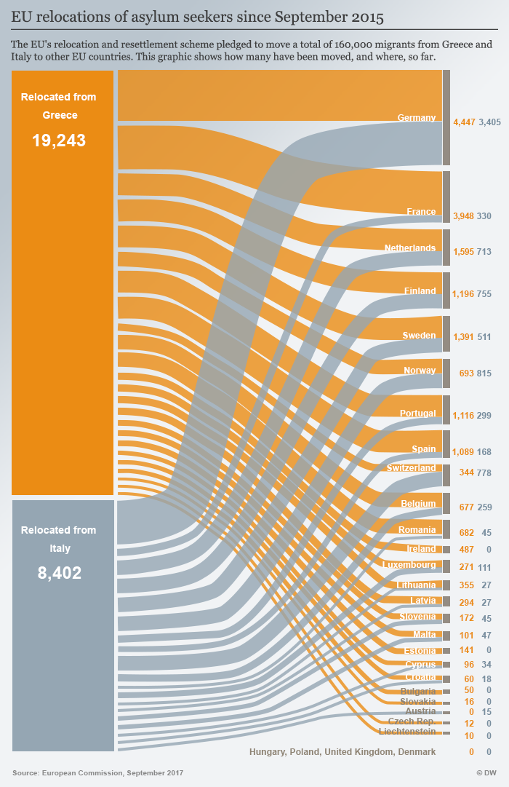
Critical Issues of Asylum Policy
The refugee crisis of 2015-2016
In 2014: 662 680 applications were recorded in the EU
In 2015: 1 349 638 applications (more than twice the level of 2014)
In 2016: 1 236 325 asylum applications (9 % decrease compared to 2015)
In 2017: 707 000 asylum applications (43 % decrease compared to 2016)
Weaknesses and responses
uneven distribution of responsibilities
burden of dealing with illegal entry falls onto external border member states
poor conditions in first-entry countries induce asylum seekers to apply for asylum elsewhere and refuse cooperation with authorities implementing Dublin rules
(Hess & Kasparek 2017: 38)
During the 2015-16 Crisis:
a hard-fought compromise on a relocation scheme (2015) was weakly materialized
once a migrant’s data was registered in Eurodac, he or she was obliged to remain in the country of first entry
member states most affected started to move towards lax fingerprint registration practice
(Hess & Kasparek 2017: 58)

Slide 15
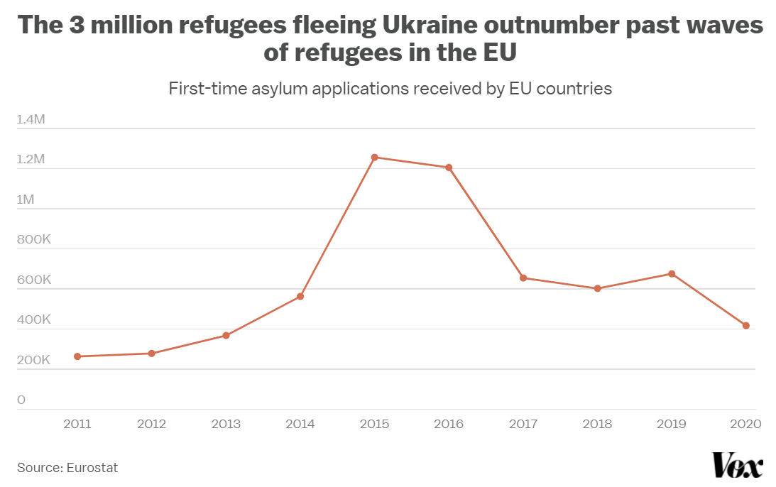
Critical Issues of Asylum Policy
2022: Ukrainian refugees in the EU
from 2013 to 2021: nearly 6 million people applied for asylum in EU
about 2.5 million sought asylum during 2015 and 2016
March 2022: over 4 million fled Ukraine within a month
EU measures
4
On 23 March adoption of a financial package:
release of €3.4 billion in recovery funds
to help MS absorb refugees (chiefly those neighbouring Ukraine)
intended for housing, education, health, employment and child care.
drawn from REACT-EU recovery program (intended for recovery from corona pandemic)
In a week, after the Russian invasion on 24/2:
humanitarian exception clause of Schengen Borders Code (Art. 6(5c)) activated
reprogramming funding of initially around 200 million for border management support
crisis management coordination team established (IPCR)
Temporary Protection Directive (TPD) granting en masse collective protection status

Slide 16
Leading statement for in-class debate of tomorrow:
Member states should be allowed to (continue to) externalize reception and registration in neighbouring (third-state) countries.

Slide 17
Leading statement for in-class debate of today:
The Dublin mechanism should be based on a system of quotas.
(that is: refugees should be distributed amongst member-states according to a formula pre-established at EU level)

Slide 18
END
Santino Lo Bianco PhD
Email: s.lobianco@hhs.nl

