Slide 1
Distinction
Key thinkers: Pierre Bourdieu & Robert Putnam
Lecturer: Olivera Tesnohlidkova
o.tesnohlidkova@mail.muni.cz
Office hours: contact via e-mail beforehand

Slide 2

Pierre Bourdieu (1930-2002)
Distinction: A Critique of the Judgement of Taste (1979)
Distinction – double meaning: to distinguish & taste (to differentiate and appreciate)
Choices which we tend to attribute to individual taste (e.g., what to wear) originate in society and depend on our training, (length of) our education and our social environment
There is a link between different tastes/preferences (e.g., between music and food preferences)

Slide 3
3 types of taste
(corresponding to educational levels and social classes)
1) Legitimate taste - increases with educational level and is highest in those fractions of the dominant class that are richest in educational capital
2) Middle-brow taste - more common in the middle classes
3) Popular taste – most frequent among the working classes and varies in inverse ratio to education capital

Slide 4
Capital
Social inequality is organized in class inequality
  Class divisions are based on the different conditions of existence - endowments of capital and social conditioning, i.e., sets of dispositions (habitus)
Capital - resources enabling people to profit from participating in different fields
4 main types of capital
  Economic (financial wealth, assets, material goods)
  Cultural (cultural skills, knowledge, titles, qualifications)
  Social (useful social connections)
  Symbolic (social legitimation, honour, respect) – legitimated form of other capitals
Social positions of individuals depend on the overall volume and composition of their capital
  Volume and composition of capital can vary over time; they mark the trajectory of one’s social biography

Slide 5
Cultural capital
Determines collective identity (people with similar cultural capital are likely to associate with each other)
3 forms:
  Embodied – inherited and acquired, usually through family socialization(e.g., language/dialect)
  Objectified – material objects/artifacts
  Institutionalized – institutional recognition of cultural capital

Slide 6
Habitus
Set of durable, transposable dispositions that shape our practices (perceptions, judgement, how we act and make sense of the world)
Culture of a social group embodied in the individual - "society written into the body, into the biological individual" (In Other Words: Essays Towards a Reflexive Sociology, 1990: 63)
Habitus ≠ habit
Class-specific; durable (historically conditioned and internalized); transposable (operates across different settings – political, social, religious etc.)
Judgements of taste are part of social identity, as they express class-based habitus (i.e., our tastes affirm our class)
Structured and structuring – it is the product of our social class and reaffirms our social class by shaping our practices

Slide 7
Field
Society is divided into different spheres, i.e., fields (economy, art, politics, science, religion, etc.)
Semi-autonomous – each field has its own sets of rules, structures, forms of authority
Arenas of struggle – competitive ‘market’ in which individuals employ relevant types of capital to fulfill their interests (preserving or changing the distribution of capital in that field)

Slide 8
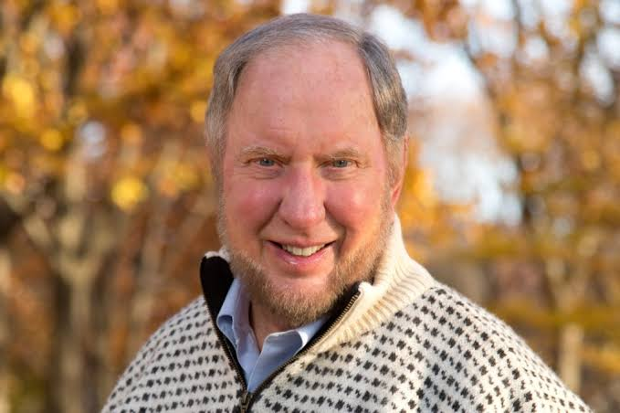
Robert Putnam (1941-)
"Bowling Alone: America's Declining Social Capital“ in Journal of Democracy (1995)
Bowling Alone: The Collapse and Revival of American Community (2000)
Decline in community involvement in the U.S. in the last 50 years
Social capital - the social connections/networks we create have values
  Trust is at the core of social capital – networks assume mutual obligations
  Social capital has individual and collective aspect

Slide 9
Social capital can be used for both benevolent and malevolent purposes
  Promoting mutual support, cooperation, trust, institutional effectiveness
  OR sectarianism, ethnocentrism, corruption
Bonding (exclusive) vs bridging (inclusive) social capital
  Not exclusive categories
  Bonding – reinforcing exclusive identities and homogeneous groups (e.g., fraternal organizations, church-based women’s reading groups)
    Creates in-group loyalty, but also out-group antagonism
  Bridging – outward looking, encompassing people across diverse social groups (civil rights movement, youth service groups, ecumenical religious organizations)

Slide 10
Practical dimensions of social capital
Groups and Networks
Trust and Solidarity
Collective Action and Cooperation
Social Cohesion and Inclusion
Information and Communication
Generalized reciprocity – similar to “paying it forward”

