Slide 1
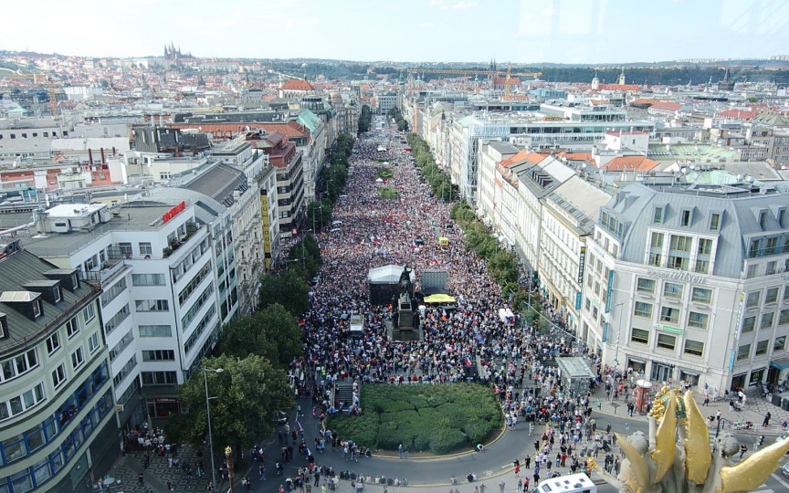
GLCb1014 Social Movements: Multidisciplinary Approach
Lecture 2: Mobilizing grievances

Slide 2
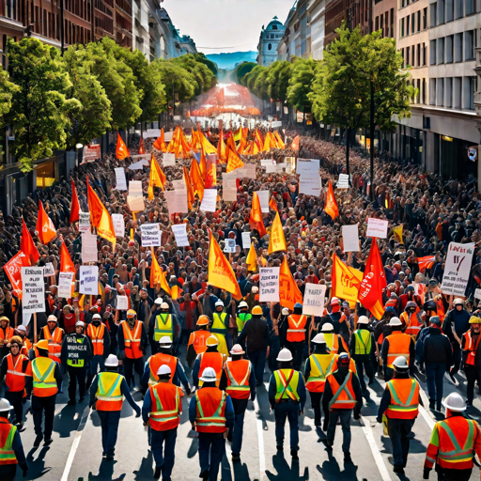
The relationship between mobilization and grievances
Grievances/problems have to become mobilizing grievances/problems to trigger collective action
Ubiquitous injustices and problems? (theory of New Social Movements)

Slide 3
Grievance/dissatisfaction
Everyday/individual vs. Mobilizing/collective
There is no automatic relationship between material deprivation and mobilizing injustices
Wrongs/dissatisfaction is not primarily a psychological condition, it is not about crossing "objective" boundaries of tolerance
Mobilizing injustices are shaped through interpretive processes, they are socially constructed

Slide 4
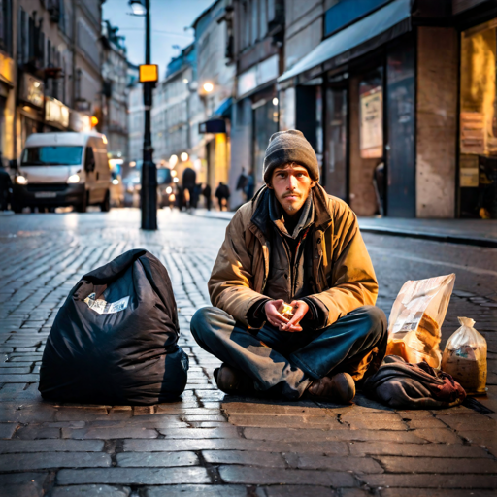
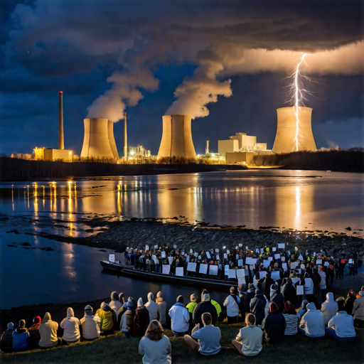
Which grievances/problems?
Structural/material conditions
Group conflicts/inequalities - Marx et al.
Social pressures/tensions/disintegration - Durkheim et al.
2.1 Social disintegration/disintegration theory (wars, disasters)
2.2 Absolute deprivation (poverty, homelessness ...)
2.3 Disruption of the everyday (disruption of routine, sense of security, changes in social organisation/control ...)
Psycho-social factors (frustration-aggression, relative deprivation, status mismatch)
BUT: what to compare with? Is the problem felt? Is it perceived as legitimate (fair)? Is it felt as a threat of loss? How is it interpreted? -> these psychological processes are key

Slide 5
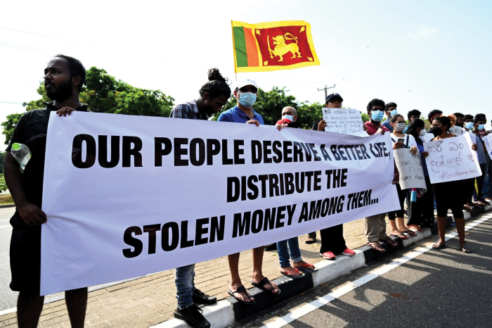
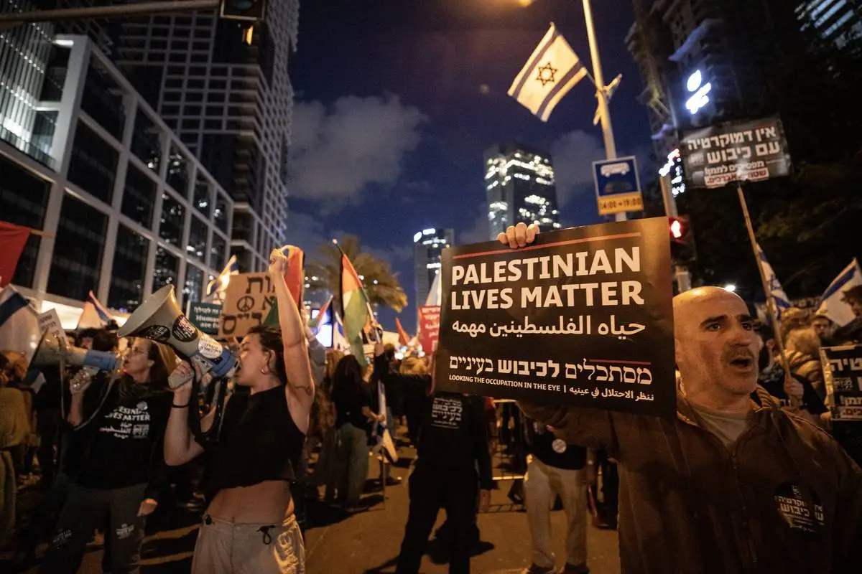
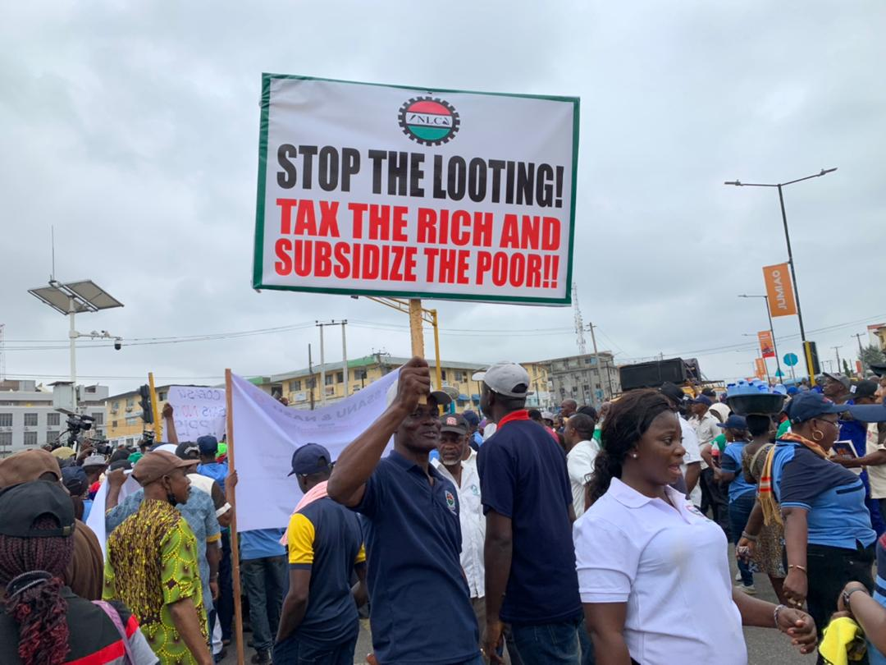
Problems/grievances and their framing
Framing - labeling, interpretation of collective action
The mediating role of culture
Key role of opinion, meanings
Diagnostic, prognostic, motivational frames
Problematization - politicization + attribution of blame/responsibility

Slide 6
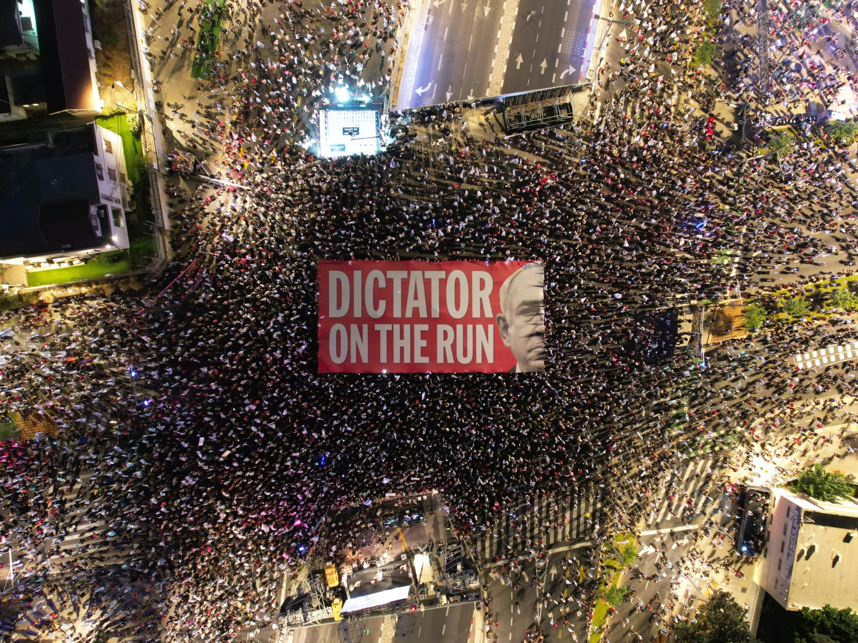
Summary
Individual/daily problems/grievances vs. mobilizing problems/grievances
Key motivating incentives for collective action
Under what conditions do they arise?
Not an automatic, mechanical response to material conditions (but their presence is often necessary)
Often related to a sense of loss and disruption of the everyday
Psychological processes an important factor (vs. psychological states)
Key framing processes and interpretations

Slide 7
Pro-Palestine protest in London
https://www.youtube.com/watch?v=AFr2M0qgXxg
Pro-Ukraine protest in London
https://www.youtube.com/watch?v=4Vu35Ff0cKM

