Slide 1
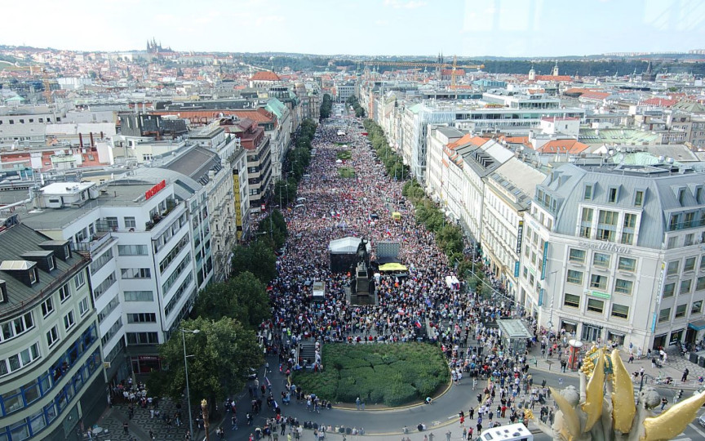
GLCb1014 Social Movements: Multidisciplinary Approach
Lecture 4: Participation in social movements

Slide 2
Political participation (Van Deth)

Slide 3
Political participation
Having necessary resources: time, money, and civic skills (Brady et al. 1995)
Developing civic skills (communication and organization skills that facilitate effective participation)

Slide 4
Obstacles of participation
Citizens cannot participate
Citizens don´t want to participate
Nobody asked them

Slide 5
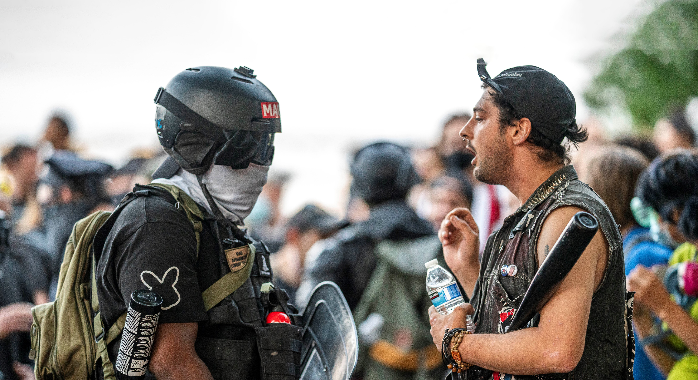
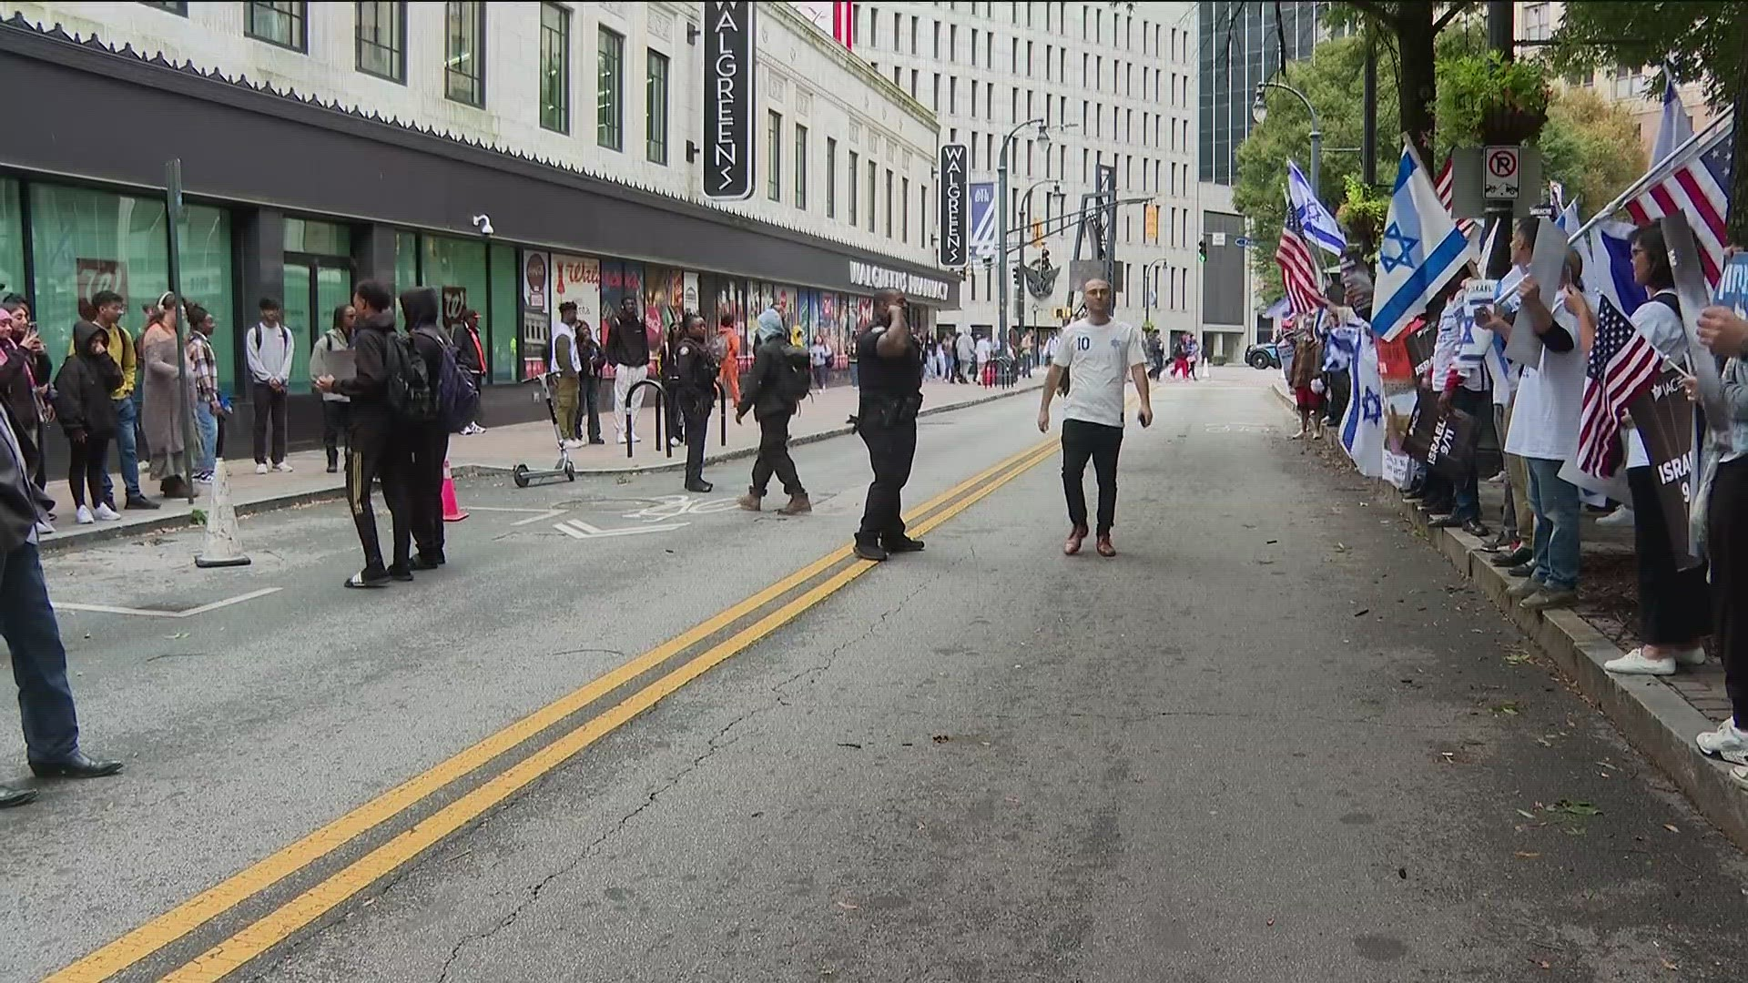
Recruitment
Why some people engage and others not?
Social networks/organizations
Biographies/identities
Collectiver identity + sense of efficacy
Motivation

Slide 6
Participation in social movements
The role of social networks (embeddedness) and groups
Outside the networks recruit mostly very closed groups (sects)
Weaker role of attitudes!
Important: membership in organisations, previous experience of collective action, relationships with other people in the social movement
Networks: create predispositions to collective action (collective identity), create opportunities, influence decisions (move from predispositions and opportunities to action)

Slide 7
Organization membership – CR (EVS 2017)
Member: Belong to sports or recreation | 35,3
Member: Belong to education, arts, music or cultural activities | 18,8
Member: Belong to none | 13,7
Member: Belong to conservation, the environment, ecology, animal rights | 12,5
Member: Belong to religious organization | 11,9
Member: Belong to humanitarian or charitable organization | 10,2
Member: Belong to professional associations | 9,8
Member: Belong to labour unions | 7,7
Member: Belong to self-help group, mutual aid group | 7,1
Member: Belong to political parties | 4,7
Member: Belong to consumer groups | 4,4

Slide 8
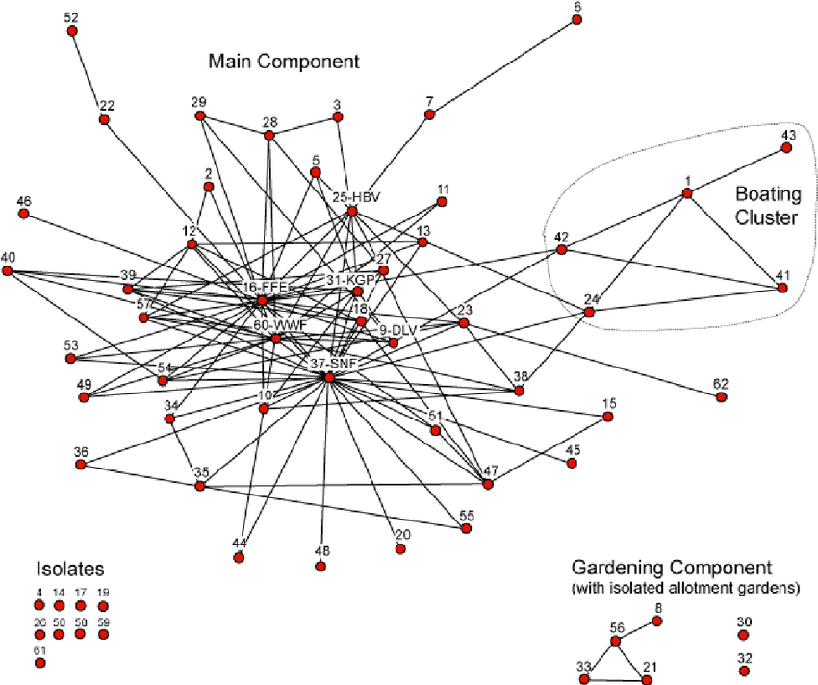
Multiple membership
Contributes to increased confidence
Facilitates the flow of information
Facilitates collaboration between organisations
The social network of the Ecopark movement consists of 62 organizations perceived as active in the protection of the National Urban Park by at least two respondents. They are divided in a Main Component (47 nodes), Gardening Component (4), and several unconnected Isolates (11). Also indicated is the Boating Cluster. The network is generally sparse and of low density; of the 2162 possible links, only 190 were realized in the valued network, whereas 119 were in the symmetrical network. Distances were nonetheless short, with an average of 2.33, and a maximum distance of 5 in the symmetrical network (of the Main Component).

Slide 9
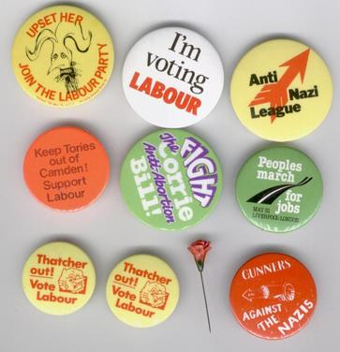
Maintaining commitment: Collective identity
Identity formation as a process - the possibility of multiplying and mixing identities
Identities promote mobilisation (especially in larger groups, without the possibility of specific incentives - prestige, respect, friendship) – solidarity
Inclusive vs. Exclusive collective identities - the higher the inclusiveness, the less capacity for mobilization
Identity formation: objects (typ. with signs, symbols), personalities, artifacts (books, films music ...), rituals (dramatization, denial of traditional cultural codes ...)

