Slide 1
Conflicts and VNSA
Lucie Konečná
GLCb2026 Africas Contemporary Security Challenges
28/2/2024

Slide 2
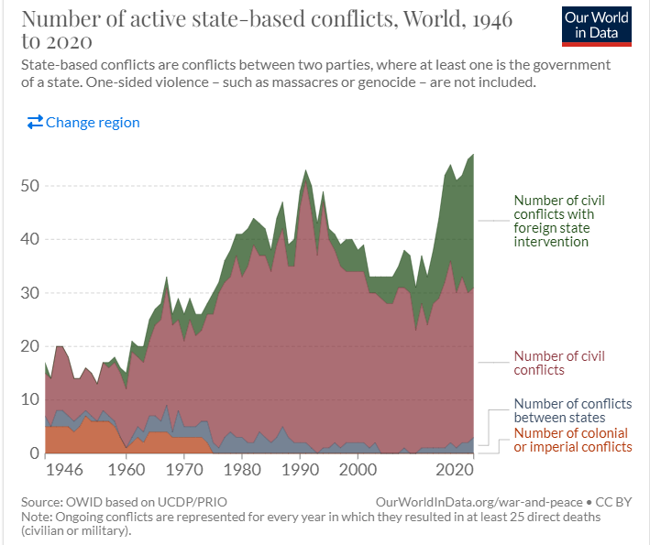
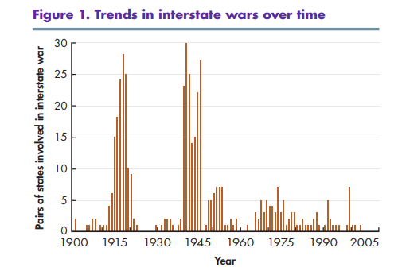
Contemporary Conflict Trends
1. A decrease in the number of interstate wars and an increase in the number of intrastate wars:
1981-2005 –Bakassi conflict
1989-1991 - Mauritania–Senegal Border War
1996-1997 First Congo War, 1998-2003 Second Congo War, 2000 - Six-Day War
1998-2018 - Eritrean–Ethiopian War
2008 - Djiboutian–Eritrean border conflict
2. Internationalization of national/intrastate conflicts

Slide 3
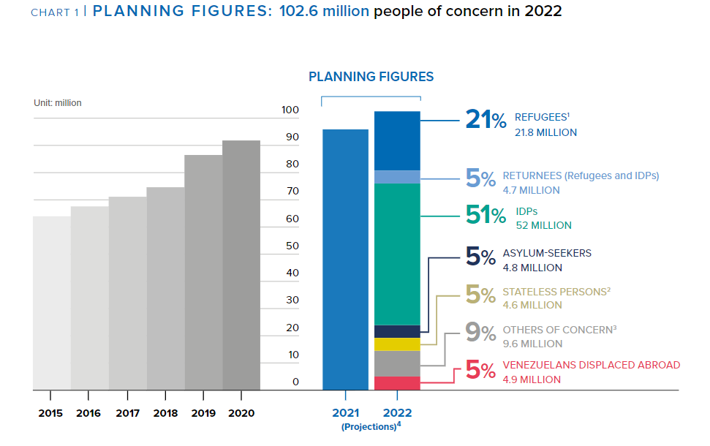
Contemporary Conflict Trends
3. Engagement of foreign units that are motivated by the economic interests of their countries
4. An increase in identity conflicts
5. An increase in conflicts involving VNSA
6. An increase in civilian casualties
7. Increasing numbers of refugees and internally displaced persons
8. Development of humanitarian activities and aid
9. Privatization of conflicts
10. Brutalization of conflicts
11. Extending the duration of conflicts

Slide 4
VNSA - General Info
Primary, secondary, and tertiary conflict actors
Intrastate, Interstate, and Non-state/Sub-state conflicts
Violent Non-State Actors:
a) use violence to achieve their goals
b) are not integrated within formalized state structures
Violence that involves violent non-state actors is often described as unconventional
Violent non-state actors involved in a low-intensity conflict may prefer the status quo over negotiation and mediation because their power is much lower

Slide 5
Typology of War Participants
1. Members of the armed forces according to international law:
Combatants – members of regular or irregular armed forces
Non-combatants - not intended for combat duties (medics, clerics).
2. Civilians
Real fighters in modern wars:
Conventional soldiers/army
Insurgents, guerrillas, partisans, and rebels
Terrorists
Mercenaries, PSC/PMC
Foreign volunteers
Warlords
Child soldiers
Paramilitary units and death squads
Militias

Slide 6
Factors Affecting the Rise of VNSA
Decline of bipolarity/end of Cold War and the emergence of a globalized world
Socioeconomic factors
Repressive politics
Poverty and income inequality
Weakness of security institutions
State collapse
Individual explanations (rural vs. urban, age, education, socio-economic status, unemployment, socio-psychological level)

Slide 7
VNSA Typology according to Williams
Rebels/Insurgency
Militia
Paramilitary units
Terrorist groups
Warlords
Criminal organizations and gangs
Motivations and purpose
Strength and scope
Funding and access to resources
Organizational structure
Role of violence
Relationship between VNSA and state
Functions of VNSAs for members and supporters

Slide 8
VNSA Typology according to Ezrow
Insurgencies
Warlords and Marauders
Paramilitary units
Terrorist Organizations
Private security companies
Organized crime and gangs
Motivation
Strategy and tactics
Funding and access to resources
Organizational structure
Scope and power
Victims
Legitimacy and popularity

Slide 9
VNSA Typology according to Schneckener

Slide 10
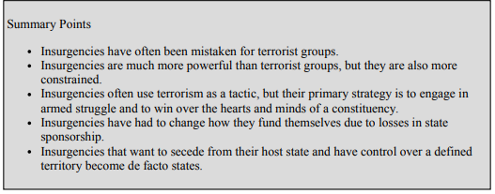
Insurgency
The primary raison d'être of these groups is to achieve some political goal
Territorial control
Strategy - irregular attacks and war of attrition
Hierarchical structure, in recent years there has been decentralization
A threat to the legitimacy of the state
Four basic types: liberationist, separatist, reformist/revolutionary, and religious/traditional.

Slide 11
Insurgency

Slide 12
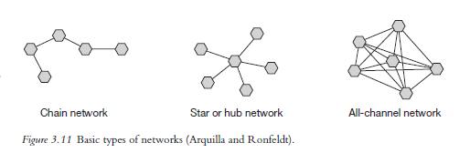
Terrorist Organizations
A deliberate form of politically motivated violence
Lack of territorial character
Low threat to state legitimacy (very little public support)
Strategy - psychological impact, shock a wide audience, attacks mainly on civilians
Structure - currently mainly network
Arquilla a Ronfeldt (2001) - Networks and Netwars: The Future of Terror, Crime, and Militancy
Zelinsky a Shubik (2008) – hierarchy, franchise, venture capital, a brand

Slide 13
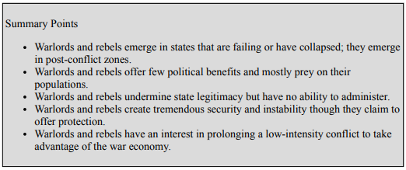
Warlordism
Primarily economically motivated violence
Strong territorial character
Hierarchical structure - headed by a charismatic leader
A threat especially to weak states
Strategy - marauding terror, unpredictable and random violence

Slide 14
Organized Crime and Gangs
Economic motivation
Often transnational
Hierarchical and network structure
Strategy - use of violence to achieve economic goals, attempt to avoid media attention, violence especially in times of uncertainty
The effort to subvert the structures of the state - they do not want to completely destroy the state
„Organized criminal groups are structured groups of three or more persons that exist for a certain period of time and whose aim is to regularly commit more serious crimes in order to obtain material benefit.“

Slide 15
Private Military Companies
Economic motivation
Territoriality is related to the type of task/contract
Hierarchical structure
Strategy - they do not have long-term strategies, it always depends on the contract
Can threaten the state's monopoly on the use of violence, ineffective as a long-term solution
Executive Outcomes, Blackwaters/Academi, Wagner Group
United Nations Mercenary Convention 2001 (The convention extends on the Geneva Conventions Protocol I which in Article 47(1) states that a mercenary cannot be a lawful combatant or prisoner of war)
Mercenaries: foreigner, independence – not a member of the army, economic motivation, obscure recruitment, short-term/ad hoc tasks, engaged in combat
Military Providing Firms, Military Consulting Firms, Military Supporting Firms

Slide 16
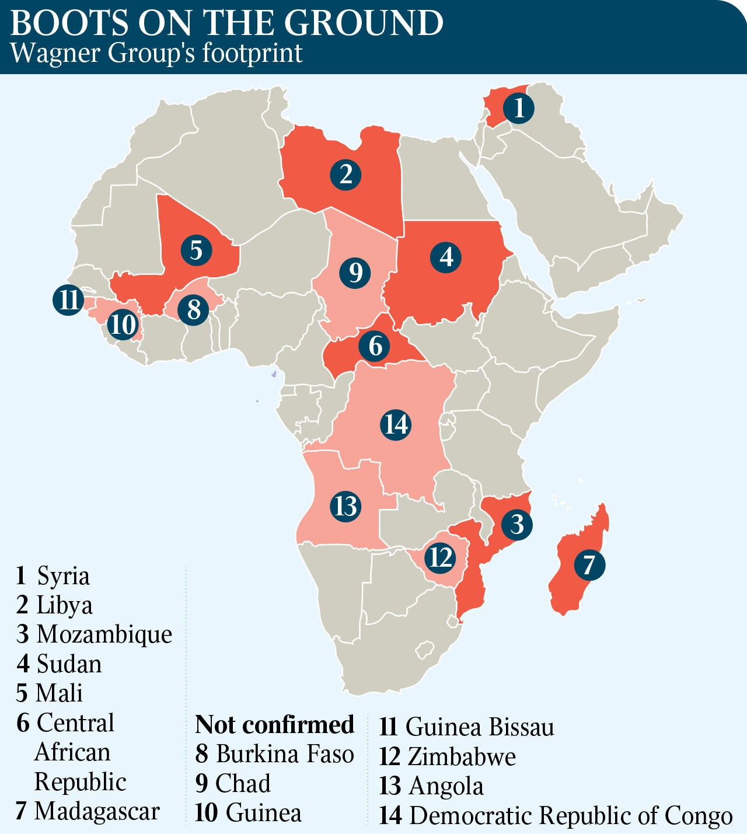
Wagner Group

Slide 17
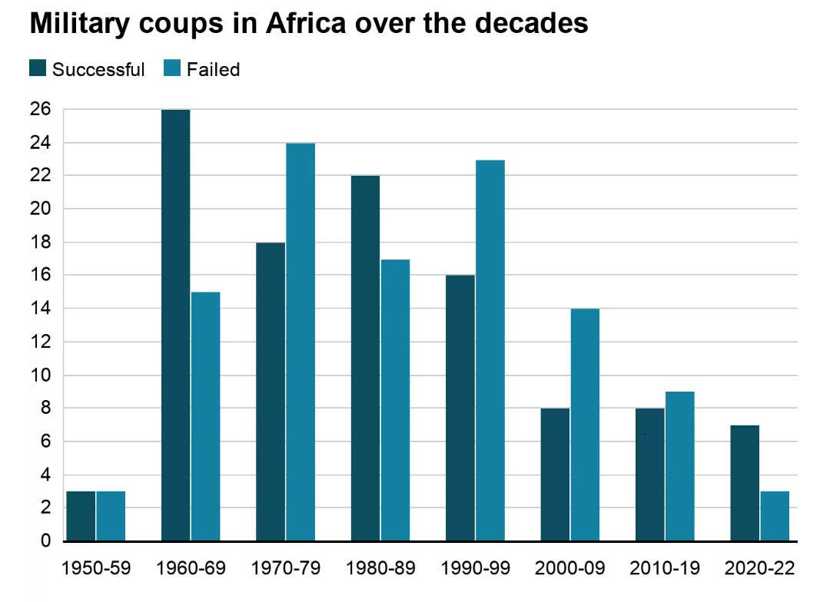
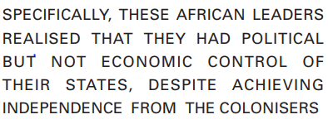
Increase of Military Coups in Africa?
Coup - an illegal and overt attempt by the military - or other civilian officials - to unseat sitting leaders.
Cultural pluralism, soldiers’ greed and grievances, poor governance, corruption, autocracy, limited economic growth, low-income levels, increase in insecurity, and fragile democracy.
Neocolonialism

Slide 18
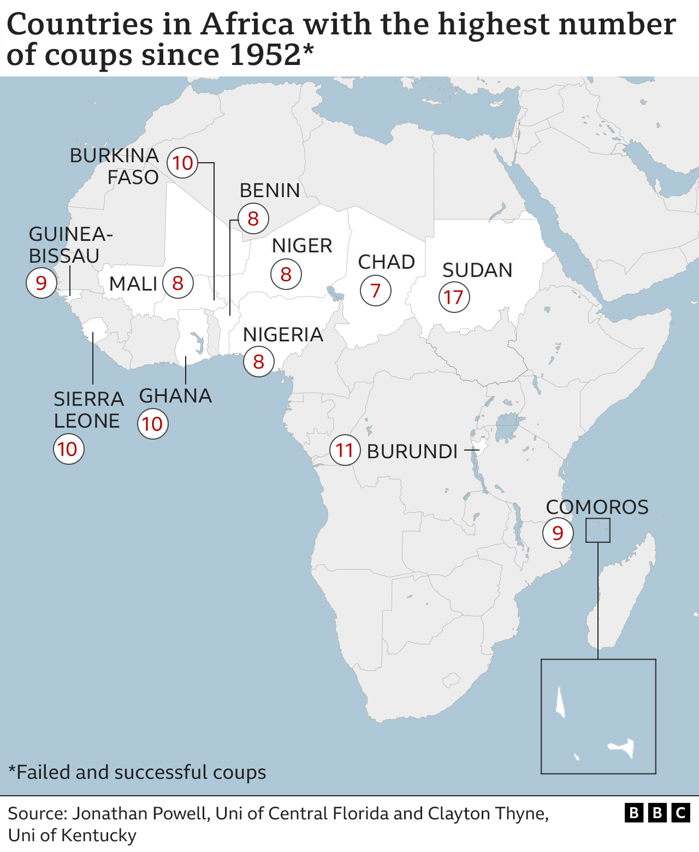
Increase of Military Coups in Africa?

Slide 19
Increase of Military Coups in Africa?
Year | State
2019 | 2019 Gabonese coup d'état attempt 2019 Sudanese coup d'état 2019 Amhara Region coup d'état attempt (Ethiopia)
2020 | 2020 Malian coup d'état 2020 Sudanese coup d'état attempt 2020–21 Central African Republic coup d'état attempt
2021 | 2021 Nigerien coup d'état attempt 2021 Malian coup d'état 2021 Guinean coup d'état 2021 Chad’s covert coup September 2021 Sudanese coup d'état attempt October–November 2021 Sudanese coup d'état
2022 | January 2022 Burkina Faso coup d'état 2022 Guinea-Bissau coup d'état attempt May Malian coup d'état attempt September 2022 Burkina Faso coup d'état December 2022 – Gambian coup d'état attempt
2023 | July – Nigerien coup d'état August – Gabonese coup d'état September Burkina Faso coup d’état attempt November Sierra Leone coup attempt November Guinea-Bissau coup d'état attempt

Slide 20
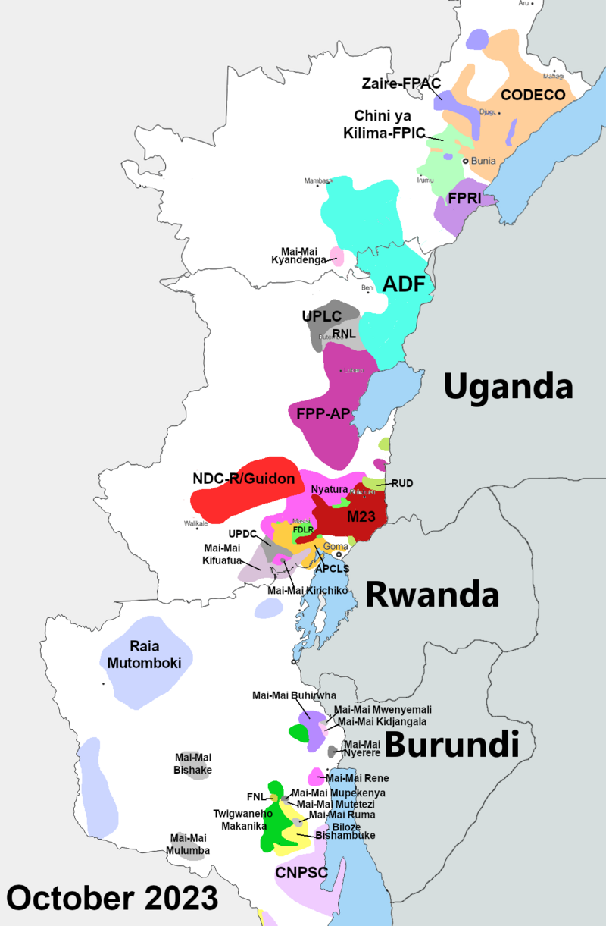
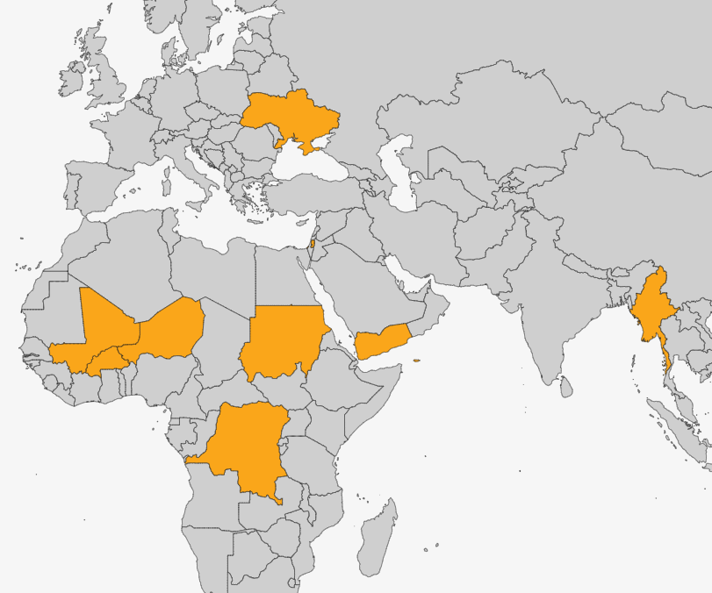
The Armed Conflict Location & Event Data Project (ACLED) – Conflicts to watch 2024
v

Slide 21
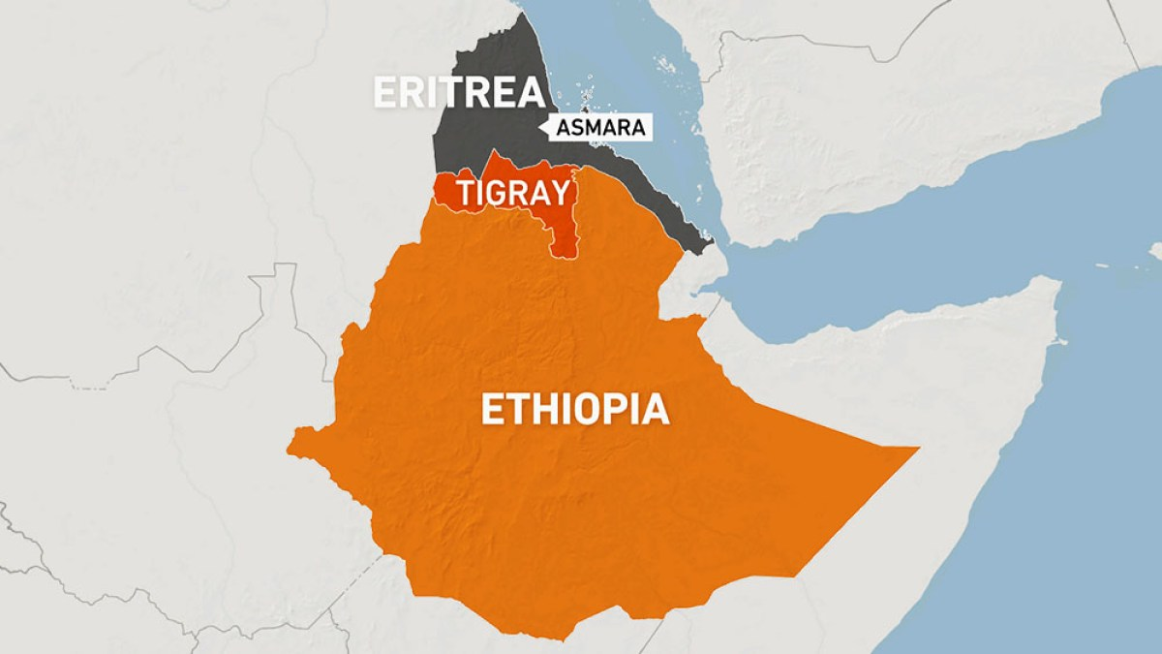
Recent war in Ethiopia

Slide 22
Recent war in Ethiopia
Primary actors: Ethiopian National Defense Force (ENDF), Tigray People's Liberation Front (TPLF) (Tigray Defense Forces).
Secondary actors: Eritrean Defence Forces (EDF), Oromo Liberation Army (OLA).
August 2020 – postponement of parliamentary elections,TPLF own elections.
November 3, 2020 - the beginning of the conflict.
June 2021 - conquest of Mekele, expansion into Ahmara and Afar.
August 2021 - involvement of OLA in the conflict.
November 2, 2021 - state of emergency, detention camps.
December 2021 withdrawal from Ahmara and Afar, stalemate.
War crimes on both sides of the conflict.
March 24, 2022 - Humanitarian ceasefire, end August 24, 2022.
3 November 2022 – Treaty on Cessation of Hostilities (Pretoria Agreement).

Slide 23
Thank you for your attention

