Slide 1
Food and water security
Lucie Konečná
GLCb2026 Africas Contemporary Security Challenges
10/4/2024

Slide 2
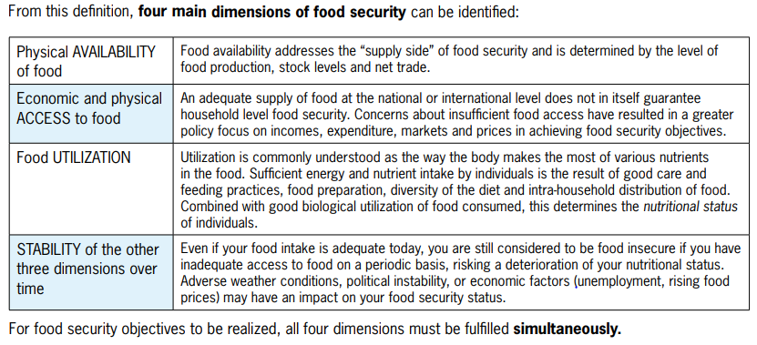
Food Security - Definition
“Food security exists when all people, at all times, have physical and economic access to sufficient safe and nutritious food that meets their dietary needs and food preferences for an active and healthy life.” 1996 World Food Summit.
“Food insecurity, on the other hand, is defined by the United States Department of Agriculture (USDA) as a situation of "limited or uncertain availability of nutritionally adequate and safe foods or limited or uncertain ability to acquire acceptable foods in socially acceptable ways.“
4 Dimensions + 2 new dimensions (Agency and Sustainability).

Slide 3
Food Insecurity - Definition

Slide 4
IPC – Integrated Food Security Phase Classification

Slide 5
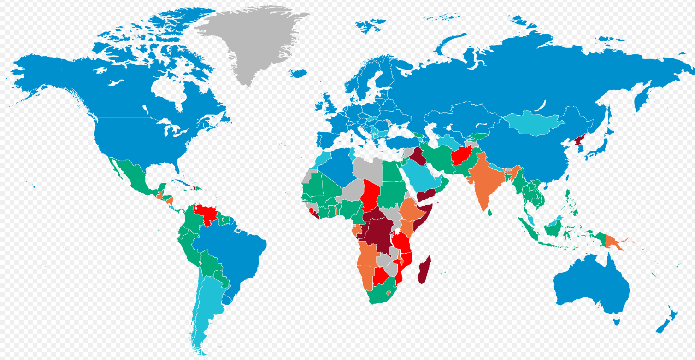
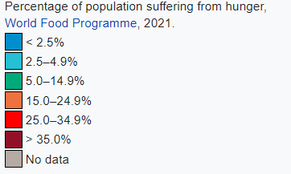
Hunger in the World

Slide 6
Food Security – General Info
282.6 million people in Africa face hunger (2023).
Food security situation is determined by several drivers including conflicts, climate variability and extremes, economic slowdowns and downturns, and the unaffordability of healthy diets - poverty.
Food and Agriculture Organization of the United Nations, FAO (1945).
World Food Programme (WFP), the International Fund for Agricultural Development (IFAD), the World Health Organization (WHO), and the United Nations Children's Fund (UNICEF) - State of Food Security and Nutrition in the World - SOFI
The biggest deterioration occurred between 2019 and 2020.
125.1 million people live in Eastern Africa, followed by Western Africa (75.2 million), Central Africa (57.1 million), Northern Africa (17.4 million) and Southern Africa (6.8 million).

Slide 7
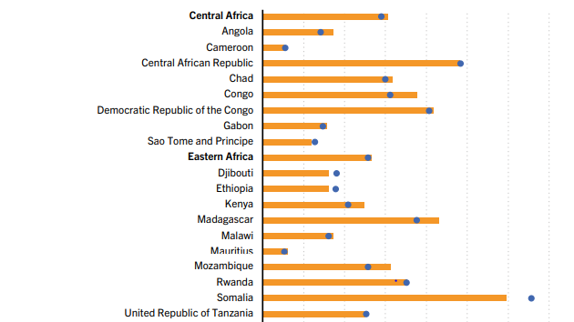
Food Security - FAO

Slide 8
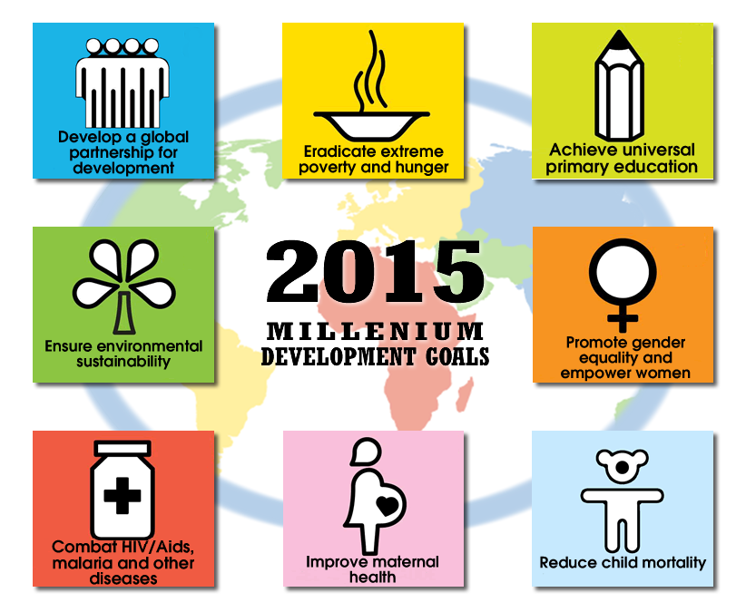
Food Security
Shared vision of humanity and a social contract between the world’s leaders.

Slide 9
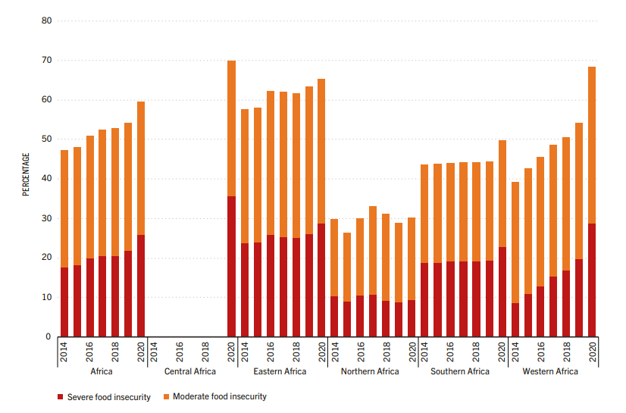
Food Security - FAO
The Food Insecurity Experience Scale - (FIES) :
a) Moderate food insecurity (uncertain ability to obtain food and have been forced to reduce, at times over the year, the quality and/or quantity of food they consume due to lack of money or other resources.
b) Severe food insecurity (run out of food, experienced hunger and, at the most extreme, have gone for days without eating)

Slide 10
Food Security - FAO
Food security and nutrition indicators:
Undernourishment
Food Insecurity Experience Scale
Stunting, wasting and overweight in children under five years of age
Low birthweight
Adult obesity
Anaemia in women of reproductive age
Exclusive breastfeeding

Slide 11
Global Food Security Index

Slide 12
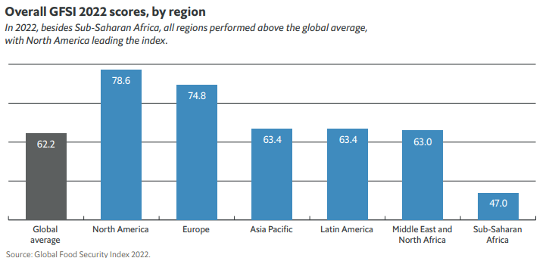
Global Food Security Index

Slide 13
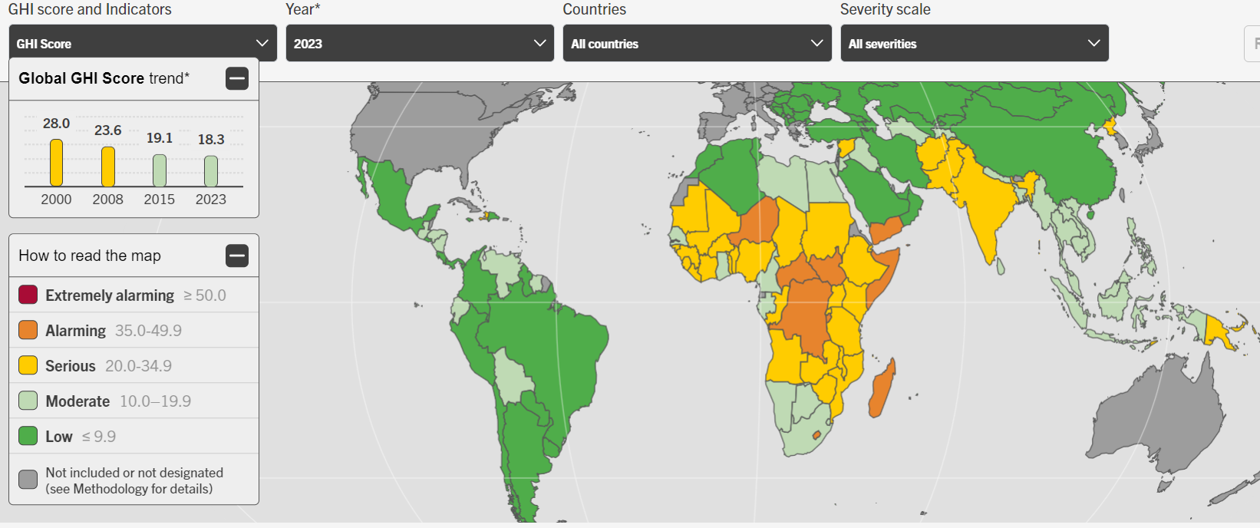
Global Hunger Index
Around 20% of people in Africa are facing chronic hunger, compared with only 10% globally.
Russia's war on Ukraine has exacerbated food supply problems, while climate change and the pandemic have also contributed.

Slide 14
Global Hunger Index

Slide 15
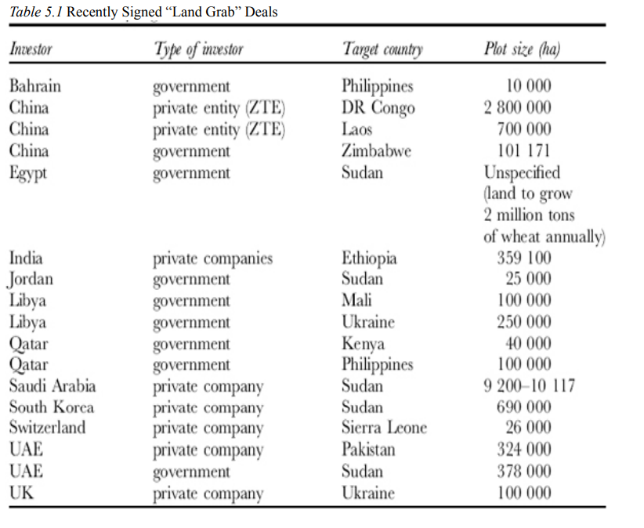
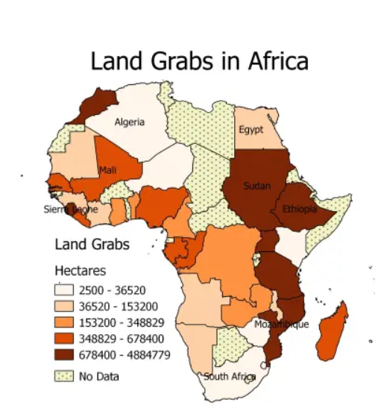
Land Grabbing: A New Challenge to Global Food Security

Slide 16
Droughts in Eastern Africa
Two main rainy seasons per year: the so-called long rains from March-April to May-June, the so-called short rains from October to December.
Eastern Africa has experienced severe weather in recent decades, including intense droughts in 1996, 1998, 2005, 2011-2012, 2016-2017 and 2020-2023.
2023 - A total of 70 million people are exposed to some level of drought risk in East Africa.
Drought and Famine 2011 - approx. 250 thousand deaths.
Causes of food crises and famine in the East African region:
a) Natural causes (Droughts, Soil Quality)
b) Social and demographic causes (Low agricultural productivity, Poverty, AIDS, Environmental degradation, Population growth)
c) Economic and political-security causes (International trade, Government policy/Government disinterest, Armed conflicts)
d) Climate change

Slide 17
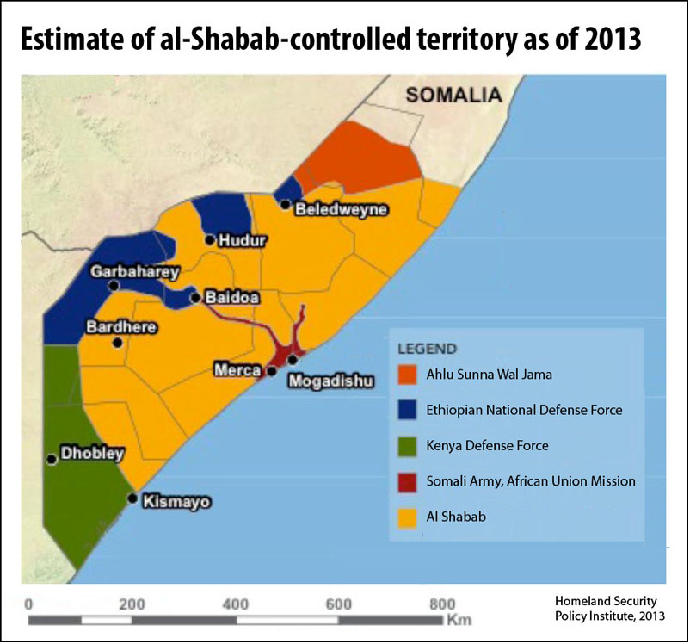
Droughts in Eastern Africa

Slide 18
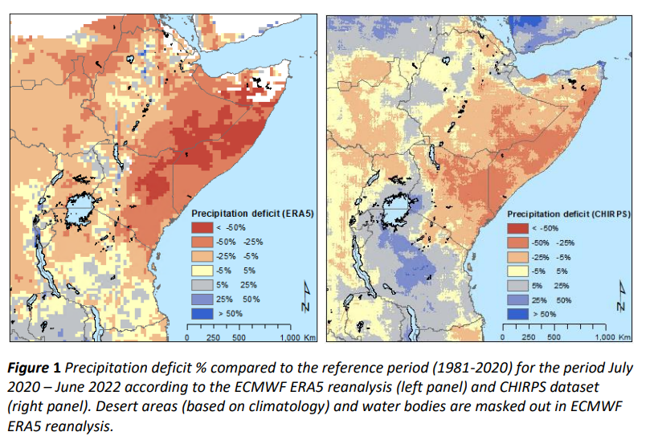
Droughts in Eastern Africa

Slide 19
Water Security
Broad vs. Narrow definition:
“Water security is the reliable availability of an acceptable quantity and quality of water for health, livelihoods and production, coupled with an acceptable level of water-related risks.„ Wolrd Bank
“Water security is defined as the capacity of a population to safeguard sustainable access to adequate quantities of acceptable quality water for sustaining livelihoods, human well-being , and socio-economic development, for ensuring protection against water-borne pollution and water-related disasters, and for preserving ecosystems in a climate of peace and political stability.” UN-Water
"Water security refers to the availability of water, in adequate quantity and quality, to sustain all these needs together (social and economic sectors, as well as the larger needs of the planet’s ecosystems) – without exceeding its ability to renew.„ WWC
World Water Council (WWC) and the Global Water Partnership (GWP).
The Convention on the Protection and Use of Transboundary Watercourses and International Lakes (Water Convention) was adopted in Helsinki in 1992 and entered into force in 1996.
UN Water.

Slide 20
Water Scarcity
Water scarcity - lack of fresh water resources to meet the standard water demand.
Physical vs. economic water scarcity.

Slide 21
Water Conflicts
Water conflict is a term describing a conflict between countries, states, or groups over the rights to access water resources.
Intrastate or interstate levels.
Water-related conflicts can be categorized:
A) Trigger
B) Weapon
C) Causality
A comprehensive online database of water-related conflicts—the Water Conflict Chronology—has been developed by the Pacific Institute.
Transboundary water conflicts:
a) Tigris and Euphrates Rivers
b) Mekong basin (China and other Asian countries)
c) Dispute over water in the Nile Basin

Slide 22
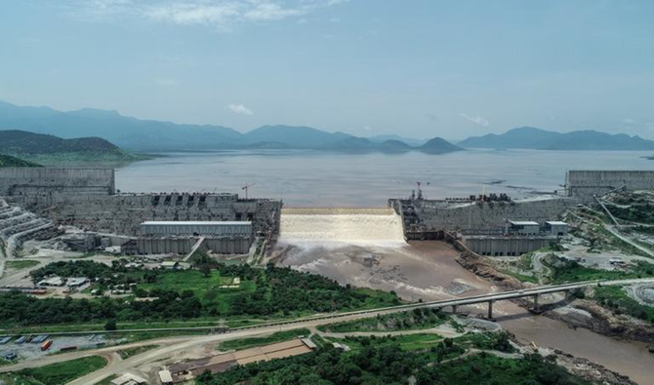
Grand Ethiopian Renaissance Dam Dispute
1959 - Agreement between Sudan and Egypt on the Full Utilization of the Nile Waters.
Nile Basin Initiative (NBI) 1999, Cooperative FrameworkAgreement (CFA) 2010.
Agreement on Declaration of Principles between The Arab Republic of Egypt, The Federal Democratic Republic of Ethiopia And The Republic of the Sudan On The Grand Ethiopian Renaissance Dam Project (2015).

Slide 23
Water Conficts in Africa
1063 conflicts in a period 1958–2022, 366 trigger conflicts, 152 - more than 40%, took place in sub-Saharan Africa.
Pacific Institute - incident is listed as a conflict when there is violence (injuries or deaths) or threats of violence (including verbal threats, military maneuvers, and shows of force).
Conflicts over rivers, lakes, groundwater and water infrustructure (dams).
Examples of conflicts:
A) Ethiopian and Somali Nomads Clashed Over Desert Water (1963–1964)
B) South Africa Seized Control of the Angola Dam - Ruacana (1975)
C) Water Shortages due to Drought Contributed to the Start of the Arab-Fur War (1987–1989)
D) Military Clashes Between Cameroon and Nigeria Over the Retreat of Lake Chad (1980s and 1990s, 2002 - ICJ)
E) African Nations Disputed the Island of Zambezi - Sedudu (1999–2000)
F) Violent Conflict Between Kenyan and Ugandan Herders (2012)
G) Fight between Garre and Degodia clans over water and pasture lands in Banissa, Kenya (2022)
H) Water pump explosion in the village of Tin Rhassane - Burkina Faso (2023)

Slide 24
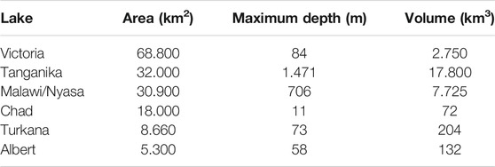
Water Conficts in Africa

Slide 25
Thank you for your attention

