Slide 1
Introduction
Lucie Konečná
GLCb2026 Africas Contemporary Security Challenges
21/2/2024

Slide 2
Assessment and requirements
Form of assessment | Max. Points
Presentation | 20
Final exam | 40
Each student will prepare a presentation. The topic is chosen by the students themselves, but they should do a detailed case study of one African country (their choice) in which they will focus on one specific security problem such as terrorism, internal conflict, influx of refugees, piracy, food insecurity, violation of human rights etc. It does not have to be a security issue that was mentioned in class, an example is the violation of human rights, various non-environmental problems, etc. The presentation itself should take approximately 15-20 minutes and will take place in the last four classes of the course. Assignment of students to dates will be made at the end of March and the schedule will be uploaded to the information system. The presentation will be graded 0-20 points. Students should discuss the topic of their presentation with the teacher in advance. The topic of the presentation should be approved by the teacher. Students should not choose case studies that the teacher discussed in detail during class
The final exam will be in the form of a written test, which will absorb the assigned literature and lecture materials. This will also include some general information from the student presentations. The test consists of 20 closed questions (each with one correct answer). A total of 40 points can be obtained from the final exam.
Assessment and marking:
A 60 – 56 points
B 55 – 51 points
C 50 – 46 points
D 45 – 41 points
E 40 – 36 points
F 35 and below

Slide 3
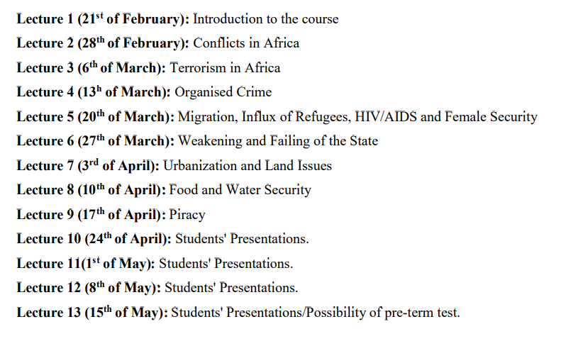
Teaching Schedule

Slide 4
Compulsory Readings
Schneckener, Ulrich. Spoilers or Governance Actors? Engaging Armed Non-State Groups in Areas of Limited Statehood. p. 3-26. (2009). https://ciaotest.cc.columbia.edu/wps/sfb/0017677/f_0017677_15156.pdf
Williams, Phil. Violent Non-State Actors and National and International Security. (2008): https://www.files.ethz.ch/isn/93880/vnsas.pdf
Rotberg, Robert. Failed States, Collapsed States, Weak States: Causes and Indicators (2006) https://www.brookings.edu/wp-content/uploads/2016/07/statefailureandstateweaknessinatimeofterror_chapter.pdf
Swain, Ashok. Understanding Emerging Security Challenges Threats and Opportunities. Routledge. 2013.
Emerson, Stephen and Hussein, Solomon. African security in the twenty-first century Challenges and opportunities. Manchester University Press. 2018.

Slide 6
General Info About Africa – Population (2020)

Slide 7
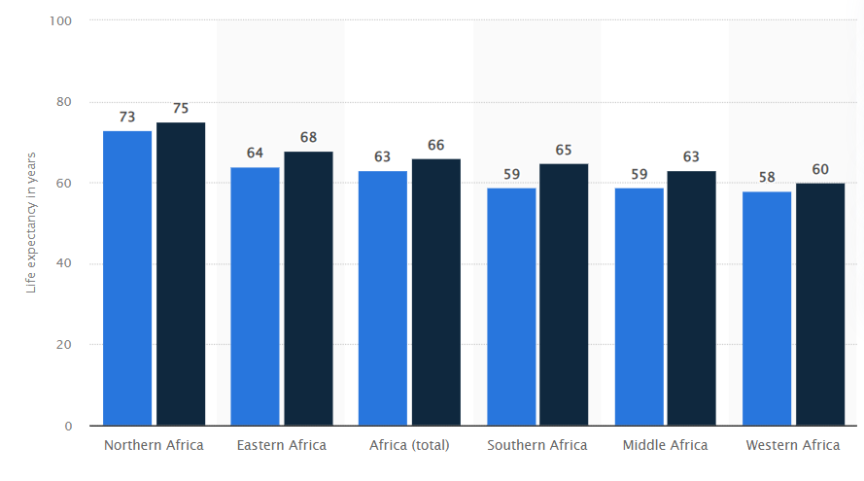
General Info About Africa - Population

Slide 8
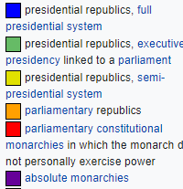
General Info about Africa – Form of Government

Slide 11
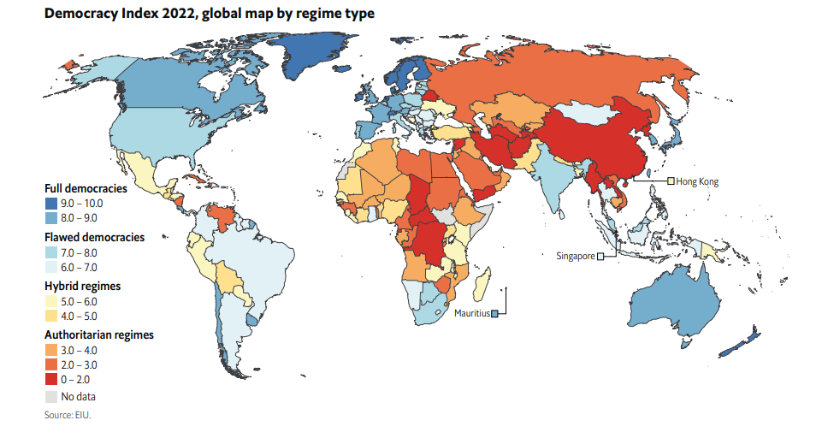
General Info about Africa – Level of Democracy

Slide 12
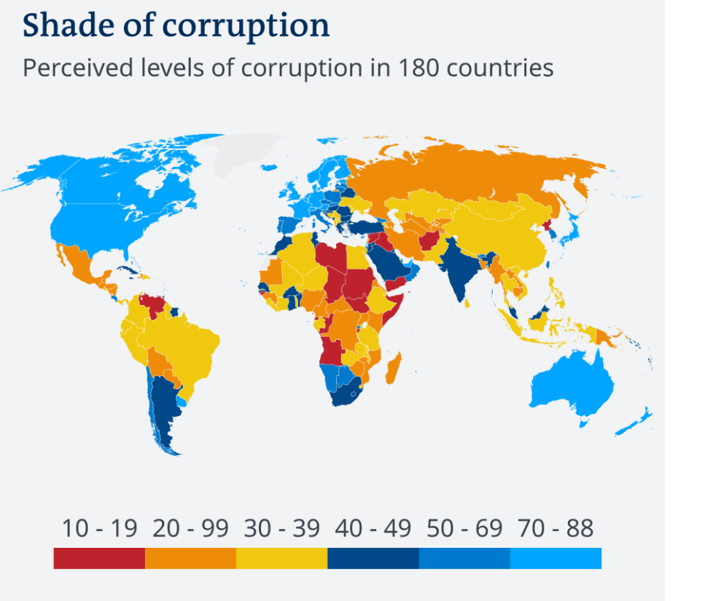
General Info about Africa – Corruption

Slide 13
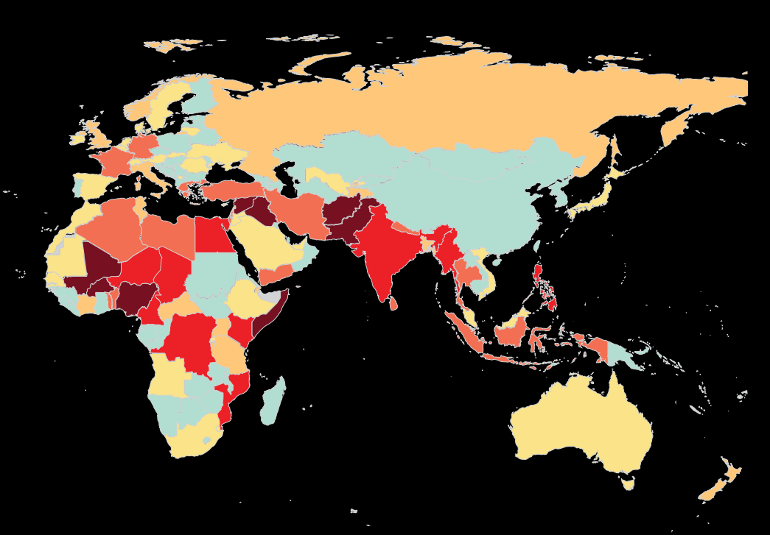
General Info about Africa - Terrorism

Slide 14
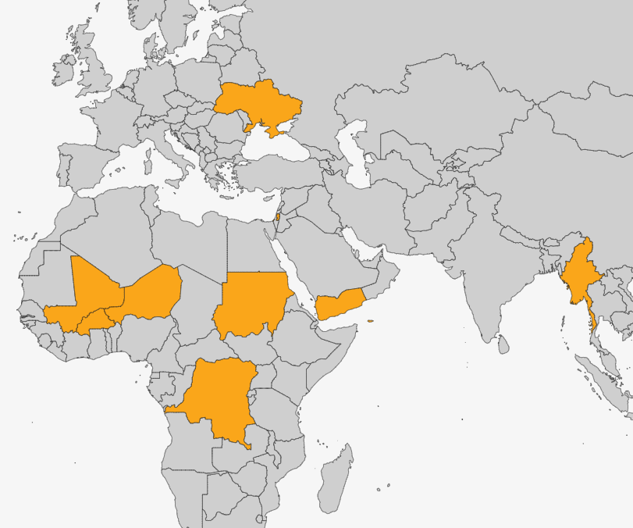
The Armed Conflict Location & Event Data Project (ACLED) – Conflicts to watch 2024

Slide 15
SIPRI Conflict Trends 2022

Slide 16
Short Quiz
1. Which African country currently has the highest incidence of HIV in the population (26% of the total population)?
2. According to the FSI, which African country has the worst performance and is often labeled a failed state?
3. Which two terrorist groups committed the most terrorist attacks in Africa in 2023?
4. Which African country hosted the largest number of refugees in 2023?
5. Which African country recorded the highest number of piracy attacks in 2023?
6. Do you know which African city is the most populous?
7. There are two states in which more than 90% of the urban population lives in slums. Do you know which states those are?
8. Which countries are currently in dispute over the Grand Ethiopian Renaissance Dam?

Slide 17
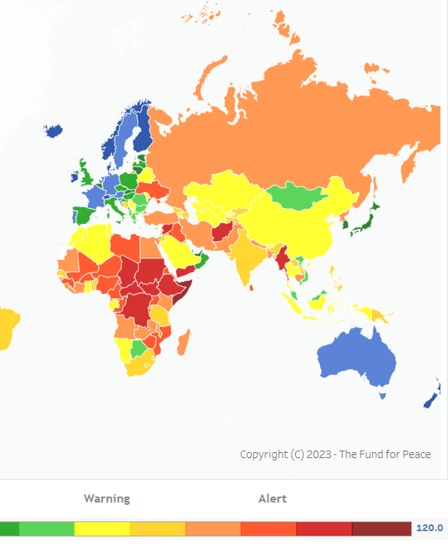
General Info Africa – FSI and HIV

Slide 18
Thank you for your attention

