Slide 1
Migration, influx of refugees and HIV/AIDS
Lucie Konečná
GLCb2026 Africas Contemporary Security Challenges
20/3/2024

Slide 2
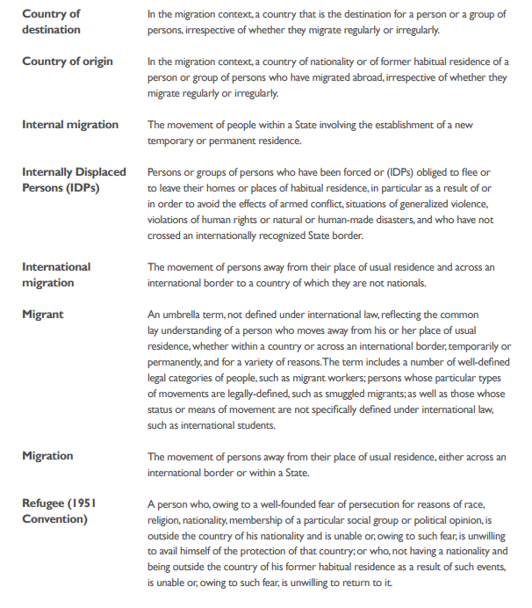
Migration Terminology

Slide 3
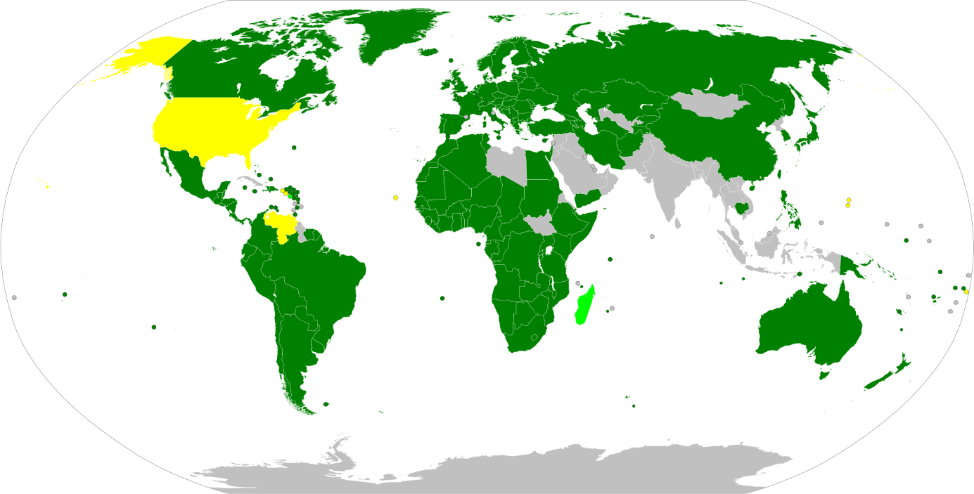
Refugee Conventions
1951 Refugee Convention (Geneva Convention of 28 July 1951)
Refugee definition: “As a result of events occurring before 1 January 1951 and owing to well-founded fear of being persecuted for reasons of race, religion, nationality, membership of a particular social group or political opinion, is outside the country of his nationality and is unable or, owing to such fear, is unwilling to avail himself of the protection of that country; or who, not having a nationality and being outside the country of his former habitual residence as a result of such events, is unable or, owing to such fear, is unwilling to return to it.“
1967 Refugee Protocol

Slide 4
Refugee Conventions
1951 Refugee Convention:
Refugees shall be treated at least like nationals in relation to
freedom to practice their religion (Article 4)
the respect and protection of artistic rights and industrial property (Article 14)
rationing (Article 20)
elementary education (Article 22)
public relief and assistance (Article 23)
labour legislation and social security (Article 24)
Refugees shall be treated at least like other non-nationals in relation to
movable and immovable property (Article 13)
the right of association in unions or other associations (Article 15)
wage-earning employment (Article 17)
self-employment (Article 18)
practice of the liberal professions (Article 19)
housing (Article 21)
education higher than elementary (Article 22)
the right to free movement and free choice of residence within the country (Article 26)

Slide 5
Refugee Conventions
1951 Refugee Convention:
The contracting states shall not
discriminate against refugees (Article 3)
take exceptional measures against a refugee solely on account of his or her nationality (Article 8)
expect refugees to pay taxes and fiscal charges that are different from those of nationals (Article 29)
impose penalties on refugees who entered illegally in search of asylum if they present themselves without delay (Article 31), which is commonly interpreted to mean that their unlawful entry and presence ought not to be prosecuted at all.
expel refugees (Article 32)
forcibly return or "refoul" refugees to the country they have fled from (Article 33).
1969 The Organisation of African Unity (OAU) Convention Governing the Specific Aspects of Refugee Problems in Africa
Kampala Convention 2009

Slide 6
UNHCR - United Nations High Commissioner for Refugees
UN agency, created in 1950, headquartered in Geneva (Switzerland).
Mandated to aid and protect refugees, forcibly displaced communities, and stateless people, and to assist in their voluntary repatriation, local integration or resettlement to a third country.
Over 17,300 staff working in 135 countries.
High Commissioner is Filippo Grandi.
Executive and Standing Committee
Goodwill ambassadors - names?

Slide 8
Migration and Refugee Trends

Slide 9
Migration and Refugee Trends

Slide 10
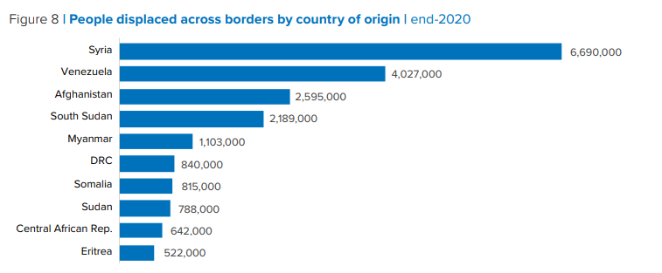
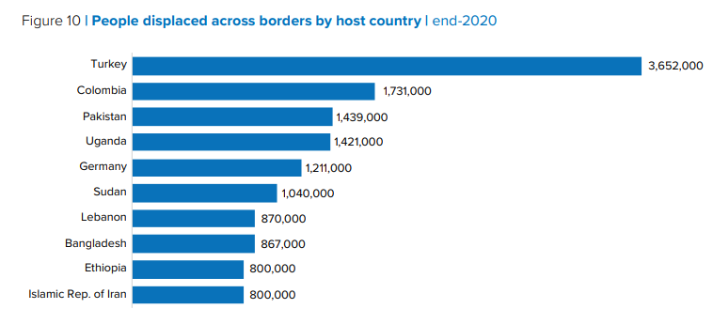
Migration and Refugee Trends

Slide 11
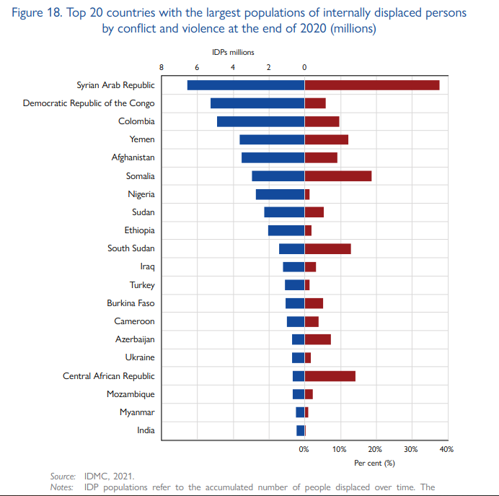
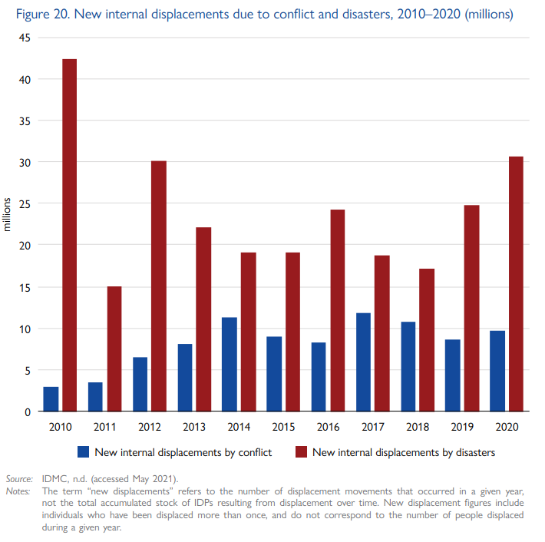
Migration and Refugee Trends

Slide 12
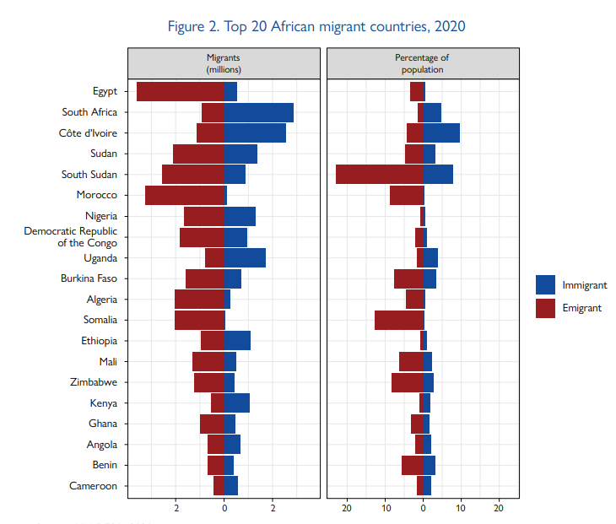
Migration and Refugee Trends in Africa

Slide 13
Migration and Refugee Trends in Africa

Slide 14
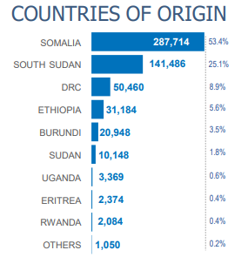
Refugees in Kenya
2006 Refugees Act
Several attempts to forcibly relocate refugees
2010 - new constitution (registration within 30 days of entry)
2012 parliament approved the law on forced relocation
Tripartite Agreement 2013
2014 Operation Usalama (peace) Watch
Working permit 700USD
https://www.youtube.com/watch?v=LE6H0GGWrq8&t=304s

Slide 15
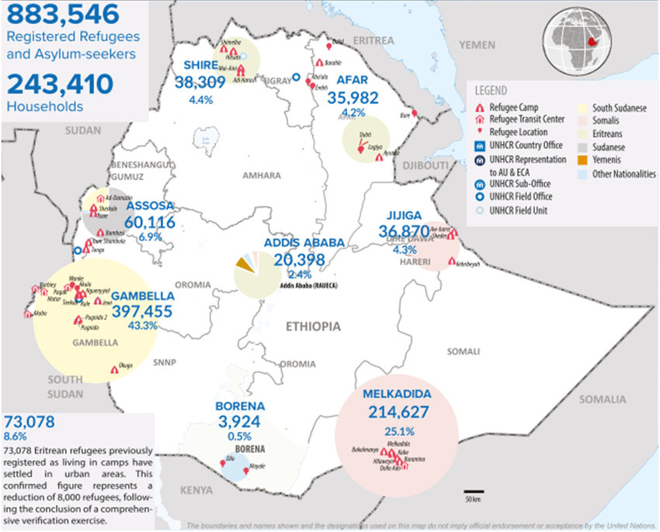
Refugees in Ethiopia
2004 Ethiopian Refugee Proclamation (Ethiopian authorities decide on the location)
2010 Out of Camp program
Nearly all of the registered refugees and asylum seekers in Ethiopia originate from neighboring states including South Sudan (48 percent), Somalia (27 percent), Eritrea (19 percent), and Sudan (6 percent).
Working permit 600USD
2016 violence in Gambella
2020 Hitsats massacre

Slide 16
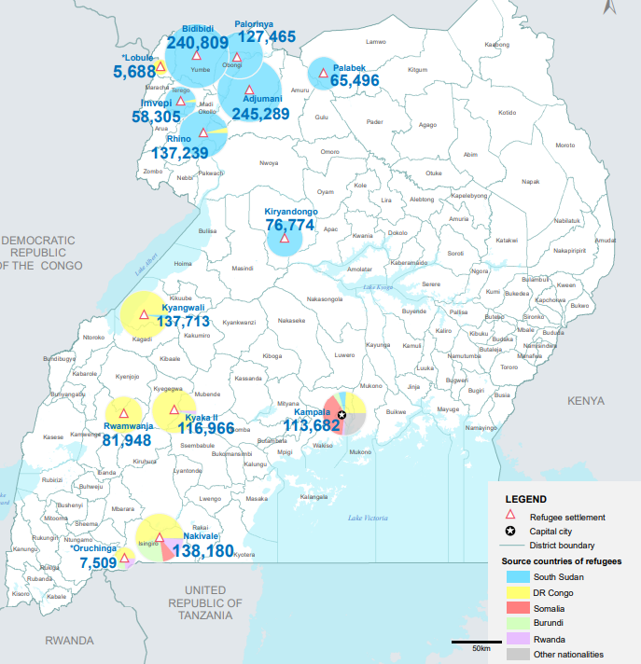
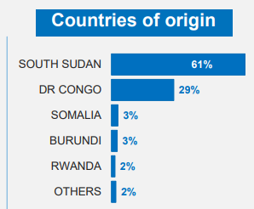
Refugees in Uganda
2006 Refugees Act (freedom to work, freedom of movement and provides land for building houses and farming)
Working permit 200USD
Violence in Rhino Camp 2020
Notes:
io

Slide 17
Refugees in Tanzania
Refugee Act 1998 (authorities decide on the location)
Tanzania’s 2003 National Refugee Policy (refugees are not allowed to leave the camps to work, trade or go to school), permit - may not travel more than 4 km from the camp
Working permit $2,000 USD
Benaco Camp riots 1994
Burundi accused of hunting refugees in Tanzanian camps

Slide 18
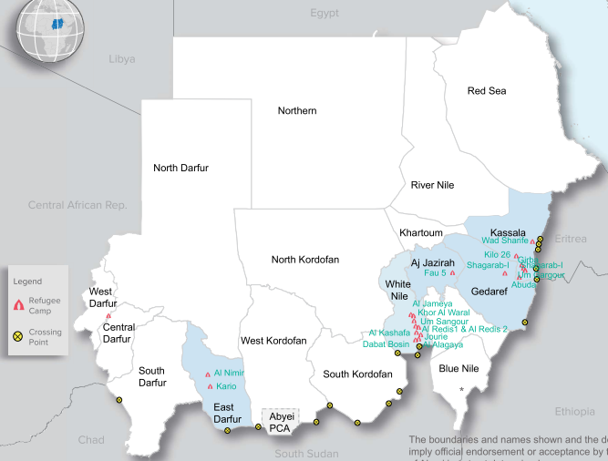
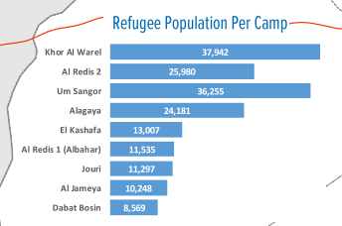
Refugees in Sudan

Slide 19
Negative Impacts of Refugeeism
Economic impacts – influence on food prices, influence on the reduction of wages of local residents, Influence on the rise in housing and rental prices and direct state expenditure on refugees.
Social impacts – internal displacement of persons, social inequalities between refugees and local people, ethnic tension.
Environmental impacts – increase in the slums, pollution or depletion of water, deforestation, soil degradation.
Political-security impacts - increase in terrorism, increase in trafficking and crime, bilateral tensions between neighboring countries.

Slide 20
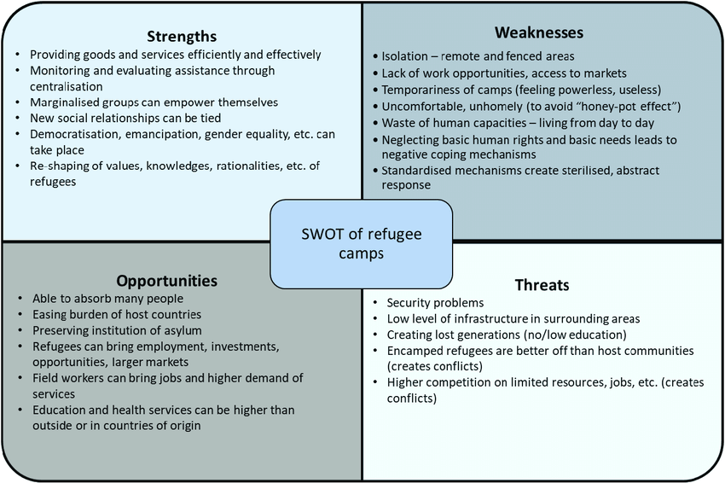
Negative Impacts of Refugeeism
According to Salehyan and Gleditsch (2006), the influx of refugees from a neighboring country can destabilize neighboring countries in the following ways:
a) Expansion of rebel social networks and diffusion of violence
b) Facilitation of transnational spreading of arms, combatants, and ideologies conducive to conflict
c) Creation of bilateral tensions

Slide 21
Refugee-Related Political Violence
a) Attacks between sending state and refugees (The violence occurs between refugees and government of sending state)
b) Attacks between receiving state and refugees (The violence occurs between refugees and government of receiving state)
c) Ethnic or factual violence among refugees (The violence occurs between groups of refugees)
d) Internal violence within receiving state (The violence occurs between refugees and local population of receiving state)
e) Interstate war or unilateral intervention (Refugees and the government of more than one state are involved in violence)
f) Attacks between refugees and transnational VNSA (The violence occurs between refugees and transnational VNSA (( non-state armed groups operating across several countries))

Slide 22
Refugee-Related Political Violence

Slide 23
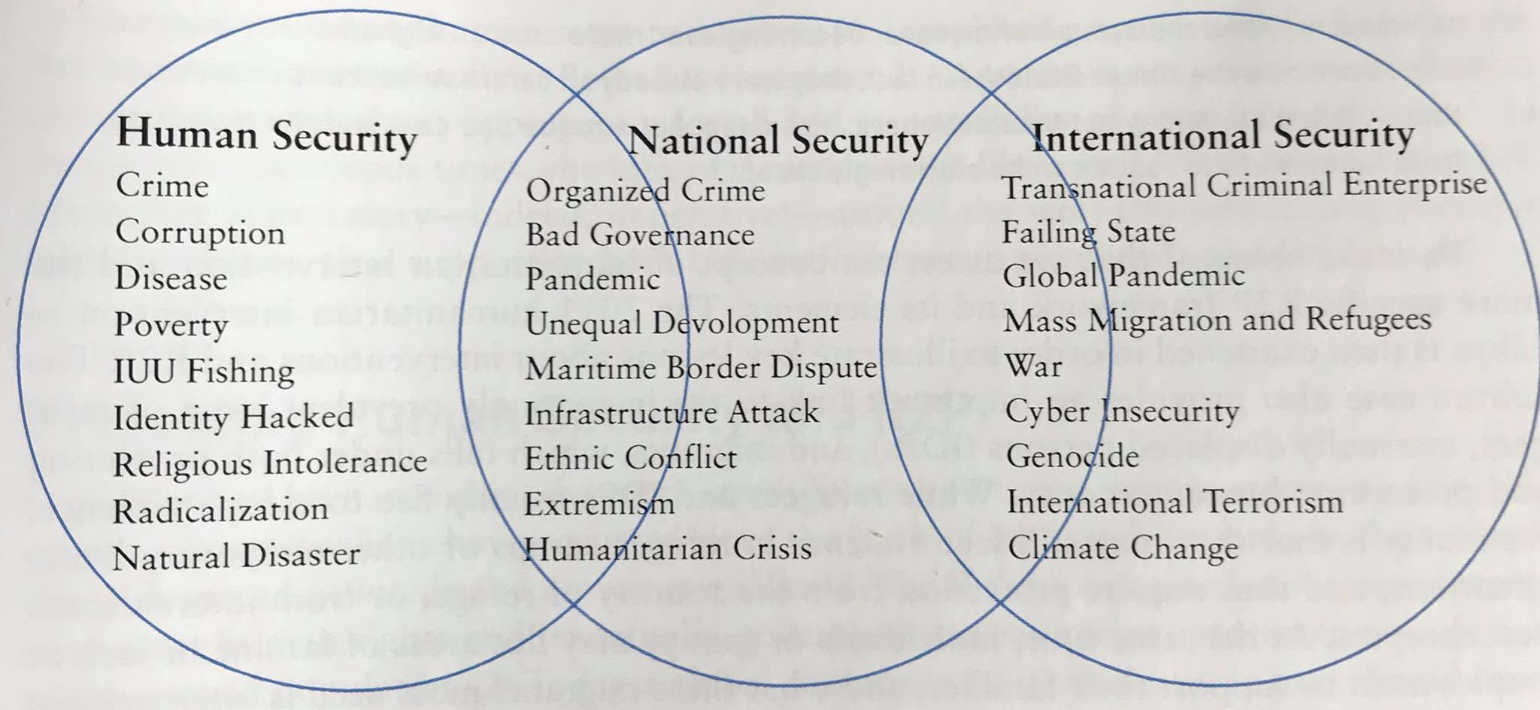
HIV/AIDS
Progress has been faltering, resources have been shrinking and inequalities have been widening - 1.3 million new HIV infections in 2022 – more than the global goals.
Globally, 38.4 million [33.9–43.8 million] people were living with HIV at the end of 2022.
Mortality - 650 000 people died of HIV-related illnesses worldwide in 2021.
Two main institutions - WHO (World Health Organization) and UNDAIDS (Joint United Nations Program on HIV/AIDS).
HIV – Human, National and International Security.
Armed conflict can increase the likelihood of exposure to HIV infection in several of the following ways:
Population displacement
Breakdown of traditional sexual norms
Vulnerability of women and girls
Rape as a weapon of war
Collapse of health systems
Increased substance use

Slide 24
HIV in Africa
State | % in the population
Eswatini | 26%
Botswana | 23,4%
Lesotho | 23,3%
South Africa | 17%
Zimbabwe | 15%
Namibia | 13,5%
Kenya | 6,2%
Tanzania | 5%
Rwanda | 3%
Burundi | 3%
Uganda | 7%

Slide 25
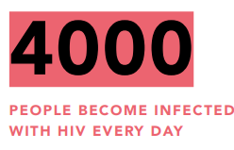
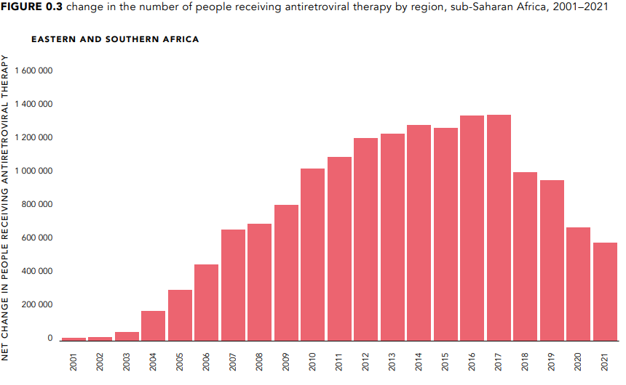
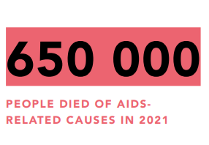
HIV/AIDS

Slide 26
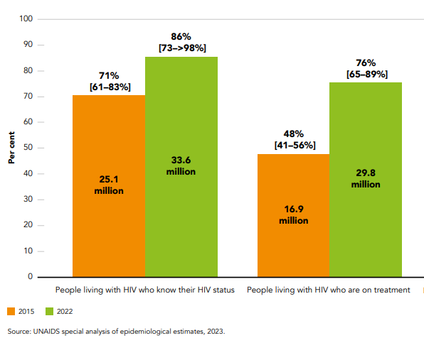
HIV in Africa

Slide 27
HIV/AIDS

Slide 28
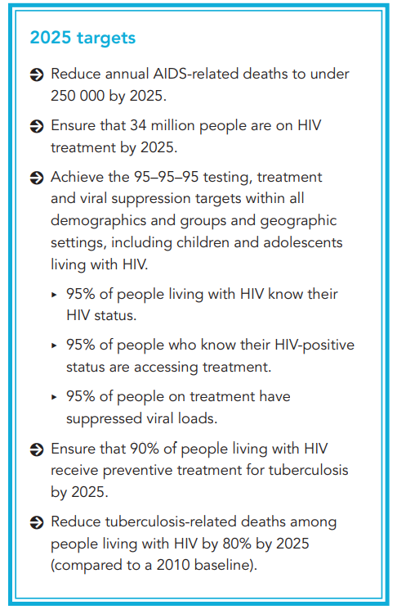
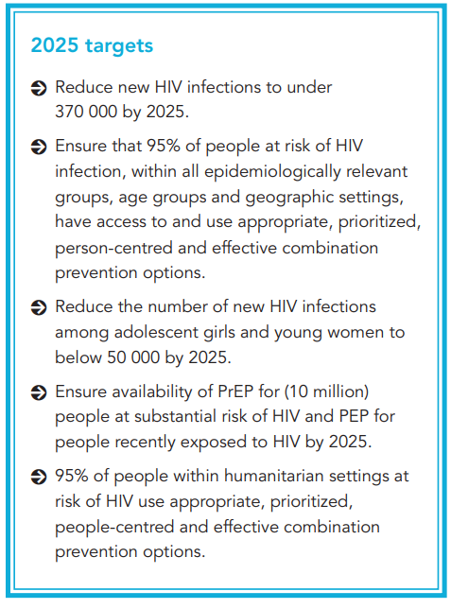
HIV/AIDS - Targets
Global AIDS Strategy 2021-2026 and Ending Inequalities and Getting on Track to End AIDS by 2030

Slide 29
HIV/AIDS - Targets

Slide 30
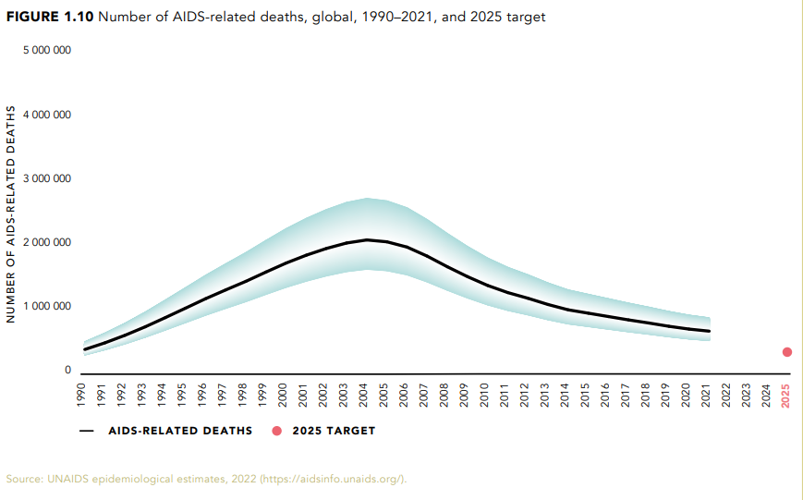
HIV/AIDS - Targets

Slide 31
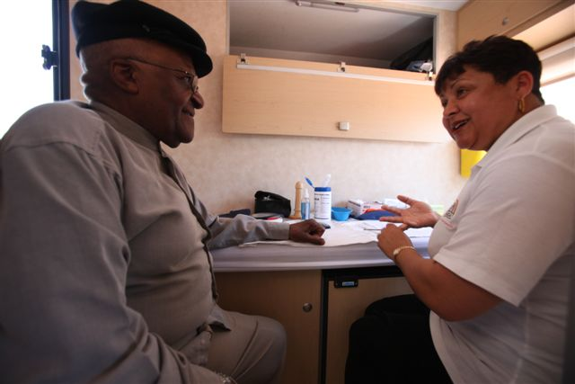
HIV in Africa
Bushmeat theory – Cameroon.
71% of the total HIV population lives in Sub-Africa.
Desmond Tutu HIV Foundation .
UNAIDS - Joint United Nations Programme on HIV/AIDS.
Causes of expansion in Africa: behavioral factors, lack of money, natural disasters and conflicts, health industry, medical suspicion, circumcision?, religious factors, educational level, poverty.

Slide 32
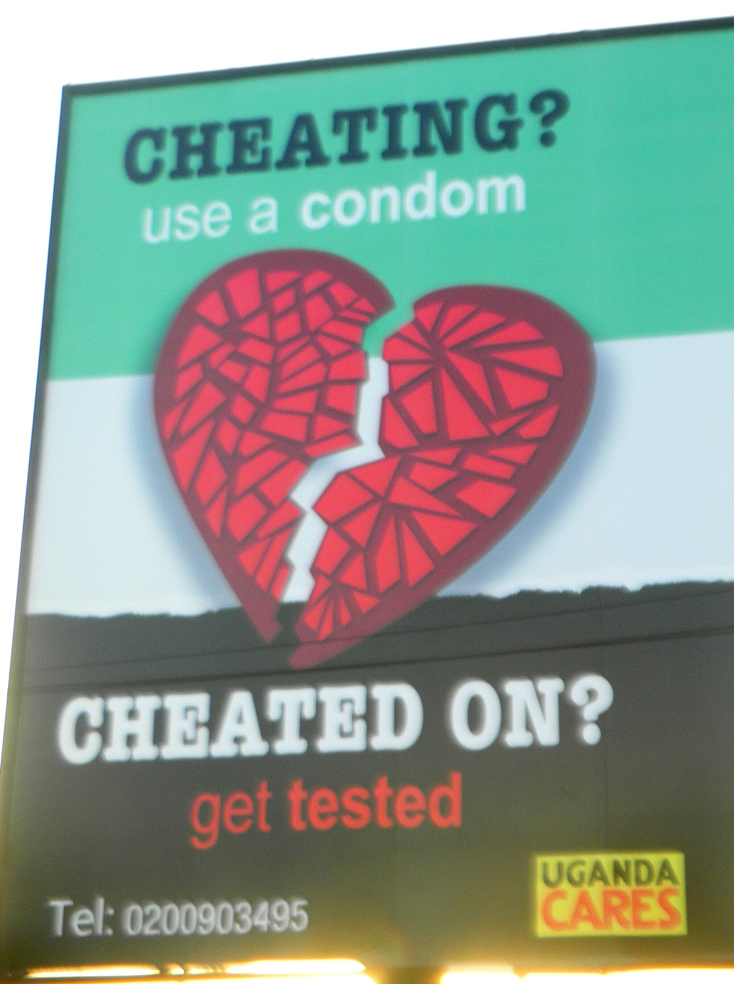
Uganda – ABC campaign

Slide 33
HIV in Africa
Justus Amuche Nweze - HIV/AIDS in sub-Saharan Africa: Current status, challenges and prospects.
Reasons for the high prevalence of HIV/AIDS in sub-Saharan Africa:
The initial responses to HIV in Africa and the West
b) Cultural behaviors and beliefs (Widow inheritance/Sexual cleansing, Postpartum sexual abstinence, Virgin cleansing fable, Ritualised non-marital sexual intercourse)
c) Multiple sexual partners
d) Poverty, conflict/war, migration, and HIV/AIDS
e) Blood transfusion and HIV
f) HIV/AIDS-associated stigma and discrimination

Slide 34
Thank you for your attention

