Slide 1
Organised Crime in Africa
Lucie Konečná
GLCb2026 Africas Contemporary Security Challenges
13/3/2024

Slide 2
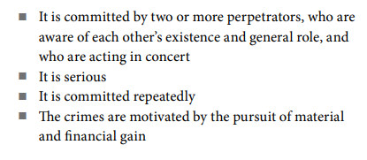
Organised Crime - Definition
„Organised crime consists of those serious criminal offenses committed by a criminal organization, which is based on a structured association of more than two persons acting in concert over a prolonged period of time in pursuit of both their criminal objectives and profits.“ Gastrow
„Organised Crime is defined as planned and co-ordinated criminal behaviour and conduct by people working together on a continuing basis.“ GoV UK
UN Convention Against Transnational Organized Crime (Palermo Convention) defines OCG:
  „Organized criminal group’ shall mean a structured group of three or more persons, existing for a period of time and acting in concert with the aim of committing one or more serious crimes or offences established in accordance with this Convention, in order to obtain, directly or indirectly, a financial or other material benefit.“
  UNODC
SARPCCO defining characters:

Slide 3
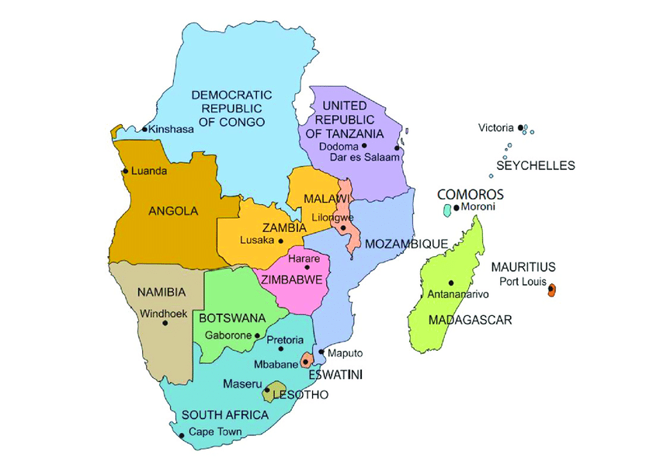
SARPCCO (Active in SADC – Southern African Development Community)

Slide 4
Organised Crime - Definition
OCG defining characters according to Šmíd:
a) hierarchical structure/organisation
b) business continuity
c) corruption
d) violence
e) illegal activity
f) penetrating economic markets
g) membership exclusivity
h) non-ideological
Mafia - type of OCG, is an informal term that is used to describe criminal organizations that bear a strong similarity to the original “Mafia”, the Sicilian Mafia and Italian Mafia, political dimension.
Gang - territorial character, less sophisticated methods and activities.
Syndicate - illegal businesses on a larger, also international scale.

Slide 5
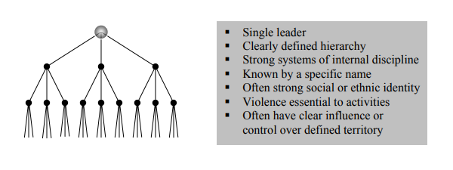
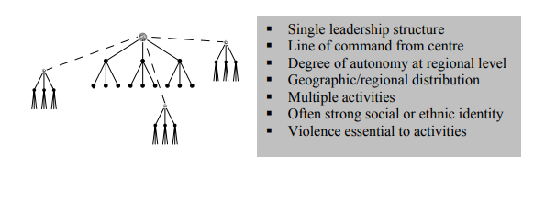
Typology of Organized Crime Groups
UNODC defining features: structure, size, activities, level of transborder operations, identity, level of violence, use of corruption, political influence, penetration into the legitimate economy and level of cooperation with other organizations.
A) Standard Hierarchy B) Regional hierarchy

Slide 6
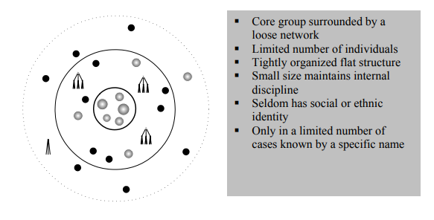
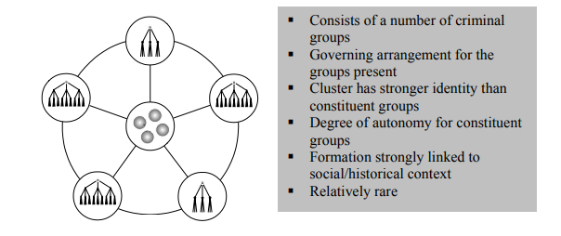
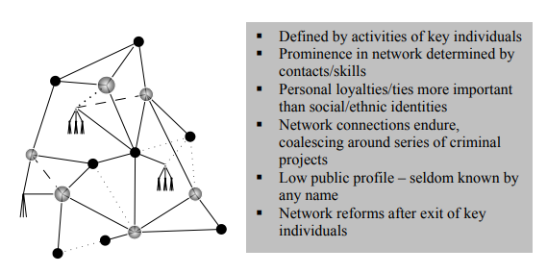
Typology of Organized Crime Groups
C) Clustered Hierarchy D) Core group
E) Criminal network

Slide 7
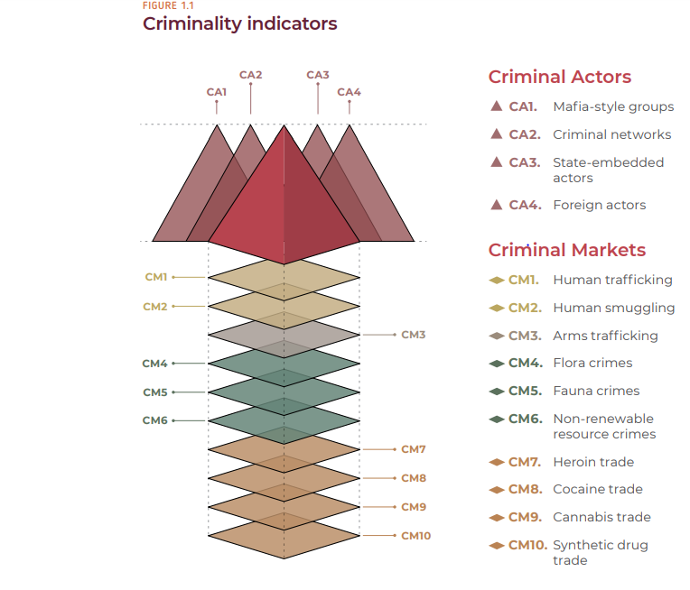
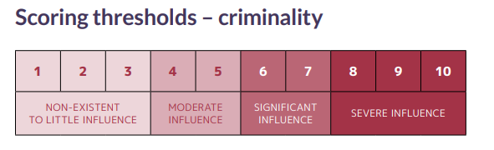
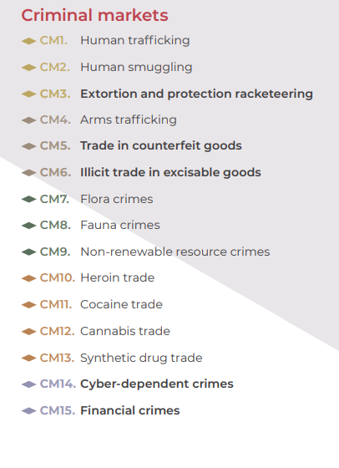
Global Organized Crime Index – Measurement and Typology

Slide 8
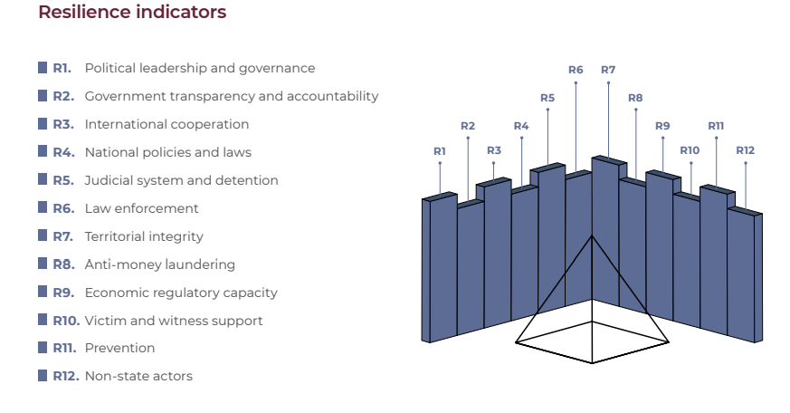
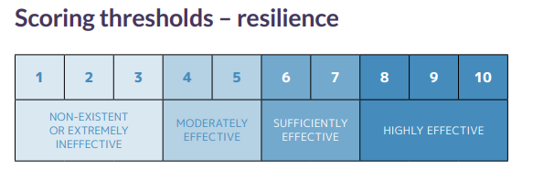
Global Organized Crime Index – Measurement and Typology

Slide 9
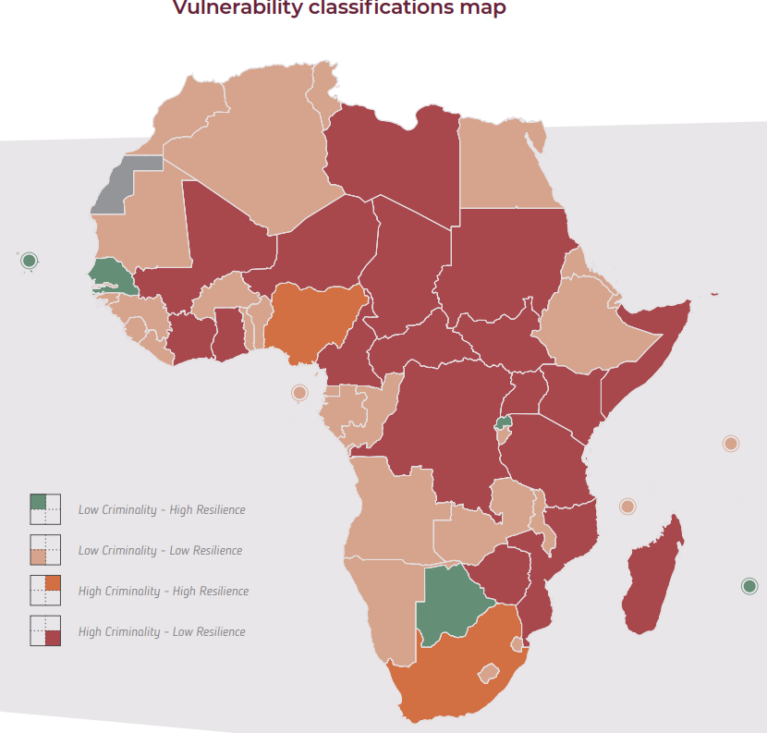
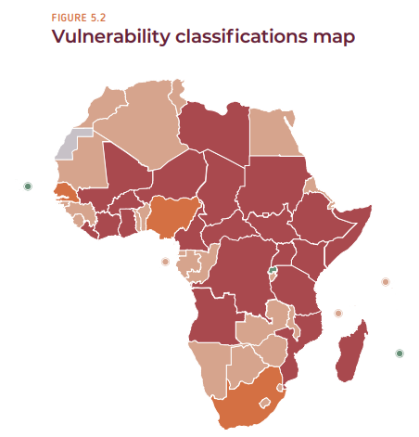
Global Organized Crime Index - Africa

Slide 10
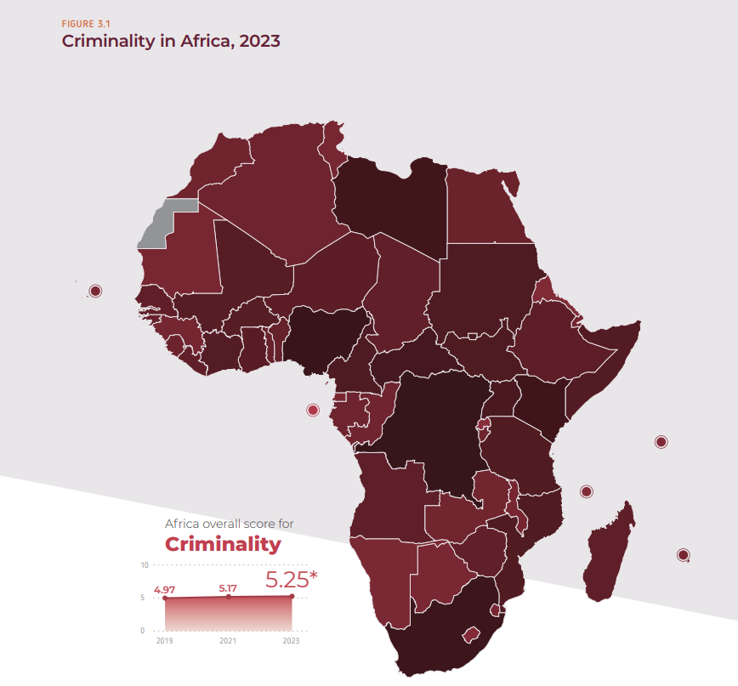
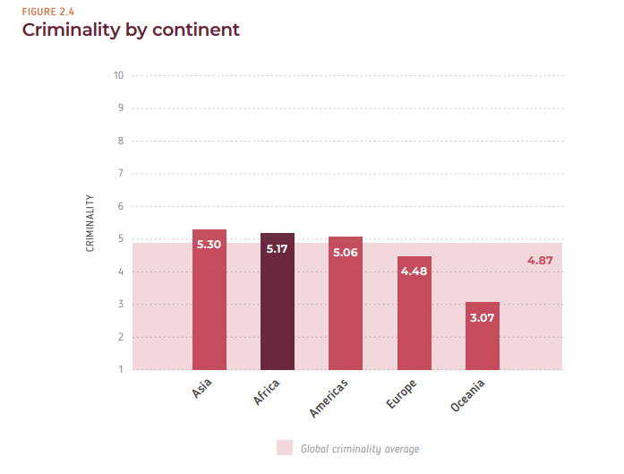
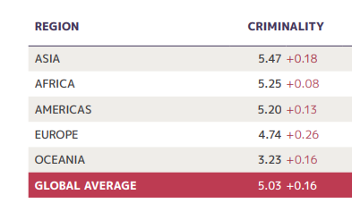

Slide 11
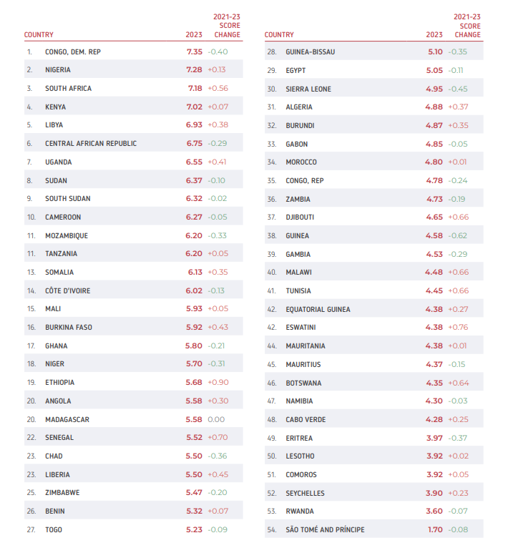
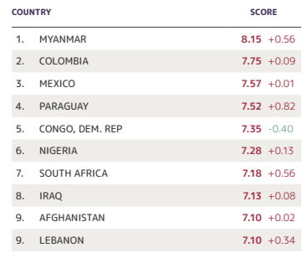
Global Organized Crime Index - Africa

Slide 12
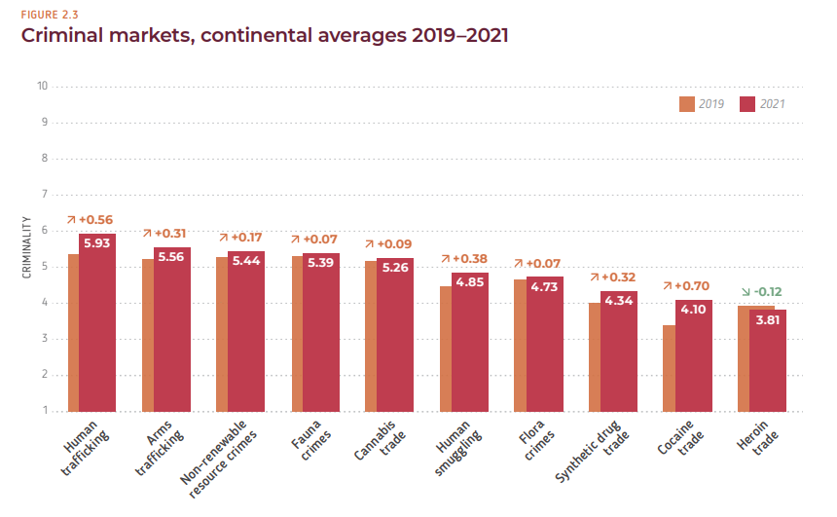
Global Organized Crime Index - Africa

Slide 13
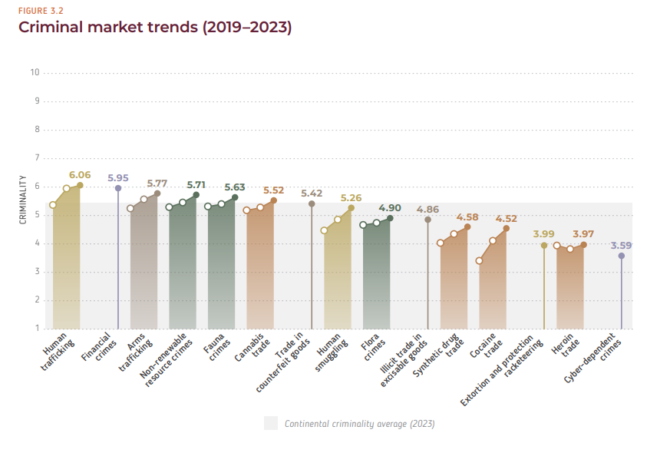
Global Organized Crime Index - Africa

Slide 14
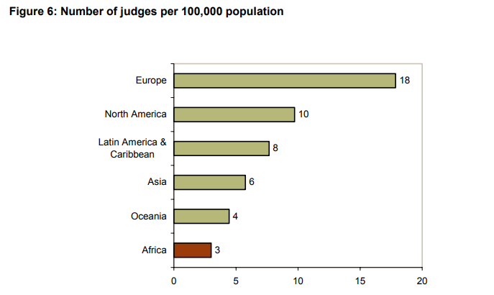
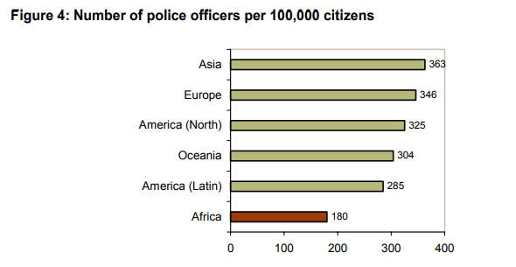
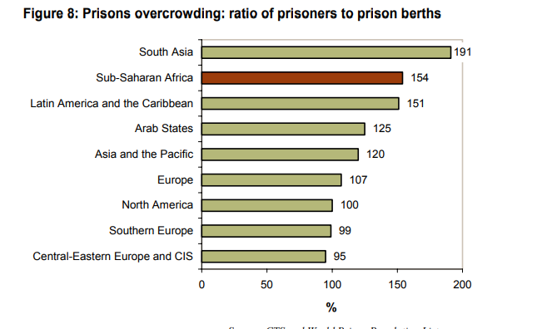
Factors Influencing the Occurrence of OC in Africa
Income inequality
Youthful population
Rapid rates of urbanization
Poorly-resourced criminal justice systems
Proliferation of firearms
Conflict fuels crime, crime feeds conflict

Slide 15
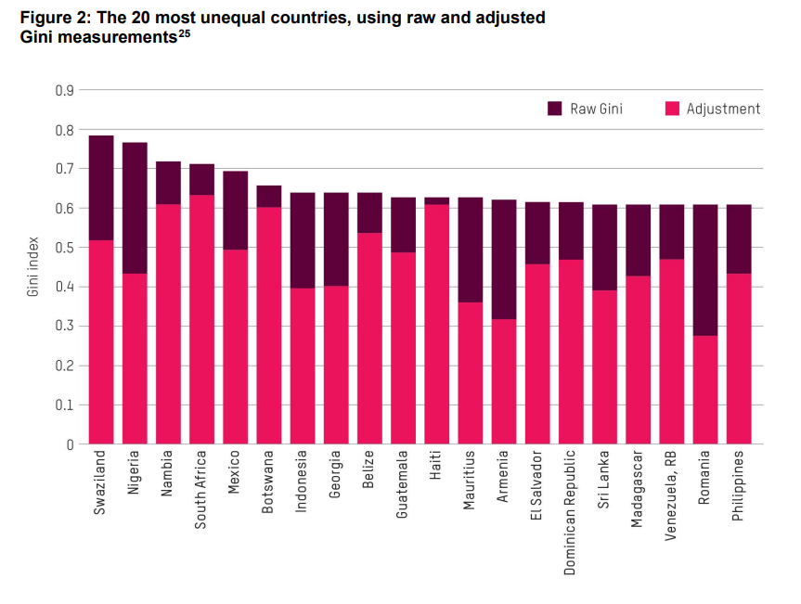
Factors Influencing the Occurrence of OC in Africa

Slide 16
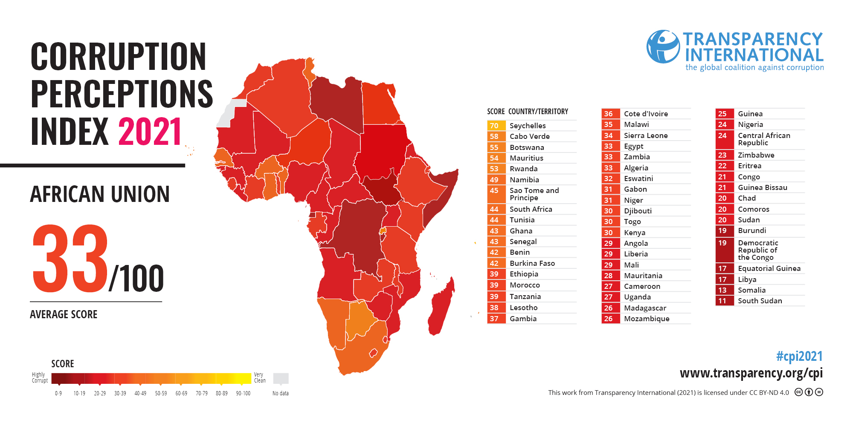
Corruption

Slide 17
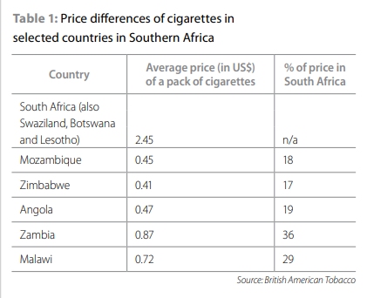
Typology of OC in Africa
A) Drug trafficking to drug abuse
B) Trafficking in human beings
C) Arms smuggling (Government stockpiles, Homemade or craft production and Lost or stolen weapons).
D) Smuggling and illegal importation of goods and counterfeit commodities
E) Resource smuggling, wildlife poaching, and environmental crime
F) Money laundering

Slide 18
Case Study - Nigeria
Nigerian criminal gangs rose to prominence in the 1980s.
Nigerian criminal organizations and networks are unique in both their ubiquity and the diverse nature of their activities.
Factors influencing the rise of OC in Nigeria: weak institutions/bad leadership, weak civil society, multiple tribal groups and power centers, high levels of corruption, endemic poverty, weak correctional agencies and lack of synergy and prebendalism.
Nigeria is “the only nation on earth among the top ten oil producing countries classified as poor.”
Highly fluid in personnel and in methods of operation” ranging “from independent entrepreneurs to highly organized syndicates.
Area Boys (Agberos), Confraternities - Neo Black Movement a.k.a. Black Axe, Supreme Vikings Confraternity and De Norsemen Kclub of Nigeria.
https://www.youtube.com/watch?v=suTJJgtIPSs
https://www.youtube.com/watch?v=ViTQ7N7iUQ0

Slide 19
Thank you for your attention

