Slide 1
Piracy
Lucie Konečná
GLCb2026 Africas Contemporary Security Challenges
17/4/2024

Slide 2
Piracy - Definition
"Piracy is unlawful depredation at sea involving the use or threat of violence and possibly, but not necessarily, robbery.„ (Murphy 2008: 7).
1982 - United Nations Convention on the Law of the Sea (UNCLOS):
a. Any illegal acts of violence or detention, or any act of depredation, committed for private ends by the crew or the passengers of a private ship or a private aircraft, and directed:
i. On the high seas, against another ship or aircraft, or against persons or property on board such ship or aircraft.
ii. Against a ship, aircraft, persons or property in a place outside the jurisdiction of any state.
b. Any act of voluntary participation in the operation of a ship or of an aircraft with knowledge of facts making it a pirate ship or aircraft.
c. Any act of inciting or of intentionally facilitating an act described in subparagraph (a) or (b).

Slide 3
Piracy - Definition
IMO “Code of Practice for the Investigation of Crimes of Piracy and Armed Robbery against Ships” defines Armed Robbery as:
Armed robbery against ships means any of the following acts:
1. any illegal act of violence or detention or any act of depredation, or threat , other than an act of piracy, committed for private ends and directed against a ship or against or property on board such a ship, within a State’s internal waters, archipelagic waters and territorial sea;
2. any act of inciting or of intentionally facilitating an act described above.
To overcome the distinctions between piracy and armed robbery at sea, the IMO has combined the two terms in a single definition: „An act of boarding or attempting to board any ship with the apparent intent or capability to use force in the furtherance of that act.“

Slide 4
Piracy - Definiton
Under the definitions of Piracy or Armed Robbery, the IMO reports incidents as follows:
1. Boarded: An illegal act of perpetrators successfully gaining access onto the vessel.
2. Hijacked: An illegal act of perpetrators successfully gaining access onto the vessel and taking over the control of the vessel from the Master and crew.
3. Fired Upon: An illegal act of perpetrators discharging weapons towards the vessel while attempting to gain access onto the vessel.
4. Attempted: An illegal act of perpetrators attempting to approach a vessel with possible intention to board but remain unsuccessful due to the timely actions of the crew.
Modern definitions of piracy include the following acts: Boarding without permission, Extortion, Hostage taking, Kidnapping of people for ransom, Murder, Cargo theft, Robbery and seizure of items or the ship, Sabotage resulting in the ship subsequently sinking and Shipwrecking done intentionally to a ship.

Slide 5
Piracy – International Framework
1982 - United Nations Convention on the Law of the Sea (UNCLOS).
1988 - SUA – Convention for the Suppression of Unlawful Acts against the Safety of Maritime Navigation.
The Hostages Convention (1979).
Several UN Security Council resolutions such as:
Resolution 1816 (2008)
Resolution 1851 (2008)
Resolution 2634 (2022)
1948 - International Maritime Organization (IMO).
1981 - International Maritime Bureau (IMB) is a specialized department of the International Chamber of Commerce.

Slide 6
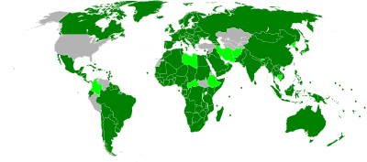
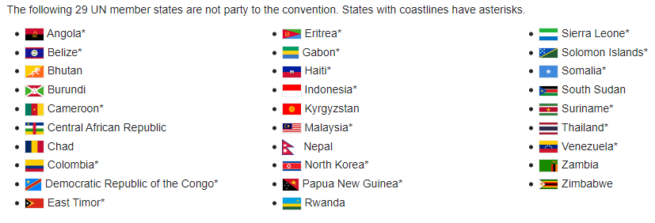
UNCLOS vs. SUA

Slide 7
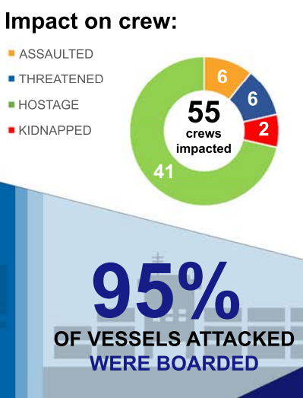
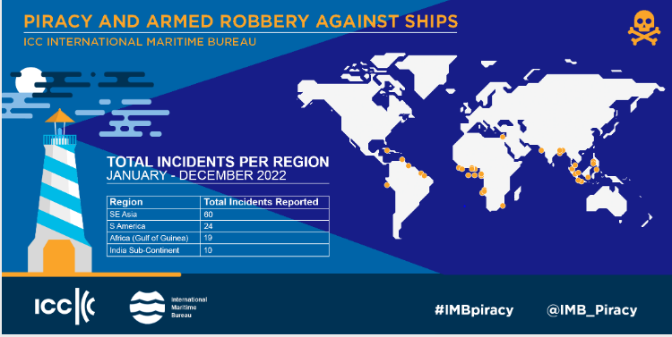
Piracy – Trends 2022

Slide 8
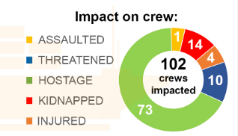
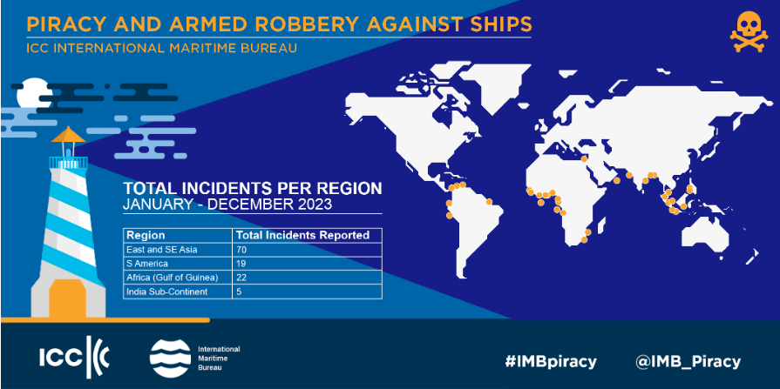
Piracy – Trends 2023

Slide 9
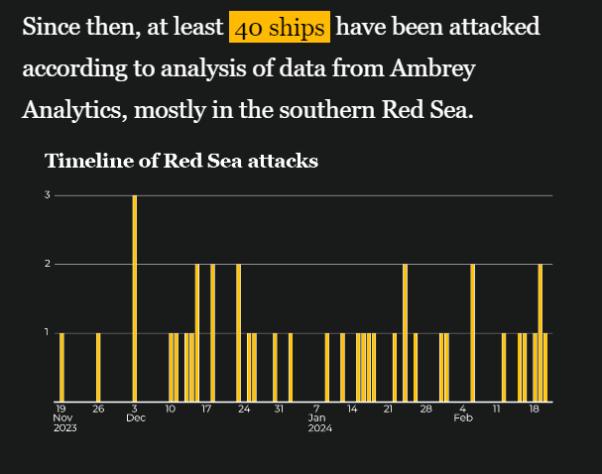
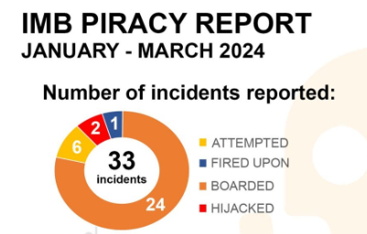
Piracy Trends - 2024 (January – March)

Slide 10
Number of pirate attacks against ships worldwide from 2010 to 2021

Slide 11
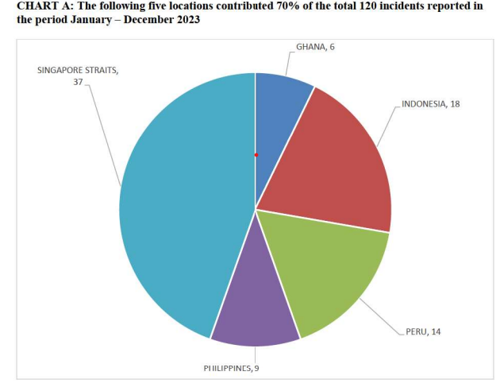
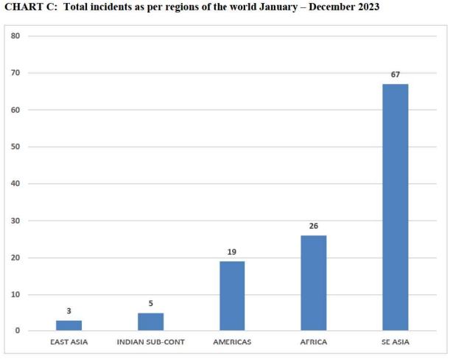
Piracy - Trends

Slide 12
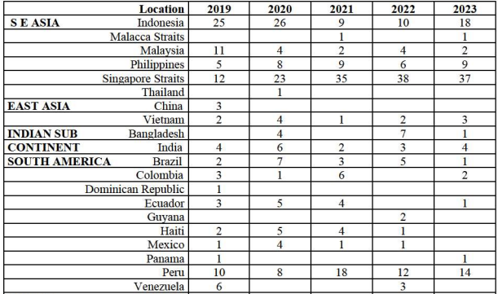
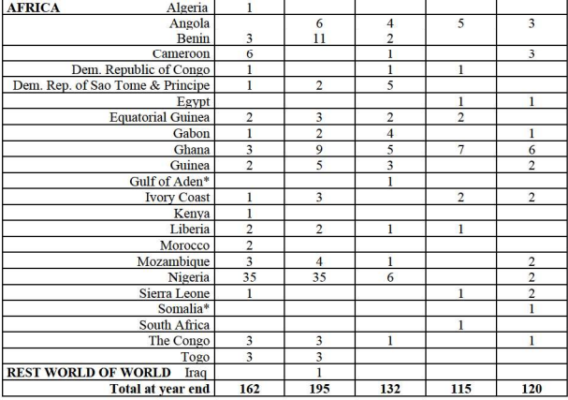
Piracy - Trends

Slide 13
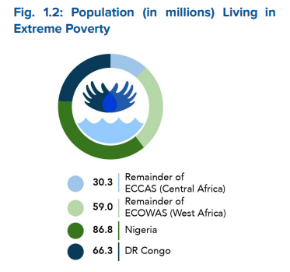
Causes of Piracy
Factors Responsible for the Emergence of Piracy (Johnson 2018)
High unemployment rate and high poverty
Terrorism - investment in land security
Lax coastal and port-side security
Endemic anarchic situation and growing conflicts
Corruption
Global proliferation of small arms
Disputes over territorial and maritime boundaries
Root causes of piracy in the Gulf of Guinea:
Corruption
Illegal, Unreported and Unregulated (IUU) Fishing
African Youth and Youth Unemployment
Governmental Structuring (weak states – ineffective courts of the corrupt elite)
Oil exploitation

Slide 14
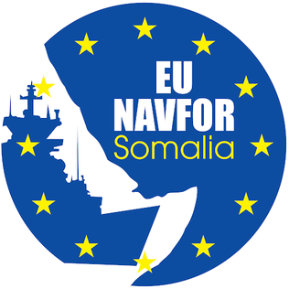
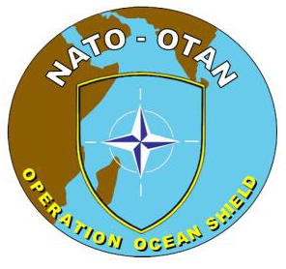
Anti-piracy Measures
Several types of anti-piracy measures include:
a) Self-Defense
b) Self-protection Measures
c) Patrol
d) International Legal Framework
e) Local/Domestic Legal Framework

Slide 15
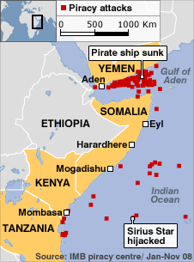
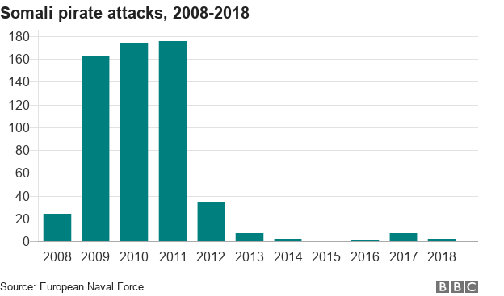
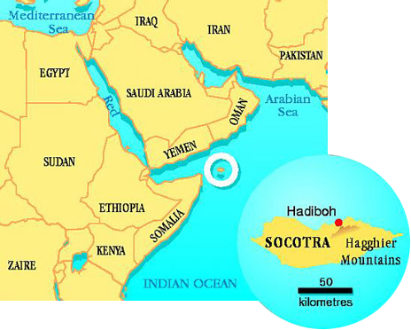
Piracy in Horn of Africa
Gulf of Aden, Guardafui Channel and Somali Sea.
Civil war in Somalia - illegally fishing on the Somali seaboard and ships began dumping industrial.
Most of the attacks in the Horn of Africa took place outside territorial waters.
Expiry of the United Nations Security Council's (UNSC) counter-piracy Resolution 2608 (2021/2022).
IGAD – Intergovernmental Authority on Development – CEWARN
Djibouti Code of Conduct 2009.

Slide 16
Djibouti Code of Conduct

Slide 17
Operation Atalanta and Ocean Shield
Other operations in EA - Combined Task Force 150, Combined Task Force 151, Chinese People's Liberation Army Navy participation, Operation Copper.
Operation Atalanta, formally European Union Naval Force (EU NAVFOR) Somalia (2008-present).
Atalanta tasks:
•Protects vessels of the World Food Programme (WFP), African Union Mission in Somalia (AMISOM) and other vulnerable shipping;
•Deters and disrupts piracy and armed robbery at sea;
•Monitors fishing activities off the coast of Somalia;
•Supports other EU missions and international organizations working to strengthen maritime security and capacity in the region.
Operation Ocean Shield (2009-2016).

Slide 18
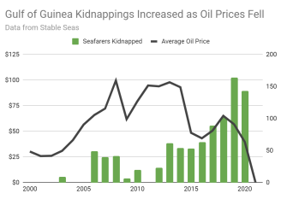
Piracy in Gulf of Guinea
The Gulf of Guinea stretches from Senegal to Angola, covering over 6,000km of coastline. It comprises 20 coastal states.
Piracy is part of heavily armed criminal enterprises.
Attacks mainly occur in territorial waters, increased after 2014.
Increased targeting of non-African hostages and a criminal shift away from oil theft from tankers has reduced the costs of these crimes to African nations since the early 2010s.
Counter-piracy measures: Operation Prosperity, Dep Blue Project and Yaoundé Code of Conduct.
MEND – The Movement for the Emancipation for the Niger Delta.
UN Resolution 2634.

Slide 19
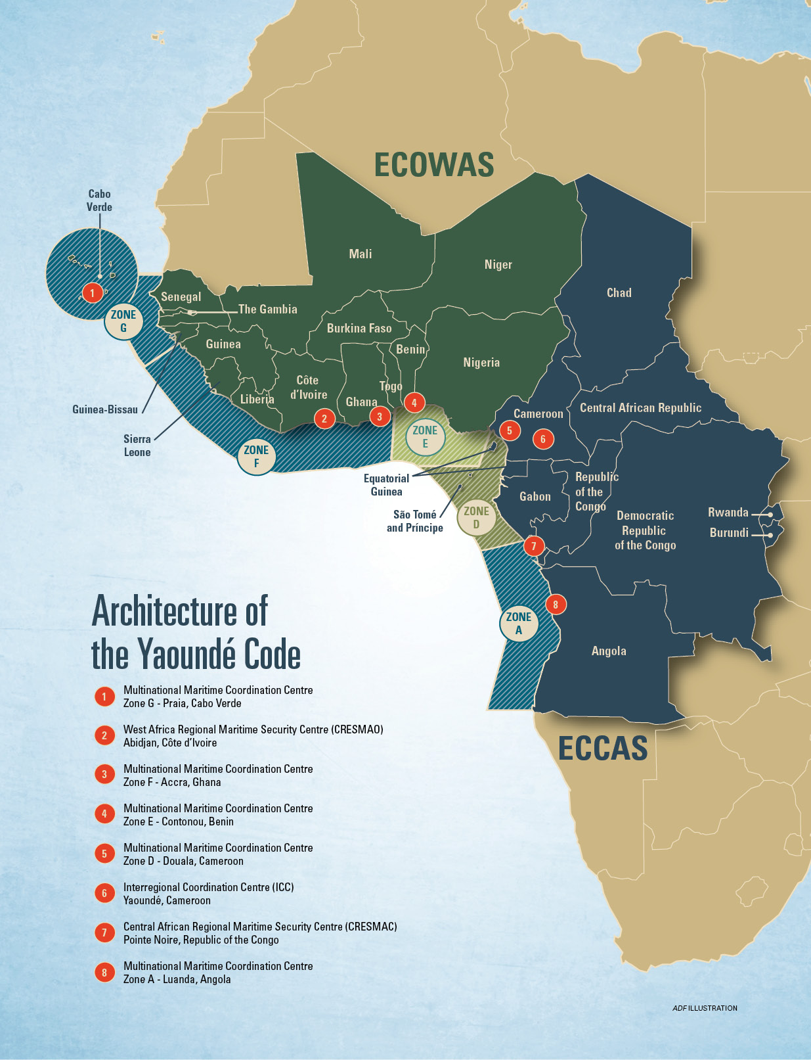
Yaoundé Code of Conduct

Slide 20
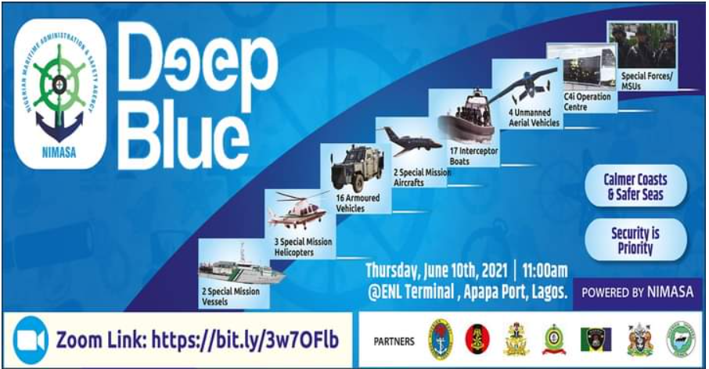
Deep Blue Project 2021
Maritime Security Units (MSU) - comprising personnel from the Nigerian Navy, Nigerian Army, Nigerian Air Force, Nigeria Police, and Department of State Services.
The land assets include the Command, Control, Communication, Computer, and Intelligence Centre (C4i) for intelligence gathering and data collection; 16 armoured vehicles for coastal patrol; and 600 specially trained troops for interdiction, known as Maritime Security Unit. The sea assets include two Special Mission Vessels and 17 Fast Interceptor Boats. The air assets comprise two Special Mission Aircraft for surveillance of the country’s Exclusive Economic Zone (EEZ); three Special Mission Helicopters for search and rescue operations; and four Unmanned Aerial Vehicles.

Slide 21
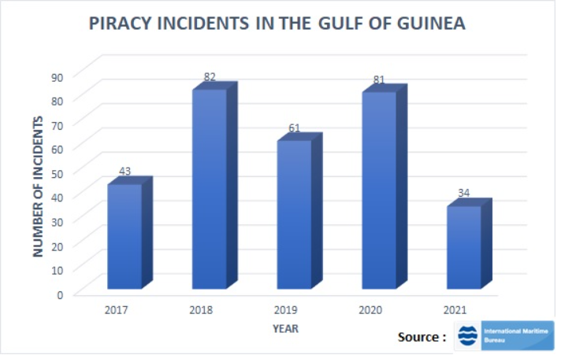
Piracy in Gulf of Guinea

Slide 22
Piracy in Gulf of Guinea

Slide 23
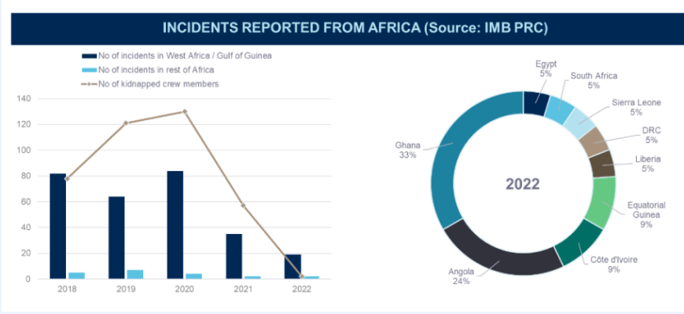
Piracy in Gulf of Guinea

Slide 24
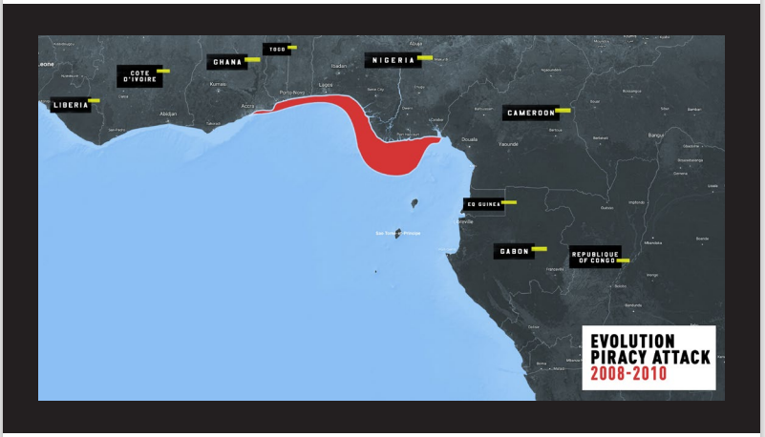
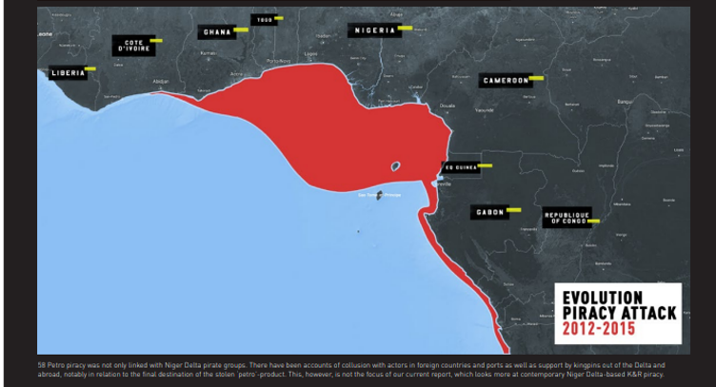
Piracy in Gulf of Guinea

Slide 25
Comparision of Piracy in EA and WA

Slide 26
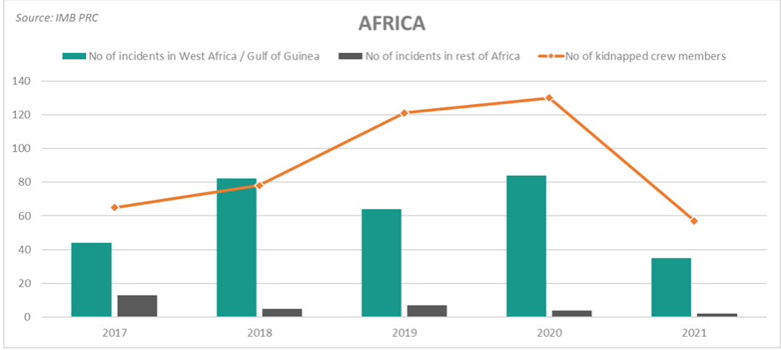
Comparision of Piracy in EA and WA

Slide 27
Piracy vs. Maritime Terrorism
Achille Lauro 1985 – SUA – Convention for the Suppression of Unlawful Acts against the Safety of Maritime Navigation.
Council for Security Cooperation in the Asia Pacific (CSCAP) defines maritime terrorism as "the conduct of terrorist acts and activities (1) within the maritime environment, (2) by means of or against ships or fixed platforms at sea or in port or against their personnel or passengers, (3) against offshore installations or settlements, including tourist resorts, port areas and port cities.“
Definition of piracy and maritime terrorism:
a) Actor motivations/OC vs. terrorism
b) motivation + violence/ maritime violence
c) violent attacks defined by law, nature of the act and method of attack/SUA (Convention for the Suppression of Unlawful Acts Against the Safety of Maritime Navigation) vs. UNCLOS (Convention on the Law of the Sea)
„Pirates are criminals who commit violence in pursuit of financial gain, while terrorists are persons who use violence as a means to achieve political ends. They exploit the maritime domain because it provides them with the opportunity to achieve these goals.“

Slide 28
Piracy vs. Maritime Terrorism

Slide 29
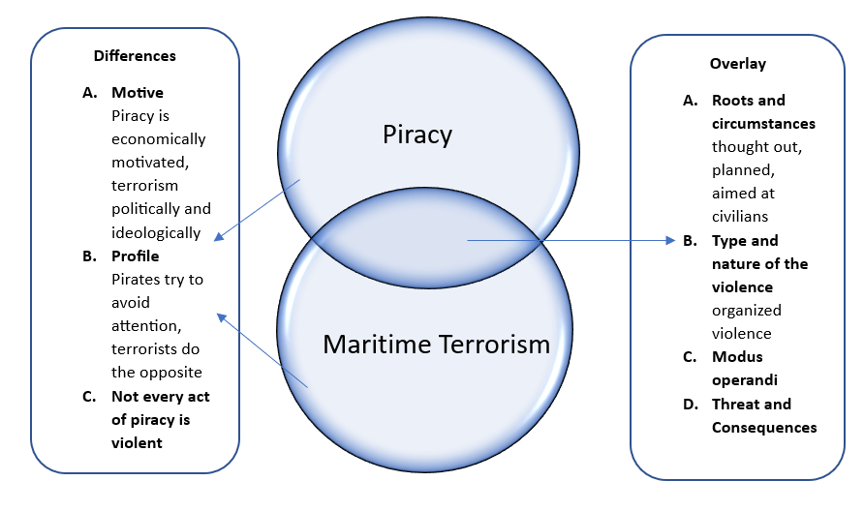
Piracy vs. Maritime Terrorism

Slide 30
Video
https://www.youtube.com/watch?v=6XtuPck0b4U

Slide 31
Thank you for your attention

