Slide 1
Terrorism
Lucie Konečná
GLCb2026 Africas Contemporary Security Challenges
06/03/2024

Slide 2
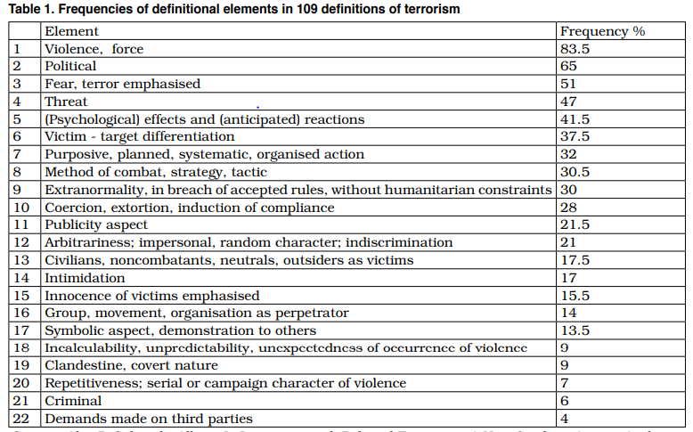
Terrorism - Definition and Typology
Peter Waldmann – Terrorist Calculus:
Violent act (or threat to commit it)
intended strong emotional reaction (fear in the enemy, positive emotions in sympathizers)
subsequent certain reaction (hasty, panic-dictated protective and retaliatory measures, but also active assistance in the combat effort)

Slide 3
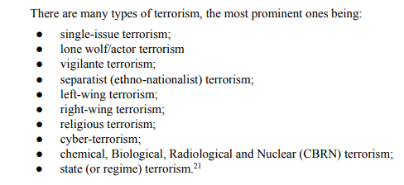
Terrorism - Definition and Typology
„Terrorism is the use of aggressive and excessive violence (or the threat of such violence) that is planned with the dominant purpose of sending a serious intimidating message to a significantly larger number of people (the target audience) than just those who are directly harmed by the primary violent acts or threats.” M. Mareš
David Rapaport: The Anarchist wave (1878–1919), the Anti-Colonial wave (the 1920s–early 1960s), the New Left wave (mid-1960s–1990s), and the Religious wave (1995–?).
Typology Mareš - the ultra-left, ultra-right, ethnic and territorial, religious, ecological, criminal, psychopathological, single-issue.
Schmid:

Slide 4
Trends of Contemporary Terrorism
2007-2022 - number of terrorist attack?
Violent conflicts the main driver of terrorism, 97% of terrorist attacks in 2022 took place in a country where is an ongoing conflict.
The worst situation is in the Sahel, 48% of all victims, the worst situation in Mali, Burkina Faso and Niger. Islamic State in West Africa (ISWA), Jamaat Nusrat Al-Islam wal Muslimeen (JNIM).
Improvement in Nigeria (Boko Haram)
IS the deadliest terrorist group (Islamic State - Khorasan Province (ISKP), Islamic State - Sinai Province (ISSP) and ISWA).
Three main trends in Africa.
https://www.start.umd.edu/gtd/

Slide 5
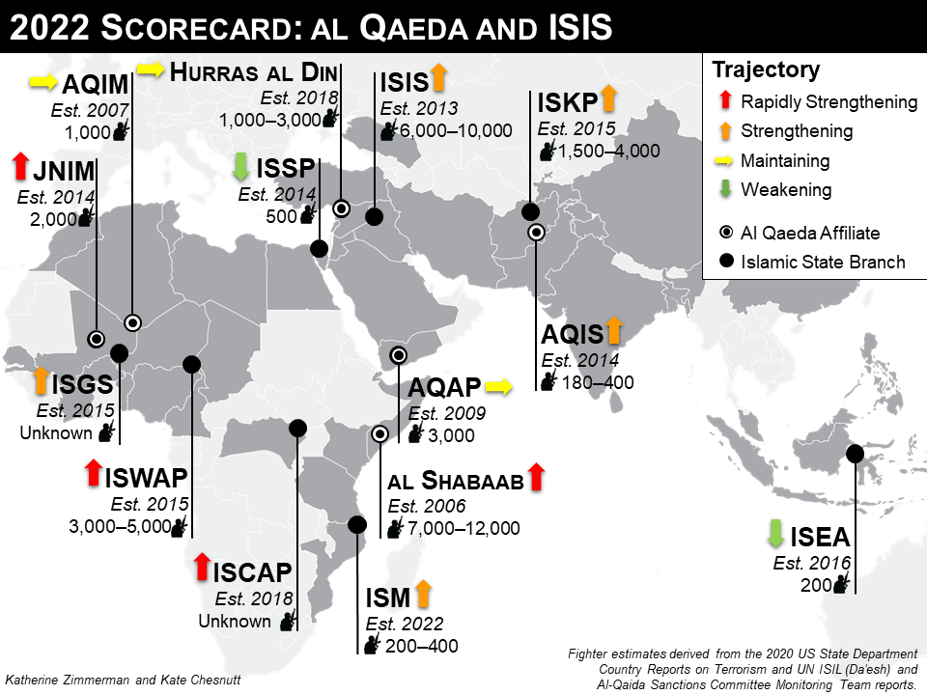

Slide 6
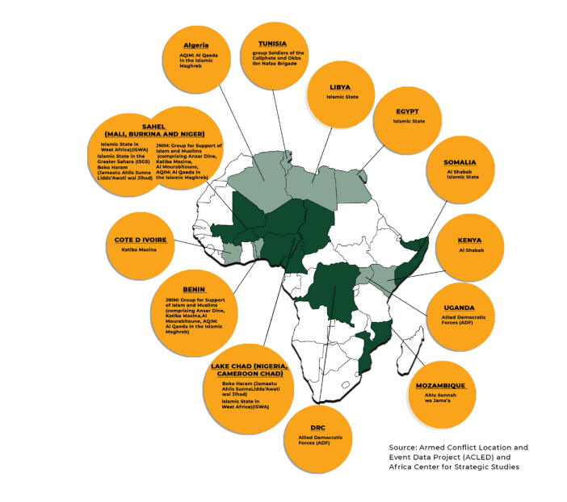
Trends of Contemporary Terrorism - Africa
Uqba ibn Nafi Brigad
Al-Shabaab
Allied Democratic Froces
Ansar al-Sunna/Ahlu Sunnah wa Jama‘a
Boko Haram
JNIM
ISGS
ISWA/ISWAP

Slide 7
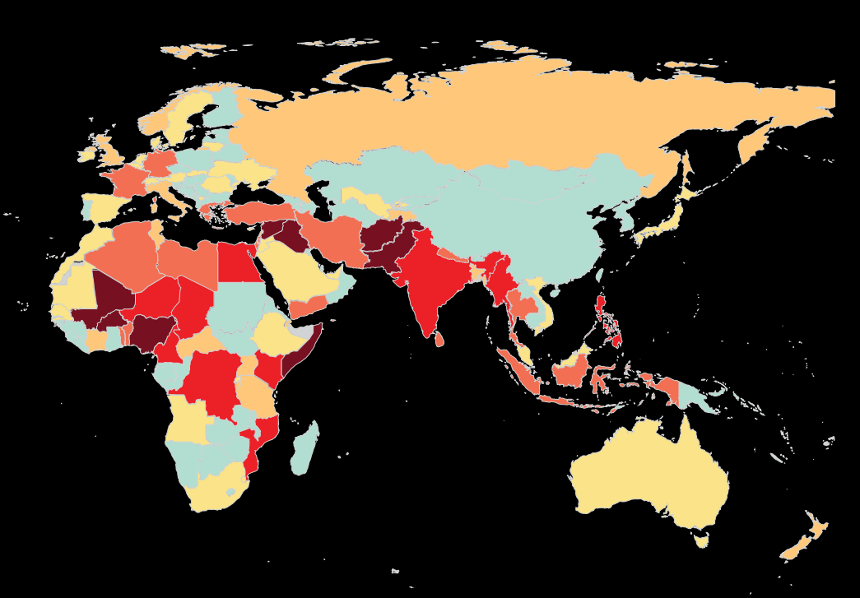
Trends of Contemporary Terrorism

Slide 8
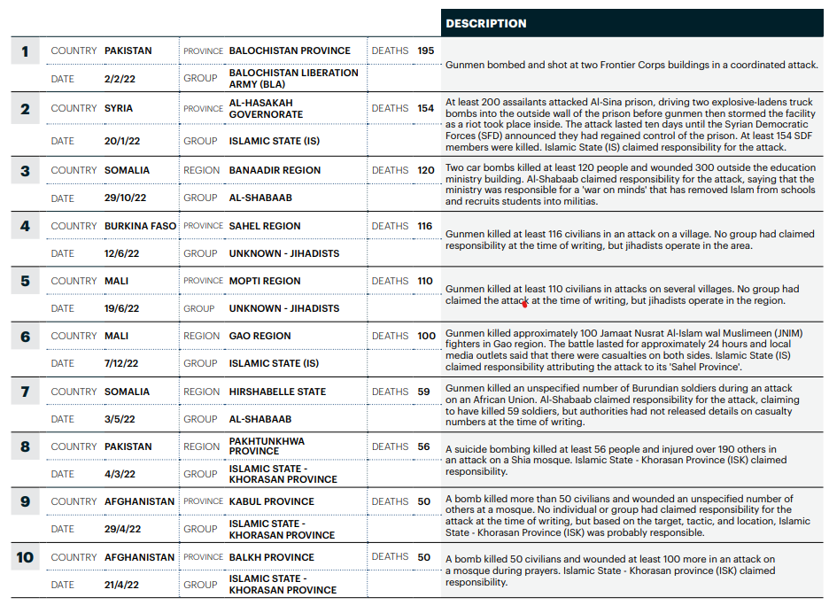
Trends of Contemporary Terrorism

Slide 9
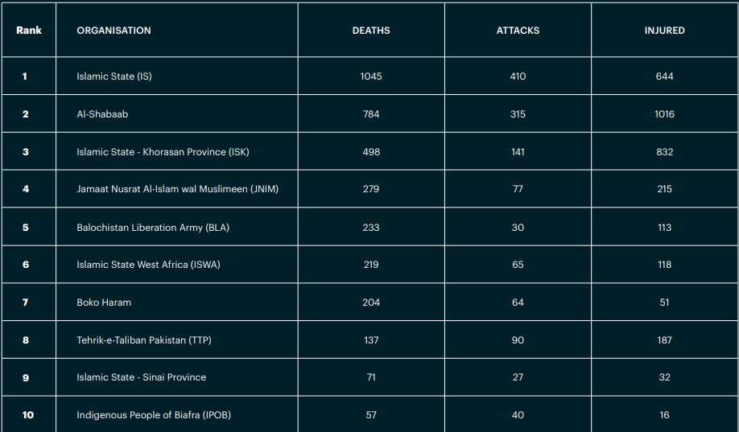
Deadliest Groups 2022

Slide 10
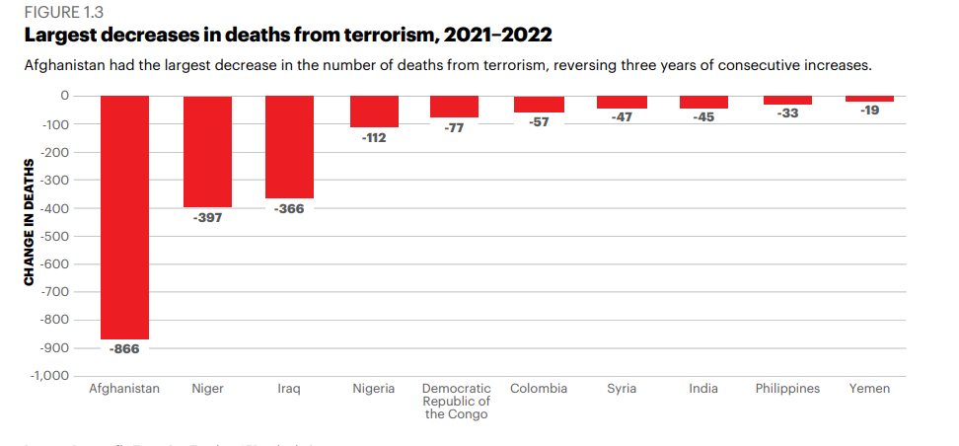
Trends of Contemporary Terrorism

Slide 11
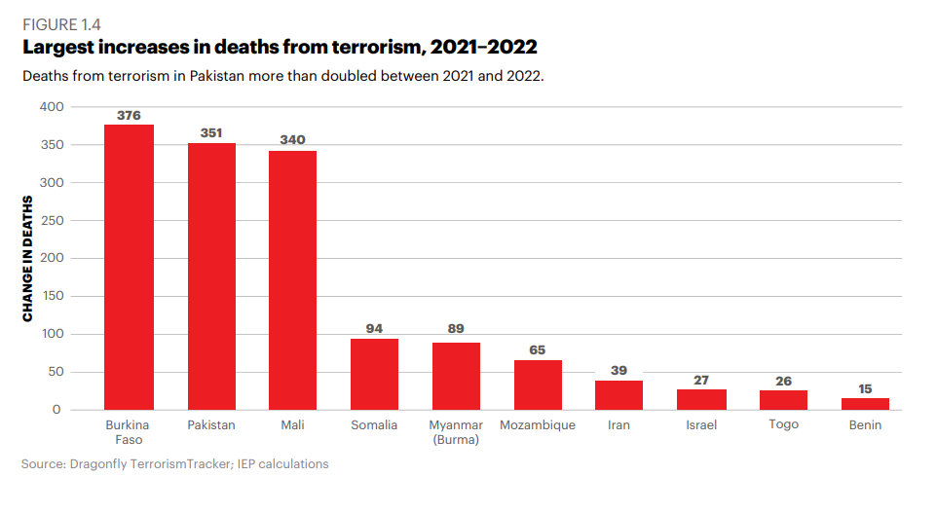
Trends of Contemporary Terrorism

Slide 12
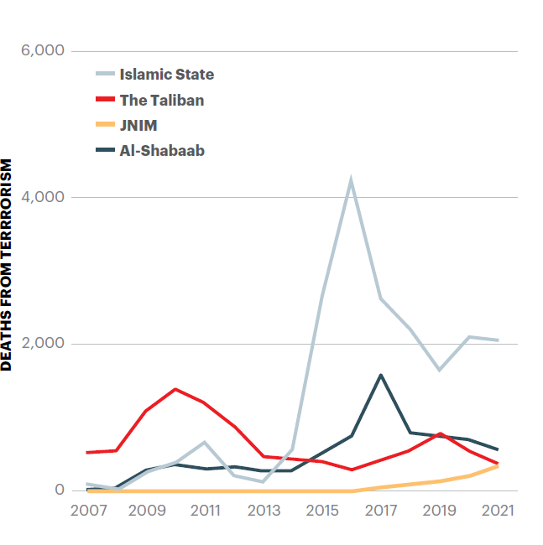
Trends of Contemporary Terrorism 2021
Islamic State (IS), Al-Shabaab, Taliban and Jamaat Nusrat Al-Islam wal Muslimeen
3,364 (47% of all victims).

Slide 13
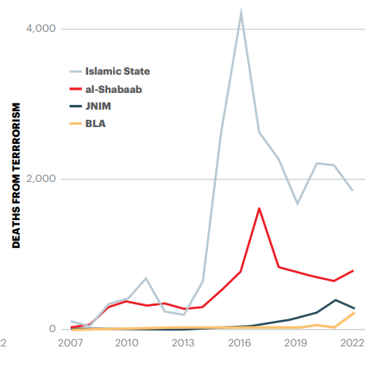
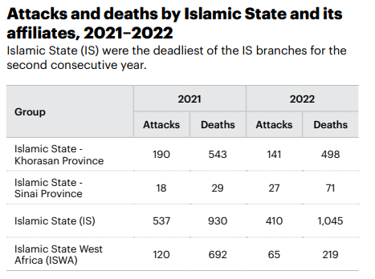
Trends of Contemporary Terrorism 2022
Islamic State (IS), Al-Shabaab, Jamaat Nusrat Al-Islam wal Muslimeen and the Balochistan Liberation Army.
3,129 (47% of all victims).

Slide 14
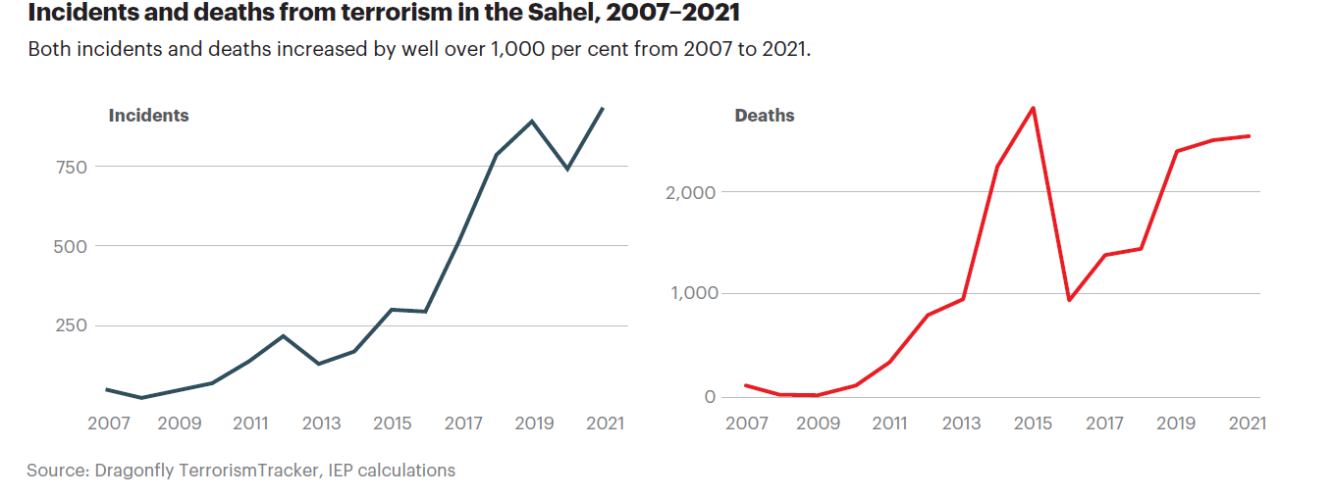
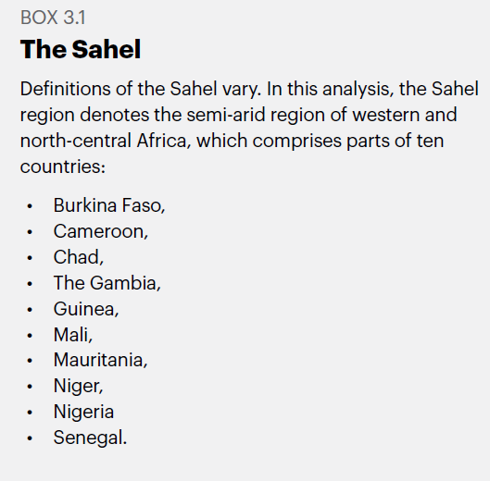
Trends in Sahel
Three types of terrorist groups in the Sahel – international, local with ethnic-nationalist-religious overtones and local arising as a reaction to a certain problem (Dan Nan Ambassagou Association, Koglweogos).
Factors affecting the success of TG in the Sahel: rapid population growth, lack of water and food, political instability, corruption, weakness of the security apparatus, terrain and porous borders, poverty, etc.

Slide 15
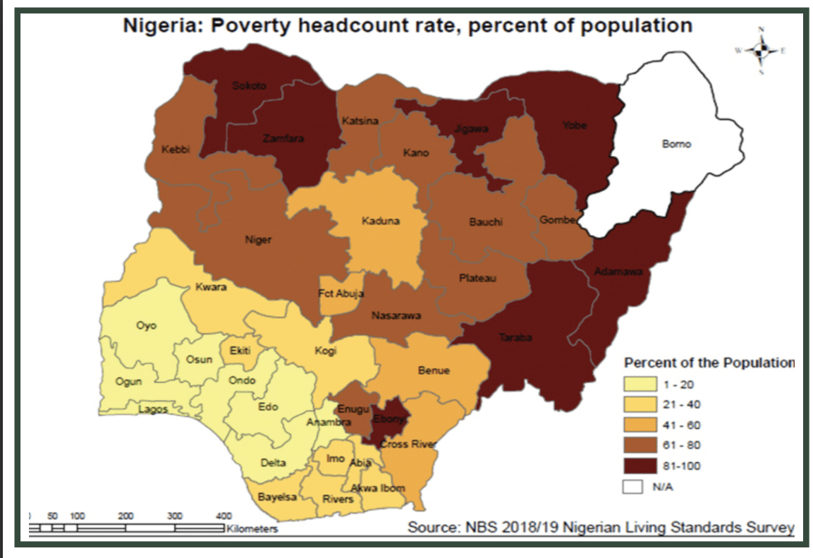
Case Study: Boko Haram

Slide 16
Case Study: Boko Haram
Factors influencing the creation of BH - high level of corruption, poverty, non-transparency, unemployment, corruption of the elites, social inequalities, lack of national awareness, weak security apparatus, etc.
The Rise of Boko Haram – Mauduguri 2001 - Mohammed Yusuf.
Jama'atu Ahlis Sunna Lidda'awati wal-Jihad – (Boko Haram – Hausa language).
Organization structure and ideology.
Abubakar Shekau (2009) – violent activity, wide spectrum of activity, Sambisa.
Khalid Barnawi – Ansaru (2012) x Abu Musab al-Barnawi – ISWAP (2015/2016).
International links to the Islamic State and al-Qaeda.
Bakura Doro a Bakura Sa’alaba

Slide 17
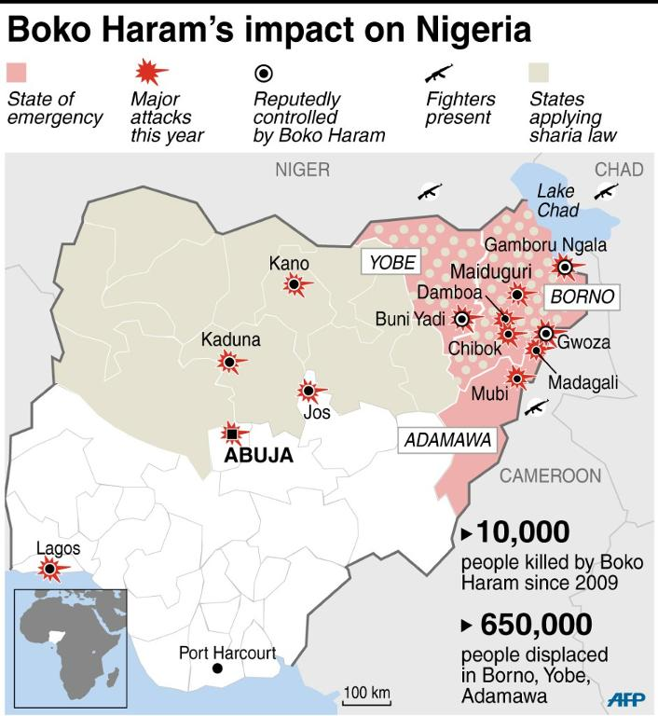
Case Study: Boko Haram

Slide 18
Thank you for your attention

